Slide 1
Computational Learning
UNIT- IV

Slide 2
Introduction
Probability learning is the process of using past experiences to predict the likelihood of future events, enabling organisms to extract statistical regularities from their environment and guide their behaviour.

Slide 3
Probability Learning
Probability learning is a machine learning technique that uses probability theory to make predictions and decisions.
It's a statistical approach that models uncertainty in data by using probability distributions.

Slide 4
Probability Distribution
A probability distribution is an idealized frequency distribution.
A frequency distribution describes a specific sample or dataset. It’s the number of times each possible value of a variable occurs in the dataset.
The number of times a value occurs in a sample is determined by its probability of occurrence.

Slide 5
Probability is a number between 0 and 1 that says how likely something is to occur:
0 means it’s impossible.
1 means it’s certain.

Slide 6
Bayesian
Bayesian modifies a prior belief with current experiment data using Bayesian inference(considering the Bayes Theorme to calculate a probability of hypothesis with given prior evidence).
For example, a Bayesian can combine a prior belief that the coin is fair with the current experiment data (56 heads out of 100) to form a new belief

Slide 7
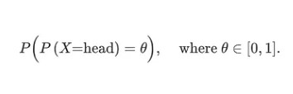
A Frequentist estimates the most likely value for P(head) (a point estimate). But a Bayesian tracks all possibilities with the corresponding certainties. This calculation is complex but contains richer information for further computation.

Slide 8
Hypothesis
The hypothesis is one of the commonly used concepts of statistics in Machine Learning.
It is specifically used in Supervised Machine learning, where an ML model learns a function that best maps the input to corresponding outputs with the help of an available dataset.

Slide 9
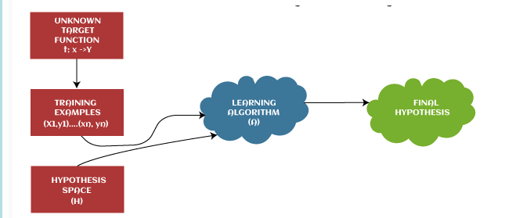
Hypothesis

Slide 10
There are some common methods given to find out the possible hypothesis from the Hypothesis space, where hypothesis space is represented by uppercase-h (H) and hypothesis by lowercase-h (h). These are defined as follows:

Slide 11
The hypothesis (h) can be formulated in machine learning as follows:
Y= mx + c
Where,
Y: Range
m: Slope of the line which divided test data or changes in y divided by change in x.
x: domain
c: intercept (constant)

Slide 12
Hypothesis space (H):
Hypothesis space is defined as a set of all possible legal hypotheses; hence it is also known as a hypothesis set.

Slide 13
Sample complexity
Sample complexity is a concept in machine learning that determines the number of data samples required to achieve a certain level of learning performance.
Its importance lies in its ability to assess the efficiency of a learning algorithm.
A more efficient algorithm needs fewer samples to learn effectively, reducing the resources required for data acquisition and storage.

Slide 14
There are two types of sample complexities that are often referenced: worst-case sample complexity and average-case sample complexity.
Worst-case sample complexity refers to the maximum number of samples required to reach a specific learning goal, irrespective of the data distribution.
Average-case sample complexity, on the other hand, considers the average number of samples needed, assuming the data follows a certain distribution.

Slide 15
Mathematical backbone of sample complexity
Probably Approximately Correct (PAC) learning theory provides a framework to relate VC(Vapnik-Chervonenkis) dimension to sample complexity.
PAC learning seeks to identify the minimum sample size that will, with high probability, produce a hypothesis within a specified error tolerance of the best possible hypothesis.

Slide 16
The PAC learning bound is given by:
N >= (1/ε) * (log|H| + log(1/δ)),
Where,
N(m) is the sample size,
ε is the maximum acceptable error (the 'approximately correct' part- (desired accuracy)),
|H| is the size of the hypothesis space (related to VC dimension),
δ is the acceptable failure probability (desired confidence).

Slide 17
Finite hypothesis
A finite hypothesis space consists of a limited, countable set of hypotheses (models or functions) that can be selected to explain or predict outcomes based on the input data.
Example: Decision trees with a limited depth, a fixed number of linear classifiers, or a specific set of rules in rule-based learning.

Slide 18
Implications
Easier to manage and evaluate since the number of hypotheses is small.
Risk of under-fitting if the hypothesis space is too constrained and does not capture the underlying data distribution.
It can be easier to ensure generalization since over-fitting can be less of a concern due to the limited complexity.

Slide 19
An overfit model can result in high model accuracy on training data but low accuracy on new data due to memorization instead of generalization(Generalization is the model's ability to understand and apply learned patterns to unseen data).
An underfit model performs poorly on training data and testing data because it fails to capture the dominant patterns in the data set.

Slide 20
Infinite hypothesis space
An infinite hypothesis space contains an unbounded or uncountable set of hypotheses. This means there are potentially limitless models that could be considered for fitting the data.
Example: Linear regression with any real-valued coefficients, neural networks with varying architectures and parameters, or kernel methods in support vector machines (SVMs).

Slide 21
Implications
Greater flexibility and the ability to capture complex patterns in the data.
Higher risk of over-fitting, as the model can become too complex and fit noise in the data rather than the underlying distribution.
Requires more advanced techniques for regularization and validation to ensure that the model generalizes well to unseen data.

Slide 22
Mistake bound model
The mistake bound (MB) model in machine learning is a model that evaluates a learner based on the total number of mistakes it makes before reaching the correct hypothesis.
The model is used in cumulative learning scenarios, where the learning process is made up of rounds.
In each round, the learner is asked about an aspect of the learned phenomenon, makes a prediction, and is told if it was correct.

Slide 23
The goal of the learner is to make the minimum number of mistakes possible in the learning process.

Slide 24
Mistake bound model algorithm
An algorithm A is said to learn C in the mistake bound model if for any concept c ∈ C, and for any ordering of examples consistent with c, the total number of mistakes ever made by A is bounded by p(n, size(c)),
Where p is a polynomial.
We say that A is a polynomial time learning algorithm if its running time per stage is also polynomial in n and size(c).

Slide 25
Conjunctions
Let us assume that we know that the target concept c will be a conjunction of a set of (possibly negated) variables, with an example space of n-bit strings. Consider the following algorithm:

Slide 26
Algorithm for MB
1. Initialize hypothesis h to be x1x1 x2x2 . . . xnxn .
2. Predict using h(x).
3. If the prediction is False but the label is actually True, remove all the literals in h which are False in x. (So if the first mistake is on 1001, the new h will be x1x2 x3 x4.)
4. If the prediction is True but the label is actually False, then output “no consistent conjunction”. 5. Return to step 2.

Slide 27
Lower Bound: In fact no deterministic algorithm can achieve a mistake bound better than n in the worst case.
This can be seen by considering the sequence of n examples in which the ith example has all bits except the ith bit set to 1

Slide 28
The target concept c will be a monotone conjunction constructed by including xi only if the algorithm predicts the ith example to be True (in which case the ith example’s label will be False).
(If the algorithm predicts the ith example to be False, then the target concept will not include xi , and so the true label will be True.) The algorithm will have made n mistakes by the time all of these n examples are processed.

Slide 29
Learning set of rules
A learning rule set in machine learning is a collection of rules that describe a dataset. The process of creating these rules from data is called rule learning.
Rule types
The most common type of rule learning is inductive rule learning, also known as rule induction. Other types of rules include association rules, which are used to express relationships in large datasets

Slide 30
Inductive Learning Algorithm (ILA) is an iterative and inductive machine learning algorithm that is used for generating a set of classification rules, which produces rules of the form “IF-THEN”, for a set of examples, producing rules at each iteration and appending to the set of rules.
An association rule identifies the relationship between two or more items in large datasets, typically expressed as an "if-then" statement like {Diapers} → {Beer}.

Slide 31
Rule form
The basic form of a rule is "IF PREMISE THEN CONSEQUENT". This means that the consequent is true whenever the premise is true.

Slide 32
Learning set of rules is of Two ways:
First learn decision tree and translate that tree into rules, one rule for each leaf node.
Use a genetic algorithm that encodes each rule as a bit string.
We have two types of algorithms that learn directly from set of rules:
First order rules
Sequential covering algorithm

Slide 33
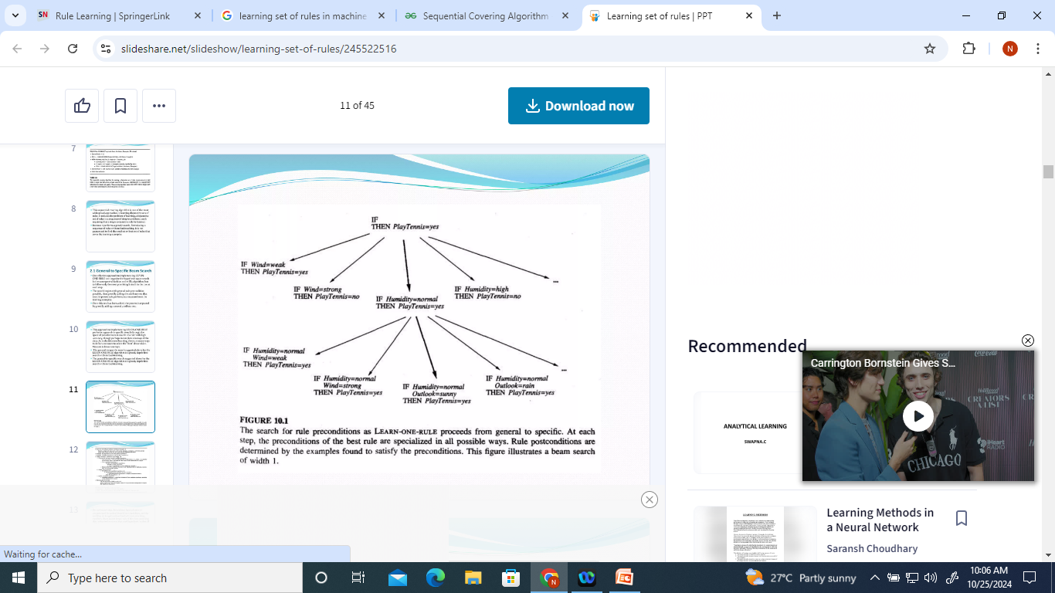
Example 1

Slide 34
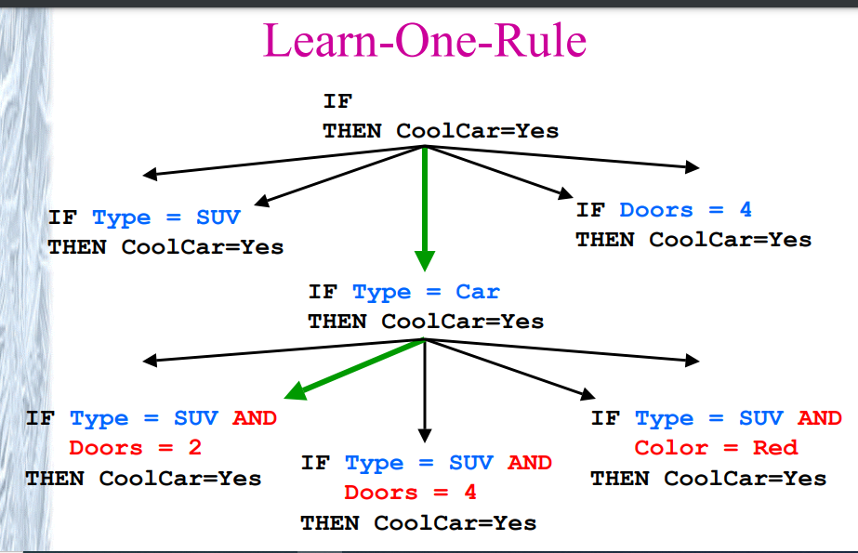
Example 2:

Slide 35
Learning strategies
Some strategies for learning rule sets include:
Learn-One-Rule: Searches from general to specific.
Find-S: Searches from specific to general.
FOIL: Learns one rule at a time, removing positive examples covered by the learned rule before attempting to learn another rule.

Slide 36
Sequential Covering Algorithm
Sequential Covering is a popular algorithm based on Rule-Based Classification used for learning a disjunctive set of rules.
The basic idea here is to learn one rule, remove the data that it covers, then repeat the same process.
In this way, it covers all the rules involved with it in a sequential manner during the training phase.

Slide 37
Sequential Covering Algorithm
The algorithm involves a set of ‘ordered rules’ or ‘list of decisions’ to be made.
Step 1 – create an empty decision list, ‘R’.
Step 2 – ‘Learn-One-Rule’ Algorithm It extracts the best rule for a particular class ‘y’, where a rule.
In the beginning,
Step 2.a – if all training examples ∈ class ‘y’, then it’s classified as positive example.
Step 2.b – else if all training examples ∉ class ‘y’, then it’s classified as negative example.

Slide 38
Step 3 – The rule becomes ‘desirable’ when it covers a majority of the positive examples. Step 4 – When this rule is obtained, delete all the training data associated with that rule. (i.e. when the rule is applied to the dataset, it covers most of the training data, and has to be removed).
Step 5 – The new rule is added to the bottom of decision list, ‘R’.

Slide 39
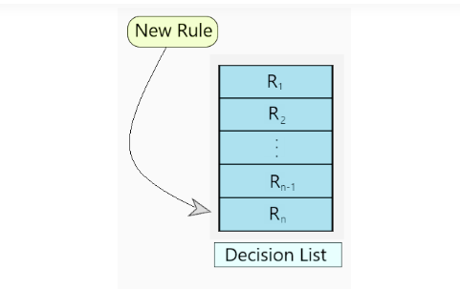
Decision List format

Slide 40
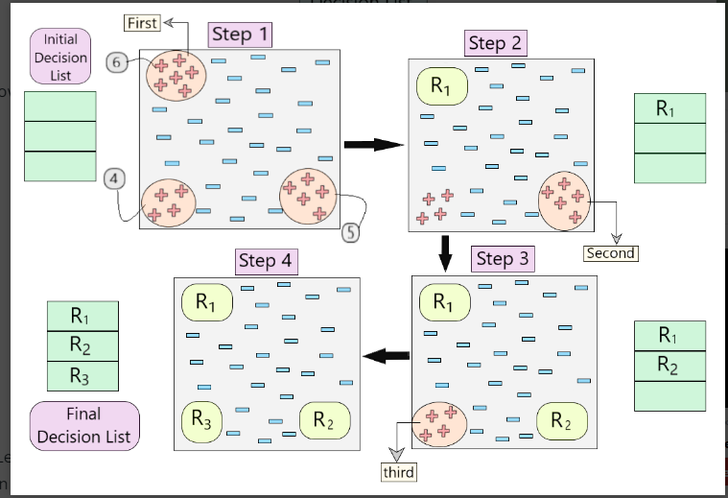
Working of the algorithm

Slide 41
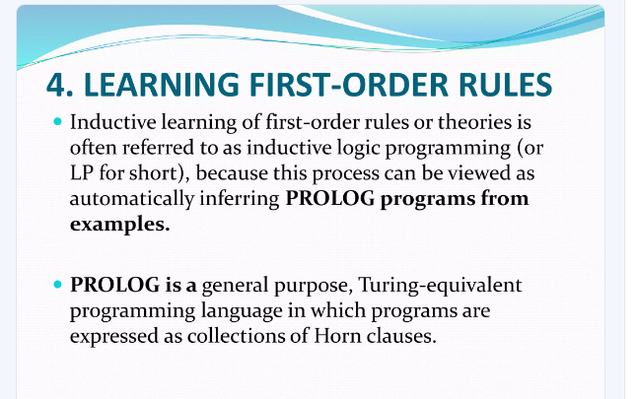

Slide 42
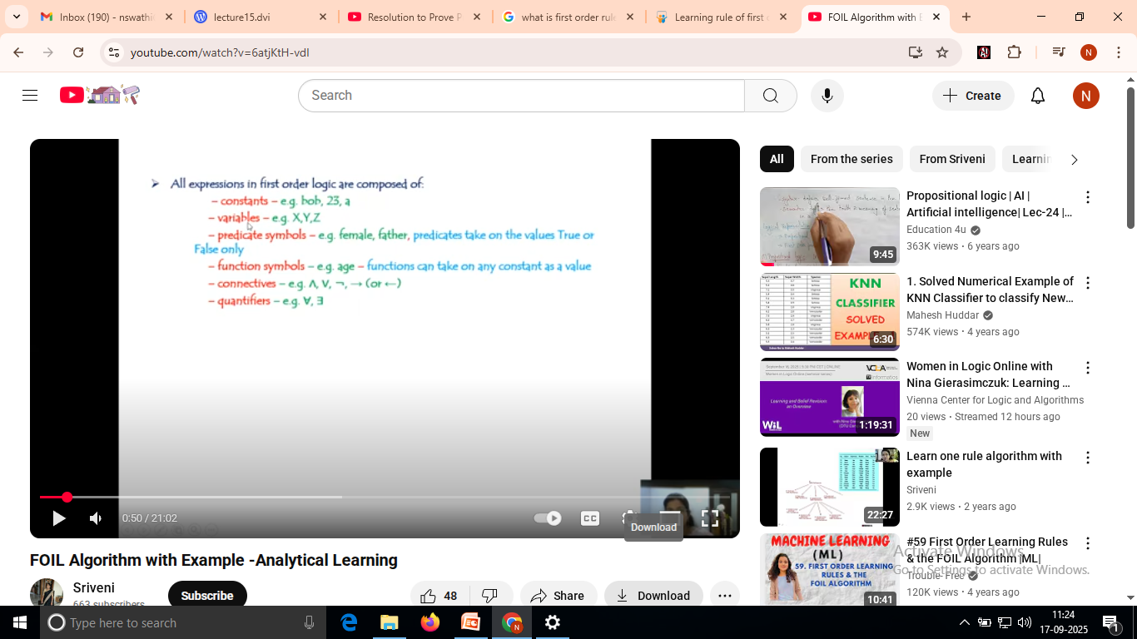
First order rules

Slide 43
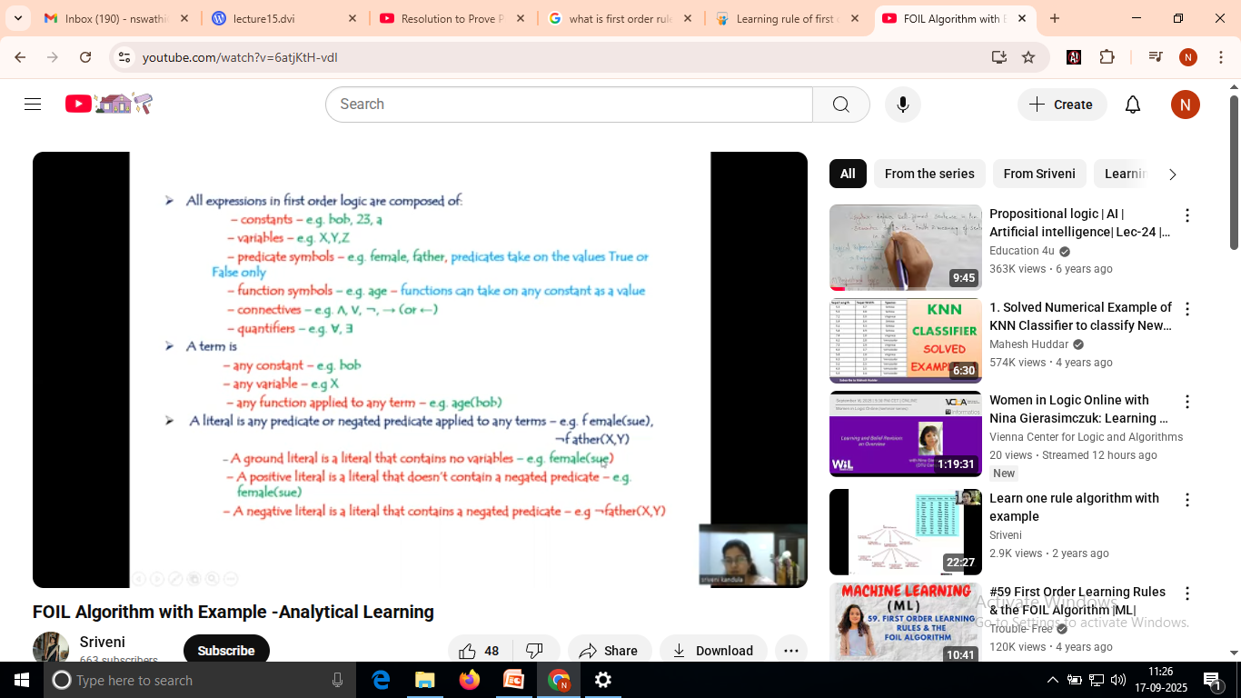

Slide 44
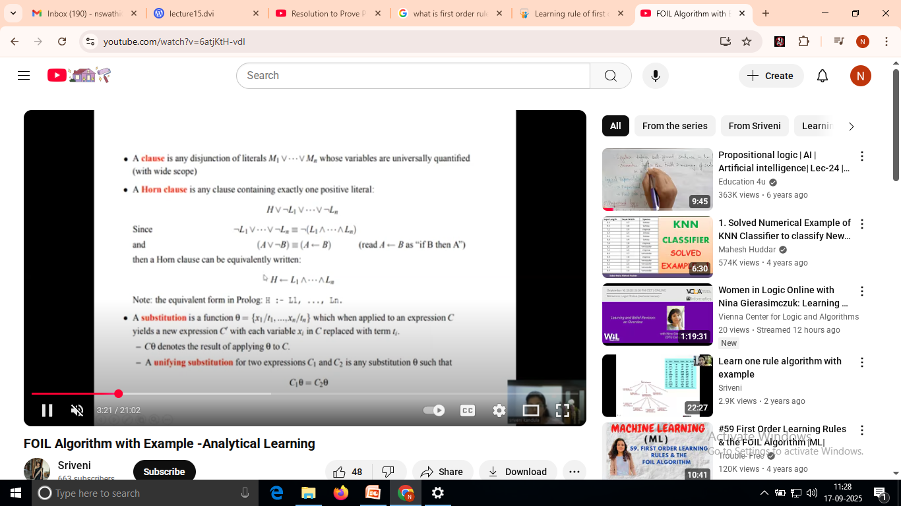

Slide 45
