Slide 1
Support Vector Machine & Its implementation with R
K K Singh
RGUKT NUZVID

Slide 2
Overview
Introduction to Support Vector Machines (SVM)
Linear SVM
Linear SVM, Estimation of parameters
Discussion

Slide 3
Introduction to Support Vector Machines (SVM)
It can represent linear and non-linear functions and it has an efficient training algorithm
Derived from statistical learning theory by Vapnik and Chervonenk (COLT-92)
SVM got into mainstream because of their exceptional performance in Handwritten Digit Recognition.

Slide 4
Linear SVM
x
f
y^{est}
f(x,w,b) = sign(w x + b)
w x + b>0
Let n training examples (tuple
< x_{i} y_{i} >) are there.
By default a vector is a column vector
So, x_{i}=(x_{i1}, x_{i2},…x_{id}) ^{T}
y_{i} ∈ (-1,1)
w are vector, b is intercept
How would you find f ?
w x + b=0
w x + b<0
denotes +1
denotes -1

Slide 5

Linear SVM
f(x,w,b) = sign(w x + b)
denotes +1
denotes -1
Class 1
which is best?
Class 2

Slide 6
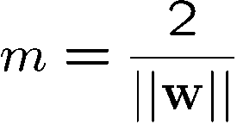



Good Decision Boundary: Margin Should Be Large
The decision boundary should be as far away from the data of both classes as possible
maximize the margin (M)
M
Class 1
Class 2
margin of a linear classifier is the width that the boundary could be increased by before hitting a data point.
Support vectors
Data points that the margin
pushes up against
Assignments: 1. Why support vector is called as vector??
2. Why W^{T}X+b=1? Why not W^{T}X+b=C?

Slide 7
Formulate Margin: Distance between the two margin line
M=Margin Width
x⁺
“Predict Class = +1”
X⁻
wx+b=1
wx+b=0
“Predict Class = -1”
wx+b=-1
What we know:
w . x⁺ + b = +1 …….(1)
w . x⁻ + b = -1 ……..(2)
Eqn (1) – (2)
w . (x⁺ - x⁻ )= 2

Slide 8
Linear SVM ,Estimation of w & b
Classification of training data
if y_{i} = +1
if y_{i} = -1
for all i
2) Maximize the Margin
Or minimize
A Quadratic Optimization Problem is formulated.
Minimize:
subject to:
How??

Slide 9
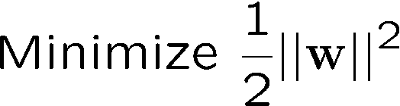
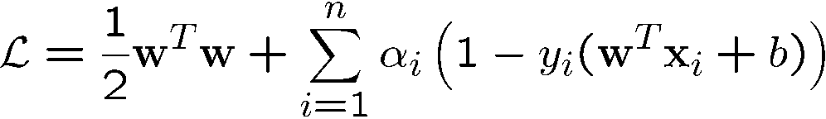
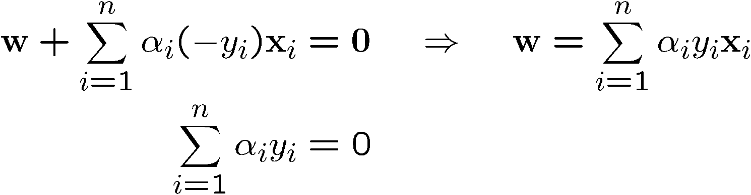
Lagrangian Multiplier method (for convex Optimization)
||..|| symbol is called Norm
The Lagrangian Equation
Minimize:
Subject to: and
Lagrangian multipliers
Why?
α_{i} ≥0
α_{i}(y_{i} (w.x_{i} + b) – 1) =0, ∀ i in(1,n)
Setting the differential w.r.t. w and b to zero, we have
Constraints are inequalities, so gradients w.r.t. α_{i} cant be set to zero,
so the Constraints are to be transformed in equalities as α_{i}(y_{i} (w.x_{i} + b) – 1) =0
From Complementary slackness condition, α _{i} is vanished for support vector, and so difficult to compute them from primal function.
Notes:
Complementary slackness condition

Slide 10
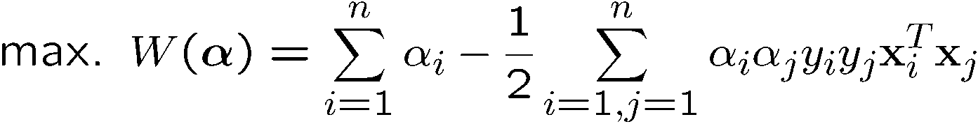
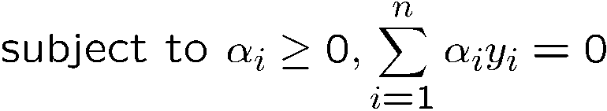
The Dual Optimization Problem
We can transform the problem to its dual.
One of the important advantage of using the dual form in SVM is that it allow us to apply kernels.
This is a convex quadratic programming (QP) problem
Global maximum of α_{i} can always be found
Now Constraints are equalities.
Assignment: verify Σx_{i} Σx_{j}= Σ Σx_{i}x_{j}= Σ Σx_{i}^{T}x_{j}
Where x_{i} is i_{th} row of a matrix X
α’s → New variables
(Lagrangian multipliers)
Notes:
As the quadratic term is negative, so the original minimization problem become maximization problem

Slide 11
The Optimization Problem Solution
The solution has the form:
Each non-zero α_{i} indicates that corresponding x_{i} is a support vector.
Then the classifying function will have the form:
w =Σα_{i}y_{i}x_{i} b= y_{k} - w^{T}x_{k} for any x_{k} such that α_{k}≠ 0
f(x) = wx + b
Class of the input x =sign(f(x)-1)

Slide 12
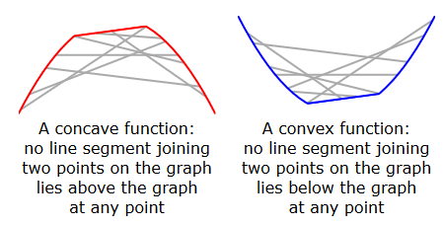
Concept in support
The solution to the dual problem provides a lower bound to the solution of the primal (minimization) problem. (Wikipedia)

Slide 13
Dataset with noise
denotes +1
denotes -1
Hard Margin: So far we require all data points be classified correctly
- No training error
What if the training set is noisy?
- Solution 1: use very powerful kernels

Slide 14
Soft Margin Classification
Slack variables ξi can be added to allow misclassification of difficult or noisy examples.
What should our quadratic optimization criterion be?
Minimize
ε₁₁
ε₂
wx+b=1
ε₇
wx+b=0
wx+b=-1

Slide 15
Hard Margin v.s. Soft Margin
The old formulation:
The new formulation incorporating slack (ξ :Xi) variables:
Parameter C can be viewed as a way to control overfitting.
Find w and b such that
Φ(w) =½ w^{T}w is minimized and for all {(x_{i} ,y_{i})}
y_{i} (w^{T}x_{i} + b) ≥ 1
Find w and b such that
Φ(w) =½ w^{T}w + CΣξ_{i} is minimized and for all {(x_{i} ,y_{i})}
y_{i} (w^{T}x_{i} + b) ≥ 1- ξ_{i} and ξ_{i} ≥ 0 for all i

Slide 16
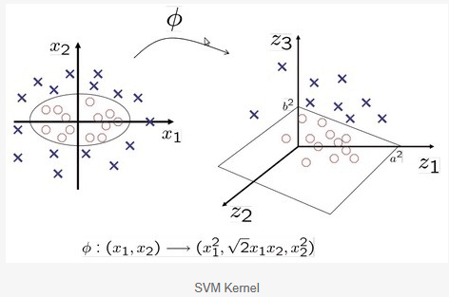
What is Kernel?
The kernel function transforms the data into a higher dimensional feature space to make it possible to perform the linear separation. See the image below -

Slide 17
Non-linear SVMs: Feature spaces
General idea: the original input space can always be mapped to some higher-dimensional feature space where the training set is separable:
Φ: x → φ(x)
(a,b)
Can we make it leanly separable by adding an additional dimension….????? (Hints: transform: x₁->x₁²-2ax₁, x₂->x₂²-2ax₂

Slide 18
The “Kernel Trick”
The linear classifier relies on dot product between vectors K(x_{i},x_{j})=x_{i}^{T}x_{j}
If every data point is mapped into high-dimensional space via some transformation Φ: x → φ(x), the dot product becomes:
K(x_{i},x_{j})= φ(x_{i}) ^{T}φ(x_{j})
A kernel function is some function that corresponds to an inner product in some expanded feature space.
Example:
2-dimensional (polynomial) vectors x=[x₁ x₂]; let K(x_{i},x_{j})=(1 + x_{i}^{T}x_{j})²,
Need to show that K(x_{i},x_{j})= φ(x_{i}) ^{T}φ(x_{j}):
K(x_{i},x_{j})=(1 + x_{i}^{T}x_{j})²=(1 + x_{i1}x_{j1}+ x_{i2}x_{j} )²,,
= 1+ x_{i1}²x_{j1}² + 2 x_{i1}x_{j1} x_{i2}x_{j2}+ x_{i2}²x_{j2}² + 2x_{i1}x_{j1} + 2x_{i2}x_{j2}
= [1 x_{i1}² √2 x_{i1}x_{i2} x_{i2}² √2x_{i1} √2x_{i2}]^{T} [1 x_{j1}² √2 x_{j1}x_{j2} x_{j2}² √2x_{j1} √2x_{j2}]
= φ(x_{i}) ^{T}φ(x_{j}), where φ(x) = [1 x₁² √2 x₁x₂ x₂² √2x₁ √2x₂]
There are two types of x (x,x)

Slide 19
Examples of Kernel Functions
Linear: K(x_{i},x_{j})= x_{i} ^{T}x_{j}
Polynomial of power p: K(x_{i},x_{j})= (1+ x_{i} ^{T}x_{j})^{p}
Gaussian (radial-basis function network):
Sigmoid: K(x_{i},x_{j})= tanh(β₀x_{i} ^{T}x_{j} + β₁)
Notes:
Mercer’s theorem:
Every semi-positive definite symmetric function is a kernel
Semi-positive definite symmetric functions correspond to a semi-positive definite symmetric Gram matrix:

Slide 20
Non-linear SVMs Mathematically
Dual problem formulation:
The solution is:
Optimization techniques for finding α_{i}’s remain the same!
Find α₁…α_{N} such that
Q(α) =Σα_{i} - ½ΣΣα_{i}α_{j}y_{i}y_{j}K(x_{i}, x_{j}) is maximized and
(1) Σα_{i}y_{i} = 0
(2) α_{i} ≥ 0 for all α_{i}
f(x) = Σα_{i}y_{i}K(x_{i}, x_{j})+ b

Slide 21
Properties of SVM
Flexibility in choosing a similarity function
Sparseness of solution when dealing with large data sets
- only support vectors are used to specify the separating hyper plane
Ability to handle large feature spaces
- complexity does not depend on the dimensionality of the feature space
Overfitting can be controlled by soft margin approach
Nice math property: a simple convex optimization problem which is guaranteed to converge to a single global solution

Slide 22
SVM Applications
SVM has been used successfully in many real-world problems
- text (and hypertext) categorization
- image classification
- bioinformatics (Protein classification,
Cancer classification)
- hand-written character recognition

Slide 23
Weakness of SVM
It is sensitive to noise
- A relatively small number of mislabeled examples can dramatically decrease the performance
It only considers two classes
- how to do multi-class classification with SVM?
- Answer:
1) with output arity m, learn m SVM’s
SVM 1 learns “Output==1” vs “Output != 1”
SVM 2 learns “Output==2” vs “Output != 2”
:
SVM m learns “Output==m” vs “Output != m”
2)To predict the output for a new input, just predict with each SVM and find out which one puts the prediction the furthest into the positive region.

Slide 24
Thank you

Slide 25
Application : Text Categorization
Task: The classification of natural text (or hypertext) documents into a fixed number of predefined categories based on their content.
- email filtering, web searching, sorting documents by topic, etc..
A document can be assigned to more than one category, so this can be viewed as a series of binary classification problems, one for each category

Slide 26

Representation of Text
IR’s vector space model (aka bag-of-words representation)
A doc is represented by a vector indexed by a pre-fixed set or dictionary of terms
Values of an entry can be binary or weights
Normalization, stop words, word stems
Doc x => φ(x)
The distance between two documents is φ(x)·φ(z)
K(x,z) = 〈φ(x)·φ(z) is a valid kernel, SVM can be used with K(x,z) for discrimination.

Slide 27
Some Issues
Choice of kernel
- Gaussian or polynomial kernel is default
- if ineffective, more elaborate kernels are needed
- domain experts can give assistance in formulating appropriate similarity measures
Choice of kernel parameters
- e.g. σ in Gaussian kernel
- σ is the distance between closest points with different classifications
- In the absence of reliable criteria, applications rely on the use of a validation set or cross-validation to set such parameters.
Optimization criterion – Hard margin v.s. Soft margin
- a lengthy series of experiments in which various parameters are tested

Slide 28
Reference
Support Vector Machine Classification of Microarray Gene Expression Data, Michael P. S. Brown William Noble Grundy, David Lin, Nello Cristianini, Charles Sugnet, Manuel Ares, Jr., David Haussler
www.cs.utexas.edu/users/mooney/cs391L/svm.ppt
Text categorization with Support Vector Machines: learning with many relevant features
T. Joachims, ECML - 98
http://www.kernel-machines.org/

Slide 29

Some relevant mathematical terminologies
A norm is a function that assigns a strictly positive length or size to each vector in a vector space
Let p ≥ 1 be a real number. The -norm of vectors is
In Euclidian space , norm |w|=||w||, & ||w||² = w^{T}w
The outer product (or tensor product ) u ⊗ v is equivalent to a matrix (m × n) multiplication uvT, provided that u is represented as a m × 1 column vector and v as a n × 1 column vector
The Inner product: If m = n, then one can take the matrix product the other way, yielding a scalar (or 1 × 1 matrix): ⟨ u , v ⟩ = u T v
which is the standard inner product for Euclidean vector spaces, better known as the dot product. The inner product is the trace of the outer product
Back

Slide 30
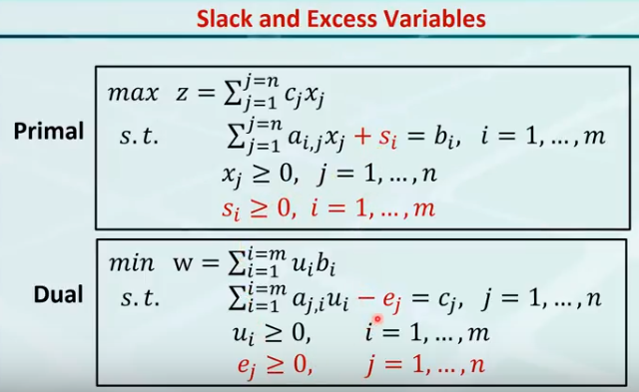
s_{i}, and e_{j} are slacks which make inequalities to equalities constraints.

Slide 31
Example
12
8
x1
x2
1 2
3 4
12
24
y1
y2
c= , x= , A= , b= , y=
Family of lines: 12x₁+8x₂=k, let k=(24,48,72,96,120)
12
10
8
6
4
2
Primal:
Max:Z= 12x₁+8x₂
s.t. X₁+2x₂≤ 12
3x₁+4x₂ ≤ 24
x₁,x₂≥0
Min: Z=12y₁+24y₂
s.t. y₁+3y₂ ≥ 12
2y₁+4y₂ ≥ 8
y₁,y₂≥0
Feasible area
Primal problem
Dual problem
2 4 6 8 10 12
Optimal sol: x1=8,x2=0,Z=96
12
10
8
6
4
2
Feasible area
2 4 6 8 10 12
Optimal sol: x1=0,x2=4,Z=96

Slide 32
Complementary Slackness theorem
Let x=[x1,x2…….xn] be the feasible solution of the primal
Let y=[y1,y2…….yn] be the feasible solution of the dual
Then x is primal optimal and y is dual optimal iff
s_{i}y_{i}=0 , for (i=1,2,…n), where n is # of variables in primal
And e_{j}x_{j}=0 for (j=1,2…..m) where n is # of constraints in primal
s_{i}, and e_{j} are slacks which make inequalities to equalities constraints.
Once x or y is on the constraints line, the corresponding slack is zero
Optimal sol: x1=8,x2=0, Z=96
slacks: s1=4, s2=0
Optimal sol: y1=0, y2=4, Z=96
slacks: e1=0, e2=-8
slack
Having optimal solution: c^{T}x=b^{T}y => y^{T}Ax=b^{T}y => y_{i}(a_{i}x_{i}-b_{i})=0
Back

Slide 33
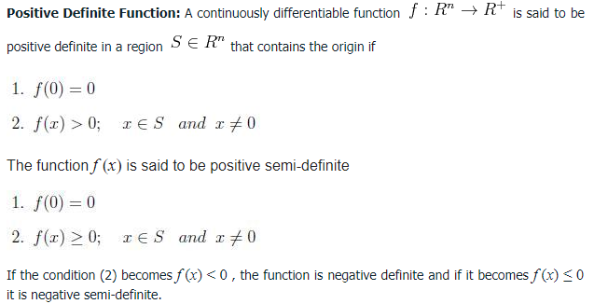
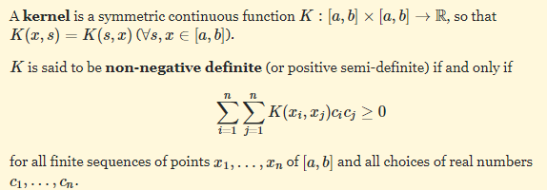
A symmetric function on variables x1,x2 , ...,xn is a function that is unchanged by any permutation of its variables.

Slide 34
A contour plot of the function z=f(x,y) consists of a family of curves f(x,y)=c (called level or contour curves) in the xy plane for various values of c.

