Slide 1
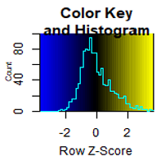
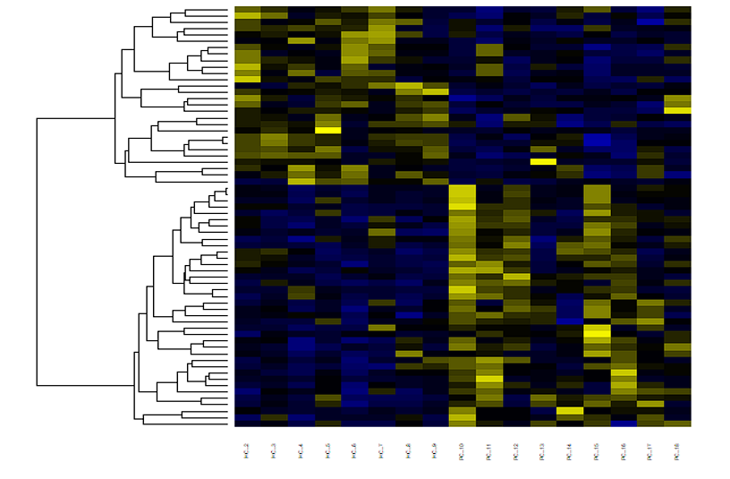
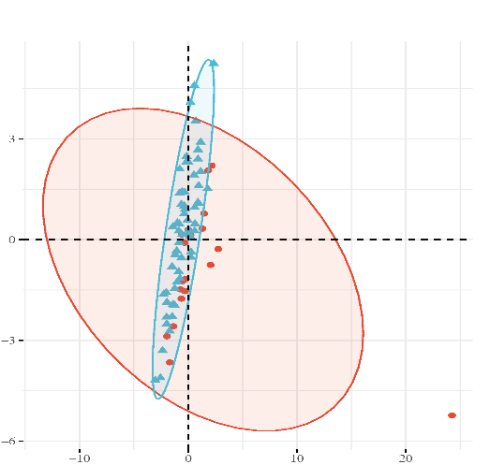
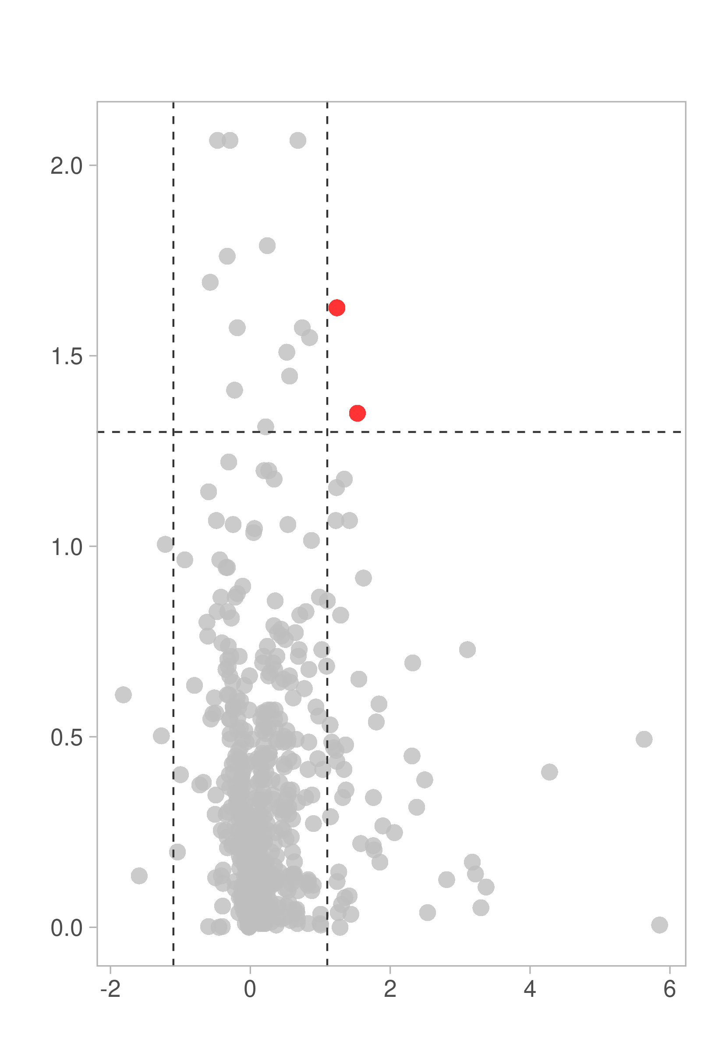
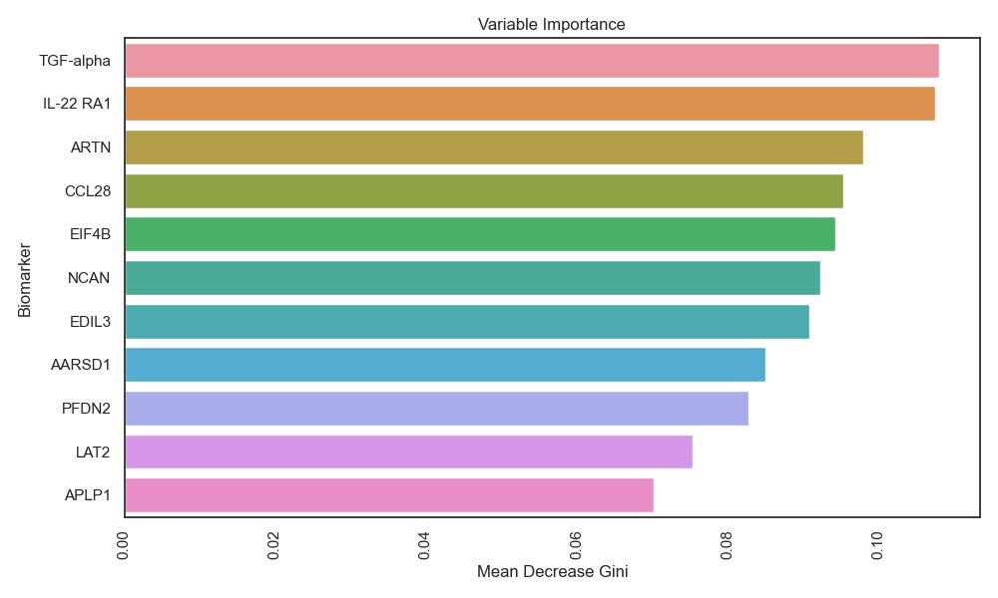


A.
B.
Figure 1
BBB Leakage
BBB Normal
PC2 (13.6%)
Leakage
Normal
PC1 (30.3%)
E.
Variable Importance
C.
Up:02
Down:00
Insignificant
- $\log_{10} p value$
Mean Decrease Gini
$\log_{2}$Fold Change

Slide 2
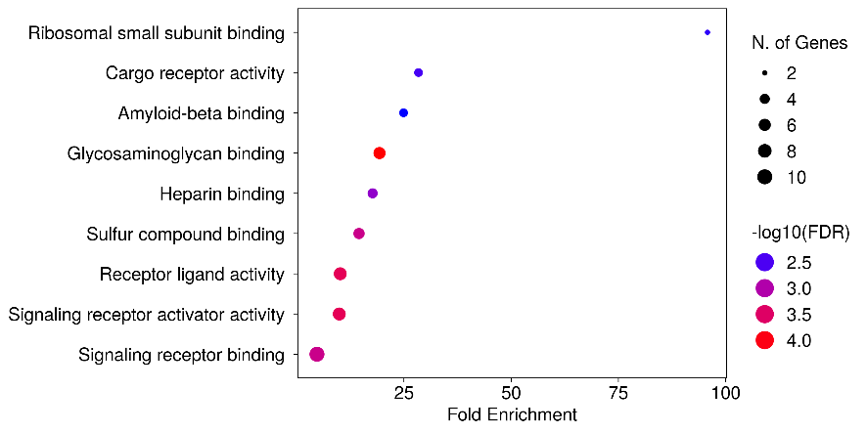
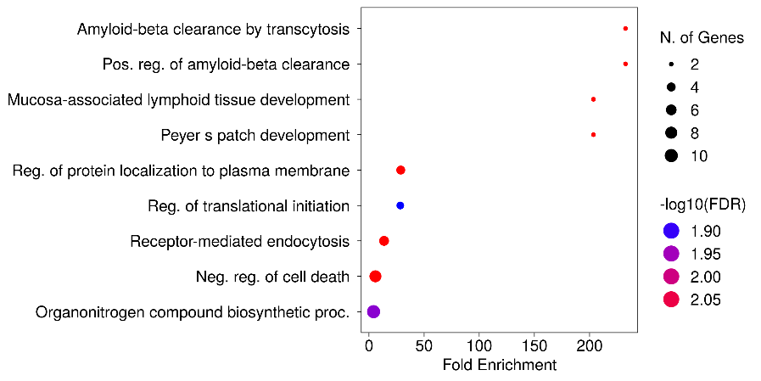
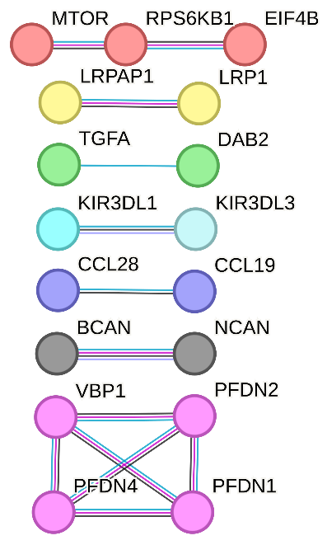
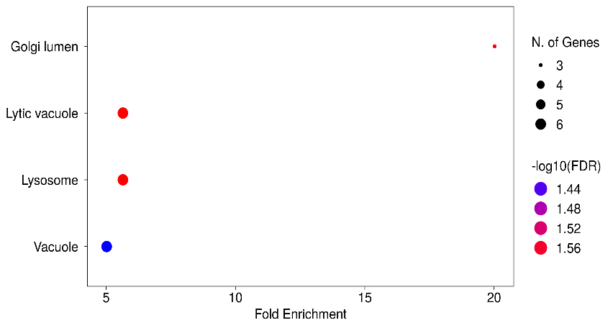
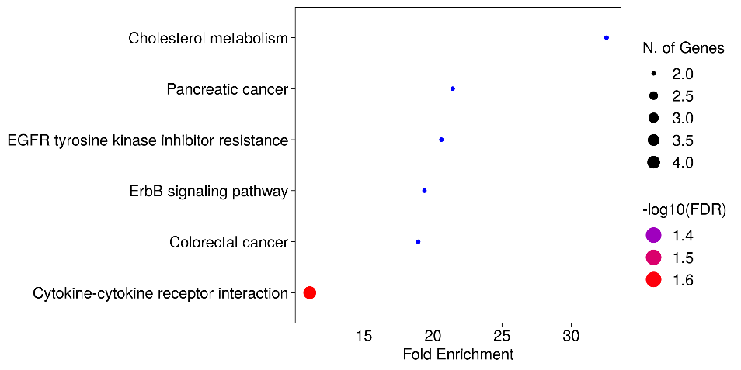
A.
GO Molecular Function
B.
GO Biological Process
Figure 2
E.
C.
GO Cellular Component
D.
Kegg Pathway
31 proteins are used
as input

Slide 3
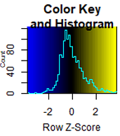
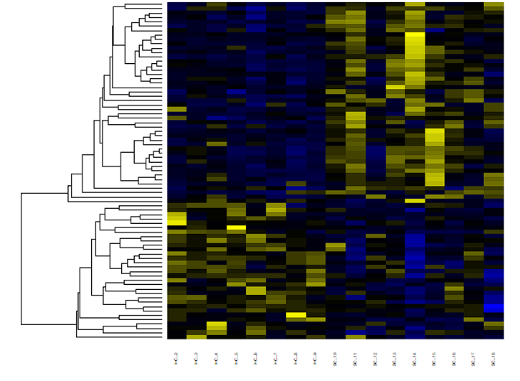
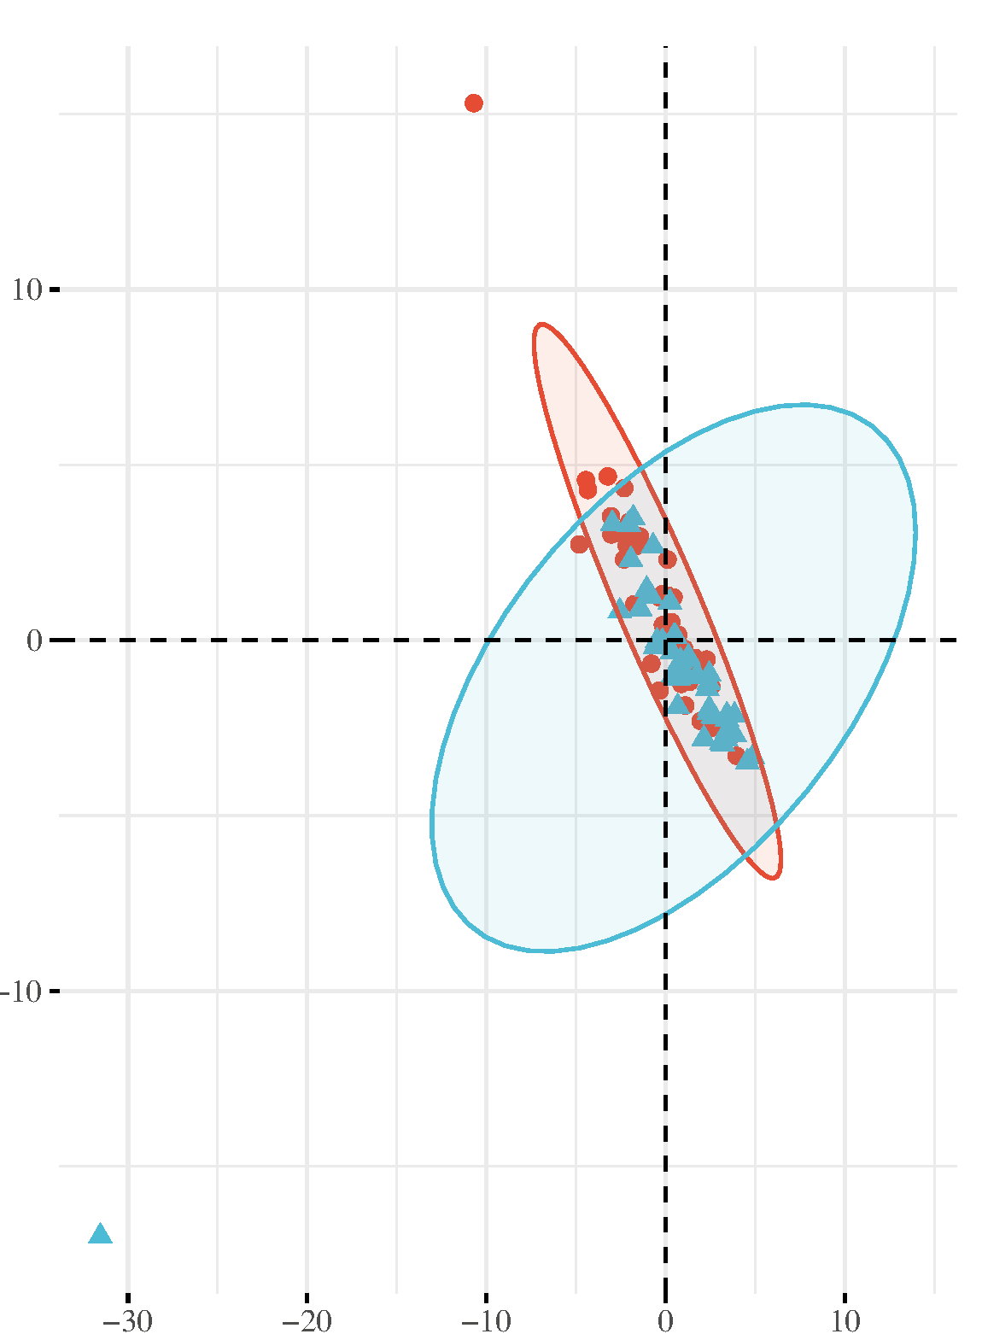
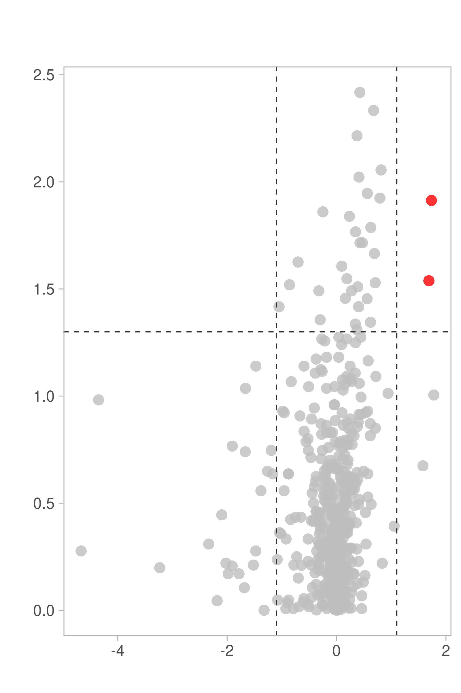
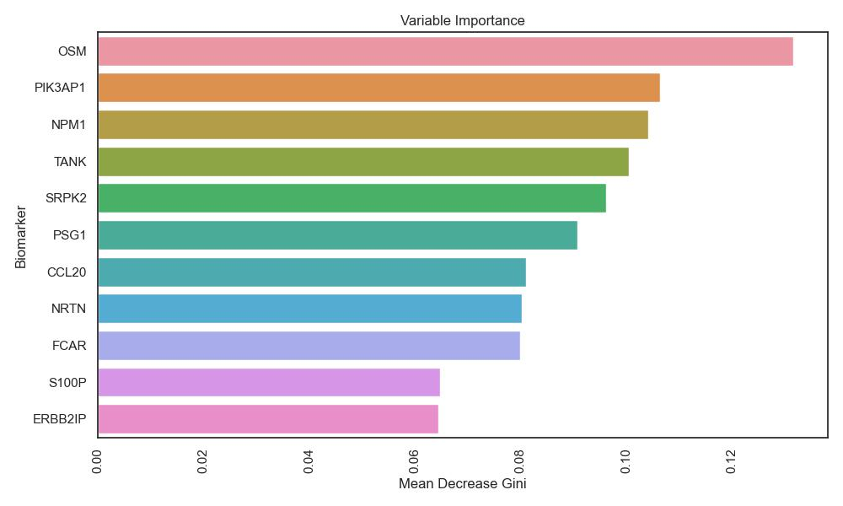


A.
B.
Figure 3
CI
NCI
PC2 (16.2%)
CI
NCI
PC1 (27.3%)
E.
Variable Importance
C.
Up:02
Down:00
Insignificant
- $\log_{10} p value$
Mean Decrease Gini
$\log_{2}$Fold Change

Slide 4
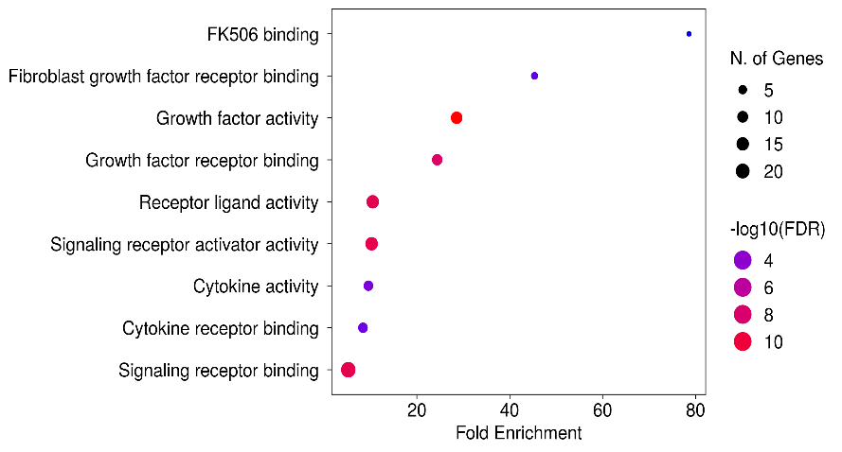
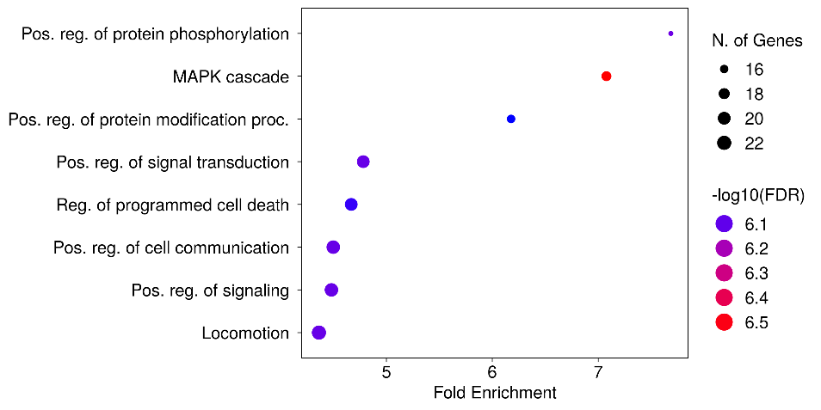
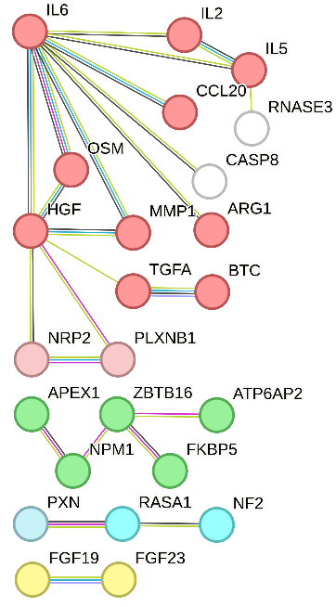
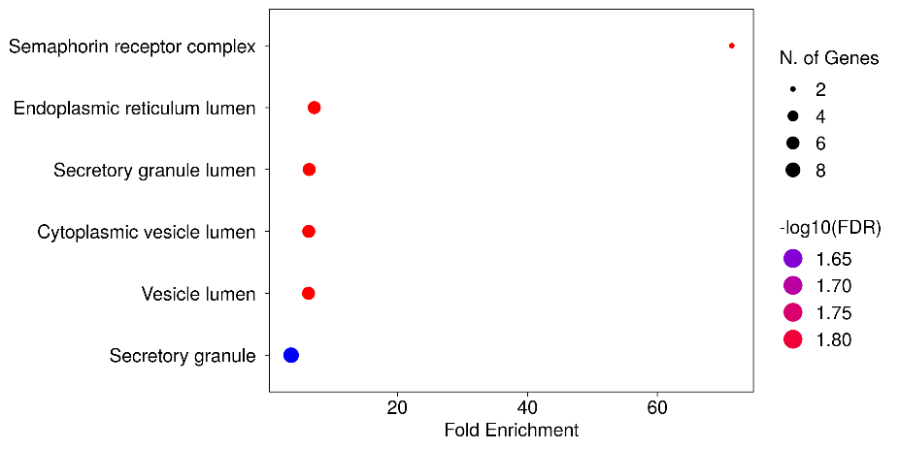
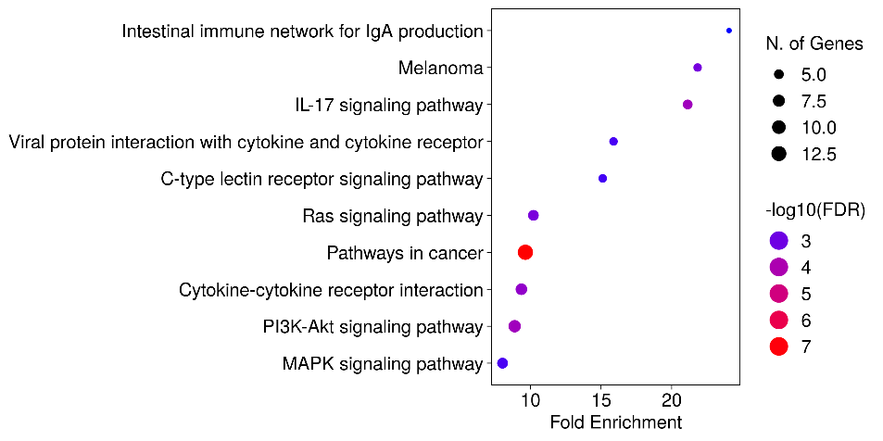
A.
GO Molecular Function
B.
GO Biological Process
Figure 4
E.
C.
GO Cellular Component
D.
Kegg Pathway
66 proteins are used
as input

