Slide 1
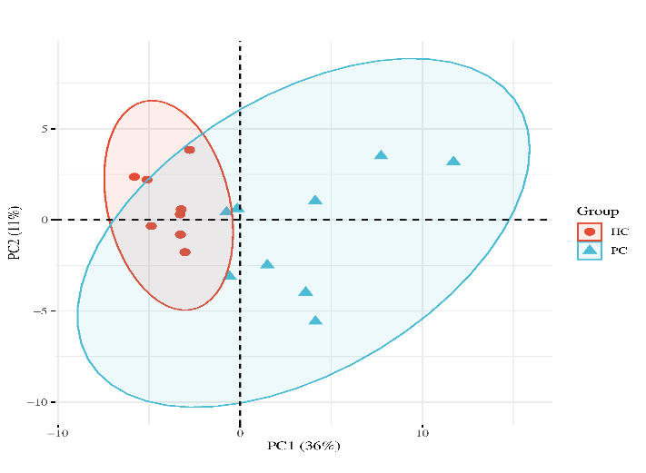
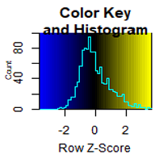
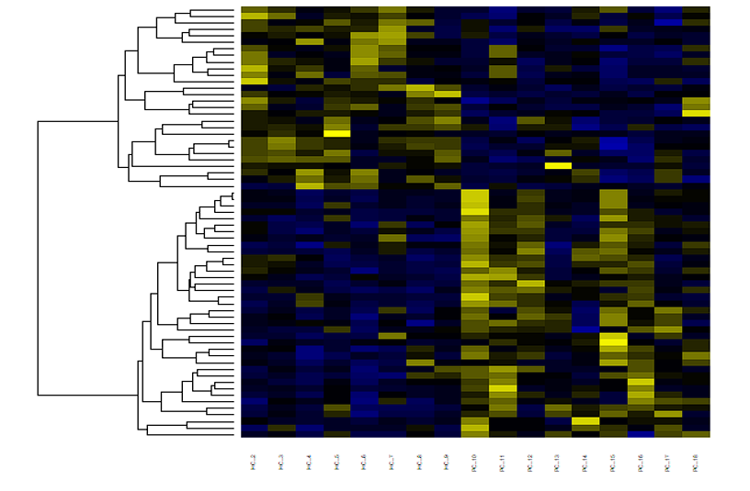
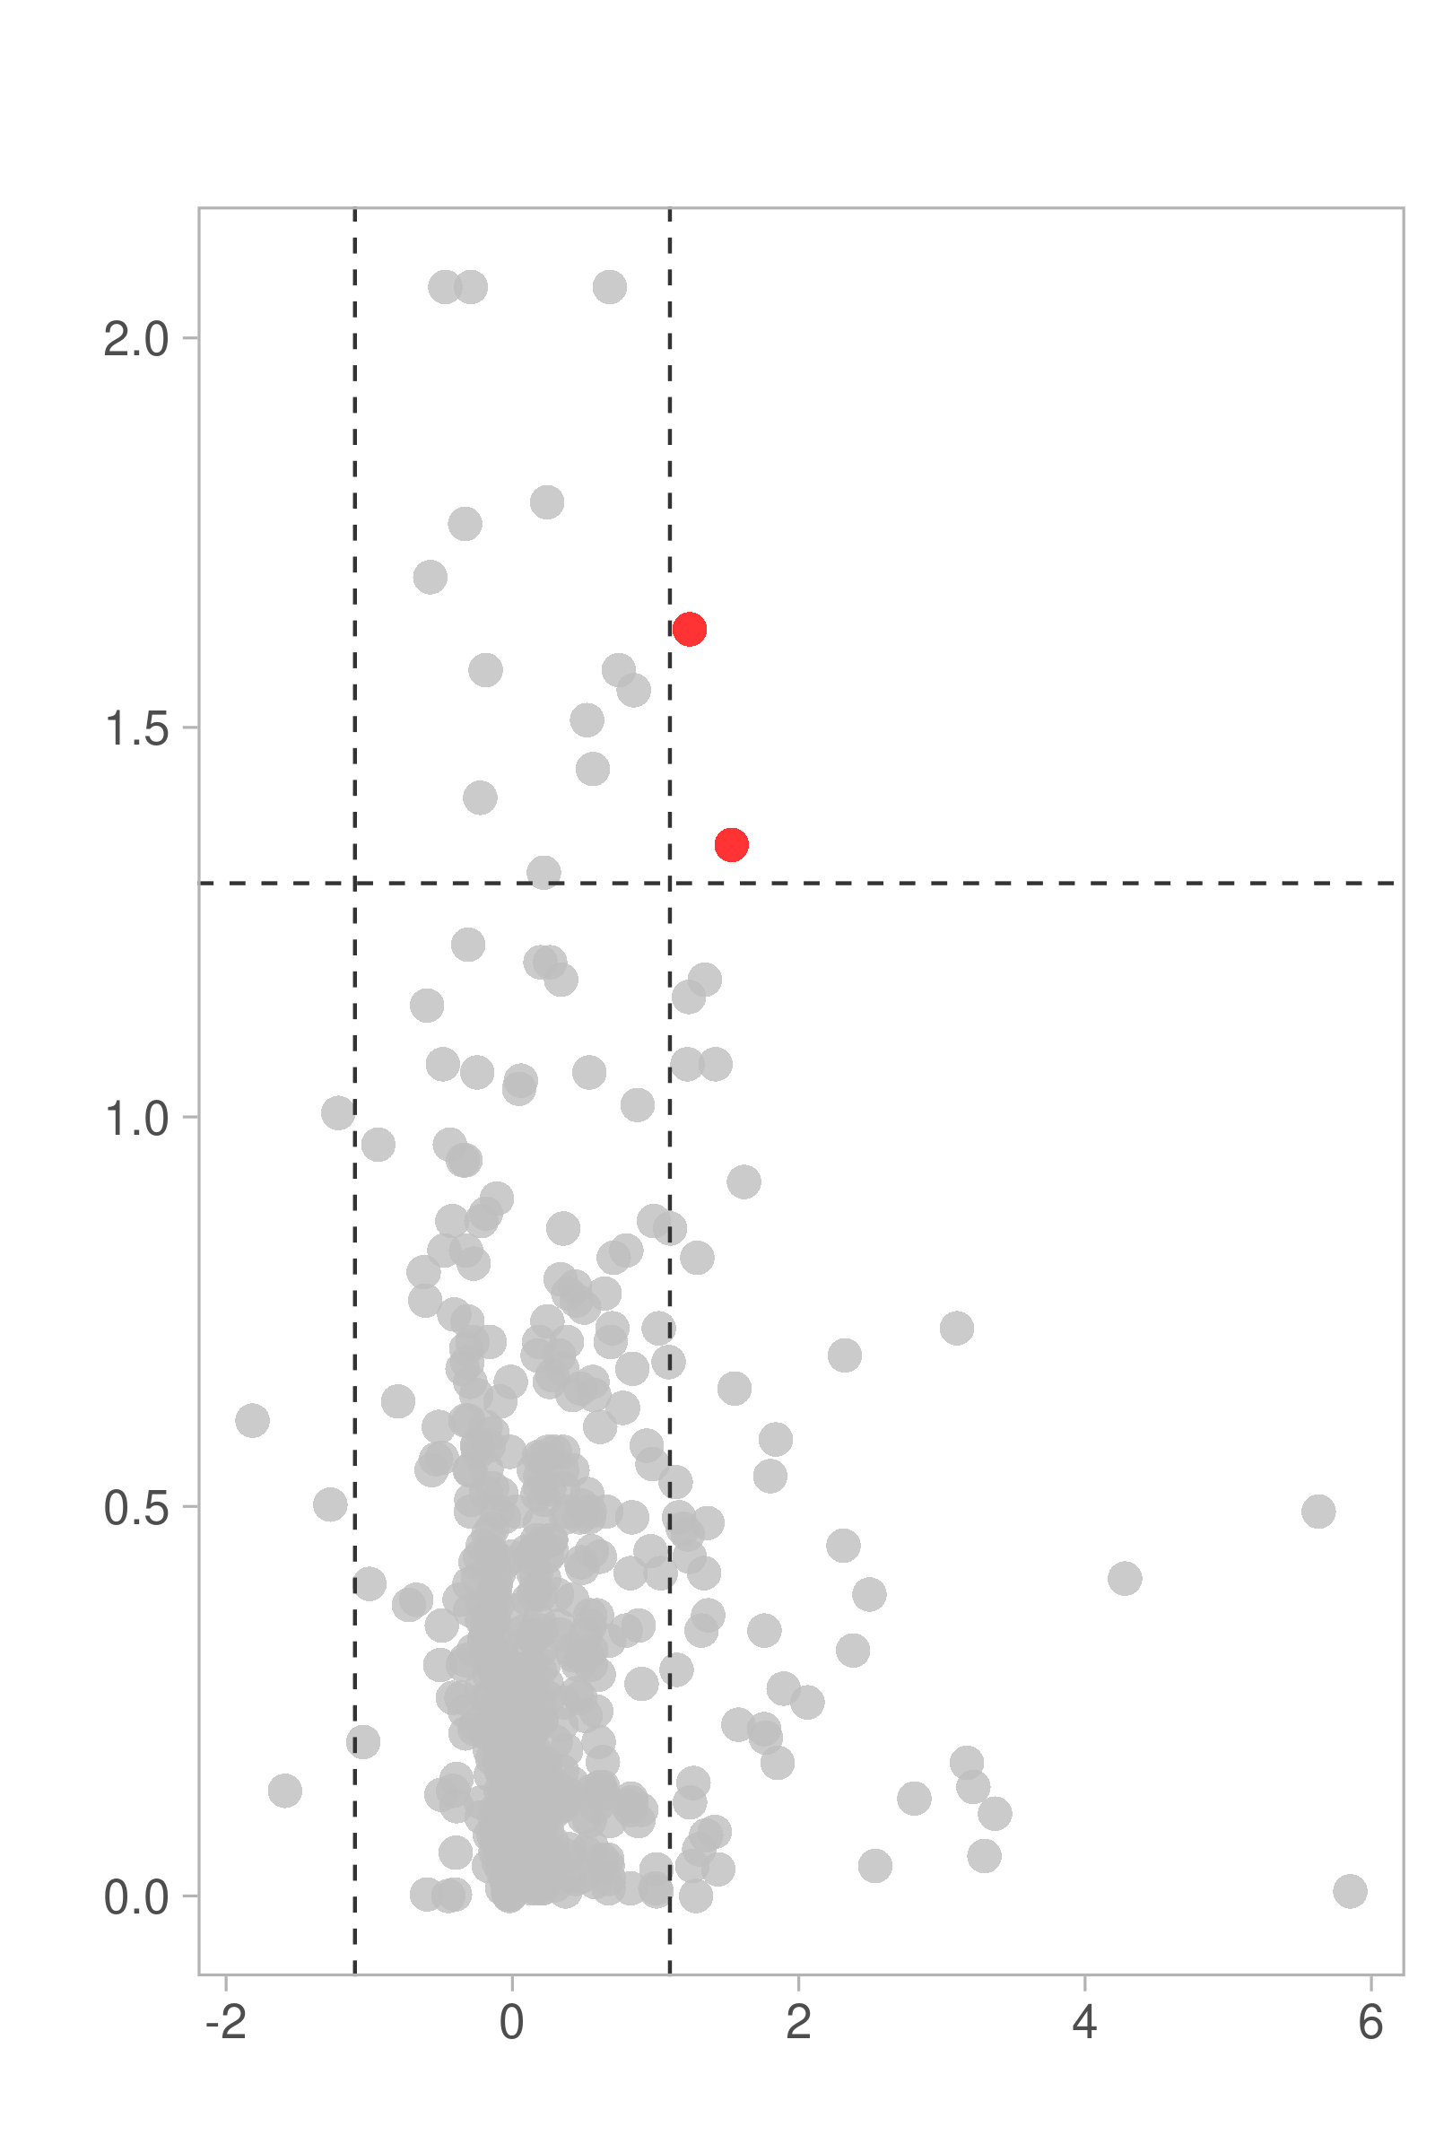


A.
B.
Figure 1
HC
PDAC
PC2 (11%)
HC
PDAC
PC1 (36%)
C.
Up:02
Down:00
Insignificant
- $\log_{10} p value$
$\log_{2}$Fold Change

Slide 2
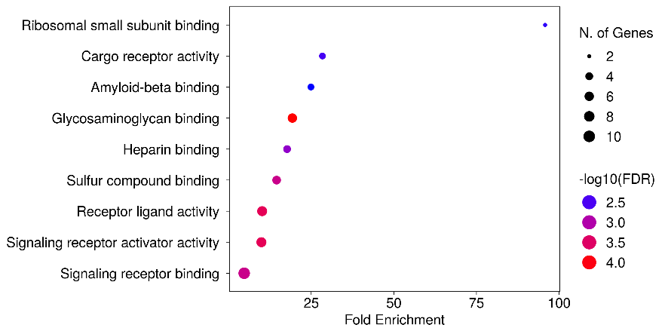
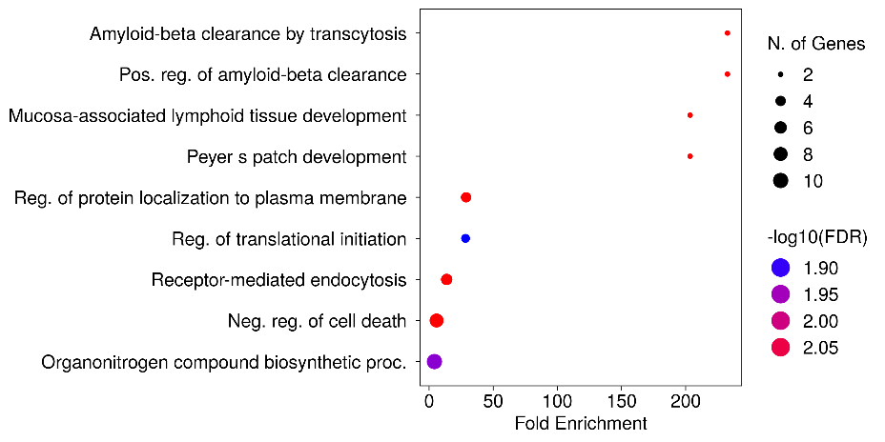
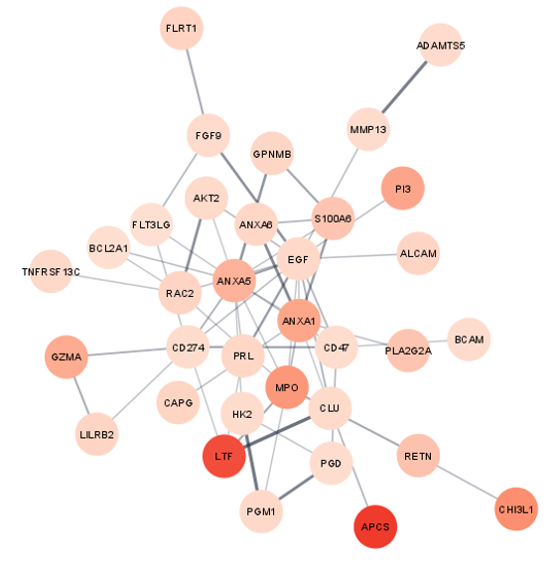
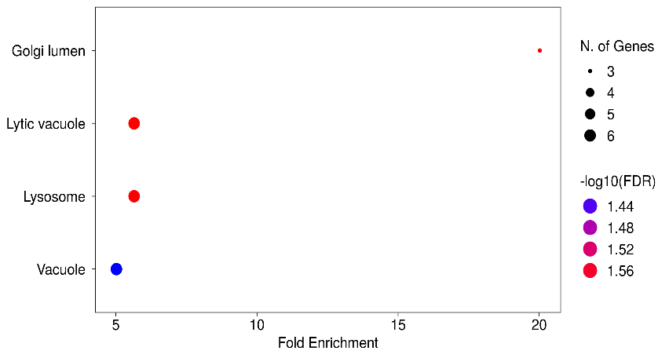
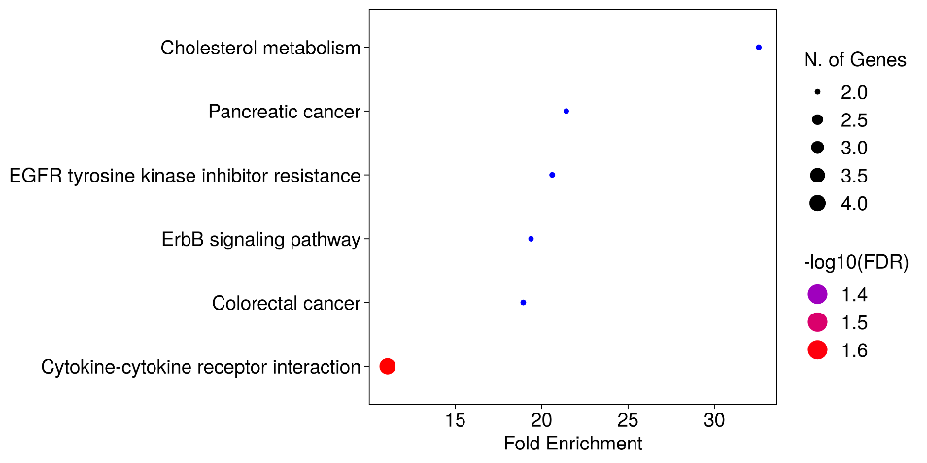
A.
GO Molecular Function
B.
GO Biological Process
Figure 2
Cytoscape
C.
GO Cellular Component
D.
E.
Kegg Pathway
66 proteins are used as input

Slide 3
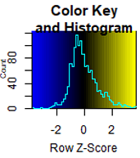
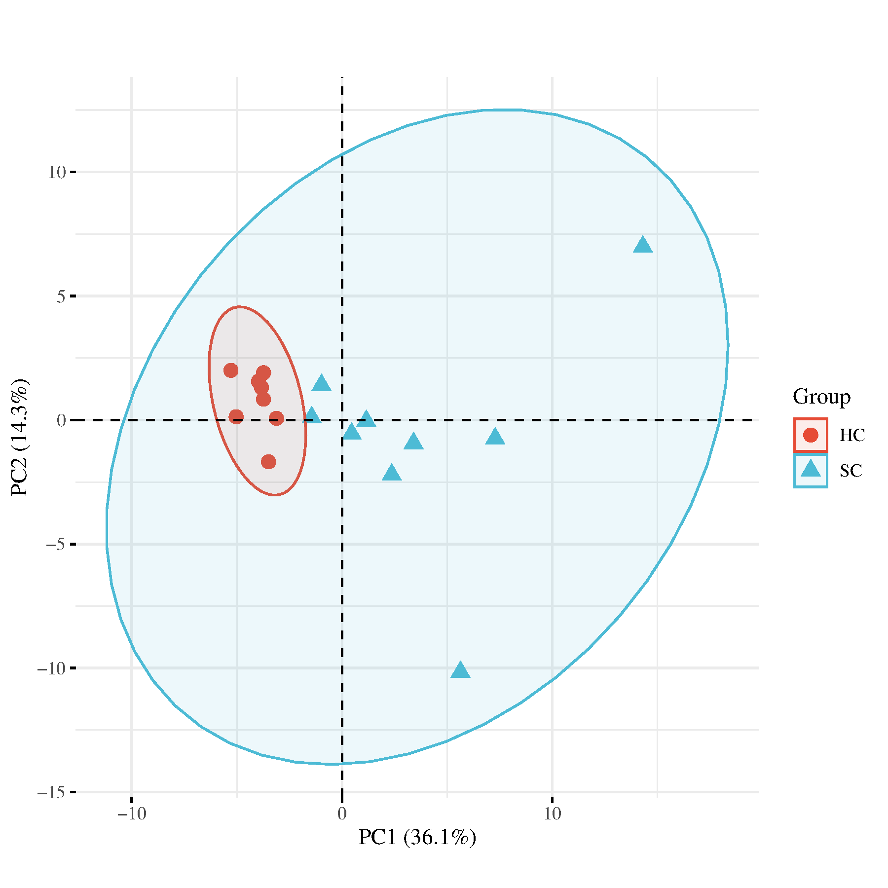
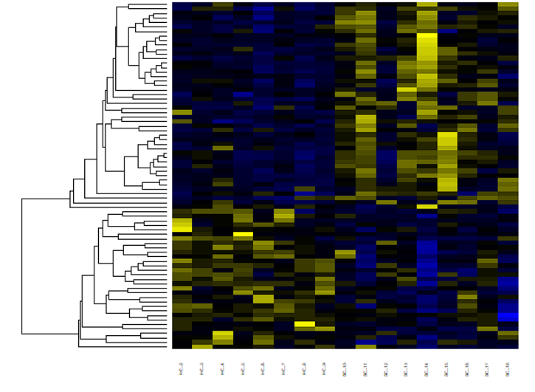
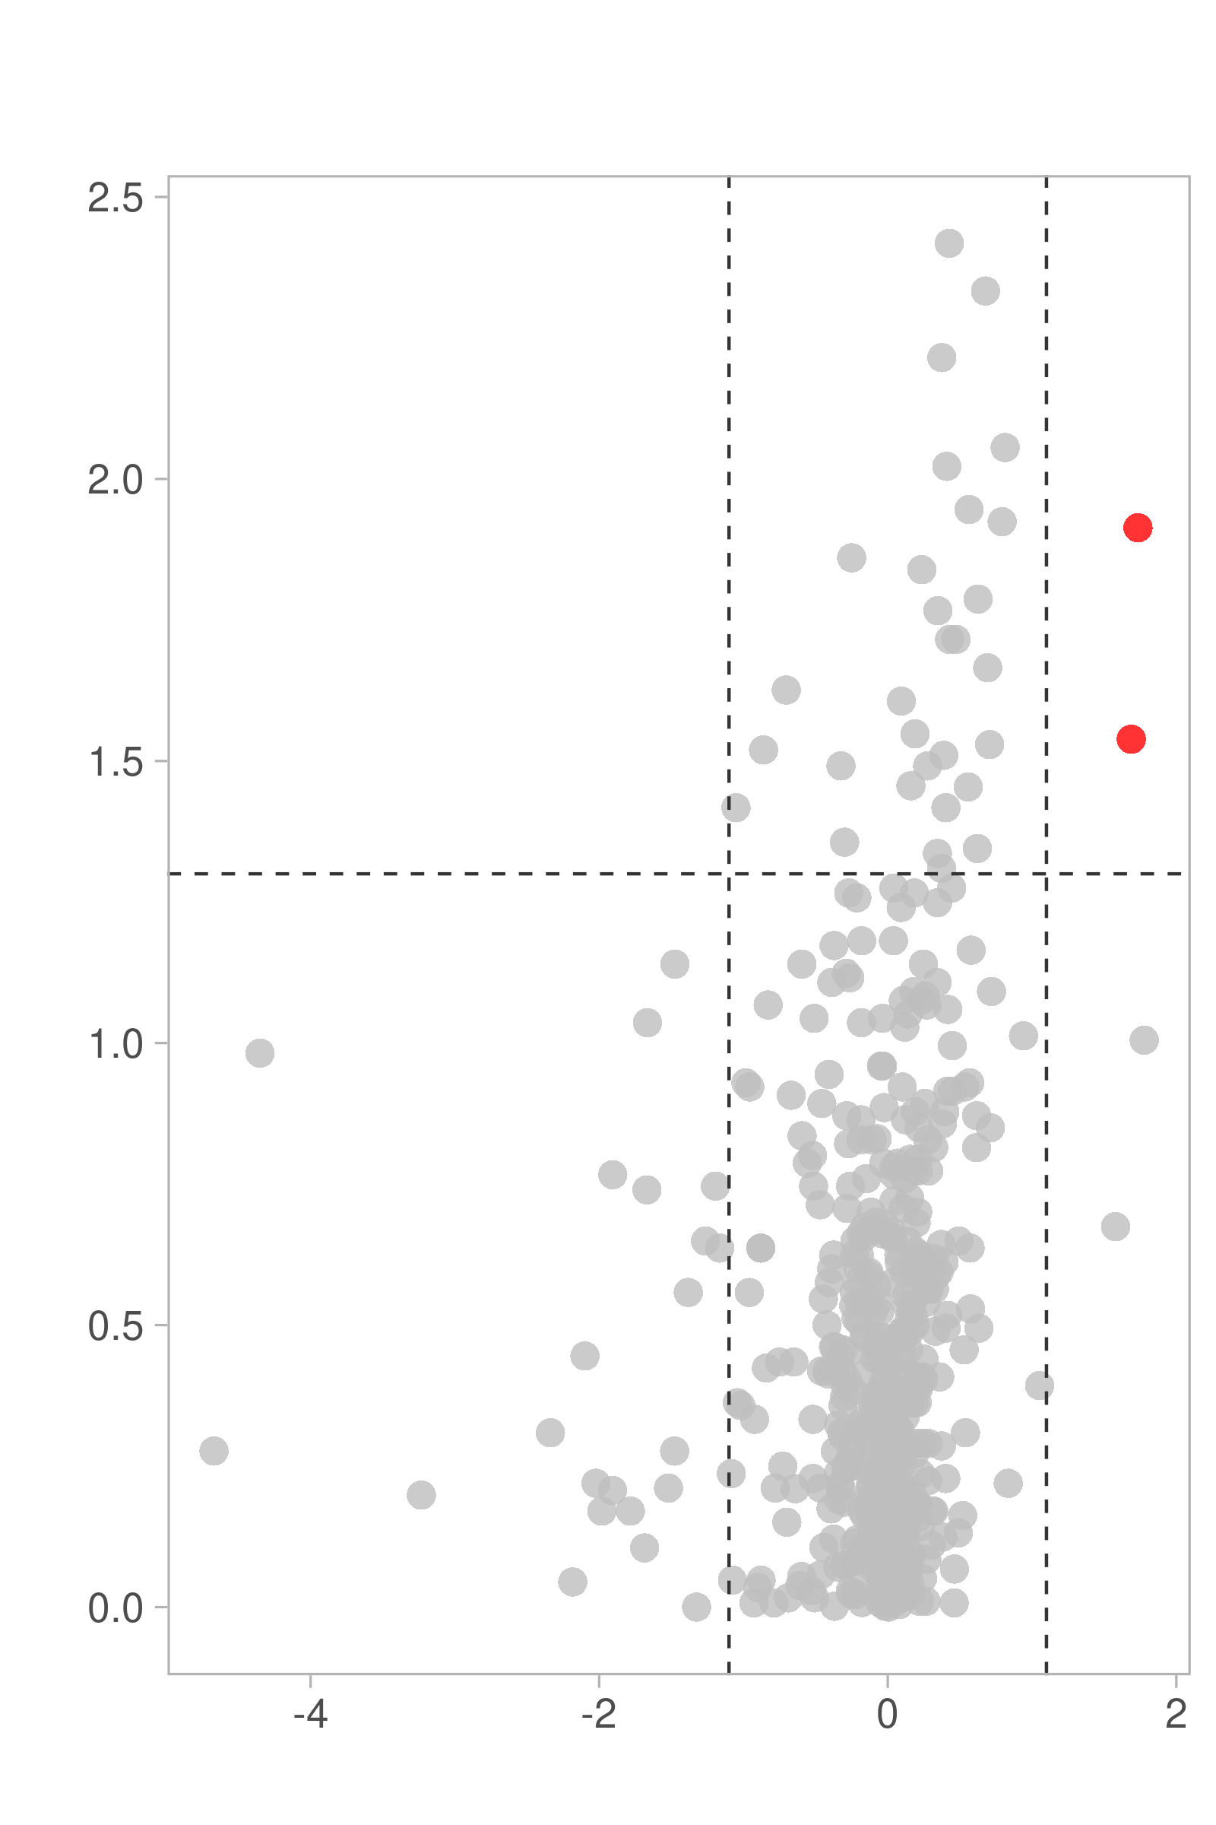


A.
B.
Figure 3
HC
GAC
PC2 (14.3%)
Leakage
Normal
PC1 (27.3%)
C.
Up:02
Down:00
Insignificant
- $\log_{10} p value$
$\log_{2}$Fold Change

Slide 4
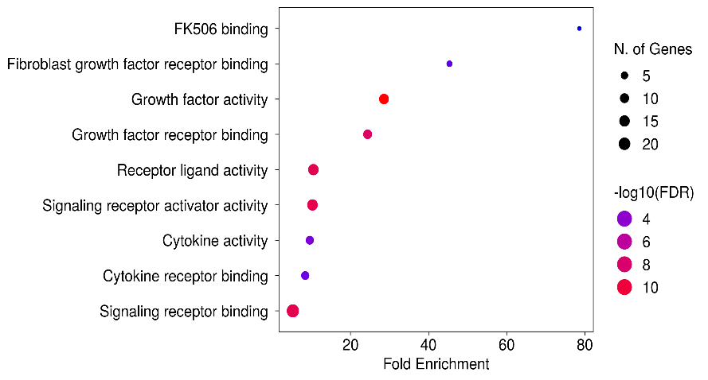
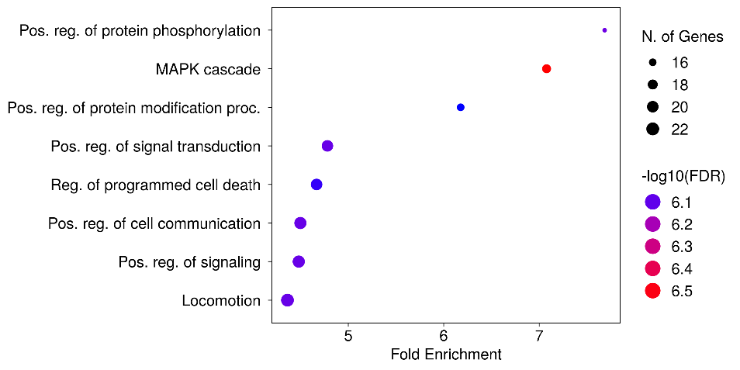
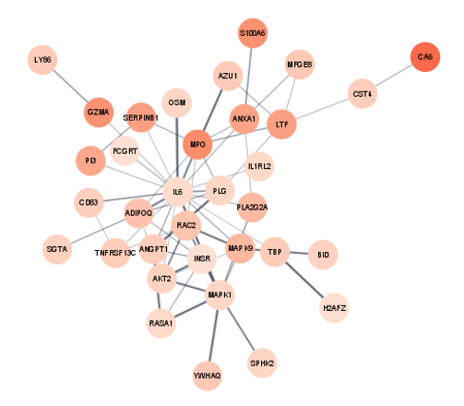
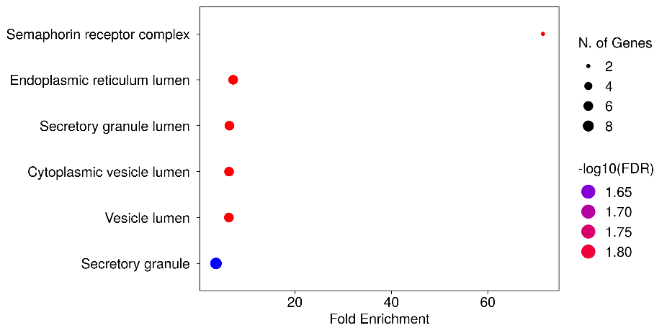
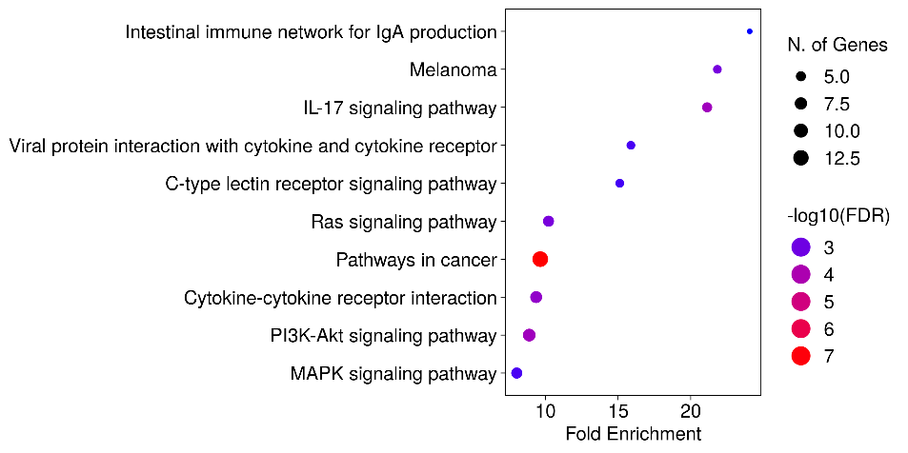
A.
GO Molecular Function
B.
GO Biological Process
Figure 4
Cytoscape
E.
C.
GO Cellular Component
D.
Kegg Pathway
77 proteins are used as input

