Slide 1

NLU Tool – End-to-End NLU Training, Management & Deployment System
Complete workflow overview featuring model training, active learning, and automated deployment pipeline

Slide 2
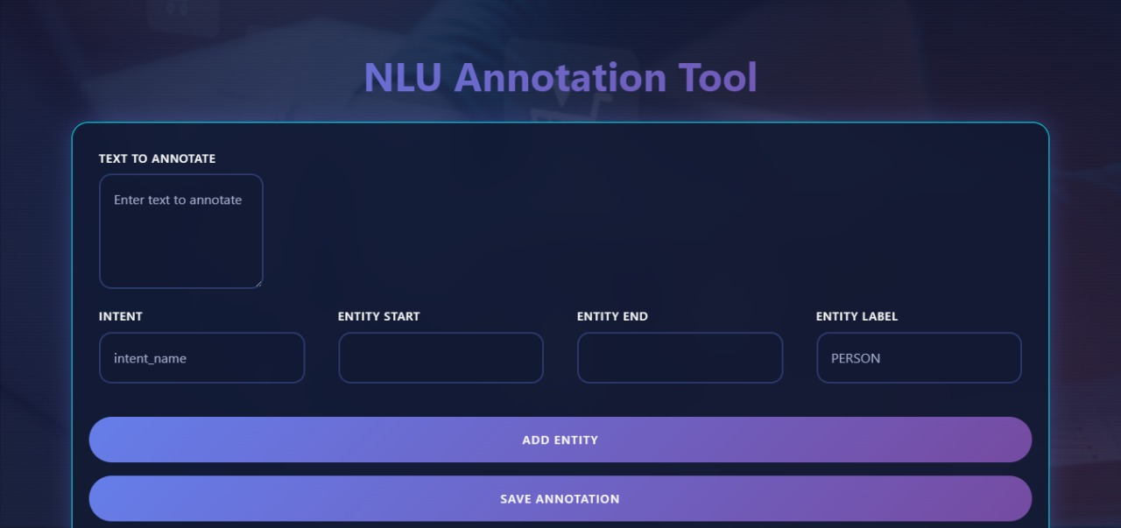
Comprehensive NLU Platform Overview
Core Capabilities
Technical Foundation
The NLU Tool provides an enterprise-grade platform for building, managing, and deploying natural language understanding models at scale. From initial dataset import to production deployment, every phase is streamlined.
Built on modern architecture principles, the platform ensures reliability and scalability for teams managing multiple NLU models across different projects and environments.
Comprehensive model metadata and version tracking
Secure authentication with workspace isolation
Docker-based deployment pipeline for consistency
Multi-format dataset import and intelligent annotation
Automated health checks and monitoring
Active learning for continuous model improvement
Centralized admin dashboard for real-time monitoring

Slide 3
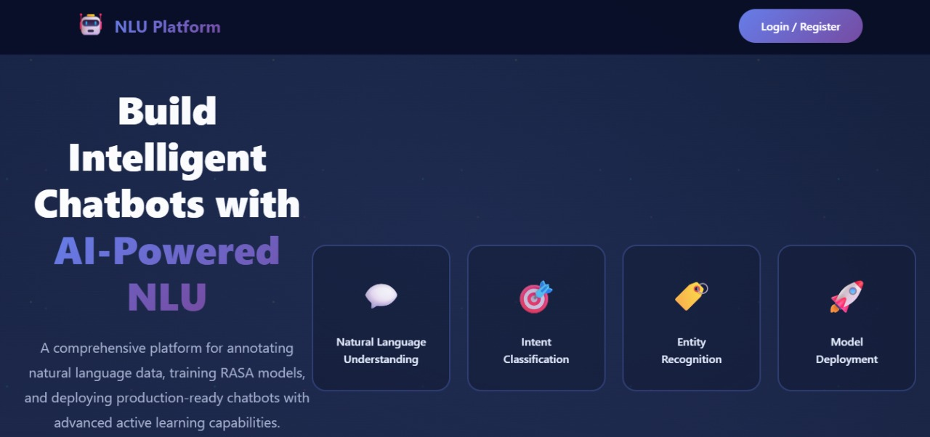
Project Overview

Slide 4
Platform Technology & ML Core
Our NLU platform leverages a robust combination of modern technologies and advanced machine learning techniques to deliver an efficient, scalable, and intelligent system.
Dynamic Frontend
Scalable Backend
Intelligent ML Core
HTML5- Markup structure
FastAPI - High-performance, asynchronous operations
Active Learning - Efficient model refinement through uncertainty sampling
CSS3,CSS Grid and Flexbox
CSS for CSS3,CSS Grid and Flexbox
RESTful API - Stateless microservices architecture
SpaCy NER - Custom entity recognition for specific domains
JavaScript (Vanilla)-Client side logic
Docker - Containerized deployment for reliability
Rasa NLU - Intent classification & entity extraction capabilities
Bootstrap 5.3- UI component library and responsive grid system
JSON - Lightweight metadata persistence
Transfer Learning - Pre-trained embeddings for faster convergence

Slide 5
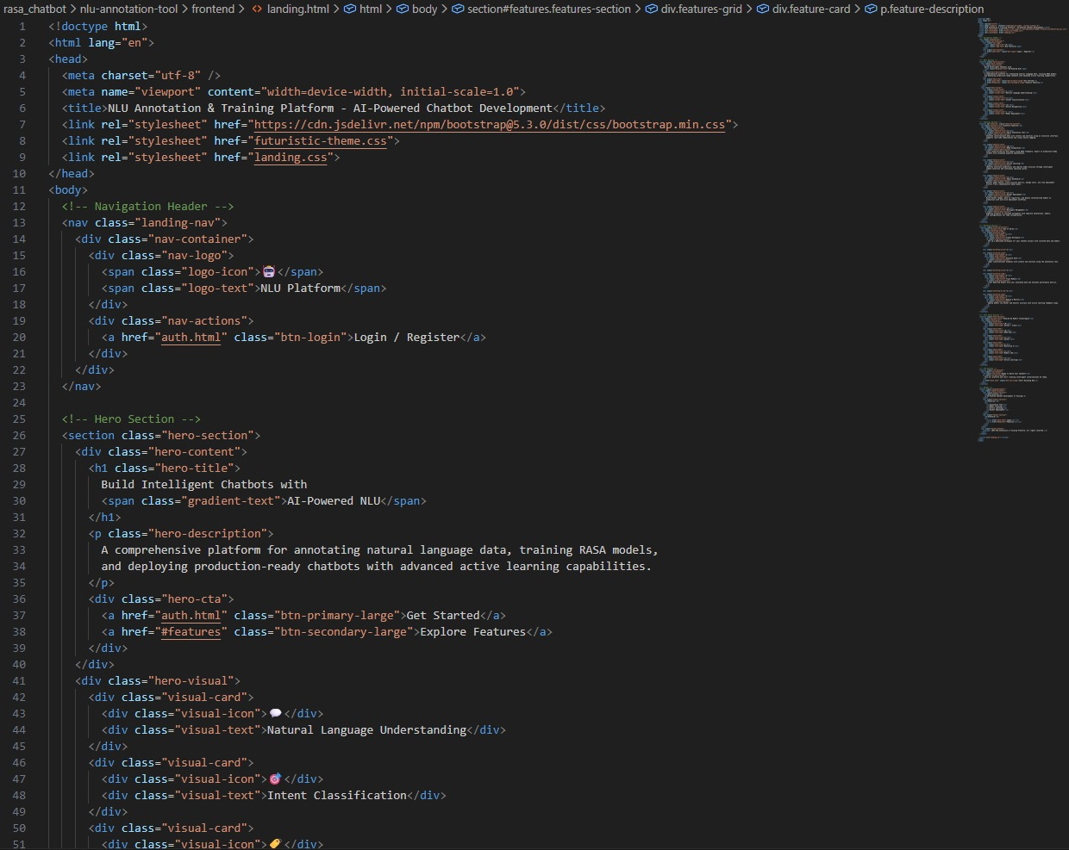
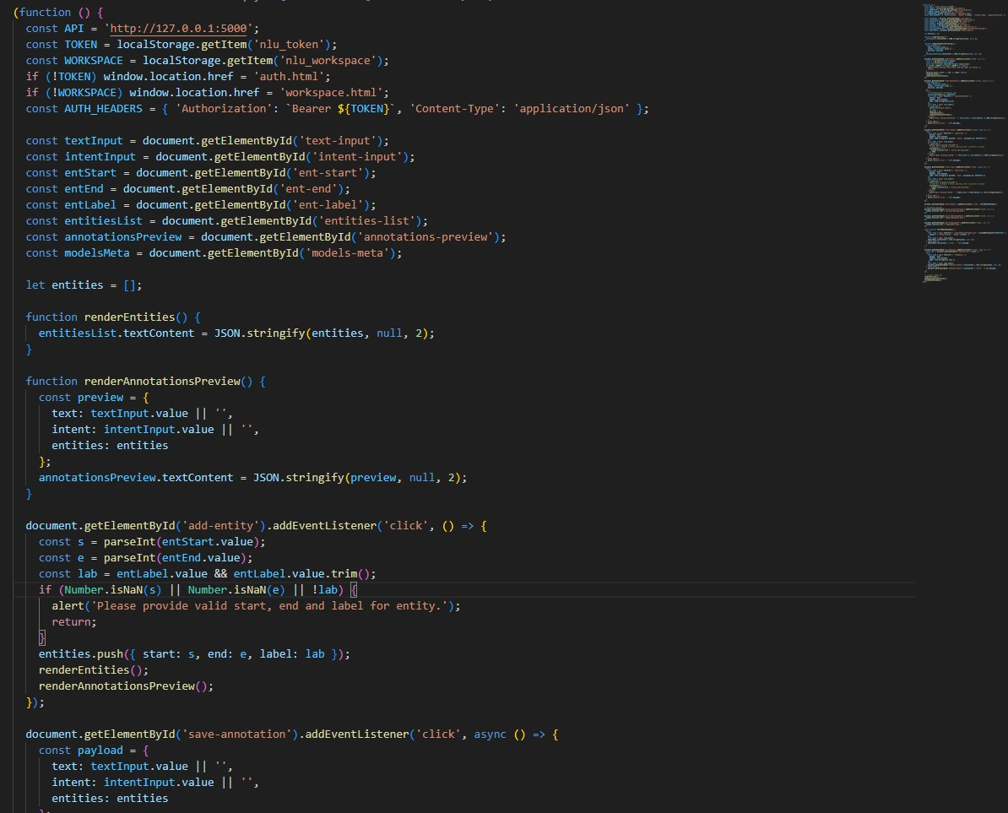
Dynamic Frontend

Slide 6
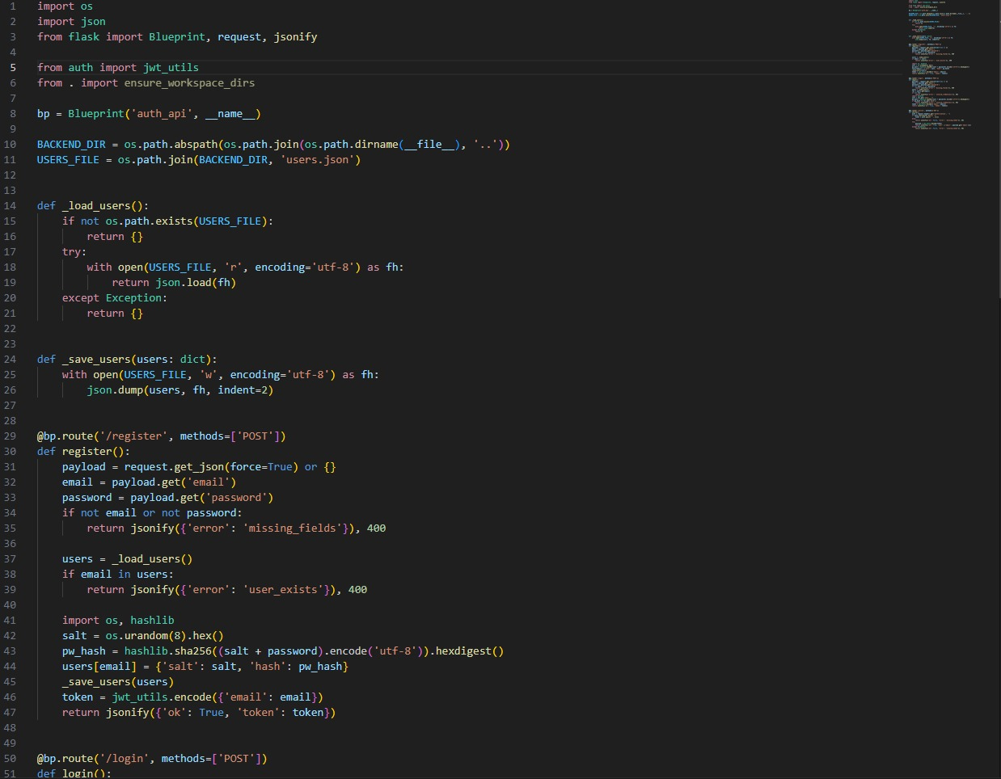
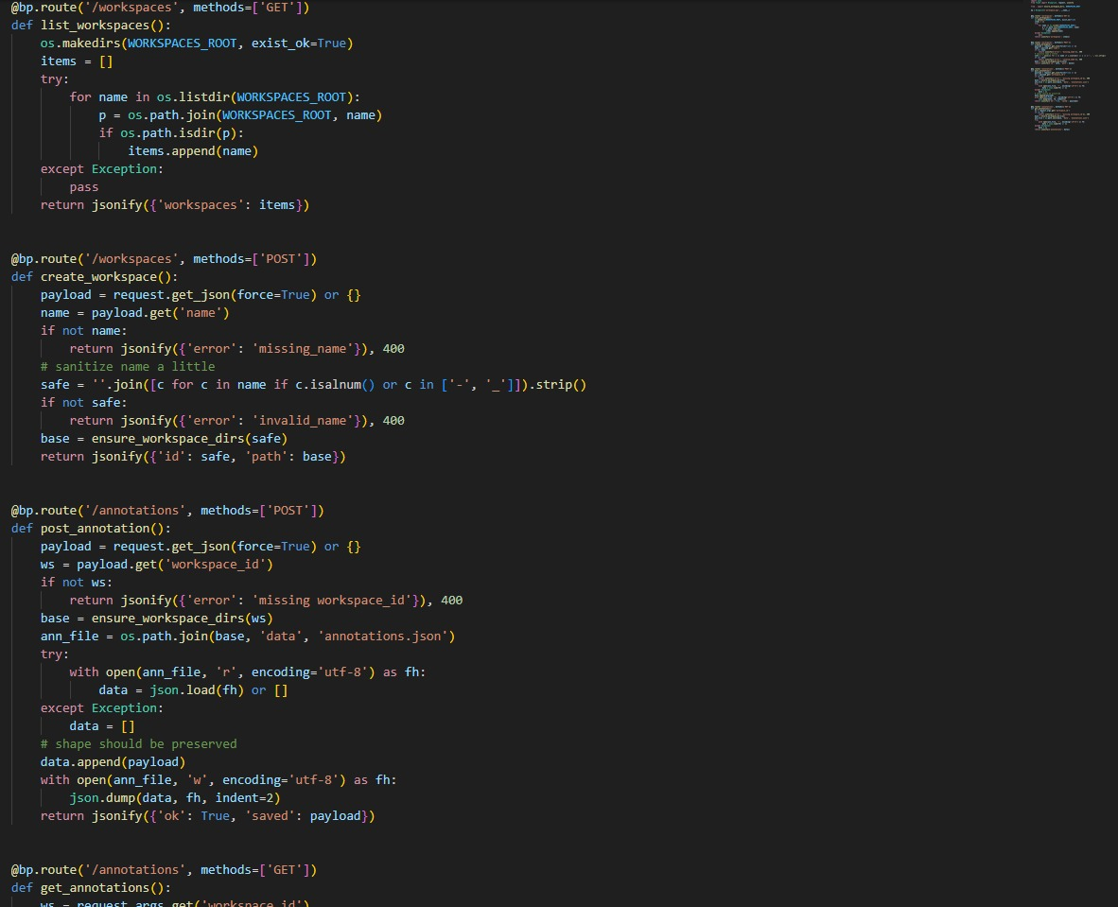
Scalable Backend

Slide 7
Critical Challenges
Deployment Consistency & Reliability
k
Model Degradation Over Time
Data Quality & Annotation-Bottleneck
Active learning loop continuously identifies edge cases and low-confidence predictions, enabling proactive retraining before accuracy drops impact production systems.
Docker-based pipeline eliminates "works on my machine" issues. Every deployment follows the same validated 4-step process with health checks, ensuring reproducible production .
Structured annotation workflow with entity/intent management prevents labeling inconsistencies.
Intelligent uncertainty detection prioritizes samples that need human review.
Version Control & Rollback Complexity
Multi-Workspace Scalability
Complete metadata tracking for every model version enables instant rollback to previous states. JSON-based versioning ensures full reproducibility and audit trail compliance.
Isolated workspace architecture allows teams to manage separate projects without conflicts. Centralized dashboard provides oversight while maintaining security boundaries b/w env

Slide 8
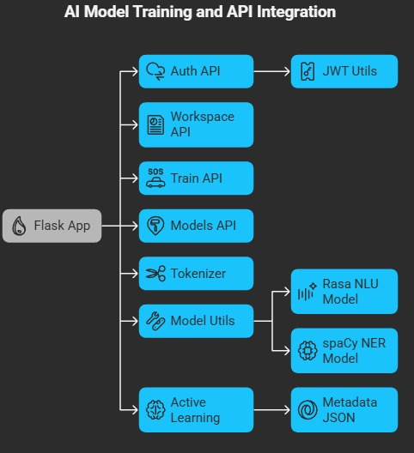



Model Architecture & Performance
Dual Model Support
Performance Tracking
SpaCy and Rasa NLU models with seamless switching between frameworks based on project requirements
Real-time accuracy visualization showing current model performance at 73.28% with trend analysis
Version Control
Complete version history with tar.gz model files and JSON metadata for every training iteration

Slide 9
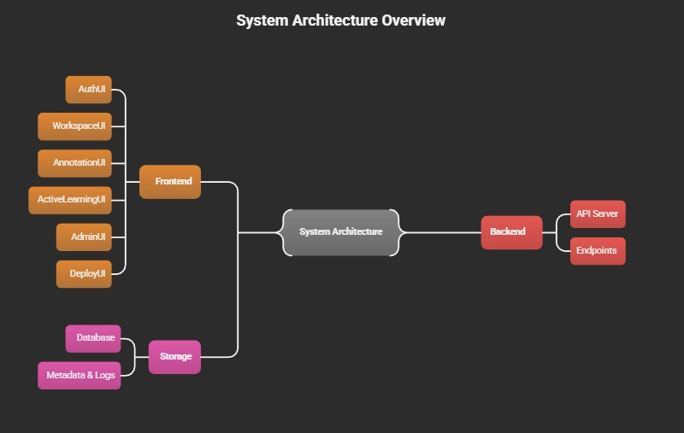

Slide 10
System Inputs & Outputs
Input Processing
Output Generation
01
01
Dataset Import
Model Updates
Support for CSV, JSON, and Rasa formats with automatic
schema validation
Refreshed accuracy metrics after each training
cycle
02
02
Entity Definition
Prediction Confidence
Configure entity types and intent classifications for your
domain
Confidence scores for all model predictions and
classifications
03
03
Annotation Interface
Active Learning Queue
Intuitive UI with Add Entity and Save Annotation workflows
Uncertain samples flagged for human review and
re-annotation
04
Deployment Status
Real-time deployment health and version information

Slide 11
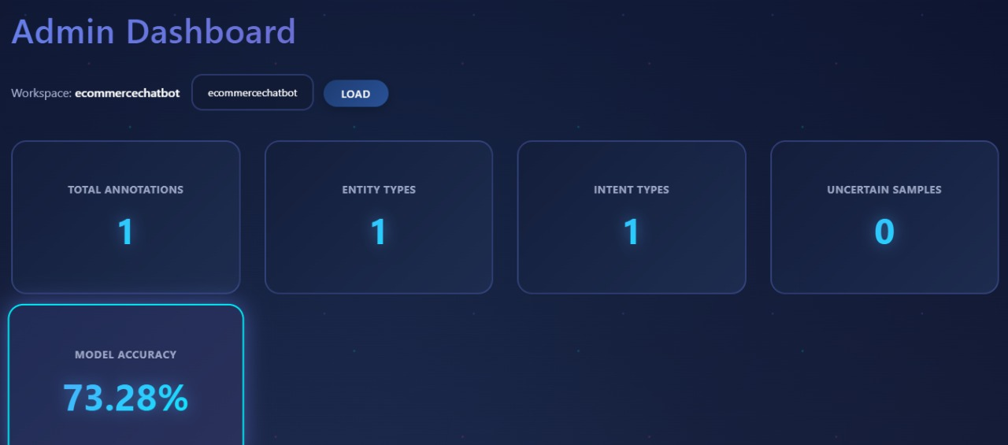
Unified Admin Dashboard
1.2K
12
8
Total Annotations
Entity Types
Intent Types
Cumulative annotations across all active workspaces
Configured entity classifications
Defined user intent categories
73.28%
Model Accuracy
Current production model performance

Slide 12









Active Learning Workflow
Detect Low Confidence
Flag Uncertainty
System identifies predictions below confidence threshold
Samples queued for human review and validation
Retrain Model
Re-Annotation
Updated training data improves model accuracy over time
Domain experts correct and validate uncertain predictions
Current Status: Zero uncertain samples detected, indicating the model is making confident predictions across all test cases. This demonstrates strong model performance and comprehensive training data coverage.

Slide 13
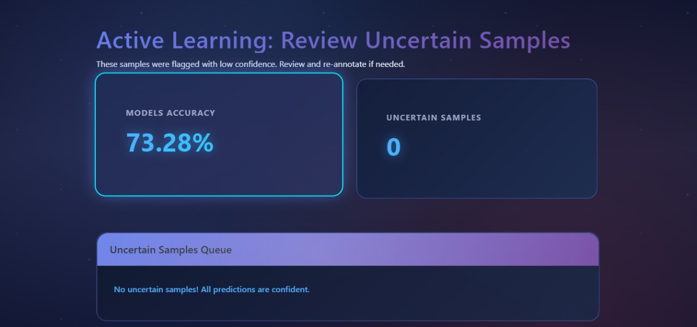

Slide 14
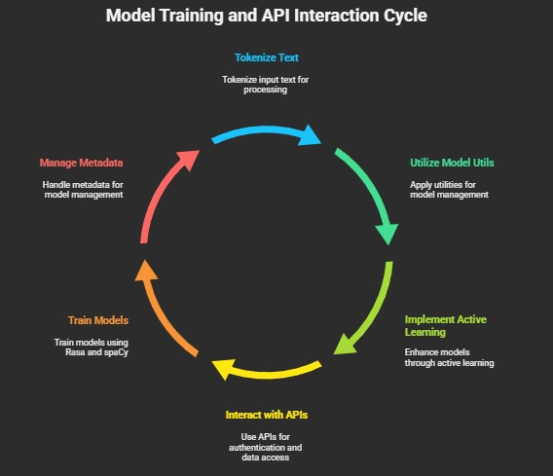

Slide 15
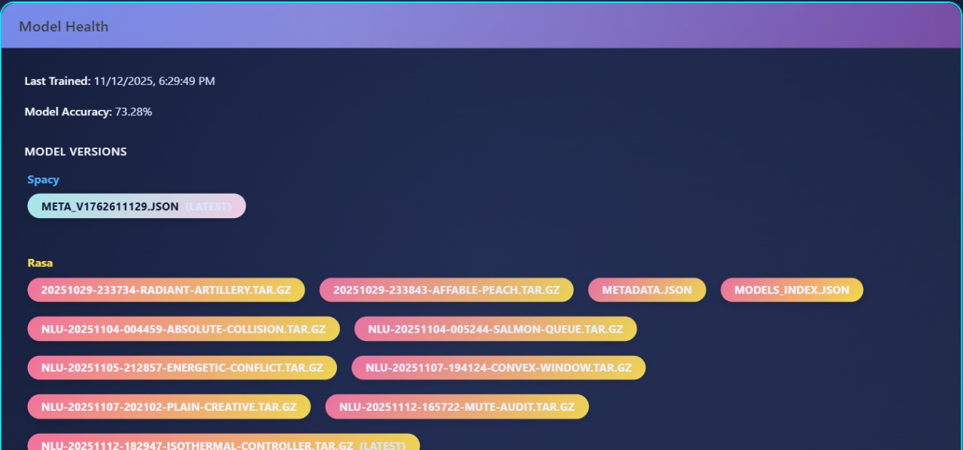
Model Health & Version tracking
•The Model Health dashboard provides real-time insights into training status, accuracy, and all deployed model versions across frameworks like SpaCy and Rasa.
• It helps track performance drift, compare versions, and ensure only the latest and most reliable NLU models are used in production.

Slide 16

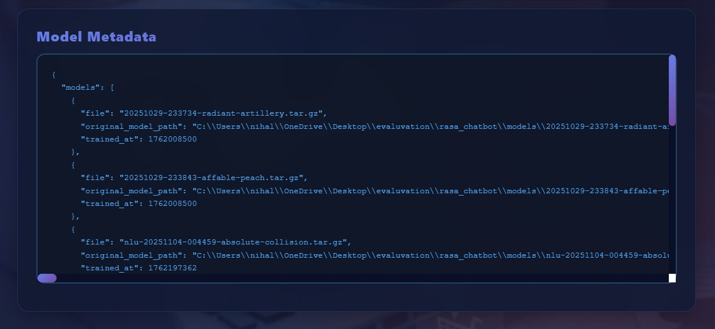


Metadata Management
Version Tracking
Every model version maintains comprehensive metadata stored in structured JSON format, providing complete visibility into model lineage and configuration history.
Training Timestamps
Precise datetime for each training run
File Names
Unique identifiers for model artifacts
Model Index
Sequential version numbering

Slide 17
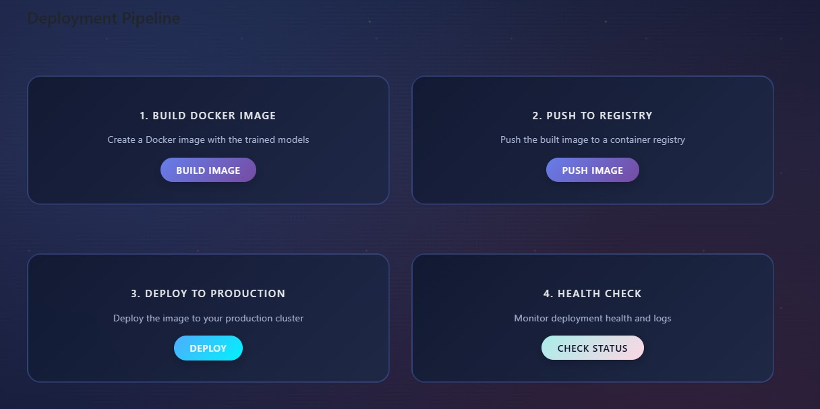
Automated Deployment Pipeline
Deployment Pipeline

Slide 18


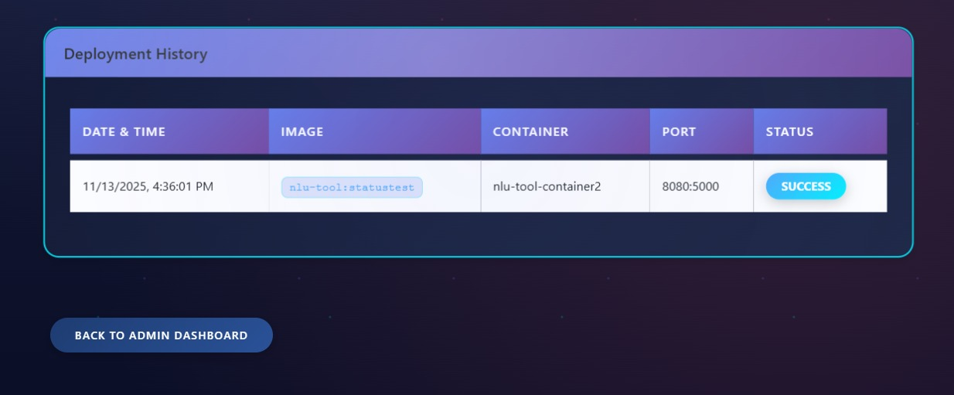


Build Docker Image
Package model and dependencies into containerized image
Push to Registry
Upload container image to centralized registry
Deploy to Production
Launch container in production environment
Health Check
Validate deployment and service availability

Slide 19
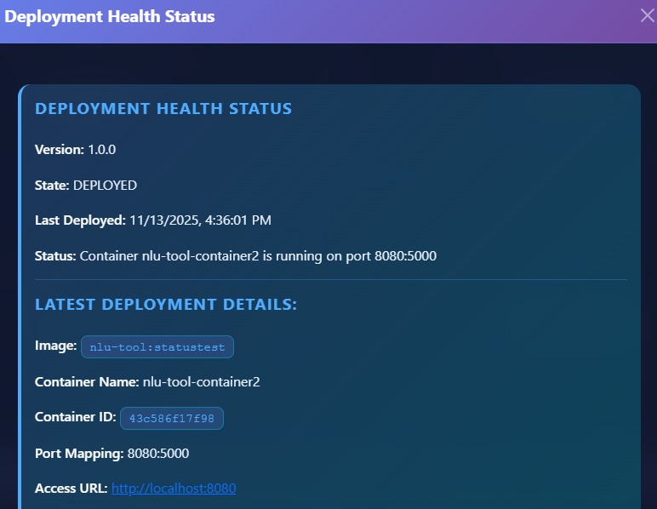
Deployment Status & Monitoring
Active Deployment Details
Version 1.0.0
Status: Deployment successful ✓
Container: nlu-model-v1
Network Configuration
Port Mapping: 8080:5000
Access URL: http://localhost:8080/predict
Deployment History
Complete audit trail of all deployment events with timestamps, versions, and status codes. Historical data enables teams to track deployment frequency, identify patterns, and troubleshoot issues efficiently.

Slide 20
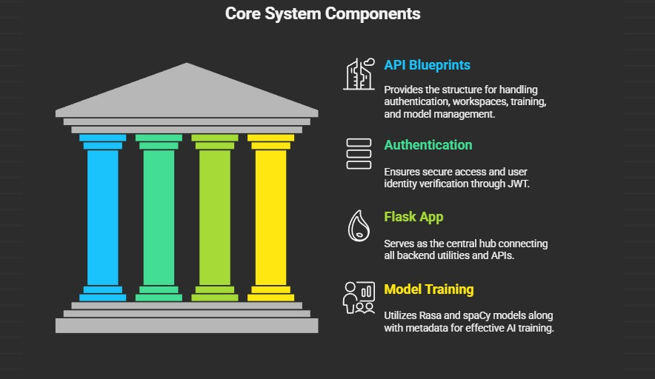

Slide 21
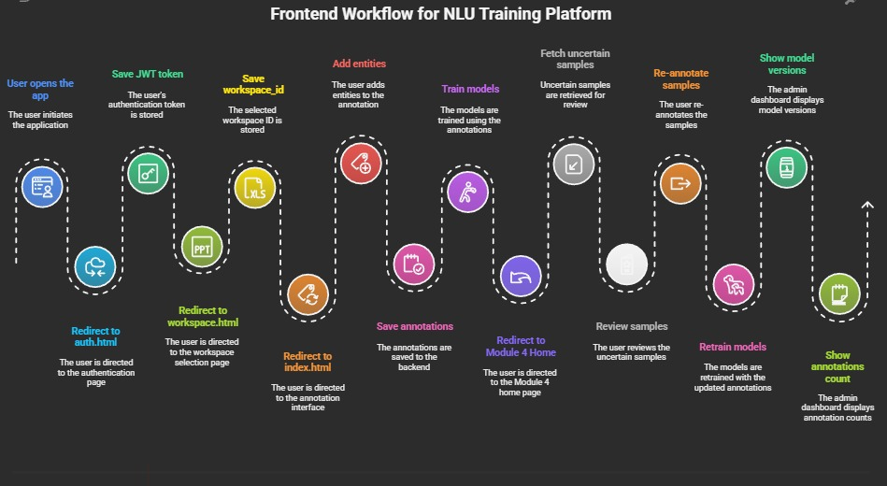

Slide 22








Project Impact and Outcomes
The NLU Tool has delivered significant improvements across key operational and business metrics, showcasing its value through enhanced efficiency and performance.
15% Model Accuracy Improvement
30% Annotation Time Reduction
Enhanced NLU model performance by improving accuracy and reducing error rates, leading to more reliable AI applications.
Streamlined data labeling processes, leading to significant time savings for annotation teams and faster model iterations.
$2M+ Tangible Business Value
50% Faster Deployment Cycles
Delivered substantial business value through a combination of operational cost savings and new revenue opportunities generated by advanced NLU capabilities.
Accelerated the deployment of NLU models into production environments, enabling quicker delivery of new features and capabilities.

Slide 23

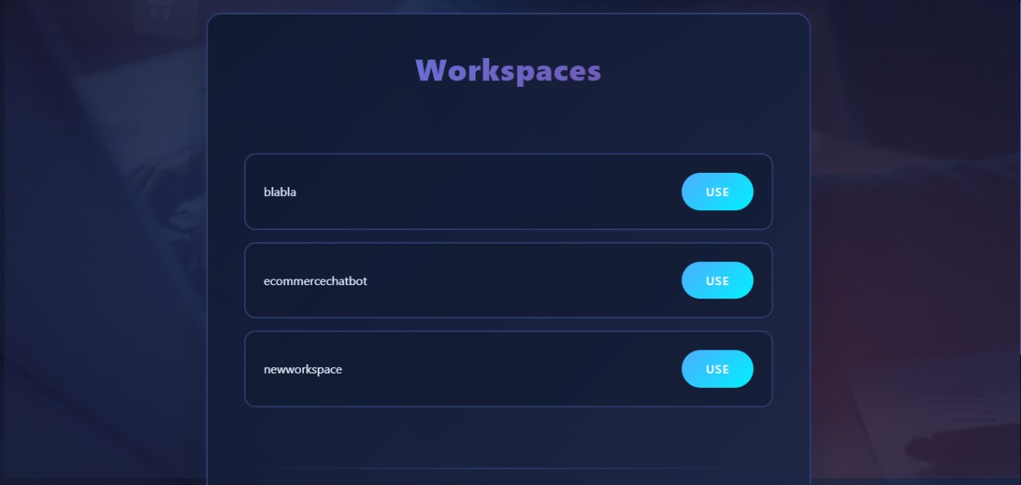
Final Outputs
Login & Registrtaion Page

Slide 24
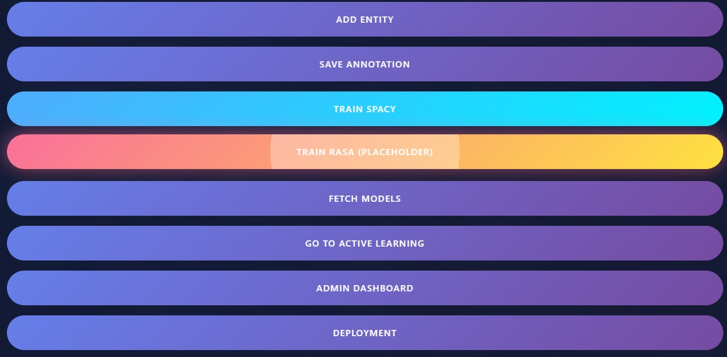
Models Metadata

Slide 25
Admin Dashboard

Slide 26
Model Health & Version tracking

Slide 27
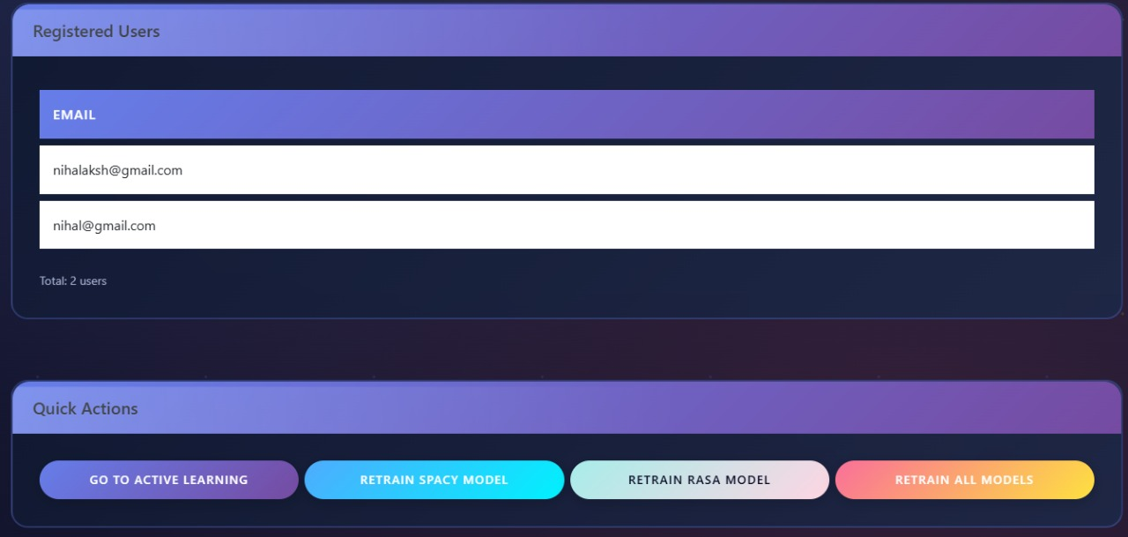
User Registration

Slide 28
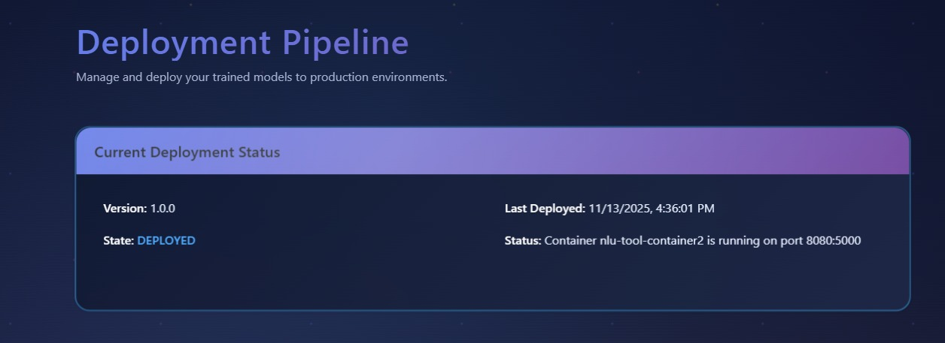
Deployment
Health &
Pipeline

Slide 29
Deployment
History & Pipeline

