Slide 1


Integrated SAP ABAP Solution for Materials Management (MM): ALV Report, Smart Forms, and Submit Report
SURE Trust - SKILL UPGRADATION FOR RURAL YOUTH EMPOWERMENT
COURSE: SAP ABAP
DURATION: NOV 2025 – APRIL 2026 (6 Months)
Submitted By:
YERRA VARSHITHA
Under the Guidance of:
Mr. Santoshkumar Ramlakhan Pal
SAP ABAP Associate Consultant
Infosys Limited
Department of ECE

Slide 2
Contents
INDEX
Introduction
Problem Statement
Objectives
Tools & Technologies
Project Modules
Methodology
Smart Form Implementation
ALV Report with Excel Download
Submit Report (ME2M)
Results
Industry Relevance
Learning Outcomes
Conclusion
Future Scope
SAP ABAP

Slide 3
Introduction
SAP plays a key role in enterprise data management and reporting
Materials Management (MM) module handles procurement and material data
Traditional reporting methods are manual and inefficient
This project focuses on automated reporting using SAP ABAP
Technologies used: ALV Reports, Smart Forms, and Submit Reports
SAP ABAP

Slide 4
Problem Statement
Manual data extraction leads to errors and delays
Limited reporting flexibility in standard SAP reports
Poor data presentation and formatting
No easy way to export data for analysis
Need for automated, structured, and user-friendly reporting system
SAP ABAP

Slide 5
Objectives
Develop user-friendly selection screens
Generate structured reports using ALV
Implement Excel download functionality
Use SUBMIT for modular programming
Design Smart Forms for professional output
SAP ABAP

Slide 6
Tools & Technologies
SAP ABAP – Programming language for development
Smart Form – For generating formatted documents
ALV (ABAP List Viewer) – For interactive reports
SAP GUI – Interface to access SAP system
SAP Tables:
MSEG (Material Data)
EKKO, EKPO, EKET, LFA1 (Purchase Data)
BUT000 (Business Partner)
SAP ABAP

Slide 7
Project Modules
ALV Report: Displays material document data (MSEG) in a structured format with sorting, filtering, and Excel download features.
Smart Form: Generates formatted output for Business Partner data (BUT000) with a clean and professional layout.
Submit Report: Retrieves purchase order data (EKKO, EKPO, EKET, LFA1) and uses SUBMIT to call standard SAP reports.
Interactive Features: Provides selection screens, filtering options, and navigation to transactions like ME23N.
SAP ABAP

Slide 8
Methodology
System Workflow
User enters input through selection screen
Data Retrieval
Data fetched from SAP tables (MSEG, EKKO, EKPO, etc.)
Processing
Data is filtered and structured
Output Generation
ALV report displays data
Smart Form generates formatted output
Integration
SUBMIT calls standard SAP report dynamically
SAP ABAP

Slide 9
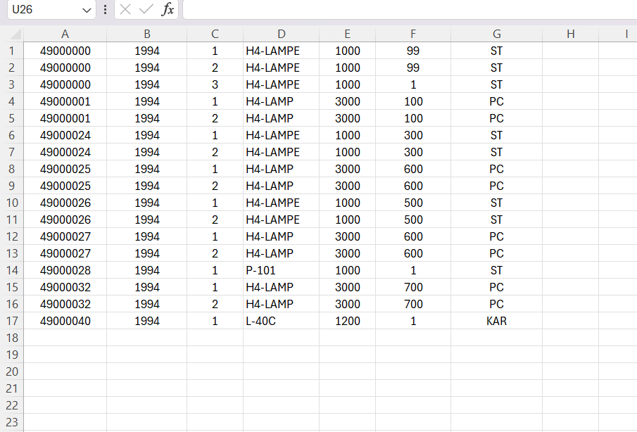
ALV Report with Excel Download
Data Source
MSEG (Material Document Table)
Display Method
REUSE_ALV_GRID_DISPLAY
Features
Sorting, filtering, interactive layout
Excel Download
GUI_DOWNLOAD used
User Interaction
File path selection using frontend services
Fig: ALV Excel Output
SAP ABAP

Slide 10
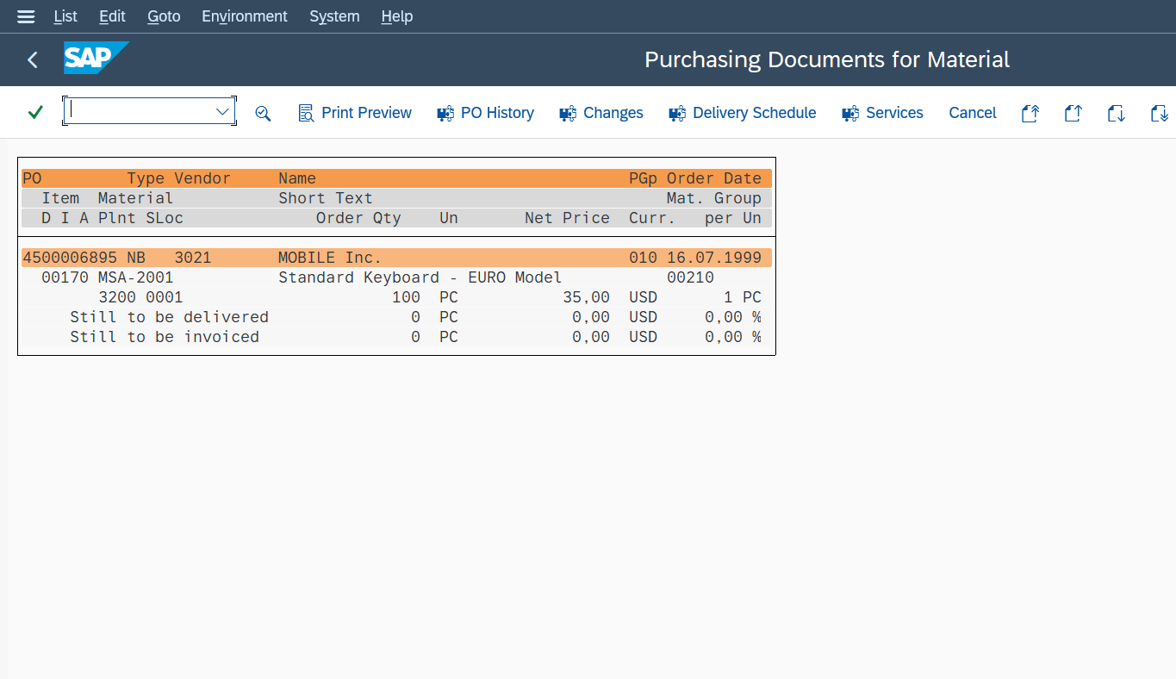
SUBMIT (ME2M Report)
Purpose
Retrieve purchase order data
Tables Used
EKKO, EKPO, EKET, LFA1
Processing
Calculates open quantity and status
SUBMIT Usage
Calls standard report RM06EM00
Navigation
Double-click → ME23N transaction
Fig: ME2M Output
SAP ABAP

Slide 11
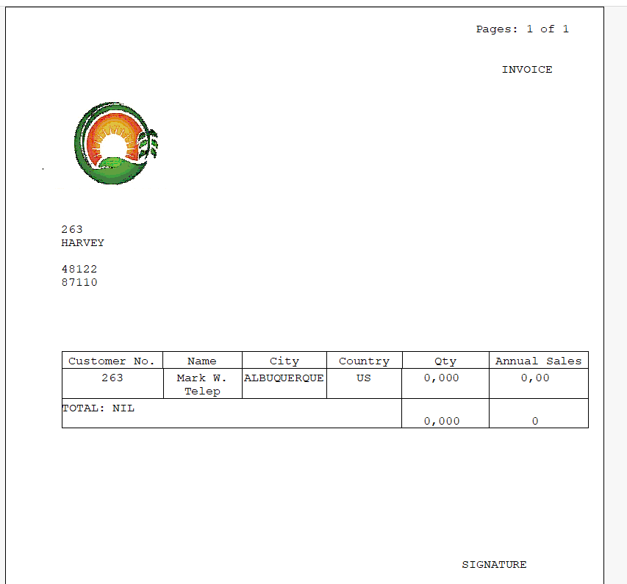
SmartForm Implementation
Data Source
BUT000 (Business Partner Table)
Form Design
Created using Smart Form Builder
Driver Program
Fetches and passes data to form
Function Module
SSF_FUNCTION_MODULE_NAME used
Output
Structured and professional document display
Fig: Smartform Output
SAP ABAP

Slide 12
Results
ALV Output
Structured material data display
Excel Output
Data exported successfully
Smart Form Output
Professional formatted document
Integration Result
Successful SUBMIT execution
SAP ABAP

Slide 13
Industry Relevance
Business Usage
Used in procurement and inventory
Efficiency
Reduces manual reporting effort
Decision Support
Helps in real-time analysis
Scalability
Can be extended to other modules
SAP ABAP

Slide 14
Learning Outcomes
Hands-on experience with ALV reporting
Understanding of Smart Forms design
Knowledge of SUBMIT and modular programming
Working with SAP standard tables
Improved debugging and problem-solving skills
SAP ABAP

Slide 15
Conclusion
Successfully developed an SAP ABAP-based reporting system in the
Materials Management (MM) domain
Integrated ALV Reports, Smart Forms, and SUBMIT functionality for efficient reporting
Improved data accuracy, structure, and reporting efficiency in the MM process
Reduced manual effort through automation of material and purchase data reporting
Demonstrated practical implementation of SAP ERP in real-time Materials
Management scenarios
SAP ABAP

Slide 16
Future Scope
Integration with SAP Fiori for an improved and user-friendly interface
Development of real-time dashboards for Materials Management data analysis
Integration with live SAP MM systems for real-time data processing
Implementation of advanced analytics and reporting for better decision-making
Automation using AI and Machine Learning for intelligent data insights and forecasting
SAP ABAP

Slide 17
THANK YOU
SAP ABAP

