Slide 1



Name of Project : GHG Emissions Prediction
Name: Varshitha P
AICTE Stud.ID:STU67cfa915447a91741662485

Slide 2

Learning Objectives
work with real world greenhouse gas emissions data
Clean and prepared data set for modelling
Build and test different regression models
Compare model performance to choose the best one
Save the final model and preprocessing tools for future use
GOAL
Source :
www.freepik.com/

Slide 3
Tools and Technology used
Python – Core programming language for all tasks
Google Colab – Cloud-based notebook environment to run and test your code
Pandas – For reading Excel sheets, merging data across years, and handling large dataframes
NumPy – Numerical operations, array manipulation
Matplotlib & Seaborn – For data visualization (like histograms, bar charts, heatmaps)
Scikit-learn – For machine learning models (Linear Regression, Random Forest), evaluation metrics (RMSE, R²), and hyperparameter tuning
GridSearchCV – To find the best model parameters using cross-validation

Slide 4
Methodology
Data Collection Collected Excel data from 2010–2016 across U.S. industries and commodities
Data Preprocessing Removed null columns, encoded categorical variables, and normalized numerical features
Feature Engineering Merged datasets by year, added source labels, and selected relevant predictors and targets
Model Building Trained Linear Regression and Random Forest using scikit-learn
Model Evaluation & Tuning Compared RMSE and R², tuned Random Forest using GridSearchCV, and saved best model

Slide 5
Problem Statement:
To predict supply chain emission factors with margins by analyzing annual greenhouse gas (GHG) emission data from 2010 to 2016, categorized by U.S. industries and commodities. The objective is to develop a regression model that uses descriptive and data quality metrics—such as substance type, unit, reliability, and temporal/technological/geographical correlation scores—to estimate emission intensity across supply chain activities.

Slide 6
Solution:
Designed a data-driven approach to predict supply chain emission factors with margins
Merged multi-year GHG emission data for industries and commodities (2010–2016)
Encoded categorical features and normalized numerical data
Trained Linear Regression and Random Forest models using scikit-learn
Tuned model parameters and selected the best-performing model based on RMSE and R²

Slide 7
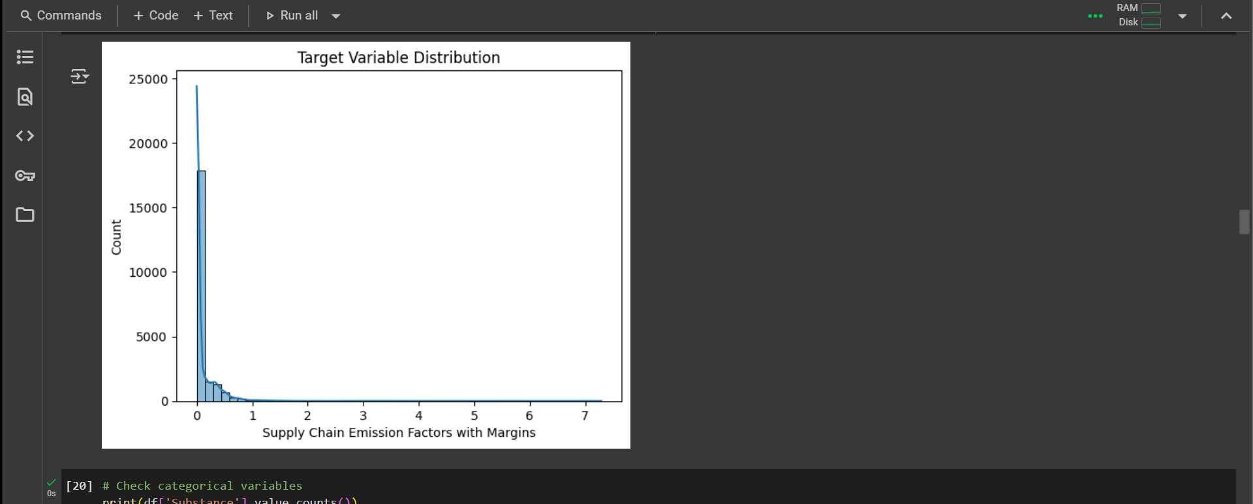
Screenshot of Output:

Slide 8
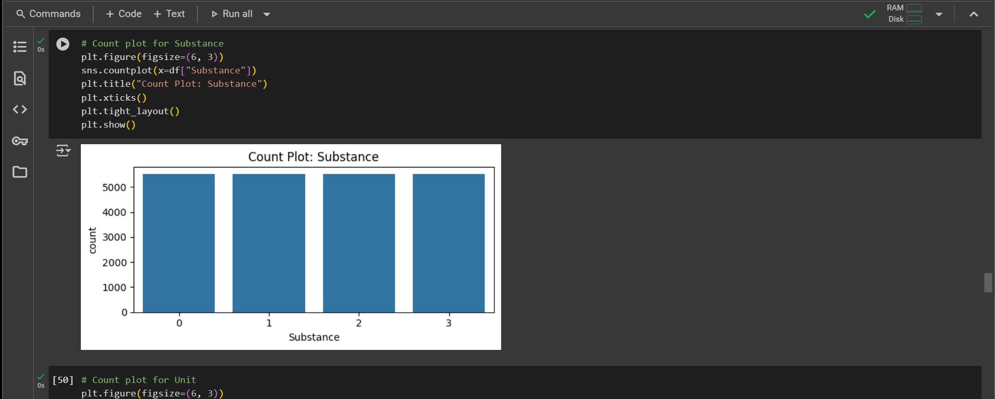
Screenshot of Output:

Slide 9
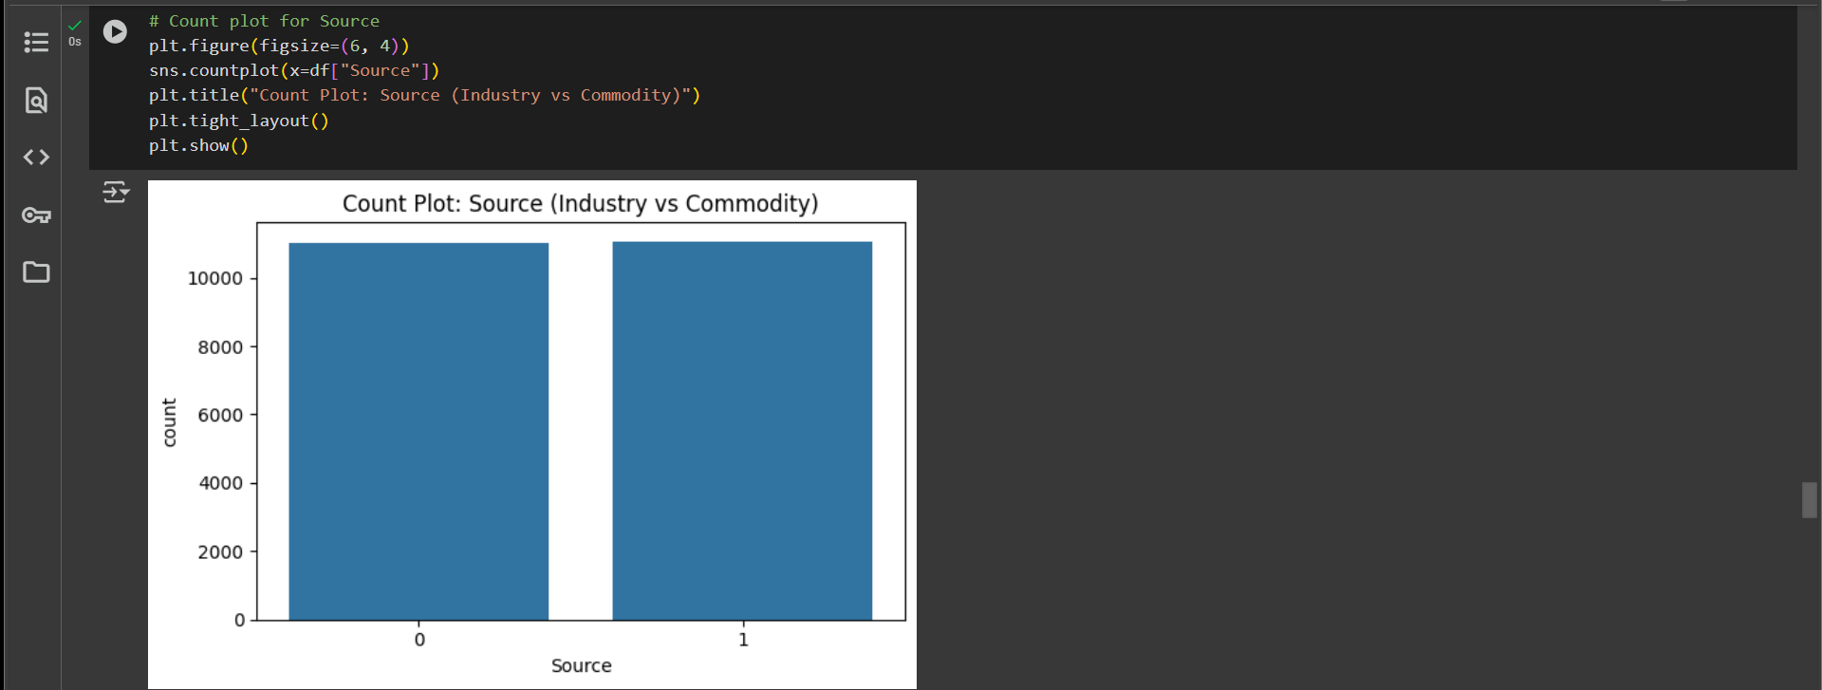
Screenshot of Output:

Slide 10
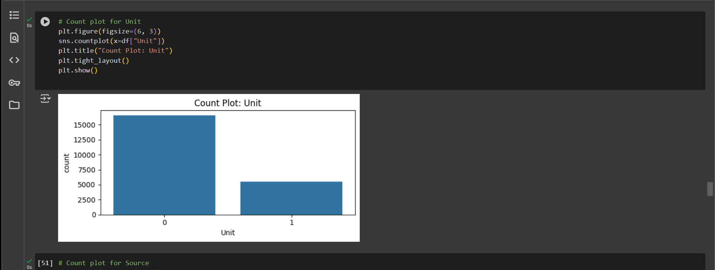
Screenshot of Output:

Slide 11
Conclusion:
Built an accurate model to predict greenhouse gas emission factors across industries and commodities
Achieved high evaluation scores, with Linear Regression delivering superior results
Successfully cleaned, engineered, and scaled real-world environmental data
Enabled model reusability through saving tools and training artifacts
Identified top-emitting sectors to support data-driven sustainability efforts
Future Scope
Integrate real-time GHG data for dynamic predictions
Expand analysis to include regional or global datasets
Incorporate deep learning techniques for complex pattern discovery
Visualize long-term emission trends using dashboard tools
Support policy decision-making through predictive impact modeling

