Slide 1
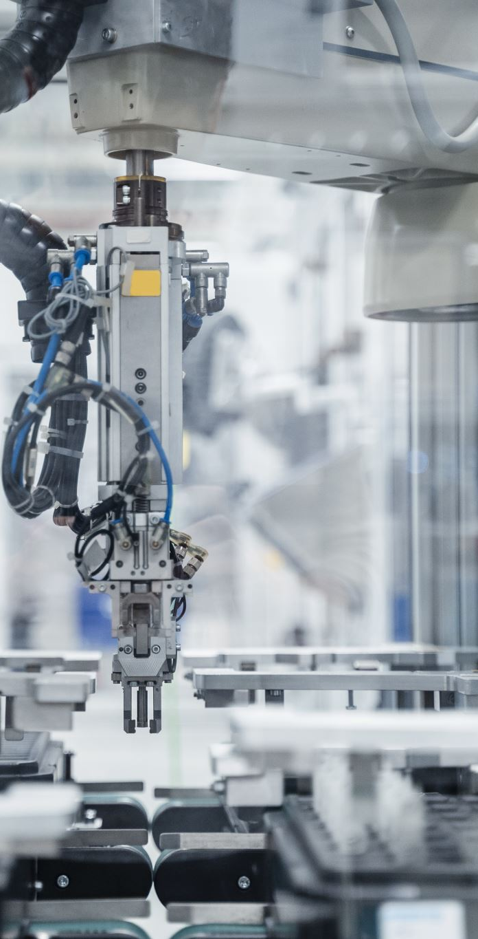
Optimization of Robotic Spray Painting Parameters in the Automobile Sector
Presented by: K. Varshitha
Batch: [Your Batch]
Guide: [Mr.Nageswara Rao]

Slide 2
Abstract
- Focuses on optimizing robotic spray painting with minimal input and maximum output.
- Key parameters: paint flow, shaping air, and viscosity.
- Taguchi method enhances process efficiency.

Slide 3
Literature Review
- Importance of robotic spray painting: Ensures precision, quality, and reduced waste.
- Studies on optimization techniques for robotic spray processes.
- Taguchi method improves parameter accuracy in spray applications.

Slide 4
Gaps in the Review
- Limited focus on maximizing output with minimal input.
- Lack of real-time process monitoring techniques.
- Need for improved accuracy in spray parameter tuning.

Slide 5
Proposed Architecture
- Application of Taguchi methodology for process optimization.
- Identification of critical factors and levels using L9 orthogonal array.
- Focus on minimizing input while maximizing coating efficiency.

Slide 6
Results
- Analysis of results using ANOVA to evaluate performance.
- Optimal parameter combination identified for improved efficiency.
- Enhanced quality and reduced paint wastage observed.

Slide 7

Conclusion
- Taguchi method effectively optimized robotic spray painting.
- Increased output with reduced input through precise parameter tuning.
- Future work: Real-time monitoring and process refinement.

