Slide 1
FINANCIAL FRAUD DETECTION
Industry Mentor:
V.Lakshman Sagar
Presented By:
Varshitha Challa
210303124305
Guide Name:
DR.SYED IBAD ALI
Intership Project Presentation 2025

Slide 2
OVERVIEW OF THE COMPANY
I am currently working as a Data Analytics Intern at SpinMark Infotech Pvt.Ltd., in Tanuku,Andhra Pradesh. Spin Mark Infotech is a technology-driven company that specializes in providing innovative software solutions and services across various industries.
The company leverages the latest technologies, including artificial intelligence, machine learning, and big data analytics, to create innovative solutions that enhance business operations and decision-making.
Internship Project Presentation 2025

Slide 3
INTRODUCTION
Financial fraud like Identity Theft,Credit Card Frauds are significant concern for individuals, businesses, and financial institutions, as it can lead to financial losses and damage to reputations.Detecting financial fraud is crucial for minimizing losses and maintaining trust in financial systems. By leveraging Machine learning models,The Financial fraud detection involves identifying and preventing fraudulent activities through various techniques and technologies.
Internship Project Presentation 2025

Slide 4
Research Papers studied
Sr. no | Paper Title | Publisher | Year | Take-away points
1. | A REVIEW RESEARCH ON ONLINE FINANCIAL FRAUDS IN INDIA | S.Jamuna,J.R.Gaur,Anshu Singh | January 2023 | Under reporting of frauds is high among Indian banks, revealed Reserve Bank of India. The RBI also revealed that 90.6 percentage of the frauds reported in 2018-2019 were happened from the year 2000 to 2018.
2. | DATA ANALYTICS AND ITS IMPACT ON FUTURE | Narayana Challa | January 2023 | The impact of data analytics on future research is significant and multifaceted. Data analytics has transformed the way research is conducted, enabling researchers to analyze large volumes of data to uncover valuable insights..
3. | Financial Fraud Detection and Prevention | Zeyi Miao | September 2024 | Traditional detection methods based on rules and statistical methods perform poorly when processing large-scale and high-dimensional data, and are prone to false positives and false negatives.
4. | Financial fraud detection through the application of machine learning techniques | Ludivia Hernandez Aros, Luisa Ximena Bustamante Molano, Fernando Gutierrez-Portela | June 2024 | Financial fraud negatively impacts organizational administrative processes, particularly affecting owners and/or investors seeking to maximize their profits. Addressing this issue, this study presents a literature review on financial fraud detection through machine learning techniques.
Internship Project Presentation 2025

Slide 5
OBJECTIVES OF THE PROJECT
Develop and implement advanced algorithms to improve the identification of fraudulent transactions while minimizing false positives.
Establish a system for real-time transaction monitoring to detect and respond to suspicious activities as they occur.
Identify unusual patterns and behaviors in transaction data that may indicate potential fraud, using statistical methods and machine learning techniques.
Creating user-friendly reports that provide stakeholders with actionable insights and detection performance.
Internship Project Presentation 2025

Slide 6
WHAT IS EXACTLY TO BE DONE?
Step-1:Collect historical data related to transactions,customer profiles, and external databases. including both legitimate and fraudulent cases, to build a comprehensive dataset for analysis.
Step-2:Clean the data to remove duplicates, correct errors, and handle missing values to ensure accuracy and consistency.
Transform the data into a suitable format for analysis, which may include normalization, encoding categorical variables, and feature extraction.
Step-3:Conduct exploratory analysis to understand the data's structure, distribution, and relationships. Identify key features that may indicate fraud.
Step-4:Choose appropriate machine learning algorithms for fraud detection, such as decision trees, random forests, or neural networks.
Step-5:Split the data into training and testing sets, and train the selected models on the training data.
Internship Project Presentation 2025

Slide 7
Step-6:Evaluate the performance of the models using the testing dataset. Use metrics such as accuracy, precision, recall, and F1-score to assess effectiveness.
Step-7:Based on evaluation results, refine the models by tuning hyperparameters, selecting different features, or trying alternative algorithms.
Implement the trained models into a production environment where they can monitor transactions in real-time.
Step-8:Develop processes for generating alerts for flagged transactions that require further investigation.
Step-9:Continuously update the models and detection systems based on new data, emerging fraud patterns, and changes in business processes.
Internship Project Presentation 2025

Slide 8
WHY IS THIS PROJECT SELECTED?
A financial fraud detection project is selected due to the increasing incidence of fraud, which lead to financial risks to organizations and consumers . With the rise of sophisticated fraudulent techniques, there is a need for robust detection systems to protect customer interests. Implementing such a project enhances customer trust and organizational reputation while leveraging advancements in data analytics and machine learning for real-time monitoring.
Additionally, effective fraud detection can lead to cost savings by preventing losses.
Internship Project Presentation 2025

Slide 9
WHERE IS THE PROJECT IS HELPFUL?
Banking Transactions:
Monitors account activities in real-time to detect unauthorized transactions.
Alerts customers and banks instantly about potential fraud, allowing for immediate action.
E-commerce Platforms:
Analyzes online transactions as they occur to identify fraudulent purchases.
Reduces chargebacks by preventing fraudulent transactions before they are completed.
Insurance Claims Processing:
Evaluates claims in real-time to flag suspicious activities, such as duplicate claims.
Enhances the efficiency of claims processing by automating fraud detection.
Internship Project Presentation 2025

Slide 10
Payment Gateways:
Continuously scans payment data for anomalies during transactions.
Provides instant feedback to merchants about the legitimacy of transactions.
Telecommunications:
Detects fraudulent calls and SIM card cloning in real-time.
Protects against identity theft and unauthorized account access.
Retail Environments:
Monitors point-of-sale transactions for signs of fraud, such as unusual purchase patterns.
Helps in identifying internal fraud by analyzing employee transactions
Internship Project Presentation 2025

Slide 11
WHO WILL BE BENEFITTED?
Financial Institutions:
Risk Mitigation: Banks and credit unions can safeguard their assets from fraudulent activities, reducing financial losses.
Customers:
Enhanced Security: Individuals benefit from increased protection of their personal and financial information.
Businesses:
Loss Prevention: Companies can minimize financial losses due to fraud, which is crucial for maintaining profitability.
Insurance Companies:
Fraud Reduction: Insurers can reduce fraudulent claims, leading to lower costs and more accurate risk assessments.
Technology Providers:
Market Growth: Companies that develop fraud detection technologies benefit from increased demand for their solutions.
Internship Project Presentation 2025

Slide 12
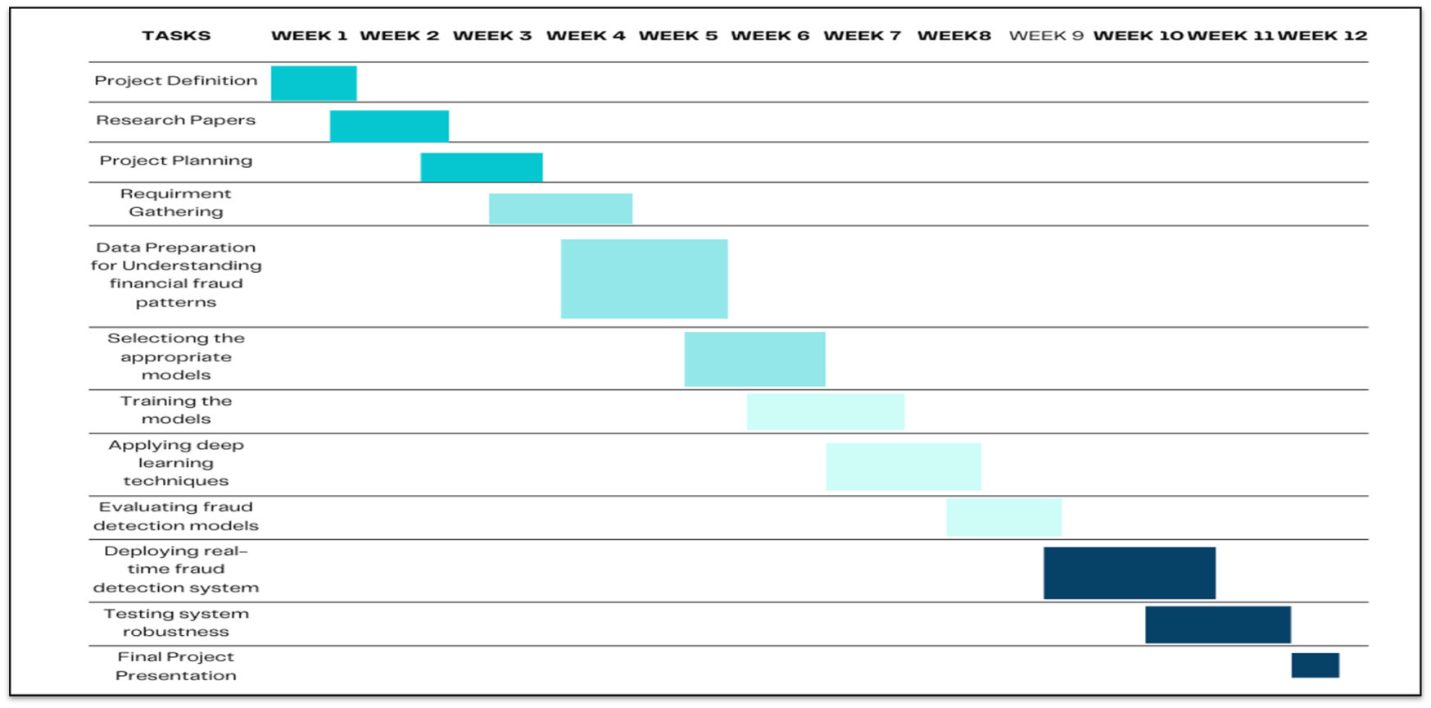
Time Line Chart
Internship Project Presentation 2025

Slide 13
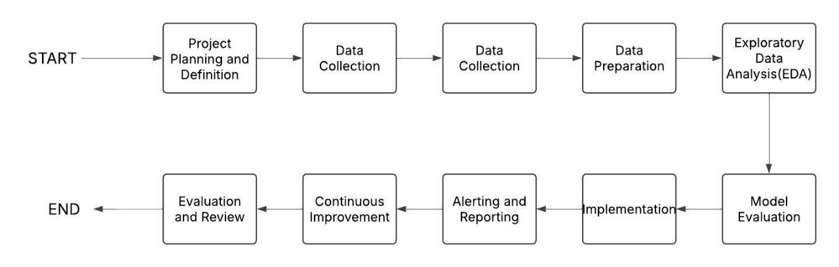
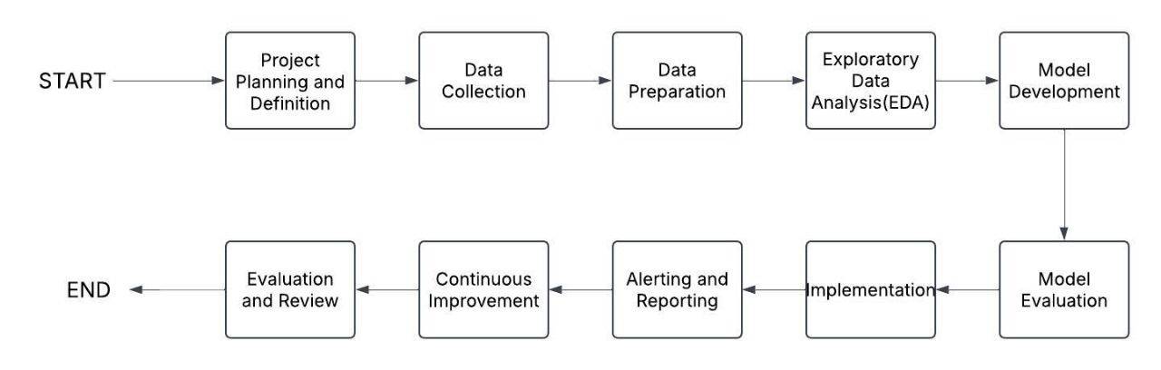
FLOW CHART
Internship Project Presentation 2025

Slide 14
Implementation Environment
A)Development Tools:
Frontend: React.js for building the user interface (analyst/admin dashboards).
Backend: Flask (Python) for REST APIs and machine learning model integration.
Data Streaming: Apache Kafka for real-time transaction ingestion
Machine Learning: XGBoost, TensorFlow, and Scikit-learn for model development.
B) Technologies:
1. Python: Primary language for data processing and ML.
2. TensorFlow: For neural network-based anomaly detection (optional).
3. Apache Kafka: Real-time data streaming and processing.
4. AWS Cloud: Scalable infrastructure for deployment.
5. React.js: Interactive dashboards for analysts and admins.
Project Presentation 2023

Slide 15
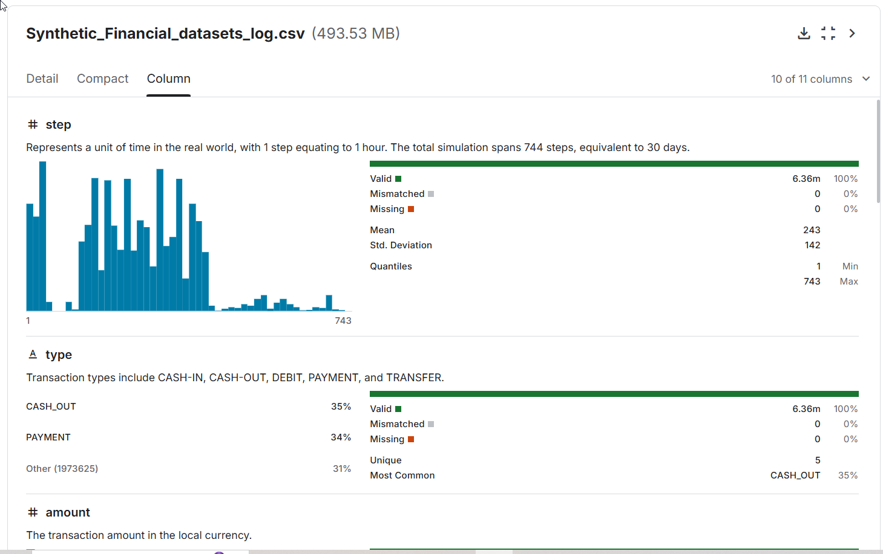
Project Presentation 2023

Slide 16
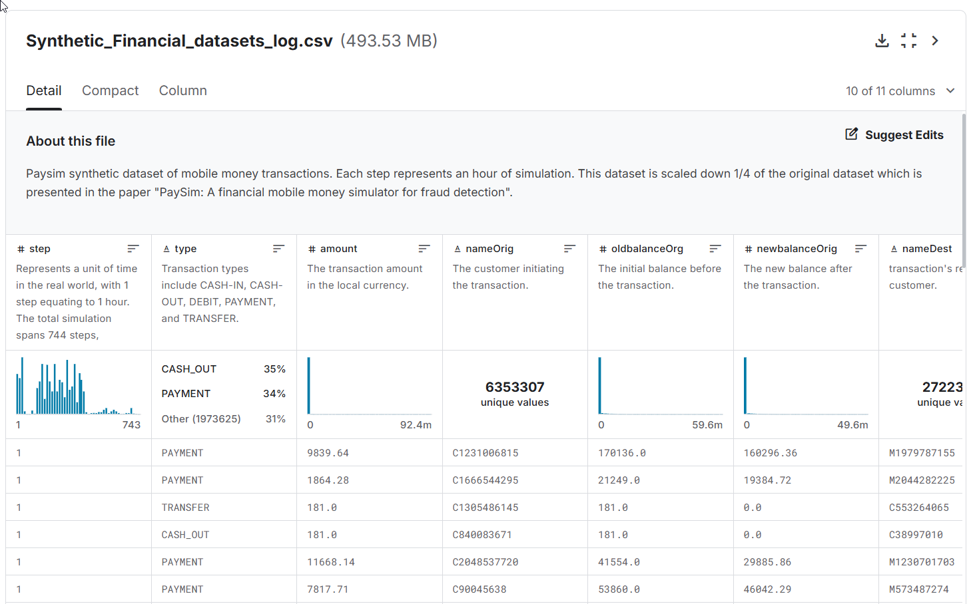
Project Presentation 2023

Slide 17
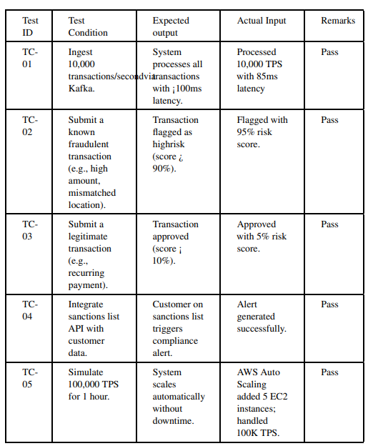
Testing for Different Test Cases:
Project Presentation 2023

Slide 18
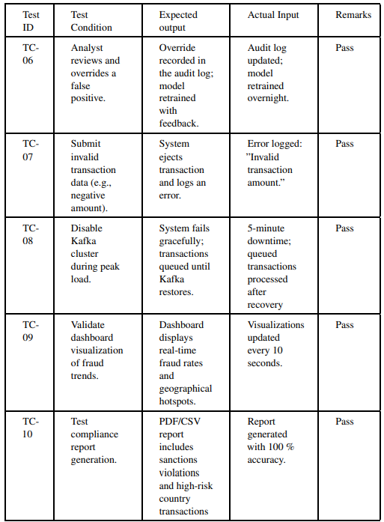
Project Presentation 2023

Slide 19
Advantages
Quick Fraud Detection:They can spot suspicious activities in real-time, allowing for immediate action.
Less Financial Loss:By catching fraud early, businesses can save money that would otherwise be lost.
Better Security:These systems help protect sensitive customer information from theft.
Stronger Reputation: Businesses that prevent fraud build trust with customers, attracting more business.
Increased Efficiency: Automating fraud detection reduces the workload for employees, allowing them to focus on more important tasks.
Internship Project Presentation 2025

Slide 20
Limitations
Dependence on Historical Data:
Limited Predictive Power: Many fraud detection models rely on historical data, which may not always accurately predict future fraud attempts, especially if new tactics are employed.
Data Quality and Availability:
Incomplete Data: Effective fraud detection relies on high-quality, comprehensive data. Incomplete or inaccurate data can hinder the system's performance.
Complexity of Implementation:
Integration Challenges: Implementing a fraud detection system can be complex, requiring integration with existing systems and processes.
Internship Project Presentation 2025

Slide 21
Conclusion
After completing the financial fraud detection project, we have established a comprehensive system that significantly enhances our ability to identify and prevent fraudulent activities in real-time.
This project has successfully integrated advanced technologies such as machine learning and data analytics, allowing for more accurate detection of suspicious patterns and behaviors.
As a result, we can minimize financial losses, protect sensitive customer information, and ensure compliance with regulatory requirements.
Internship Project Presentation 2025

Slide 22
Future Work
Real-Time Data Integration: Integrate real-time data streams for more accurate and up-to-date predictions.
Advanced Models: Experiment with deep learning models (e.g., neural networks) to further improve accuracy.
Explainability: Add explainability features to help users understand the factors influencing fraud predictions.
Scalability: Enhance the system’s scalability to handle extremely high traffic volumes.
User Feedback: Incorporate user feedback to continuously improve the system’s usability and performance.
Internship Project Presentation 2025

Slide 23
Reference
1. Fraud Data Analytics Methodology - Focuses on building a holistic fraud data analytic plan and identifying red flags
2. Fraud Analytics: Strategies and Methods for Detection and Prevention - Provides proven guidance for using analytics in fraud examinations and prevention.
3. Fraud Analytics Using Descriptive, Predictive, and Social Network Techniques - This book provides a comprehensive guide for setting up fraud detection systems.
4. Fraud and Fraud Detection: A Data Analytics Approach - Offers insights into identifying fraudulent transactions within large datasets.
Internship Project Presentation 2025

Slide 24
Thank you!
Internship Project Presentation 2023

