Slide 1
A HYBRID ENSEMBLE ANTI-NOISE QUANTUM SUPPORT VECTOR MACHINE(QSVM) ROBUST CLASSIFICATION
(Batch No:CBIT/IT/2025-26/IT2/201)
Under the Guidance of:
Dr. T. Satyanarayana Murty
Associate Professor, IT, CBIT
Presented by :
A. Nithisha, 160122737071
K. Varshitha, 160122737078

Slide 2
AGENDA
Abstract
Project Objective & plan
​Literature Review
System Architecture
Project Requisites
​Summary

Slide 3
Abstract
Noisy data is pervasive in quantum computing and severely degrades the performance of many algorithms. Existing quantum support vector machines (QSVMs) lack inherent noise resilience and struggle to learn accurate hyperplane parameters under noisy conditions. To address this limitation, we propose an Anti-Noise QSVM that embeds a sample-specific weight factor into the hinge loss to construct a noise-robust objective. An iterative optimization strategy and tailored quantum circuit are then employed to solve this objective and obtain the separating hyperplane. Experiments on synthetic and public datasets demonstrate that the proposed algorithm achieves efficient computation and consistently stable accuracy in the presence of noise
In this project, we propose a hybrid ensemble Anti-Noise Quantum Support Vector Machine, a quantum–classical framework aimed at robust and scalable classification in noisy environments. The method integrates neural network–based feature extraction to generate noise-resilient representations, an Anti-Noise QSVM that incorporates weighted hinge loss to reduce the influence of noisy samples while leveraging quantum speedup, and an ensemble voting mechanism that combines the Anti-Noise QSVM with multiple classical classifiers to enhance generalization. The approach will be evaluated on large-scale real-world datasets, including image, biomedical, and network intrusion data, using Qiskit’s statevector and noisy simulators to approximate hardware imperfections. Multiple noise types, such as Gaussian, impulse, and label noise, will also be considered to assess robustness. The expected outcome is improved accuracy, stability under diverse noise conditions, and scalability compared to existing QSVMs, classical SVMs, and deep neural networks, providing a promising step toward practical quantum–classical machine learning

Slide 4
Project Objectives & Plan
Developing a hybrid quantum-classical model integrating neural networks, Anti-Noise QSVM, and ensemble learning for robust classification under noise.
Designing a noise-resilient framework capable of handling multiple noise types (label, feature, quantum hardware noise) for stable and accurate decisions.
Evaluating the model on benchmarks and comparing to classical and other QSVMs for scalability and robustness.
Problem Statement
Quantum support vector machines (QSVMs) promise faster classification using quantum principles but suffer from performance drops in noisy environments. To address this, a robust QSVM framework with noise-resilient objective functions and sample-weighting strategies is needed to enhance stability and accuracy while retaining quantum advantages
Task | Duration | Remarks
Literature review and requirement analysis | 1-2 weeks | Study related QSVM models, noise issues, and datasets
Dataset selection and preprocessing | 1 week | Choose benchmark datasets, add noise types, data cleaning
Design neural network feature extraction module | 1-2 weeks | Develop and validate noise-resilient feature extraction
Develop Anti-Noise QSVM algorithm | 2 weeks | Implement weighted hinge loss and iterative optimization

Slide 5
Literature Review
Quantum Support Vector Machines (QSVMs) have emerged as a promising extension of classical SVM algorithms by leveraging quantum computing’s ability to process high-dimensional data efficiently. However, despite theoretical speedups and potential advantages, practical applications of QSVMs are hindered by noise—both from quantum hardware imperfections and noisy input data. Gentinetta et al. rigorously analyzed the training complexity of QSVMs under noisy conditions, showing that statistical uncertainties in quantum kernel evaluations increase the number of required quantum circuit executions significantly, posing a major challenge for scalability. This foundational work highlights the pressing need for noise-robust QSVM models to realize quantum advantages on real hardware.
Building on these challenges, research on noise-robust optimization techniques and hybrid quantum-classical learning frameworks has gained momentum. Studies like those by Ishiyama et al. and Berberich et al. propose parameter optimization methods robust to the stochastic noise inherent in quantum circuits, which improve model stability, generalization, and practical usability on current quantum devices. Additionally, hybrid quantum neural networks (HQNNs) have been studied extensively for their noise resilience characteristics. Ahmad et al.'s work on HQNNs systematically investigates the differential impact of various quantum noise channels, revealing that certain network architectures like QuanNN exhibit remarkable robustness to phase-related noise, while others demonstrate selective resilience depending on noise type and intensity.
Among these advances, Jiaye Li and colleagues’ anti-noise QSVM stands out by explicitly integrating a weighted hinge loss function with quantum optimization to combat noisy training data. Through an iterative alternating optimization strategy and a novel quantum circuit design, their approach significantly improves classification accuracy on noisy datasets compared to classical SVMs and earlier QSVM methods. This technique directly addresses the core problem of noisy data impairing QSVM performance, a gap noted by most earlier works.
The broader literature also points to the benefits of combining classical and quantum methods, through hybrid architectures or ensemble learning, to leverage strengths of both paradigms. Methods such as variational quantum circuits, quantum kernel approximations, and classical feature weighting highlight promising directions for practical, scalable quantum machine learning. Your proposed hybrid ensemble anti-noise QSVM project builds upon and synthesizes these insights by incorporating neural network–based feature extraction, weighted hinge loss optimization in QSVM, and a classical ensemble stage to achieve robust, scalable classification performance in noisy real-world scenarios. This integration aims to overcome the noise-related shortcomings of existing QSVMs, making quantum machine learning more applicable and effective for domains like healthcare and cybersecurity.
https://drive.google.com/file/d/1xqvrMnhV_J4oJS-CLxpAUJ8pPCjs1gAA/view?usp=drive_link

Slide 6
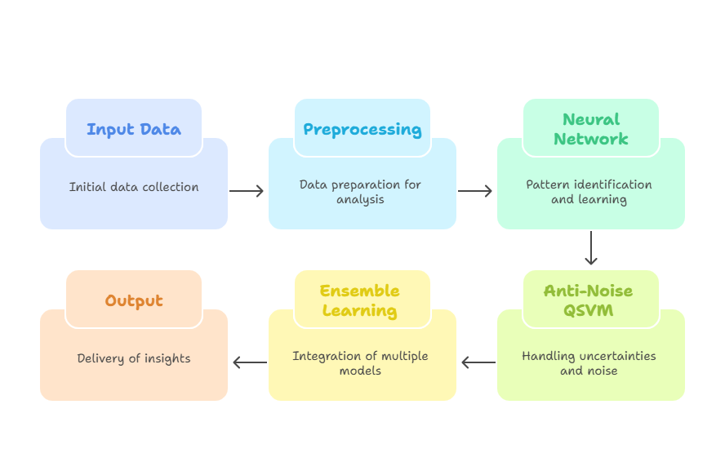
System Architecture / Design

Slide 7
Project Requisites:
Technology Stack
1. Quantum Computing Tools:
Qiskit (IBM Quantum) for quantum circuit design, simulation, and noise modeling
2. Classical Machine Learning Frameworks:
Python libraries: scikit-learn (for SVM, ensemble classifiers)
TensorFlow or PyTorch (for neural network feature extraction)
3. Data Processing:
NumPy, Pandas, SciPy for numerical data manipulation and preprocessing
Datasets
Public benchmark datasets with suitable noisy data:
Handwritten digit recognition datasets (e.g., MNIST with noise augmentation)
Biomedical datasets (e.g., Lung Cancer dataset)
Network intrusion or cybersecurity datasets

Slide 8
Summary
This project proposes the design of a practical and powerful hybrid system that combines the strengths of quantum computing and classical machine learning to tackle noisy and complex data. The framework envisions using a neural network to clean and extract meaningful features from raw noisy data, which would then be fed into an Anti-Noise Quantum Support Vector Machine. This quantum model is intended to handle noise effectively while leveraging potential quantum speedup.
To further enhance robustness, the system would integrate ensemble learning by blending predictions from multiple classical models, thereby reducing errors and improving stability. The proposed framework is aimed at addressing real-world datasets that often suffer from issues such as label errors, feature corruption, and quantum hardware imperfections. By bridging quantum computing with classical techniques, this approach has the potential to advance practical applications in fields like healthcare diagnostics, cybersecurity threat detection, and image recognition, where data noise remains a significant challenge.

Slide 9
References
1. G. Gentinetta, A. Thomsen, D. Sutter, and S. Woerner, “The complexity of quantum support vector machines,” Quantum, 2024. https://arxiv.org/pdf/2203.00031.pdf
2. Anonymous, “Noise-robust optimization of quantum machine learning models,” IEEE Transactions, 2022. https://www.nature.com/articles/s41598-022-22940-4
3. M. Akrom et al., “Entanglement detection with quantum support vector machines,” Nature Scientific Reports, 2025. https://www.nature.com/articles/s41598-025-95897-9
4. J. Berberich et al., “Training robust and generalizable quantum models,” Phys. Rev. Research, 2024. https://journals.aps.org/prresearch/pdf/10.1103/PhysRevResearch.6.043326
5. J. Wang et al., “Noisy HQNNs: A Comprehensive Analysis of Noise Robustness in Hybrid Quantum Neural Networks,” IEEE, 2021. https://arxiv.org/pdf/2505.03378.pdf
6. J. Li et al., “Quantum Support Vector Machine for Classifying Noisy Data,” IEEE Transactions on Computers, 2024. https://ieeexplore.ieee.org/document/10564586
7. M. Mafu and M. Senekane, “Design and Implementation of Efficient Quantum Support Vector Machine,” ICECET, 2021. https://ieeexplore.ieee.org/document/9385589
8. S. Ahmed, “Pattern Recognition with Quantum Support Vector Machine on Near Term Quantum Processors,” PhD Dissertation, 2019. https://repository.bracu.ac.bd/xmlui/handle/123456789/1209
9. H. Li et al., “Quantum Support Vector Machine Based on Gradient Descent,” Int. J. Theor. Phys., 2022. https://link.springer.com/article/10.1007/s10773-022-05100-0
10. M. Senekane et al., “Prediction of Solar Irradiation Using Quantum Support Vector Machine Learning,” Smart Grid Renewable Energy, 2016. https://www.scirp.org/journal/paperinformation.aspx?paperid=68467

Slide 10
THANK YOU
QUERIES?
Batch No: 201
A. Nithisha, 160122737071
K. Varshitha , 160122737078

