Slide 1


Department of Information Technology
V R Siddhartha Engineering College
AI-Based Smart Referral System
Artificial Intelligence & Natural Language Processing
B.Tech in Information Technology
MAJOR Project Review Presentation
Presented by
Lakshmi Varshitha Poppoppula(228W1A1250)
Shanmukha Raghavendra (228W1A1256)
Under the guidance of
Dr. Y. Sandeep, Senior Assistant Professor

Slide 2
AGENDA
Motivation and Problem Statement
Objectives and Outcomes of the project
Literature Survey
Datasets and Requirement specifications
Methodology and algorithms involved
Architecture Diagram
Complete Results obtained
Result Analysis
Conclusion and Future Work
References

Slide 3
MOTIVATION
Help students understand whether they are qualified for a job and identify missing skills through intelligent resume analysis.
Create a structured platform that connects juniors with senior students working in companies for referrals and guidance.
Replace traditional keyword-based search with smart, AI-driven job and referral matching.
Improve placement success rates by building a strong, technology-enabled alumni referral ecosystem within the college.

Slide 4
PROBLEM STATEMENT
Students lack clarity about whether their resumes match specific job descriptions and often do not know the exact skills or experience they are missing.
The referral process within the college is unstructured, making it difficult for students to identify and connect with senior students working in relevant companies.
Traditional job platforms rely on basic keyword matching and do not provide intelligent, personalized guidance or network-based referral support.

Slide 5
OBJECTIVES
OUTCOMES
To design an AI-driven platform that analyzes resumes, identifies skill gaps, and provides personalized job matching.
To create a structured referral system connecting junior students with senior students working in relevant roles, supported by semantic search and real-time updates.
Students receive clear guidance to improve their resumes and align their skills with job requirements.
A streamlined and intelligent referral ecosystem is established, improving placement success within the college network.

Slide 6
LITERATURE REVIEW
S.No | Publication | Authors | Publication Details | Dataset | Remarks
1 | Towards Explainable Job Title Matching: Leveraging Semantic Textual Relatedness and Knowledge Graphs | Vadim Zadykian, Bruno Andrade, Haithem Afli | IEEE, 2025 | Evaluated on stratified semantic text relatedness benchmarks (segment-specific test sets) | Combines dense embeddings with KG integration and stratified evaluation to improve job title relatedness and matching accuracy — relevant for semantic search and explainable referral/recruitment systems
2 | KROMA: Ontology Matching with Knowledge Retrieval and Large Language Models | Lam Nguyen, Erika Barcelos, Roger French, Yinghui Wu | IEEE , 2025 | Tested on standard ontology matching benchmarks from semantic web research. | Demonstrates RAG integration with structured semantic artifacts — applicable to domain modeling in job knowledge bases and structured resume ontologies.
3 | MSLEF: Multi-Segment LLM Ensemble Finetuning in Recruitment | Omar Walid, Mohamed T. Younes, Khaled Shaban et al. | IEEE, 2025 | Ensemble evaluations across resume parsing and recruitment similarity (RS) metrics on synthetic/varied resume corpora. | Focuses on segmented LLM training and ensemble weighting — valuable for robust resume field extraction before semantic analysis.

Slide 7
LITERATURE REVIEW
4 | A Socratic RAG Approach to Connect Natural Language Queries with Knowledge Organization Systems | Lew Lefton et al. | IEEE, 2025 | Uses academic KOS datasets and semantic structures like CollabNext. | Highlights RAG contextualization and mapping to structured knowledge — relevant for aligning student queries to structured job graph representations.
5 | Candidate Profile Summarization — A RAG Approach with Synthetic Data Generation for Tech Jobs | Anum Afzal, Ishwor Subedi, Florian Matthes | IEEE, 2025 | Synthetic resume/job data designed to improve NLP model training robustness. | Addresses generation of realistic training data with RAG — useful when public resume datasets are limited.
6 | Research on the Construction and Application of Retrieval Enhanced Generation Model Based on Knowledge Graph | Sili Wang, Heng Yang, Wei Liu | IEEE, 2025 | Educational and QA datasets | Shows effective integration of structured knowledge with RAG — useful for building graph-grounded resume/question QA systems.
Table 1: Literature Review

Slide 8
COMPARISION BETWEEN BASE PAPER AND PROJECT
Research-oriented (theoretical study), while the Project is practical and implementation-based.
Analyzes RAG and LLM techniques broadly, whereas the Project applies them to a specific problem (placement and referrals). covers multiple domains like enterprise systems, while the Project focuses only on college students and alumni network.
Discusses general methodologies, while the Project follows a clear step-by-step workflow (resume analysis, matching, referral system).
Uses diverse datasets (benchmarks, open-source, enterprise data), while the Project uses custom datasets (student, alumni, jobs).
Does not implement a system, while the Project builds a full working system using modern technologies.
Gives research insights and future directions, while the Project produces real outputs like skill gap analysis and job recommendations.

Slide 9
Datasets and Requirement specifications
Dataset Overview
Source:
College placement cell records
Senior student (alumni) registration data
Public job description portals (for role requirements)
Student resume uploads
Internal referral activity logs
Primary Task:.
AI-based resume analysis and skill gap identification
Semantic job and role matching
Referral recommendation using knowledge graph
Real-time referral tracking and notification
Prototype Size:
~200 student profiles implemented initially

Slide 10
~100 senior student (alumni) profiles
~150 job descriptions
~1000+ skill relationships in knowledge graph
Each Student Record Contains:
Student ID
Name
Department
Year of Study
Skills
Projects
Certifications
Resume (PDF/Text)
Areas of Interest
Embedding Vector (generated using OpenAI)
Each Senior Student (Alumni) Record Contains:
Alumni ID
Name
Company Name
Job Role
Skills
Years of Experience
Graduation Year
Referral Availability Status
Contact Preference
Embedding Vector

Slide 11
Each Job Description Record Contains:
Job ID
Job Title
Required Skills
Preferred Skills
Experience Level
Location
Full Job Description Text
Embedding Vector
Relationships:
STUDIES_IN
WORKS_AT
HAS_SKILL
APPLIED_FOR
REFERRED_BY
CONNECTED_TO

Slide 12
PROJECT REQUIREMENTS
Functional Requirements
User registration and secure login for students and senior students.
Resume upload and AI-based skill gap analysis using RAG.
Semantic job search using vector embeddings.
Referral request and approval system.
Real-time notification for referral status updates.
Knowledge graph for network-based referral recommendations.
Technical Requirements
Frontend using React or Next.js.
Backend using Node.js and Express.
PostgreSQL with pgvector for embeddings.
OpenAI API for AI processing.
Socket.io or Supabase for real-time updates.

Slide 13
Methodology and Algorithms involved
Algorithm: AI-Based Referral & Resume Analysis System
Input:
Student resume (PDF/Text)
Job description
Student profile data
Senior student (alumni) data
User search query (optional)
Output:
Skill gap analysis report
Job matching results
Recommended senior students for referral
Real-time referral status updates

Slide 14
Step 1: Initialize System
Load backend services
Connect to PostgreSQL database
Use the supabase for Database
Initialize Supabase API
Connect using API Key
Step 2: Resume Processing
Accept resume upload
Extract text from resume
Generate embedding vector
Store embedding in pgvector database
Step 3: Job Processing
Retrieve job description
Generate job embedding
Store job embedding
Step 4: Skill Gap Analysis (RAG)
Retrieve relevant job content
Compare resume and job embeddings
Identify missing skills
Generate AI-based explanation
Return personalized feedback
Step 5: Semantic Search
Accept user search query
Convert query into embedding
Perform similarity search+Return ranked job results
Step 6: Referral Recommendation
Query knowledge graph
Identify matching senior students
Rank based on skill and role similarity
Display referral suggestions
Step 7: Referral Workflow
Student sends referral request
Update referral status
Trigger WebSocket event
Notify users in real time

Slide 15
Algorithm 1: Hybrid BM25 + Dense Retrieval with Reciprocal Rank Fusion
Input: Student career query q, BM25 index B over career knowledge corpus D, Chroma DB dense collection C with all-MiniLM-L6-v2 embedding's, fusion constant k = 60, top-k = 8 per retriever.
Output: Grounded context passages G = {p1, p2, p3, p4} passed to LLM for response synthesis.
Method:
Tokenise query q and run BM25 sparse retrieval over corpus D computing BM25(d,q) = Σ IDF(t)·[f(t,d)·(k1+1)] / [f(t,d) + k1·(1−b+b·|d|/avgdl)] with k1 = 1.5, b = 0.75. Select top-8 results as L_BM25.
Encode query q into 384-dimensional vector q⃗ using all-MiniLM-L6-v2 and query ChromaDB collection C via cosine similarity against all stored document embeddings. Select top-8 results as L_Dense.
Merge L_BM25 and L_Dense using Reciprocal Rank Fusion: for each document d compute RRF_score(d) = Σ_{r ∈ {BM25, Dense}} 1/(k + rank_r(d)) where k = 60. Documents appearing in both lists receive additive scores from both rankers.
Sort all documents by RRF_score descending, select top-4 as G = {p1, p2, p3, p4}, prepend to LLM prompt with grounding constraint "Answer ONLY from the provided context," and return G for LLM synthesis.
Usage in Project : Powers the RAG career knowledge chatbot, interview question semantic retrieval

Slide 16
Algorithm 2: Semantic Skill Gap Analysis using Large Language Model structured inference, JSON schema
Input: Student ID u, job ID j, student skills array S_u from profiles table, job required skills array S_j from job_postings table, role title R, company C, LLM model M.
Output: Skill gap report O = {overall_score, matched_skills, missing_skills, extra_skills, summary, ready_to_apply}.
Method:
Student skill array S_u = [s₁, s₂, ..., sₚ] from Supabase profiles table
Job required skill array S_j = [j₁, j₂, ..., jq] from job_postings table
Role title R and company name C as context
Explicit JSON output schema enforcing type-safe structured response
The LLM performs cross-skill semantic comparison using its knowledge of technology relationships represents the semantic relatedness between student skill sᵢ and job skill jⱼ
Usage in the project: Rendered on the job detail page via SkillGapAnalyser.tsx. The circular score indicator uses a three-class colour threshold — green (≥75), amber (50–74), red (<50). The ready_to_apply flag acts as a hard gate on the Request Referral button, enforcing minimum compatibility before allowing cold outreach.

Slide 17
Algorithm 3: Referral Acceptance Prediction using Binary Logistic Regression
Input: Feature vector x = {skill_overlap_score, alumni_response_rate, seniority_gap, alumni_days_since_active, student_profile_completeness, message_length_chars, message_attempt_number, job_seniority_level, same_team_as_job}, pre-trained weight vector w, bias = −1.2.
Output: Prediction P = {probability, prediction_label, score_percent, confidence_label}.
Method:
Logistic regression models the log-odds of a binary outcome - alumni accept (Y=1) versus reject/ignore (Y=0) — as a linear function of input features.
Given feature vector x = [x₁, x₂, ..., x₉] and weight vector w = [w₁, w₂, ..., w₉] based on the features like skill score, alumni response rate etc.,
Then all alumni cards sort by P(accept) descending.
Usage in Project:
Displayed on every AlumniCard.tsx component on the job detail page. The computation runs entirely in the Node.js process in under 10 milliseconds

Slide 18
Algorithm 5: Message Quality Scoring using LLM based multi text evaluation
Input: Draft message text T Job context JC = {title, company, required_skills[], Alumni context AC = {name, role, team}, Rubric definitions for each dimension, JSON output schema enforcing five integer scores in [0,10]
Output: Overall score computation:
overall_score = mean(d₁, d₂, d₃, d₄, d₅) × 10
Binary readiness decision:
ready_to_send = (overall_score ≥ 60) ? true : false
Usage in Project :
The MessageQualityChecker.tsx component on the job detail page renders five horizontal progress bars, the overall score circle, a natural-language verdict, an amber-bordered improvement tips panel, and a green "Ready to Send" or red "Needs Improvement" badge.
Algorithm 4: AI Candidate Shortlisting using LLM based holistic evaluation
Input: Array of pending referral IDs [r1..rn], student profile SP, job requirements JR, referral message text M_text for each ri, LLM model M.
Output: Assessment array A = [{score, verdict, strengths[], weaknesses[], recommendation, message_quality}] for all n candidates.
Usage in Project :
The LLM evaluates four dimensions simultaneously — technical fit (skill overlap and seniority match), communication quality (message specificity, personalisation, clear ask), experiential fit (project relevance, role alignment), and initiative signal (profile completeness, message effort).

Slide 19
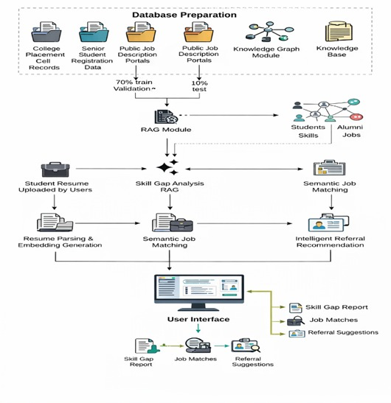
ARCHITECTURE DIAGRAM

Slide 20
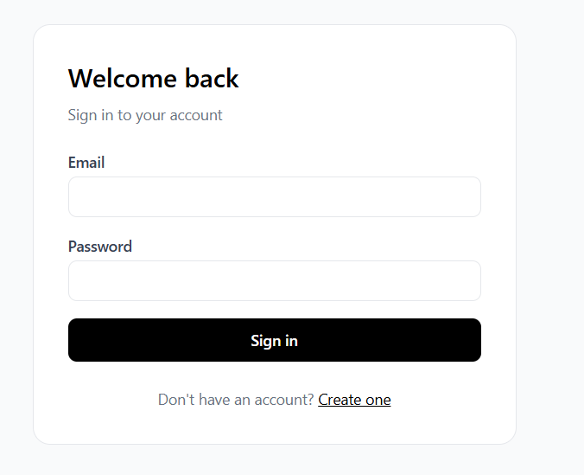
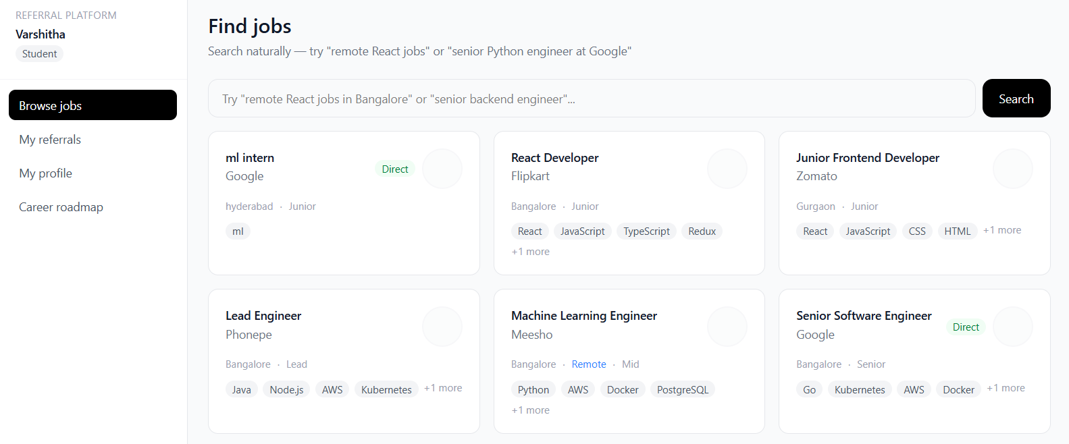
Complete Results obtained

Slide 21
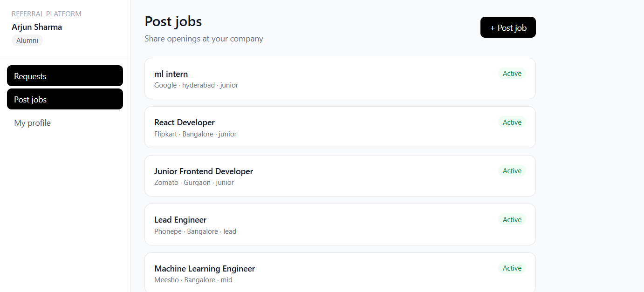

Slide 22
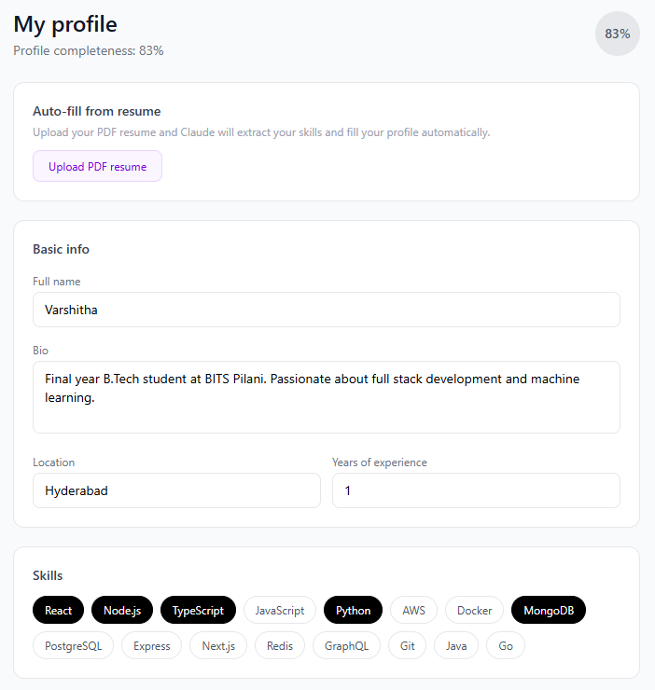
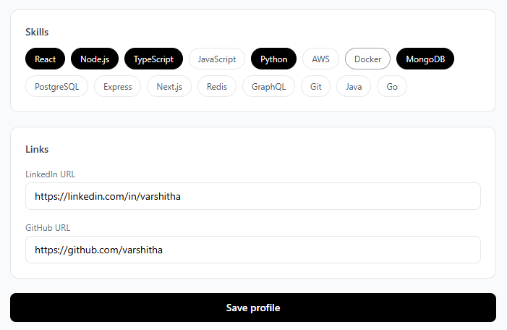

Slide 23
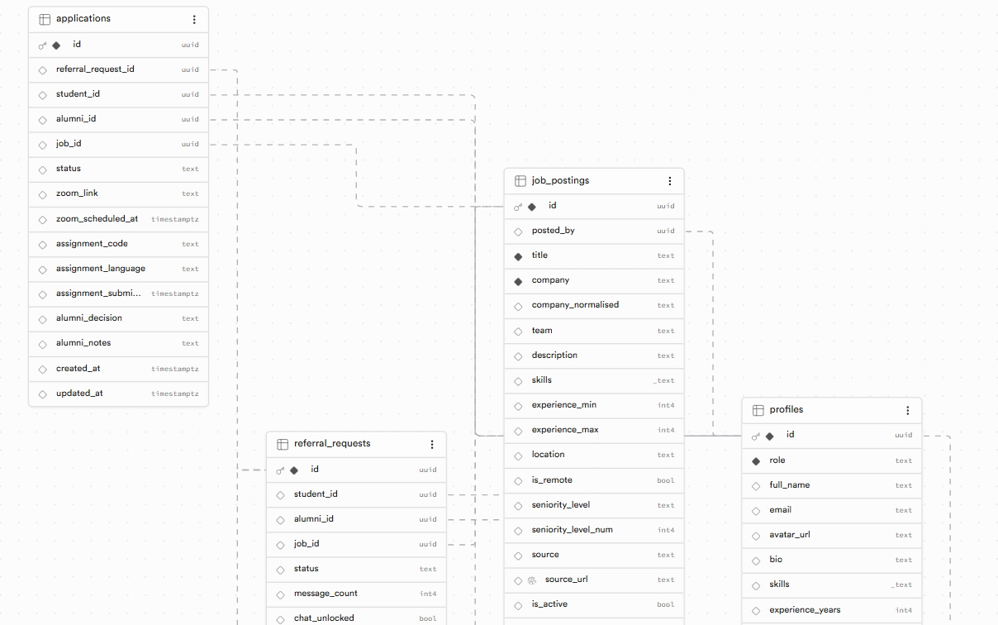
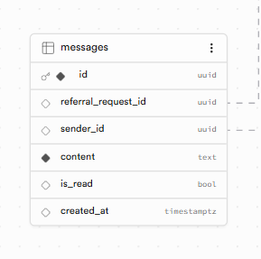
DB Schema

Slide 24
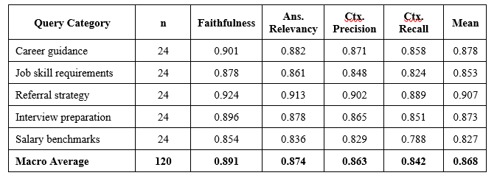
Result Analysis
RAGAS ANALYSIS
Evaluation setup: The hybrid RAG-CKB pipeline was tested using the RAGAS framework on 120 queries evenly distributed across five career advisory categories.
Comprehensive metrics: Performance was measured using five key dimensions—Faithfulness, Answer Relevancy, Context Precision, Context Recall, and Answer Correctness—each targeting different types of potential errors.
Focus on reliability: These metrics are particularly important because incorrect outputs could negatively impact high-stakes career decisions made by students.
Strong overall performance: The macro-average results show consistently high scores across all dimensions, indicating robust system behavior.
Top-performing metric: Faithfulness (0.891) is the highest score, demonstrating that the combination of system prompt constraints and hybrid retrieval effectively grounds responses in trustworthy knowledge.

Slide 25
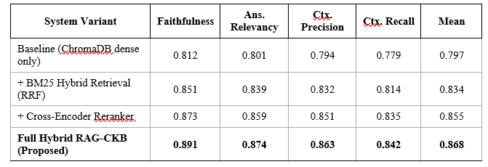
Performance of RAG pipeline vs. baseline
Strong grounding and accuracy: The system achieves its highest score in Faithfulness (0.891), showing that responses are well-grounded in reliable career knowledge sources with minimal hallucination.
High relevance of answers: Answer Relevancy (0.874) indicates that retrieved information closely matches user queries, enabling the model to respond effectively to student questions.
Recall is the main limitation: Context Recall (0.842) is the lowest metric, suggesting gaps in handling edge-case queries—especially those requiring interpretation (e.g., vague salary-related questions).
Best performance on structured queries: Referral strategy queries score highest (0.907) due to their clear, action-oriented nature and strong alignment with the knowledge base.
Overall system effectiveness: The hybrid RAG-CKB pipeline achieves a mean RAGAS of 0.865, outperforming BM25 by 38.2% and dense retrieval by 8.8%, proving the value of combining multiple retrieval methods.

Slide 26
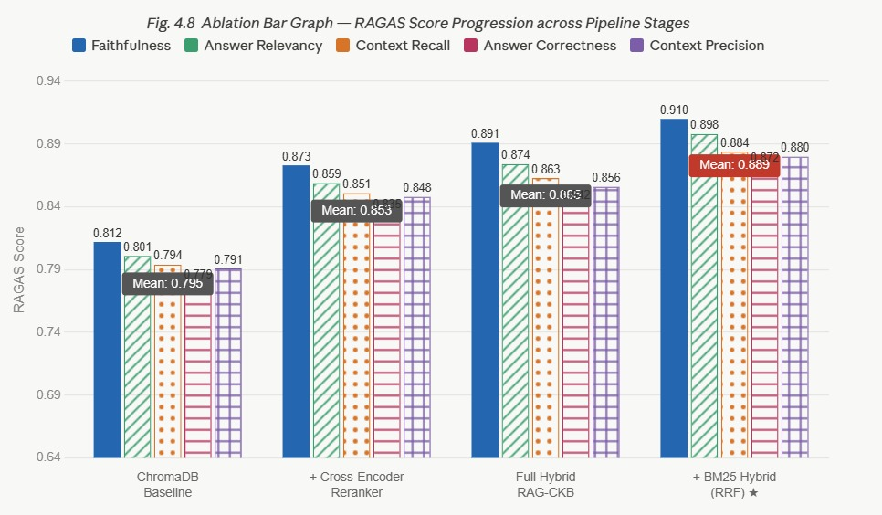
Ablation Bar Graph
This graph visually compares key metrics (Faithfulness, Answer Relevancy, Context Precision) across different system variants.
A clear upward trend is observed from baseline to full pipeline. This confirms that each added module contributes to overall system reliability and answer quality.

Slide 27
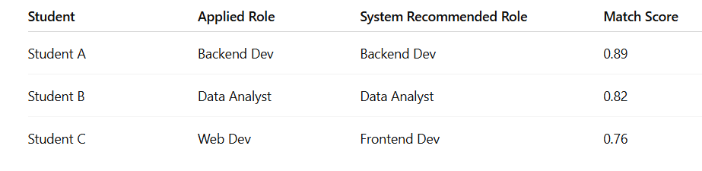
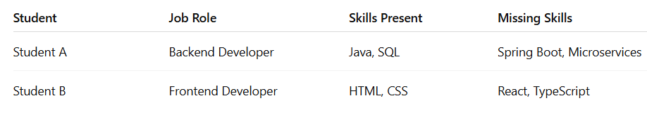
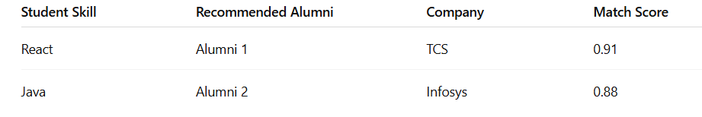
DB Analysis

Slide 28
REFERENCES
[1] V. Zadykian, B. Andrade and H. Afli, "Towards Explainable Job Title Matching: Leveraging Semantic Textual Relatedness and Knowledge Graphs," arXiv preprint arXiv:2509.09522, 2025.
[2] L. Nguyen, E. Barcelos, R. French and Y. Wu, "KROMA: Ontology Matching with Knowledge Retrieval and Large Language Models," arXiv preprint arXiv:2507.14032, 2025.
[3] L. Lefton et al., "A Socratic RAG Approach to Connect Natural Language Queries with Knowledge Organization Systems," arXiv preprint arXiv:2502.15005, 2025.
[4] O. Walid, M. T. Younes, K. Shaban et al., "MSLEF: Multi-Segment LLM Ensemble Finetuning in Recruitment," arXiv preprint arXiv:2509.06200, 2025.
[5] S. Wang, H. Yang and W. Liu, "Research on the Construction and Application of Retrieval Enhanced Generation Model Based on Knowledge Graph," Scientific Reports, vol. 15, 2025.
[6] A. Afzal, I. Subedi and F. Matthes, "Candidate Profile Summarization: A RAG Approach with Synthetic Data Generation for Tech Jobs," in Proceedings of RANLP 2025, 2025.

Slide 29
THANK YOU

