Slide 1

Mathematics for Computing -3
Applications of ADMM
1.Graphical Lasso Optimization
2.Image Super Resolution
Group C-06
Varshitha Thilak Kumar-CB.SC.U4AIE23258
Siri Sanjana S-CB.SC.U4AIE23249
Shreya Arun-CB.SC.U4AIE23253
Anagha Menon-CB.SC.U4AIE23212
1

Slide 2
ADMM
An optimisation approach called the Alternating Direction Method of Multipliers (ADMM) breaks down issues into smaller.
It works well in domains like network optimisation, image processing, and machine learning because it is especially helpful for problems with separable objectives that entail constraints.
The main benefit of ADMM is its capacity to manage large-scale optimization issues using parallel computation, which makes it ideal for distributed systems. Additionally, it works well with non-smooth issues where conventional approaches would not work well, as those involving ℓ1 -norm regularisation.
ADMM is a popular option for many intricate, limited optimisation jobs due to its robustness and versatility, even though convergence may be slower than with specialised solvers.

Slide 3
Graphical Lasso optimization
Graphical Lasso (GLasso) is a statistical method used to estimate sparse precision matrices.
The precision matrix is the inverse of the covariance matrix, and it contains important information about the conditional dependencies between random variables in a dataset.
GLasso aims to estimate this matrix while introducing sparsity, which means many of the relationships between variables are assumed to be zero.

Slide 4
Terms:
The Log Determinant Term, −log det(X): This term ensures that our variable X (the precision matrix) is positive definite and invertible.
The Trace Term, trace(C⋅X) This term pulls X to resemble the inverse of the sample covariance matrix C, meaning it encourages X to closely approximate observed data relationships.
The ℓ1-norm Penalty, λ∑i,j∣Xi,j|: The purpose of this penalty term is to promote sparsity in X by penalizing large values, effectively zeroing out weaker dependencies between nodes.

Slide 5
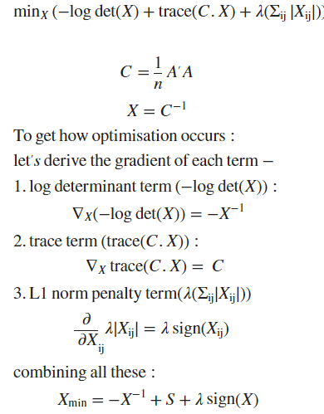
Lasso Optimization

Slide 6

Lasso optimization with ADMM
To apply the Alternating Direction Method of Multipliers (ADMM) to the Graphical Lasso optimization problem, we start by splitting the variables to make the problem easier to solve.
We introduce a new matrix variable, denoted as Z, to represent the sparse part of the precision matrix X.
The key idea here is that we separate the optimization of X (which captures the covariance structure) from the sparsity enforcement, which is handled by Z.

Slide 7




Applying ADMM

Slide 8
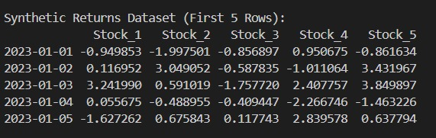
Results

Slide 9
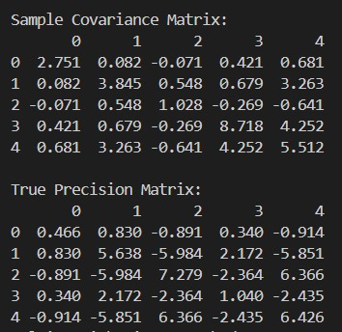
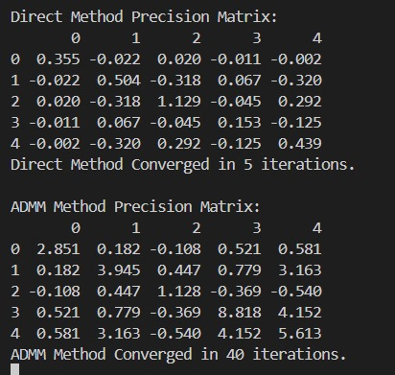
Results

Slide 10
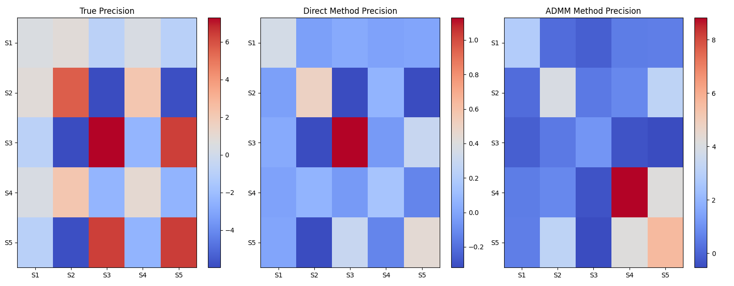
Results:

Slide 11
Conclusion
the ADMM-based approach for Graphical Lasso optimization is highly effective for large-scale, complex problems like stock market modeling.
Unlike traditional methods, ADMM decomposes the problem into manageable sub-problems, enabling efficient parallelization and faster convergence. Its key strength lies in handling sparsity constraints (L1-norm penalty) and log determinant terms with computational stability.
ADMM’s iterative steps ensure accurate, scalable solutions, balancing data fitting with sparsity to reveal significant stock relationships while ignoring weaker ones.
This makes ADMM a powerful, efficient tool for financial modeling and other applications involving high-dimensional, sparse datasets.

Slide 12
Introduction
Enhancing an image's spatial resolution by turning a low-resolution (LR) image into a high-resolution (HR) image is known as image super-resolution (SR).
High-resolution images are essential for improved analysis and decision-making in a variety of applications, including satellite imaging, medical imaging, and video improvement.
In this project, we concentrate on solving the picture super-resolution problem by applying the Alternating Direction Method of Multipliers (ADMM).
ADMM is an optimization algorithm that solves complicated problems iteratively by breaking them down into smaller, more manageable subproblems. Because it successfully manages both data fidelity and regularization, this approach is especially helpful in applications like image SR.

Slide 13
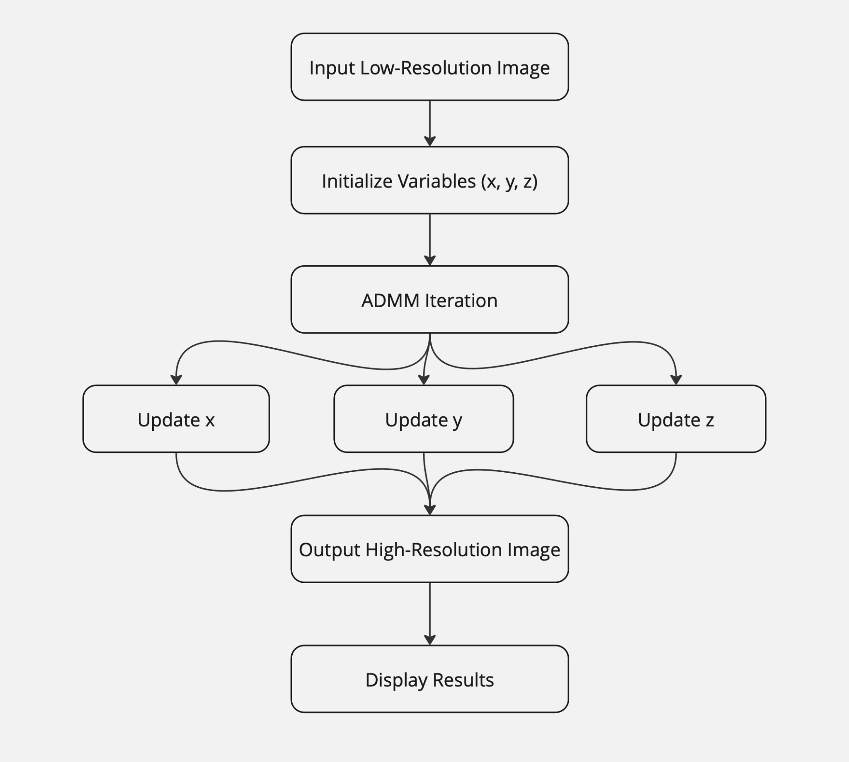
Methodology

Slide 14
Description
Input Low-Resolution Image:Usually downsampled from a high-quality image, the initial image has a lower resolution. Nevertheless, no downsampling is carried when if a natural low-resolution image is supplied.
Initialize Variables: The variables x, z and u are initialized. Here, x represents the estimated HR image, z is an surrogate variable related to the regularization term, and u is the dual variable in the ADMM optimization framework.
ADMM Iteration: Update x, y and z as per the obtained equations.
Output High-Resolution Image: The final high-resolution image is created following a predetermined number of iterations.
Display Results: To assess the improvement in quality and detail, the high-resolution image is contrasted with the low-resolution input.

Slide 15



Mathematical Formulation
1)optimization problem
2)Total variance
3)Augmented Lagrangian

Slide 16
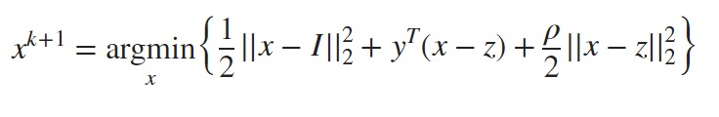
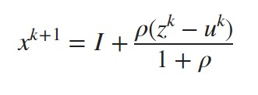




Mathematical Formulation
1) Updating x
2)Updating z
3)Updating u

Slide 17
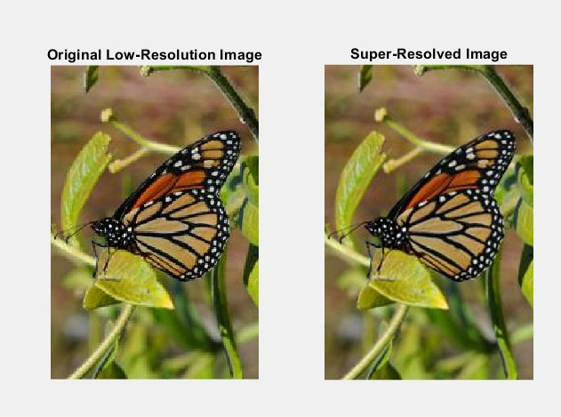
Output

