Slide 1

EaterEase
Department of Artificial Intelligence
User Interface Design
Varshitha Thilak Kumar-CB.SC.U4AIE23258
Siri Sanjana S-CB.SC.U4AIE23249

Slide 2
final .html

Slide 3
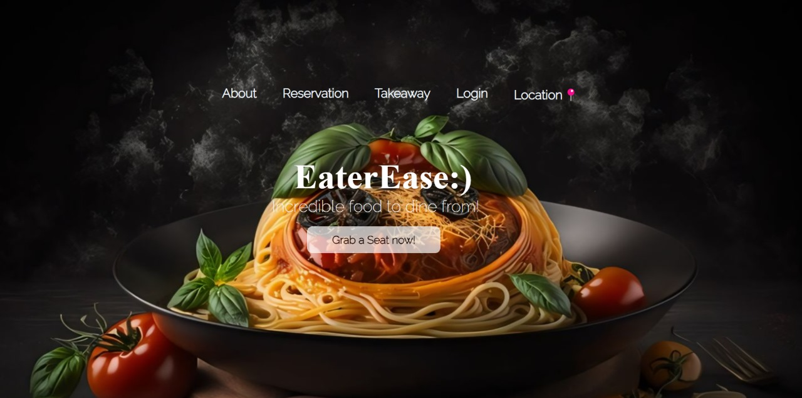

Slide 4
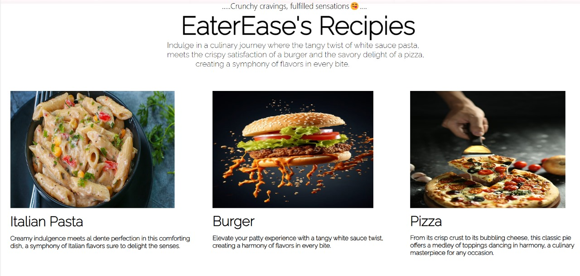

Slide 5
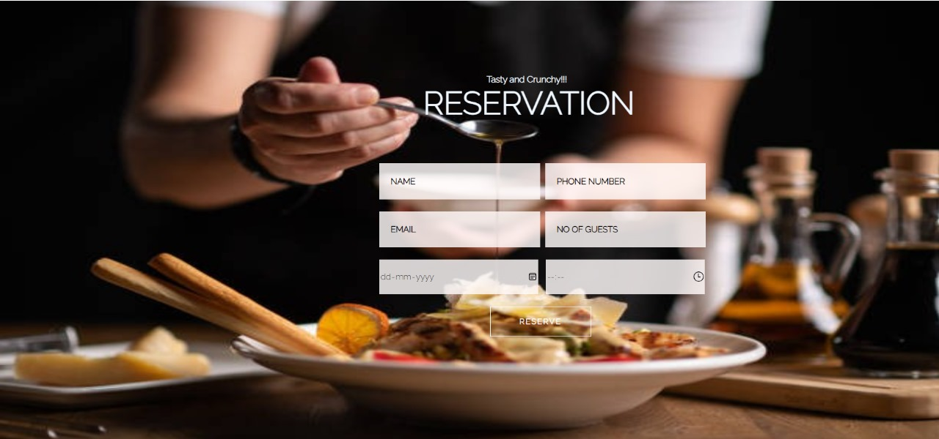

Slide 6
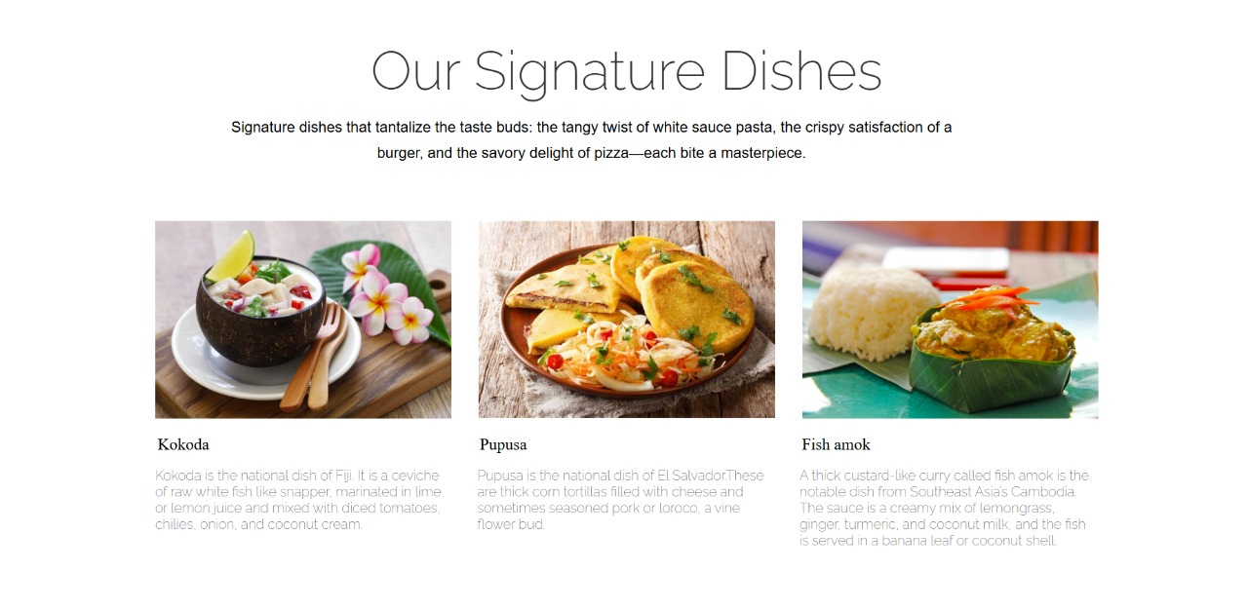

Slide 7
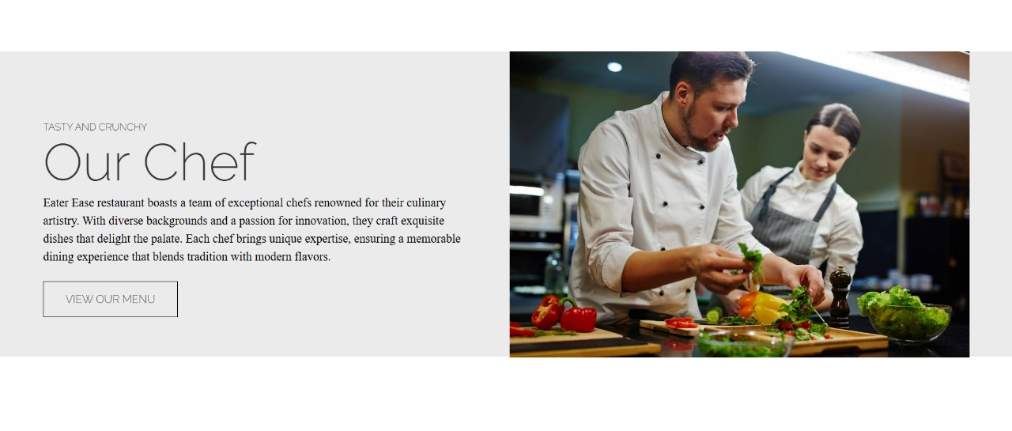

Slide 8
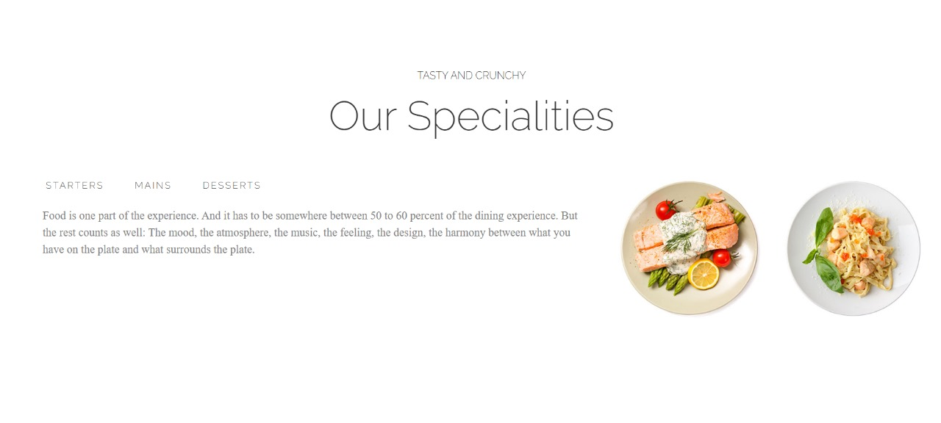

Slide 9
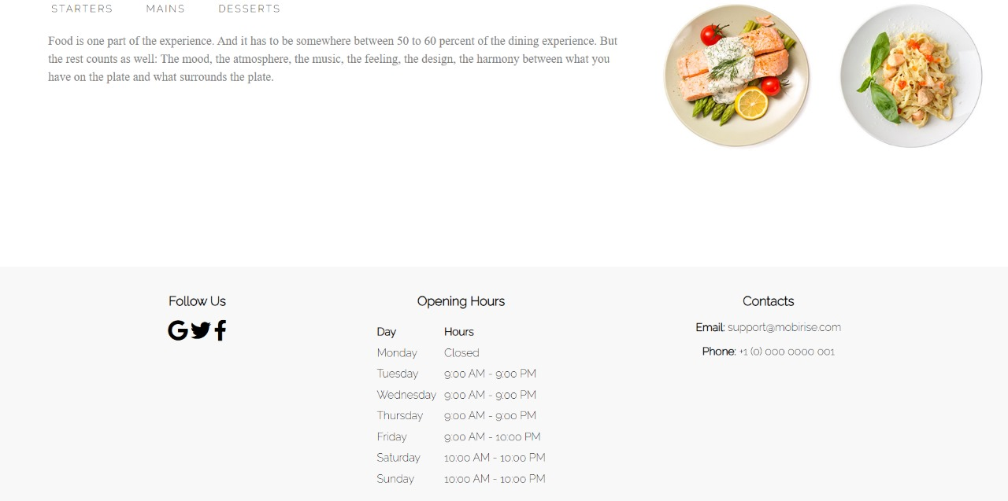

Slide 10
d2.html

Slide 11
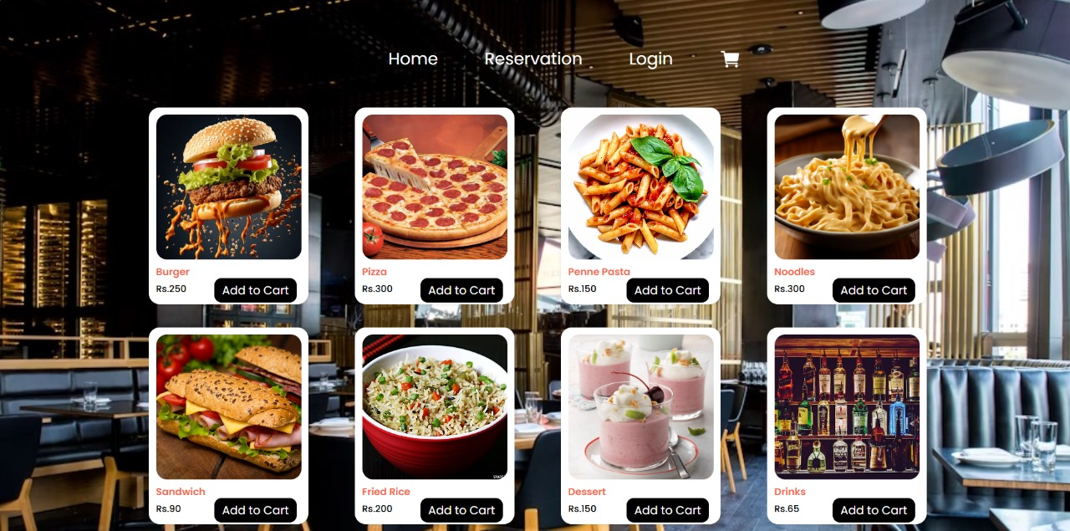
Transitions are included

Slide 12
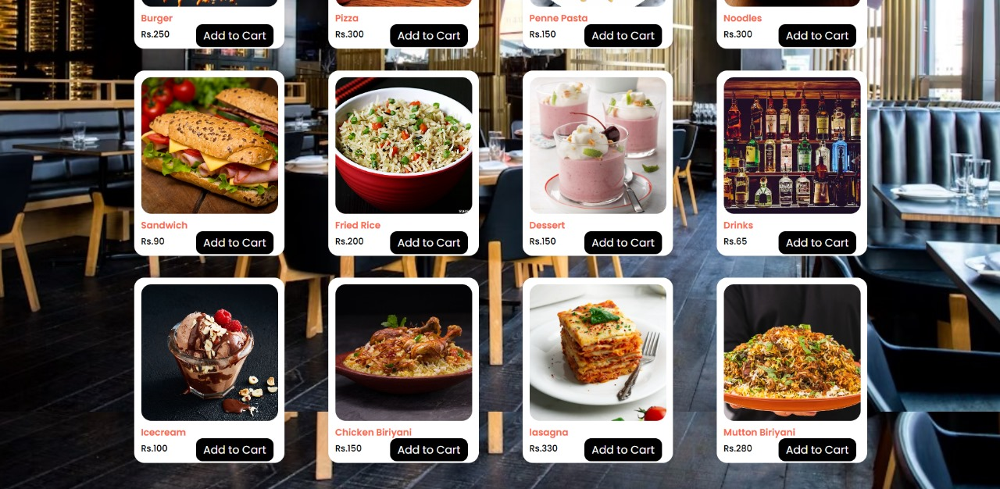

Slide 13
Login_new1.html

Slide 14
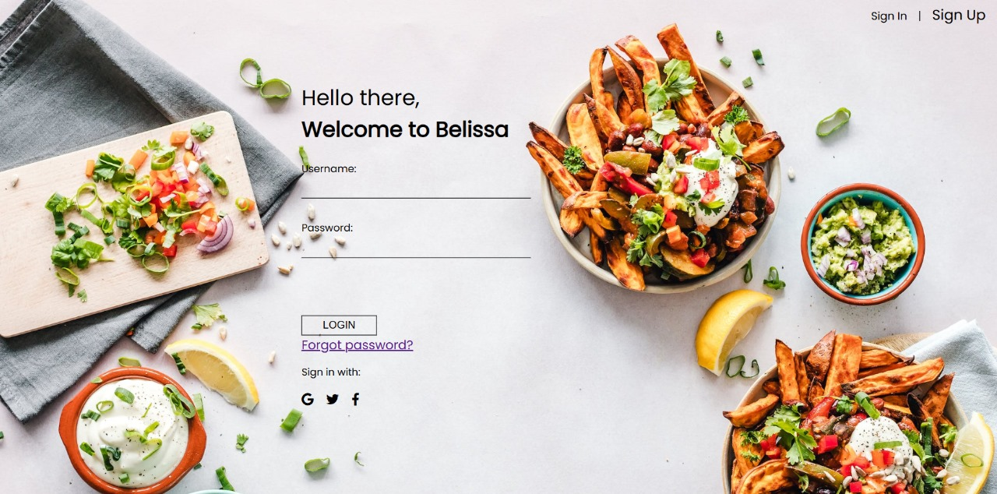

Slide 15
new.html

Slide 16
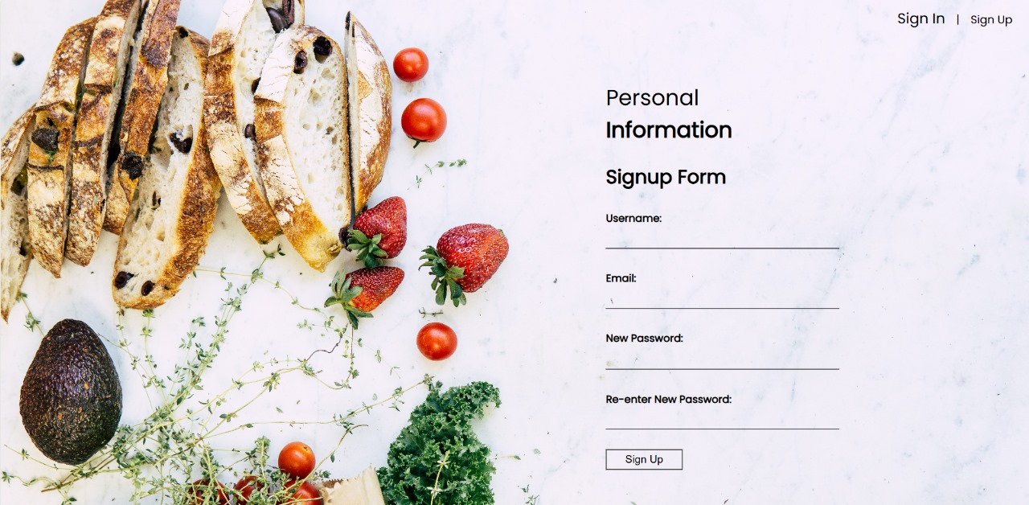

Slide 17
Location.html

Slide 18
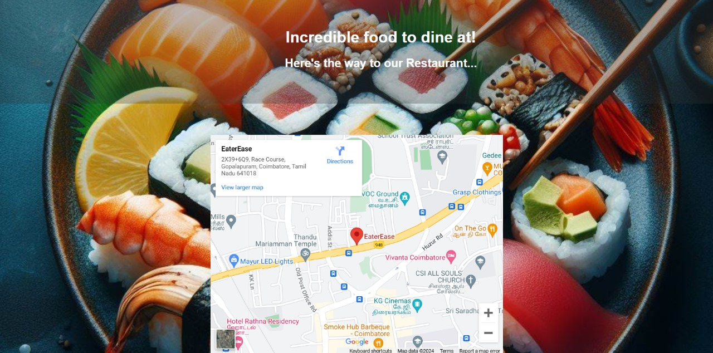

Slide 19
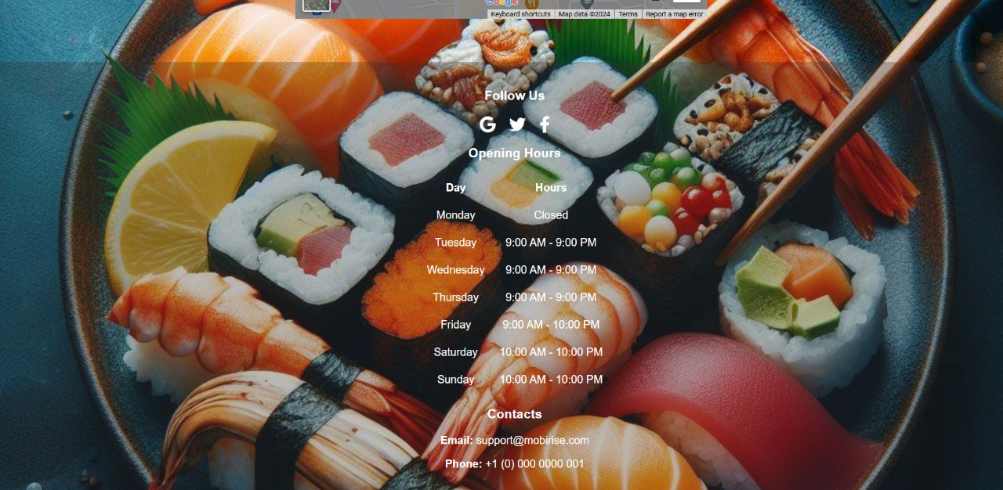

Slide 20
cart.html

Slide 21
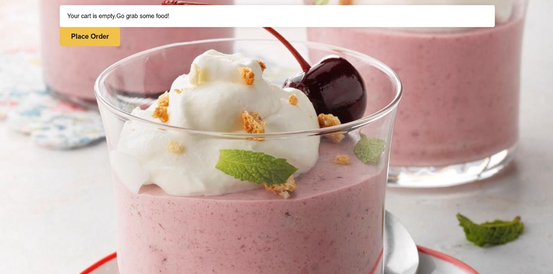

Slide 22
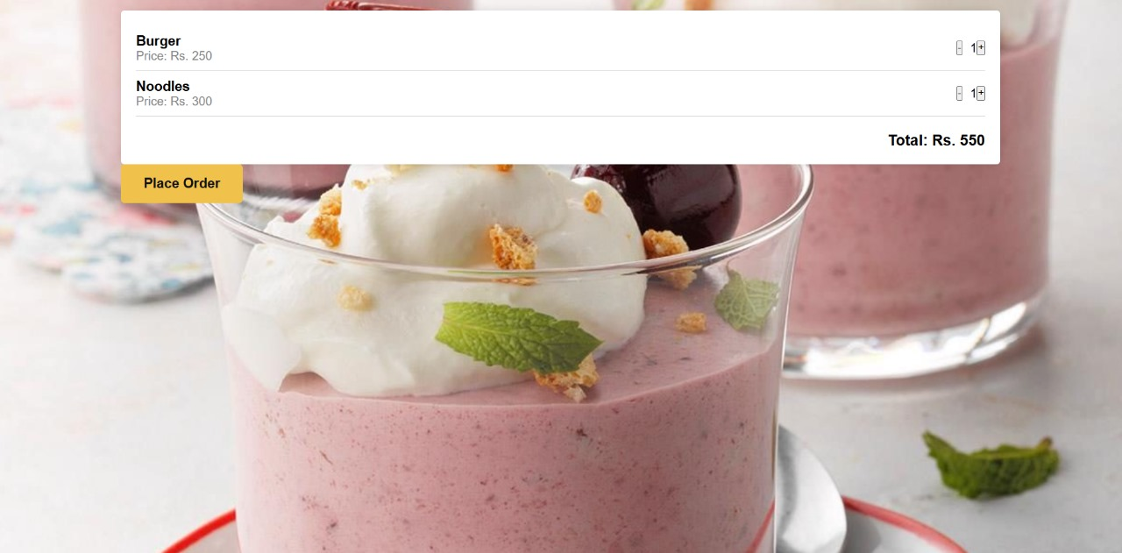

Slide 23
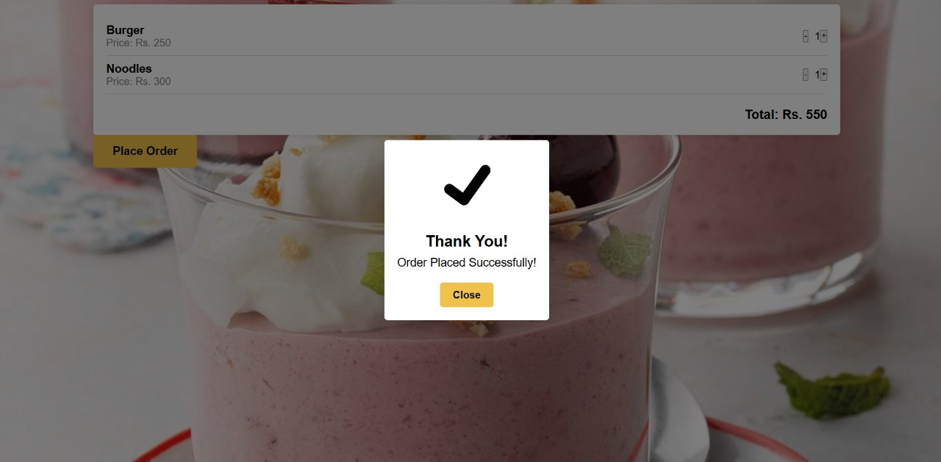

Slide 24
Thank you

