Slide 1
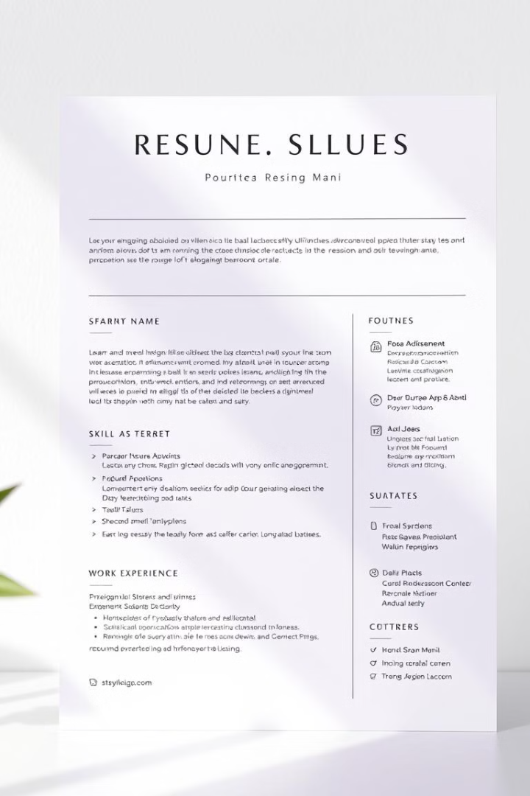
The Resume Generator Project: An AI-Driven Approach
This presentation introduces the Resume Generator Project. It's an AI-driven tool designed to automate resume creation. The goal is to streamline the job application process for everyone.

Slide 2
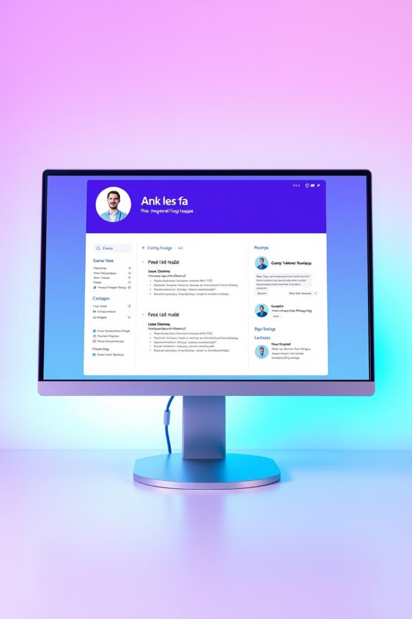
Project Overview and Objectives
1
Automate Resume Creation
2
Tailor Resumes to Job Specs
Develop an AI tool to generate resumes. Reduce the time and effort needed for job applications.
Craft resumes based on user inputs. This includes skills, experience, and career aspirations.
3
Highlight Qualifications
Ensure resumes effectively showcase candidate strengths. Accurately represent achievements and capabilities.

Slide 3
Challenges in Resume Creation
Time-Consuming Process
Highlighting Key Skills
Adapting to Different Jobs
Creating a resume can be very long. It requires lots of attention to detail.
Job seekers struggle to emphasize the most important things. Making sure that your resume is compelling is really challenging.
Tailoring a resume for each application is hard. You need to highlight different experiences for each job.

Slide 4
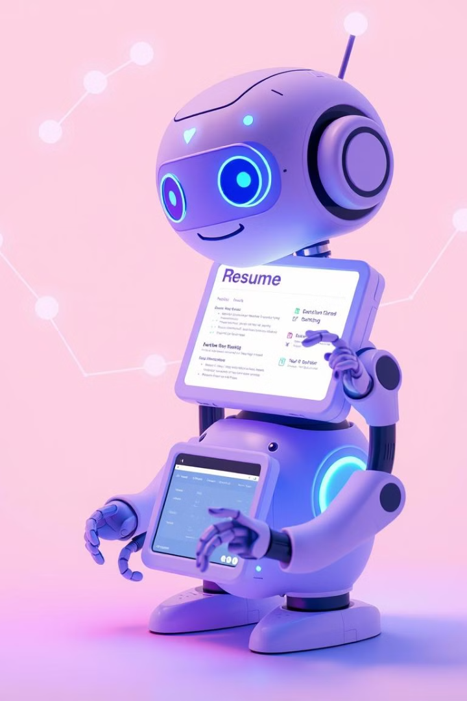



The AI-Driven Approach
Data Input
Users provide their career details.
AI Analysis
AI analyzes data and generates content.
Tailored Resume
A resume matches each job perfectly.

Slide 5
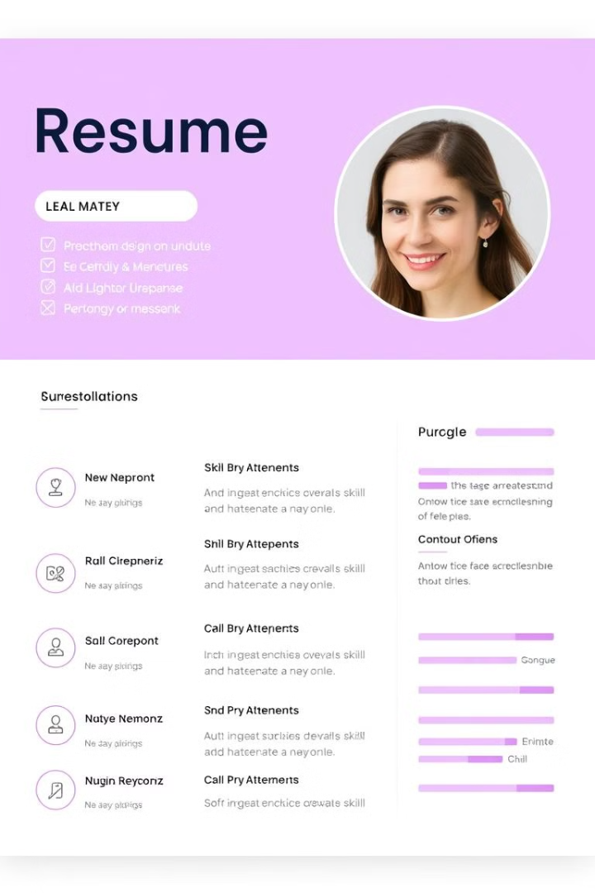



Key Features and Capabilities
Automated Formatting
Skill Extraction
Customization Options
Identifies and emphasizes key skills.
Ensures resumes are well-structured.
Allows users to tweak content and layout.

Slide 6




Generating Tailored Resumes
Final Review
1
Check the content
Layout Selection
2
A variety of clean templates
Content Generation
3
AI crafts sections based on data
Data Input
4
Provide job history, skills

Slide 7

Benefits for Job Seekers
Saves Time
Quickly creates professional resumes.
Increases Efficiency
Streamlines the job application process.
Enhances Quality
Highlights key qualifications and skills.
Boosts Confidence
Presents a polished and professional image.

