Slide 1


Agile Values and Principles
A framework for software development.
Focuses on collaboration and adaptability.

Slide 2

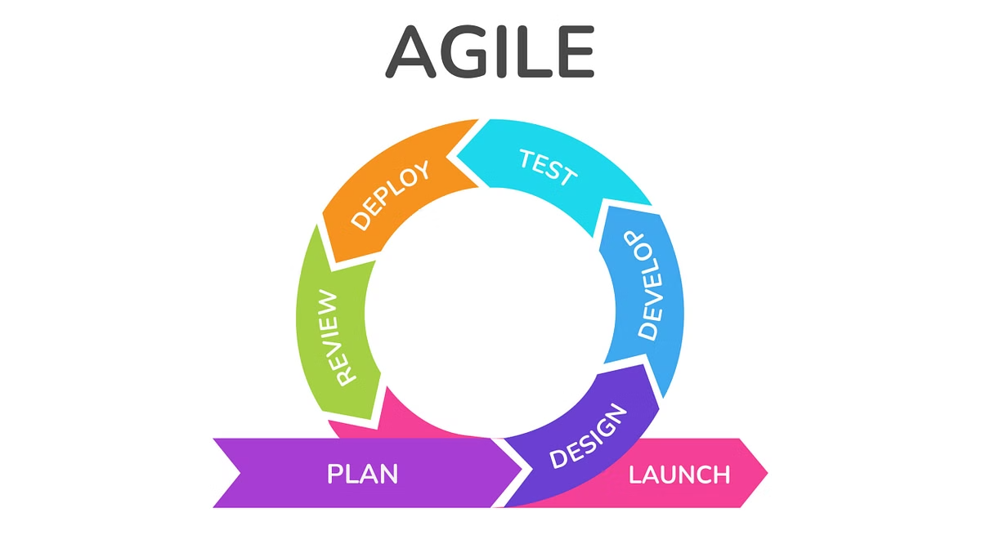
The Four Agile Values
Individuals and Interactions
Working Software
Over comprehensive documentation.
Over processes and tools.
Customer Collaboration
Responding to Change
Over contract negotiation.
Over following a plan.
These principles emphasize flexibility, strong interaction, and ongoing improvement to deliver value to both the team and stakeholders.

Slide 3

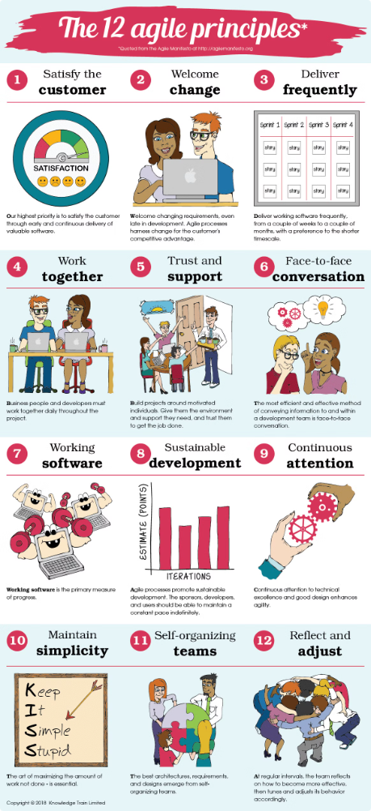
The Twelve Agile Principles
Prioritizing customer satisfaction and frequent, functional software releases.
Accepting changes, fostering collaboration between business and development teams, and building projects around motivated individuals.
Effective communication, especially face-to-face, is crucial.
Sustainable work pace, focusing on technical excellence and simplicity.

Slide 4

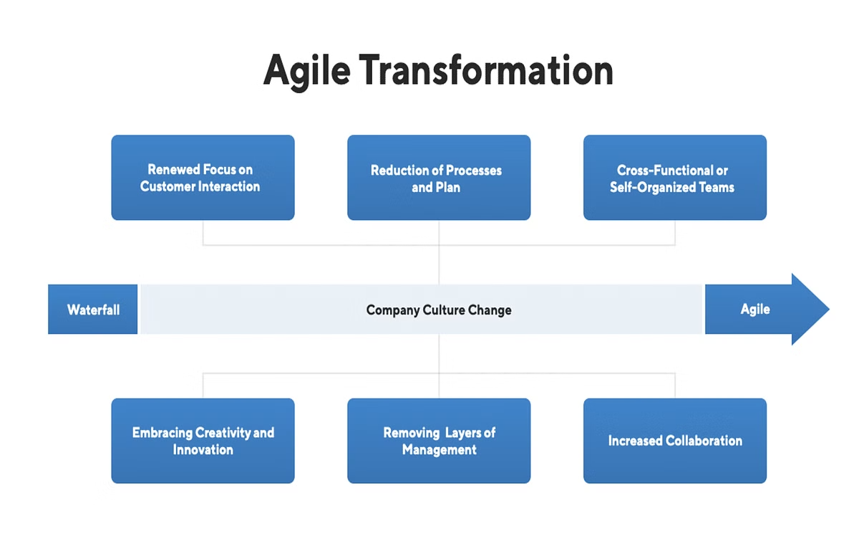
Implementing Agile in Organization
1
Assess Needs
Identify areas for improvement.
2
Training and Coaching
Equip teams with skills.
3
Pilot Project
Start small, learn and adjust.
4
Continuous Improvement
Regularly review and adapt.

