Slide 1
Executive Productivity Agent
Turning a VP's messy week into one reconciled daily brief
AIONOS Agentic AI Factory — Assignment 1

Slide 2
WHY THIS IS HARD
The problem
A VP's real commitments live scattered across meetings, email, calendars, and voice notes — not one inbox
The same commitment gets re-stated, and re-dated, multiple times as the week moves
Some items have no clear owner, and guessing wrong is worse than flagging it
A useful agent must reconcile all of this into one trustworthy view, not just list every mention

Slide 3
DATA SOURCES
Inputs used
1
4
5
2
Meeting transcript
Calendars
Email threads
Voice notes
Leadership Sync, Mon 21 Sep
Arjun, Neha, Raghav, Divya
25 messages total
Arjun's own dictated reminders
No information outside the supplied data pack was used or invented.

Slide 4
PROCESS FLOW
Architecture
Ingest
→
Extract
→
Reconcile
→
Classify
→
Brief / Q&A
Ingest — load every raw source as-is
Extract — pull candidate commitments: who said it, to whom, promised date
Reconcile — cluster mentions of the same action; most recent statement wins, earlier ones kept as a slip trail
Classify — assign owner only on an explicit first-person commitment; hedged language routes to "unclear"
Brief / Q&A — reconciled store powers the daily brief and answers direct questions

Slide 5
THE VENDOR LIST
Example: deduplication
Appears in 3 different sources — treated as ONE action, not three.
Sync, Mon 9:35 AM — "I told Raghav I'd send... by end of day tomorrow"
Email, Mon 5:40 PM — "will send first thing tomorrow morning"
Email, Tue 6:30 PM — "will send by tomorrow (Wednesday) morning for sure"
Voice note, Mon 6:40 PM — "need to get Raghav that vendor list... remind me"
Result: one action, due Wed AM, with 3 recorded slips as an audit trail.

Slide 6
MUMBAI LEASE RENEWAL
Example: refusing to guess
Raghav: "Not sure whose desk that's on right now"
Divya: "I think that's supposed to be Facilities" — a guess, not a confirmation
Divya (later): "I believe this typically sits with Facilities... not us"
Arjun himself, in the sync: "Flag it, don't assume"
Every candidate owner is hedged — so the agent escalates instead of assigning

Slide 7
WHAT THE LOGIC ACTUALLY RESTS ON
Design decisions
Latest statement wins, but superseded ones stay visible — the slip count is itself a signal
Ownership is only assigned on an explicit first-person commitment or acceptance
Voice notes are treated as the user's own commitments, never as third-party instructions
The agent's "now" is a settable clock, so the same data produces a different brief depending on the day
Every answer in Q&A carries a source citation — no free-generated claims

Slide 8
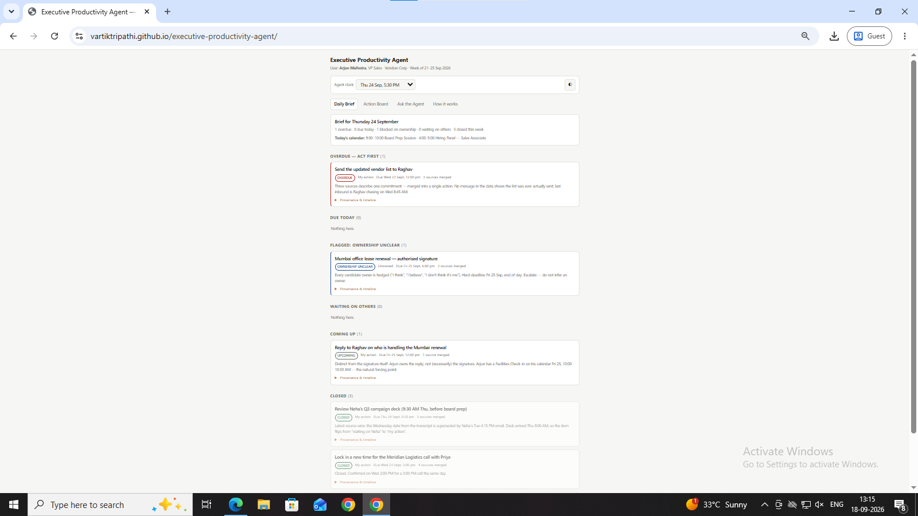
WHAT IT LOOKS LIKE
Live demo
Live: vartiktripathi.github.io/executive-productivity-agent

Slide 9
HONEST SCOPE
Limitations & next steps
Rules-based reconciliation — works well on this data pack, would need LLM-assisted extraction for messier real inboxes
No live integration yet — reads a fixed data pack, not a real calendar/email account
Next: connect real Gmail/Calendar via API, add push notifications for overdue items
Next: let ownership disputes trigger an actual nudge to the unconfirmed owner, not just a flag

Slide 10
Thank you
Executive Productivity Agent — AIONOS Agentic AI Factory
GitHub: github.com/vartiktripathi/executive-productivity-agent

