Slide 1
Threads
A thread is an execution unit that has its own program counter, a stack and a set of registers that reside in a process .
Threads can’t exist outside any process.
Each thread belongs to exactly one process.
The information like code segment, files, and data segment can be shared by the different threads.

Slide 2
Threads are popularly used to improve the application through parallelism .
Actually only one thread is executed at a time by the CPU, but the CPU switches rapidly between the threads to give an illusion that the threads are running parallelly.
Threads are also known as light-weight processes.

Slide 3
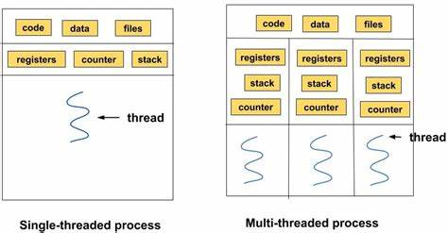

Slide 4
Pthreads refers to the POSIX standard (IEEE 1003.1c) defining an API for thread creation and synchronization.
This defines specification for thread behaviour, not an implementation.
The specification can be implemented by OS designers in any way they wish. So many systems implement the Pthreads specification; most are UNIX-type systems, including Linux, Mac OS X, and Solaris.

Slide 5
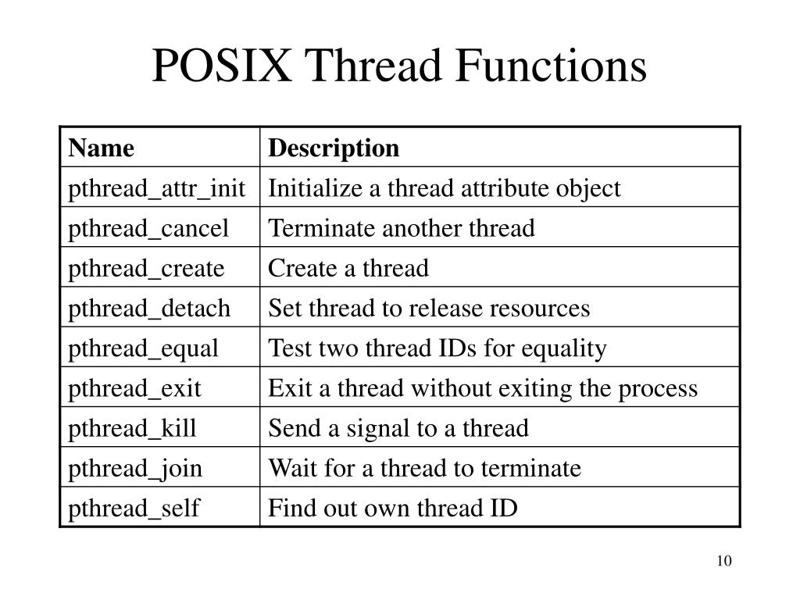

Slide 6
pthread_create - thread creation
#include <pthread.h>
int pthread_create(pthread_t *thread, const pthread_attr_t *attr,
void *(*start_routine)(void*), void *arg);
The pthread_create() function is used to create a new thread, with attributes specified by attr, within a process.
If attr is NULL, the default attributes are used.
Upon successful completion, pthread_create() stores the ID of the created thread in the location referenced by thread.
If successful, the pthread_create() function returns zero. Otherwise, an error number is returned to indicate the error.

Slide 7
The thread is created executing start_routine with arg as its sole argument.
If the start_routine returns, the effect is as if there was an implicit call to pthread_exit() using the return value of start_routine as the exit status..
On success, pthread_create() returns 0; on error, it returns an error number, and the contents of *thread are undefined

Slide 8
int pthread_join(pthread_t thread, void **retval);
The pthread_join() function waits for the thread specified by thread to terminate.
If that thread has already terminated, then pthread_join() returns immediately.
The thread specified by thread must be joinable.

Slide 9
void pthread_exit(void *retval);
The pthread_exit() function terminates the calling thread and returns a value via retval that (if the thread is joinable) is available to another thread in the same process that calls pthread_join(3).

Slide 10
#include <stdio.h>
#include <pthread.h>
// Function executed by each thread
void *printGoodMorning(void *threadId)
{ long tid = (long)threadId;
printf("Good morning from thread %ld\n", tid);
pthread_exit(NULL);
}

Slide 11
int main()
{ pthread_t threads[4];
int i;
for (i = 0; i < 4; i++)
{ int rc = pthread_create(&threads[i], NULL, printGoodMorning, (void *) i);
if (rc)
{ printf("Error creating thread %d\n", i);
return -1;
}
}

Slide 12
// Wait for all threads to finish
for (i = 0; i < 4; i++)
{ pthread_join(threads[i], NULL);
}
return 0;
}

Slide 13
Good morning from thread 0
Good morning from thread 1
Good morning from thread 2
Good morning from thread 3

Slide 14
#include <pthread.h>
#include <stdio.h>
#include <stdlib.h>
#include <unistd.h>
#include <time.h>
#define MAT_SIZE 10
#define MAX_THREADS 100

Slide 15
int i,j,k,x,y,z,a;//Parameters For Rows And Columns
int matrix1[MAT_SIZE][MAT_SIZE]; //First Matrix
int matrix2[MAT_SIZE][MAT_SIZE]; //Second Matrix
int result [MAT_SIZE][MAT_SIZE]; //Multiplied Matrix
void* mul(void*);

Slide 16
typedef struct parameters
{ int x,y;
} args;
void* mul(void*arg)
{ args* p=arg;
for(int a=0;a<j;a++)
{ result[p->x][p->y]+=matrix1[p->x][a]*matrix2[a][p->y];
}
sleep(3);
pthread_exit(0);
}

Slide 17
int main()
{ for(int x=0;x<10;x++)
{ for(int y=0;y<10;y++)
{ // matrix1[x][y] = 0;
// matrix2[x][y] = 0;
result[x][y] = 0;
}
}

Slide 18
printf("Enter number of rows for matrix 1: ");
scanf("%d",&i);
printf("Enter number of columns for matrix 1: ");
scanf("%d",&j); printf("\n --- reading Matrix 1 ---\n\n");
for(int x=0;x<i;x++)
{ for(int y=0;y<j;y++)
{ printf("Enter variable [%d,%d]: ",x+1,y+1);
scanf("%d",&matrix1[x][y]);
}
}

Slide 19
Read another matrix
Display both input matrices

Slide 20
pthread_t thread[MAX_THREADS];
int thread_number = 0;
args p[i*k];

Slide 21
for(int x=0;x<i;x++)
{ for(int y=0;y<k;y++)
{ p[thread_number].x=x;
p[thread_number].y=y;
int status;
status = pthread_create(&thread[thread_number], NULL, mul, (void *)
&p[thread_number]);
if(status!=0)
{ printf("Error In Threads");
exit(0);
}
thread_number++;
}
}

Slide 22
for(int z=0;z<(i*k);z++)
{
pthread_join(thread[z],NULL );
}

Slide 23
printf(" --- Multiplied Matrix ---\n\n");
for(int x=0;x<i;x++)
{ for(int y=0;y<k;y++)
printf("%5d",result[x][y]);
printf("\n\n");
}

Slide 24
printf(" ---> Used Threads : %d \n\n",thread_number);
for(int z=0;z<thread_number;z++)
printf(" - Thread %d ID : %d\n",z+1,(int)thread[z]);
return 0;
}

