Slide 1

Black Friday Purchases

Slide 2

Introduction
Walmart , founded in 1962 by Sam Walton , is a retail giant and one of the world's largest and most influential companies.
Headquartered in Bentonville, Arkansas , this American multinational corporation has established itself as a global powerhouse in the retail industry.
Walmart operates a vast network of hypermarkets, discount department stores, and grocery stores under various brand names across the United States and in numerous countries around the world.
Known for its "Everyday Low Prices" strategy, Walmart has redefined the retail landscape with its commitment to offering a wide range of products at affordable prices.
With its extensive supply chain and efficient distribution systems, the company has played a pivotal role in shaping consumer expectations and shopping habits. Beyond retail,
Walmart has also ventured into e-commerce, technology innovation, and sustainability initiatives, further solidifying its position as a key player in the modern retail ecosystem.

Slide 3

Objective
The objective of this project is to conduct a comprehensive analysis of customer purchase behavior, with a specific focus on purchase amounts, in relation to customer gender
During the Black Friday sales event at Walmart Inc. This study aims to provide valuable insights that can assist the management team at Walmart Inc. in making data-driven decisions.

Slide 4

Exploratory Data Analysis

Slide 5
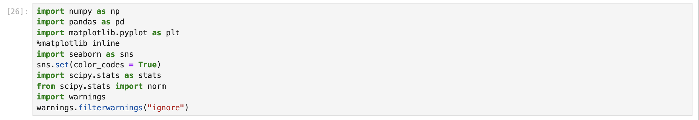
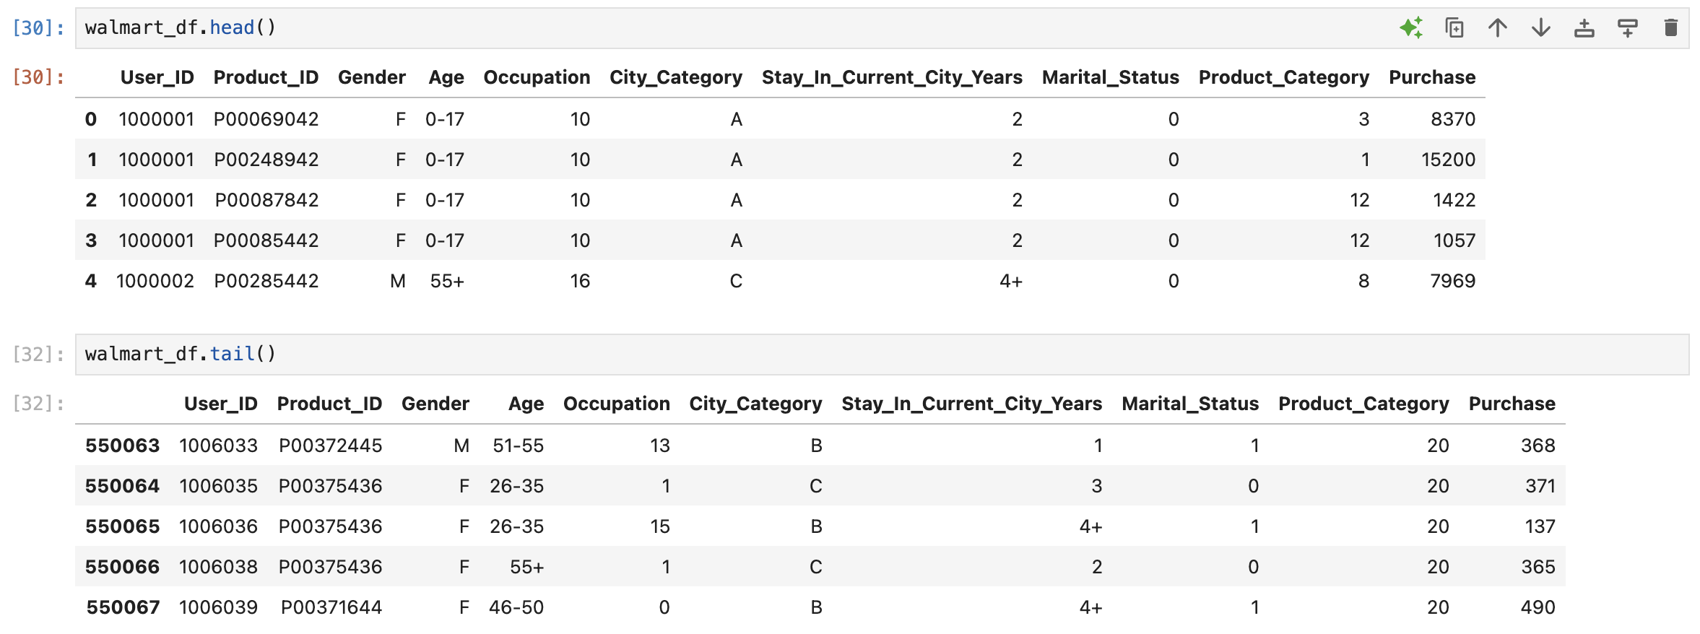

Slide 6
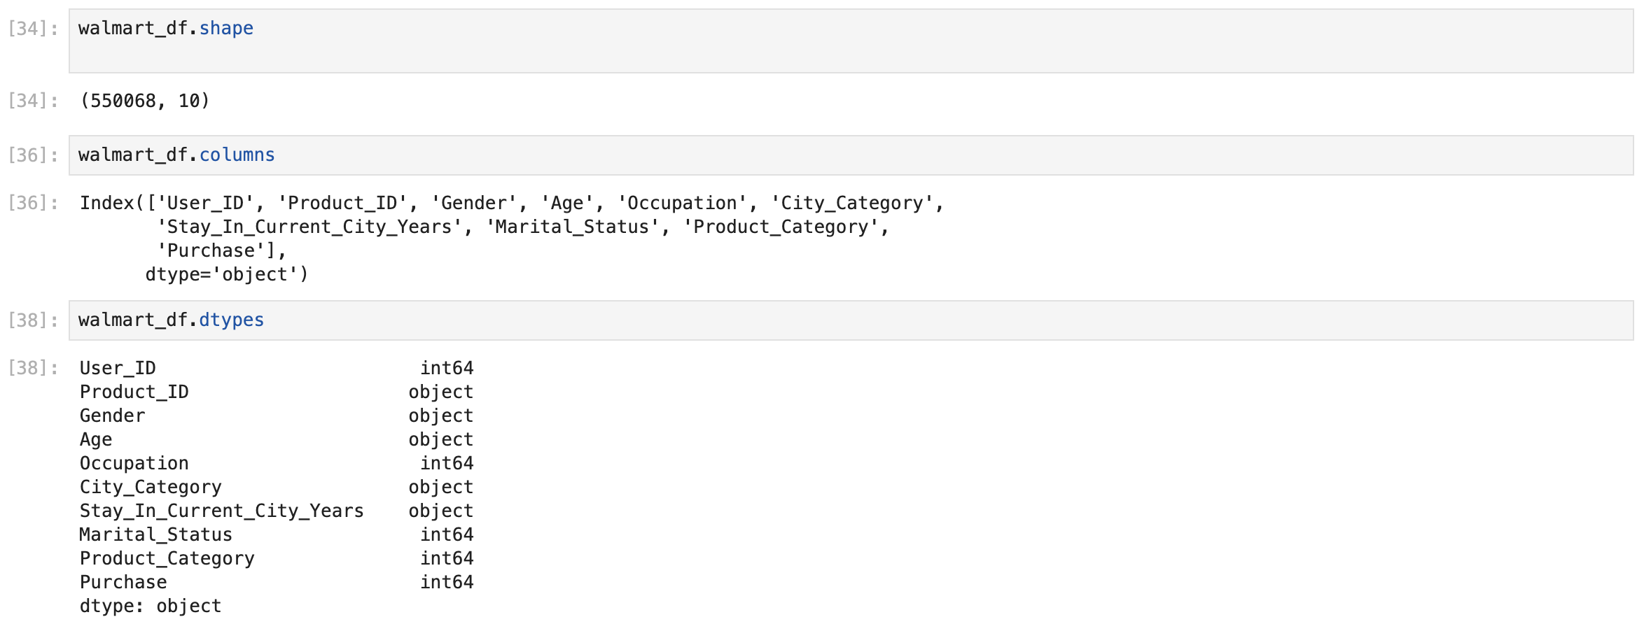

Slide 7
Insights
From the above analysis, it is clear that, data has total of 10 features with lots of mixed alpha numeric data.
Apart from Purchase Column, all the other data types are of categorical type. We will change the datatypes of all such columns to category

Slide 8
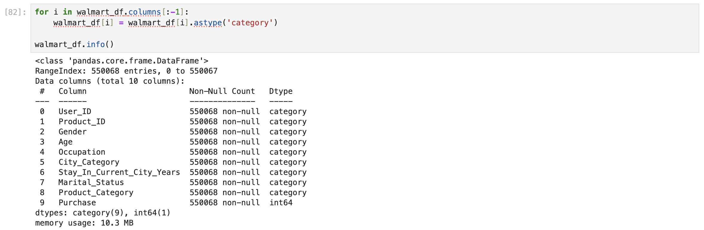
🔁 Changing the Datatype of Columns

Slide 9

Finding Unique Values and Count Them

Slide 10
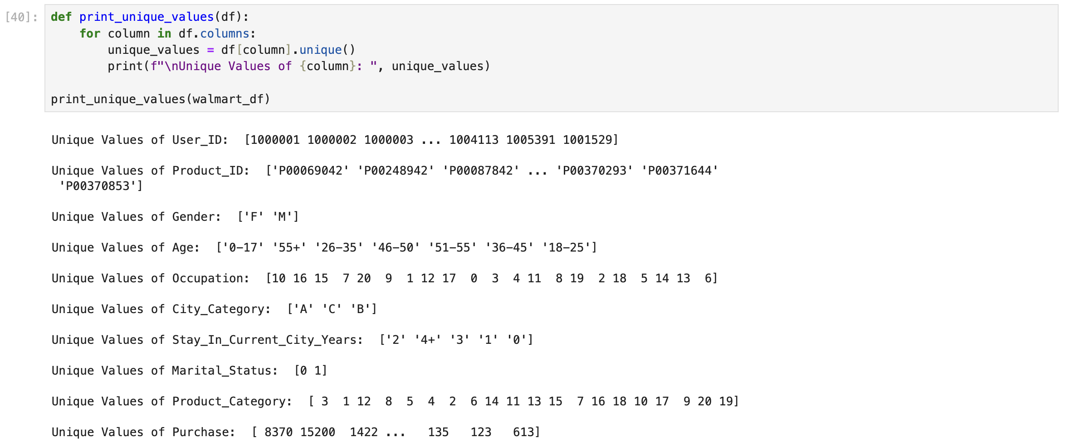

Slide 11
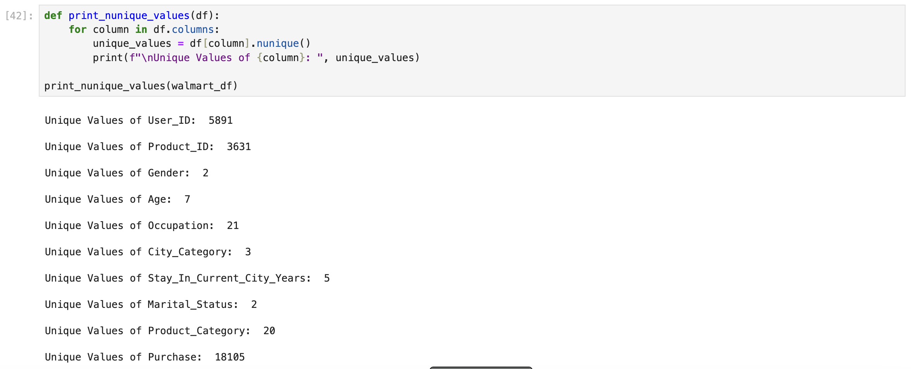

Slide 12
Data Cleaning

Slide 13
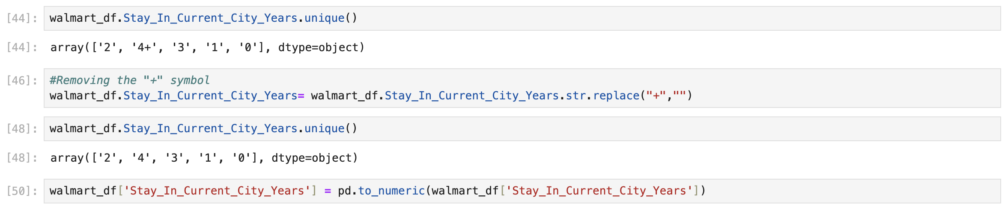

Slide 14
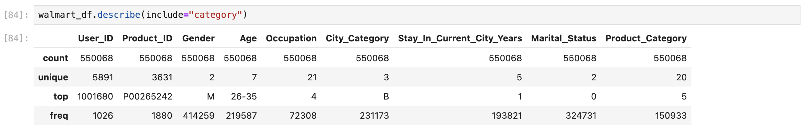
Statistical Summary

Slide 15
🔍 Insights
User_ID - Among 5,50,068 transactions there are 5891 unique user_id, indicating same customers buying multiple products.
Product_ID - Among 5,50,068 transactions there are 3631 unique products, with the product having the code P00265242 being the highest seller , with a maximum of 1,880 units sold.
Gender - Out of 5,50,068 transactions, 4,14,259 (nearly 75%) were done by male gender indicating a significant disparity in purchase behavior between males and females during the Black Friday event.
Age - We have 7 unique age groups in the dataset. 26 - 35 Age group has maximum of 2,19,587 transactions. We will analyse this feature in detail in future.
Stay_In_Current_City_Years - Customers with 1 year of stay in current city accounted to maximum of 1,93,821 transactions among all the other customers with 0,2,3,4) years of stay in current city.
Marital_Status - 59% of the total transactions were done by Unmarried Customers and 41% by Married Customers.

Slide 16

Data Visualization with Numerical Features

Slide 17
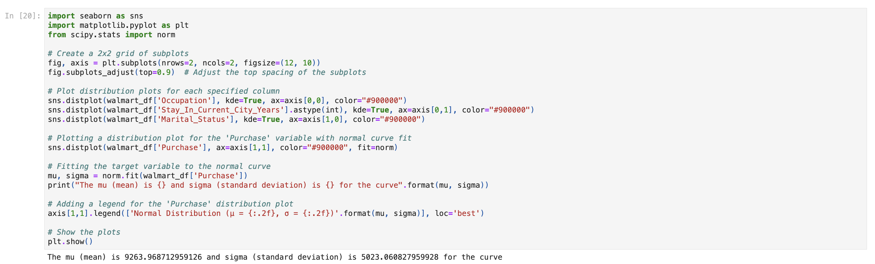

Slide 18
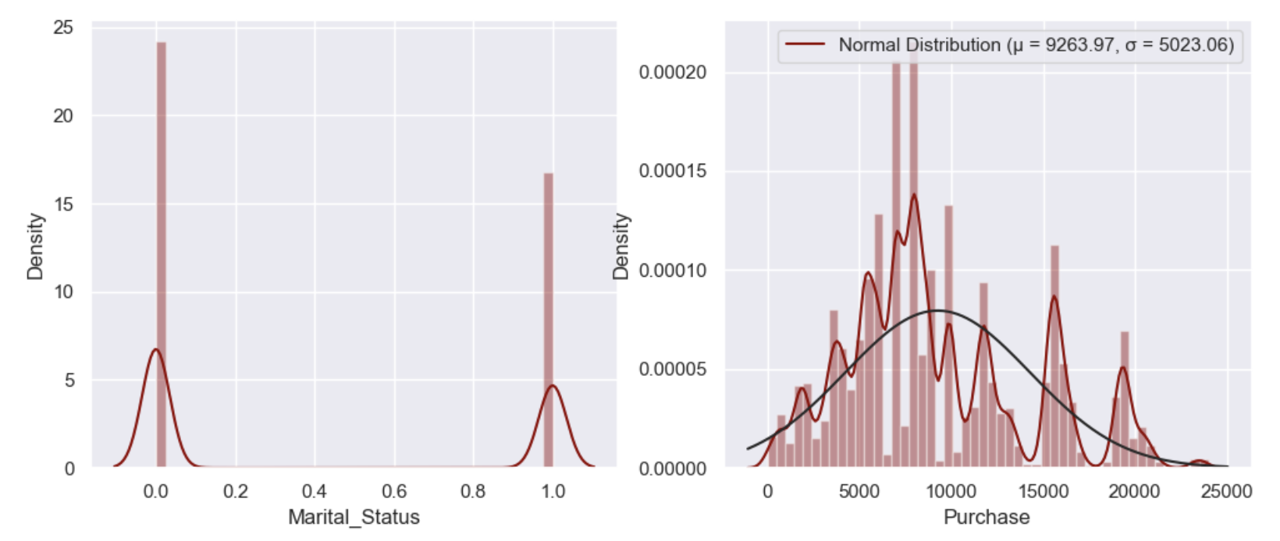

Slide 19
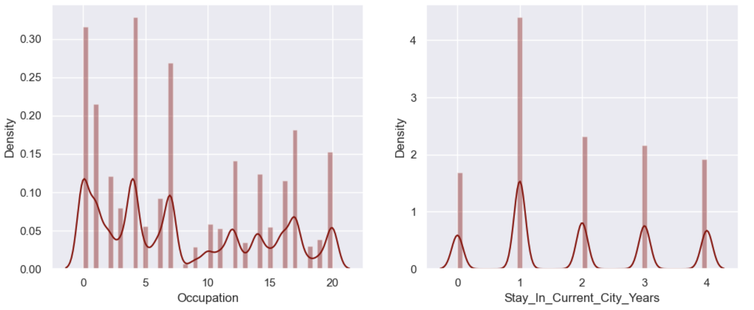

Slide 20
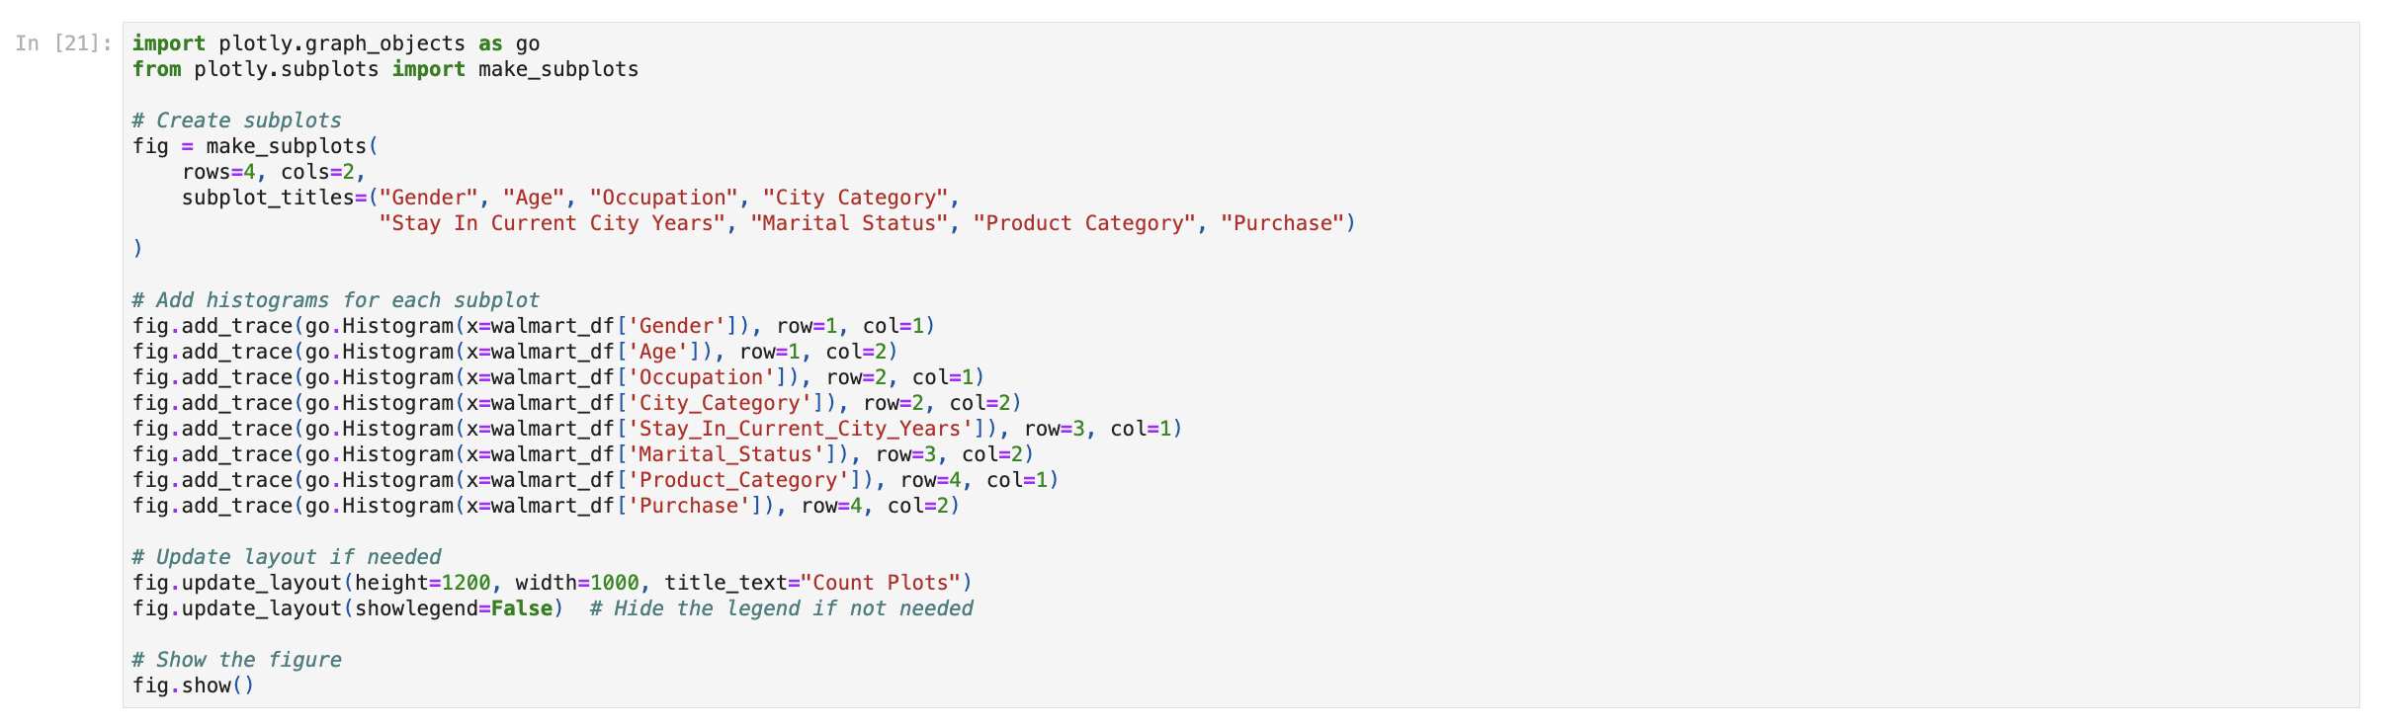

Slide 21
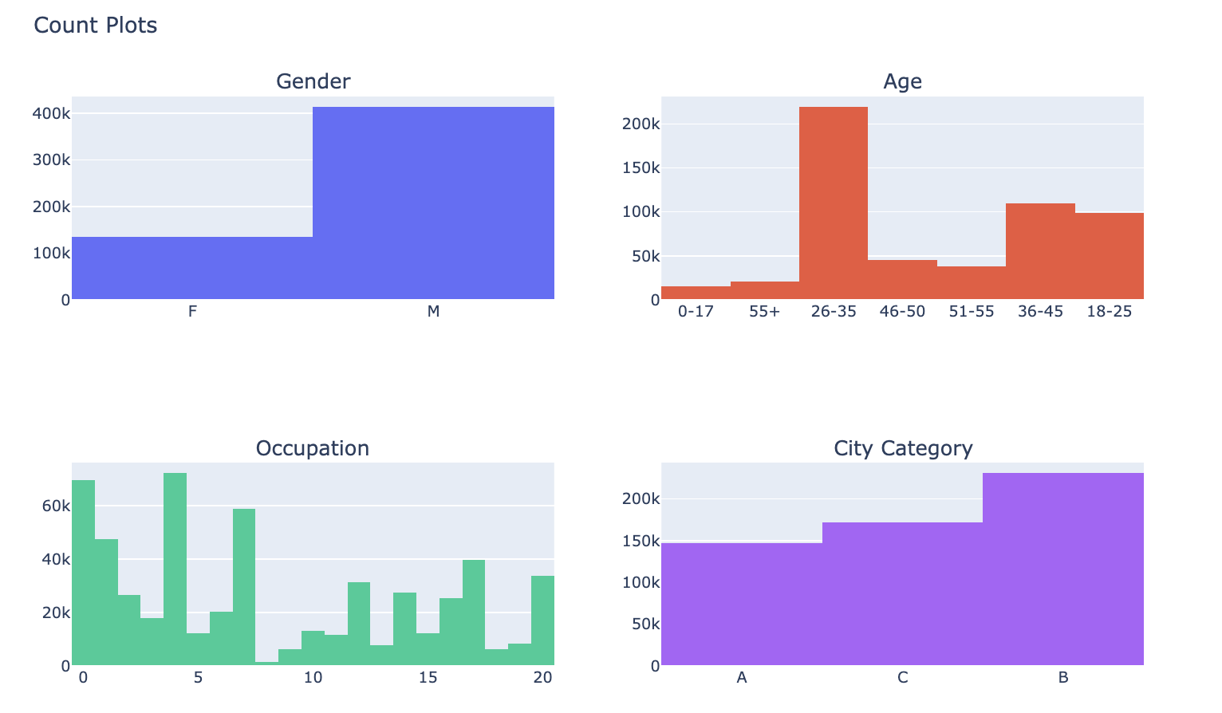

Slide 22
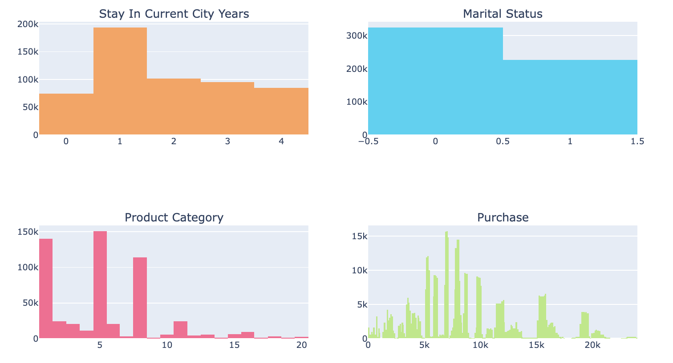

Slide 23
Observations:
Many buyers are male while the minority are female.
There are 7 categories defined to classify the age of the buyers and top 26-35 age group dominated the spending .
Majority of the buyers are single.
Occupation 8 has extremely low count compared with the others.
Majority of the products are in category 1, 5 and 8.
Higher count might represent the urban area indicates more population in City_Category.
Most buyers have one year living in the city. Remaining categories are in uniform distribution

Slide 24

THANK YOU!!!

