Slide 1
UMass Lowell Computer Science 91.503
Analysis of Algorithms
Prof. Karen Daniels
Fall, 2006
Lecture 1 (Part 3)
Design Patterns for Optimization Problems
Dynamic Programming & Greedy Algorithms

Slide 2
Dynamic Programming Approach to Optimization Problems
Characterize structure of an optimal solution.
Recursively define value of an optimal solution.
Compute value of an optimal solution in bottom-up fashion.
Construct an optimal solution from computed information.
source: 91.503 textbook Cormen, et al.

Slide 3
Dynamic Programming
Matrix Parenthesization

Slide 4
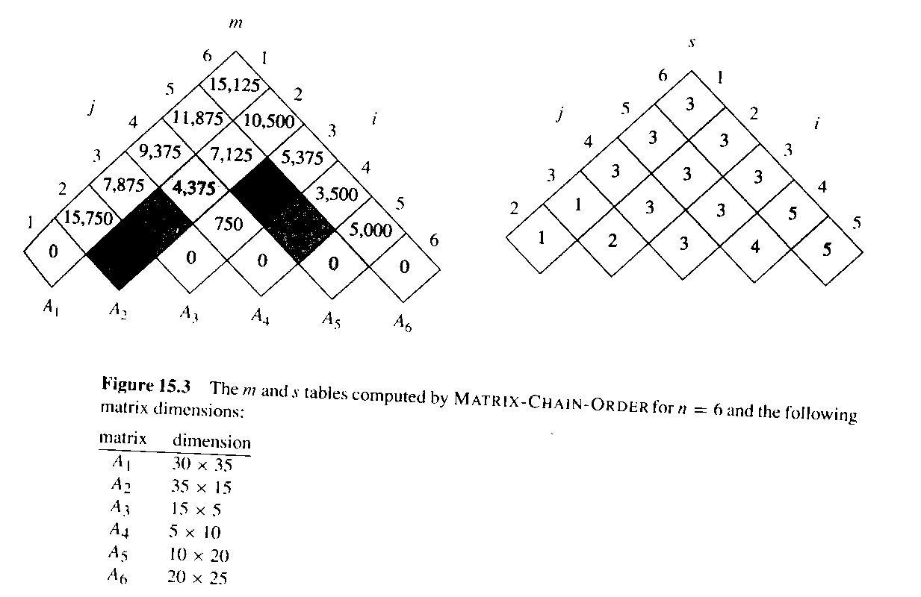
Example: Matrix Parenthesization Definitions
Given “chain” of n matrices: <A₁, A₂, … A_{n}, >
Compute product A₁A₂… A_{n} efficiently
  Minimize “cost” = number of scalar multiplications
Multiplication order matters!
source: 91.503 textbook Cormen, et al.

Slide 5
Example: Matrix Parenthesization
Step 1: Characterizing an Optimal Solution
Observation:
  Any parenthesization of A_{i}A_{i+1}… A_{j} must split it between A_{k} and A_{k+1} for some k.
THM: Optimal Matrix Parenthesization:
  If an optimal parenthesization of A_{i}A_{i+1}… A_{j} splits at k, then
  parenthesization of prefix A_{i}A_{i+1}… A_{k} must be an optimal parenthesization.
Why?
If existed less costly way to parenthesize prefix, then substituting that parenthesization would yield less costly way to parenthesize A_{i}A_{i+1}… A_{j} , contradicting optimality of that parenthesization.
common DP proof technique:
“cut-and-paste” proof by contradiction
source: 91.503 textbook Cormen, et al.

Slide 6
Example: Matrix Parenthesization
Step 2: A Recursive Solution
Recursive definition of minimum parenthesization cost:
0 if i = j
m[i,j]=
min{m[i,k] + m[k+1,j] + p_{i-1}p_{k}p_{j}} if i < j
i <= k < j
How many distinct subproblems?
each matrix A_{i} has dimensions p_{i-1} x p_{i}
source: 91.503 textbook Cormen, et al.

Slide 7
Example: Matrix Parenthesization
Step 3: Computing Optimal Costs
2,500
2,625
1,000
0
s: value of k that achieves optimal cost in computing m[i, j]
source: 91.503 textbook Cormen, et al.

Slide 8
Example: Matrix Parenthesization
Step 4: Constructing an Optimal Solution
PRINT-OPTIMAL-PARENS(s, i, j)
if i = j
then print “A”_{i}
else print “(“
PRINT-OPTIMAL-PARENS(s, i, s[i, j])
PRINT-OPTIMAL-PARENS(s, s[i, j]+1, j)
print “)“
source: 91.503 textbook Cormen, et al.

Slide 9
Dynamic Programming
Longest Common Subsequence
Notes:
I joined the UMass Lowell Computer Science faculty this summer. This collection of slides is intended to familiarize the reader/viewer with my field of research (Computational Geometry), summarize my previous research results in this field and outline my plan for Computational Geometry research at UMass Lowell.

Slide 10
Example: Longest Common Subsequence (LCS): Motivation
Strand of DNA: string over finite set {A,C,G,T}
  each element of set is a base: adenine, guanine, cytosine or thymine
Compare DNA similarities
S₁ = ACCGGTCGAGTGCGCGGAAGCCGGCCGAA
S₂ = GTCGTTCGGAATGCCGTTGCTCTGTAAA
One measure of similarity:
  find the longest string S₃ containing bases that also appear (not necessarily consecutively) in S₁ and S₂
  S₃ = GTCGTCGGAAGCCGGCCGAA
source: 91.503 textbook Cormen, et al.

Slide 11










Example: LCS
Definitions
source: 91.503 textbook Cormen, et al.
Sequence is a subsequence of if (strictly increasing indices of X) such that
  example: is subsequence of with index sequence
Z is common subsequence of X and Y if Z is subsequence of both X and Y
  example:
    common subsequence but not longest
    common subsequence. Longest?
Longest Common Subsequence Problem: Given 2 sequences X, Y, find maximum-length common subsequence Z.

Slide 12







Example: LCS
Step 1: Characterize an LCS
THM 15.1: Optimal LCS Substructure
Given sequences:
For any LCS of X and Y:
1 if then and Z_{k-1} is an LCS of X_{m-1} and Y_{n-1}
2 if then Z is an LCS of X_{m-1} and Y
3 if then Z is an LCS of X and Y_{n-1}
source: 91.503 textbook Cormen, et al.

Slide 13



Example: LCS
Step 2: A Recursive Solution (continued)
source: 91.503 textbook Cormen, et al.
Overlapping subproblem structure:
Recurrence for length of optimal solution:
Θ(mn) distinct subproblems
0 if i=0 or j=0
c[i,j]= c[i-1,j-1]+1 if i,j > 0 and x_{i}=y_{j}
max(c[i,j-1], c[i-1,j]) if i,j > 0 and x_{i}=y_{j}
Conditions of problem can exclude some subproblems!

Slide 14
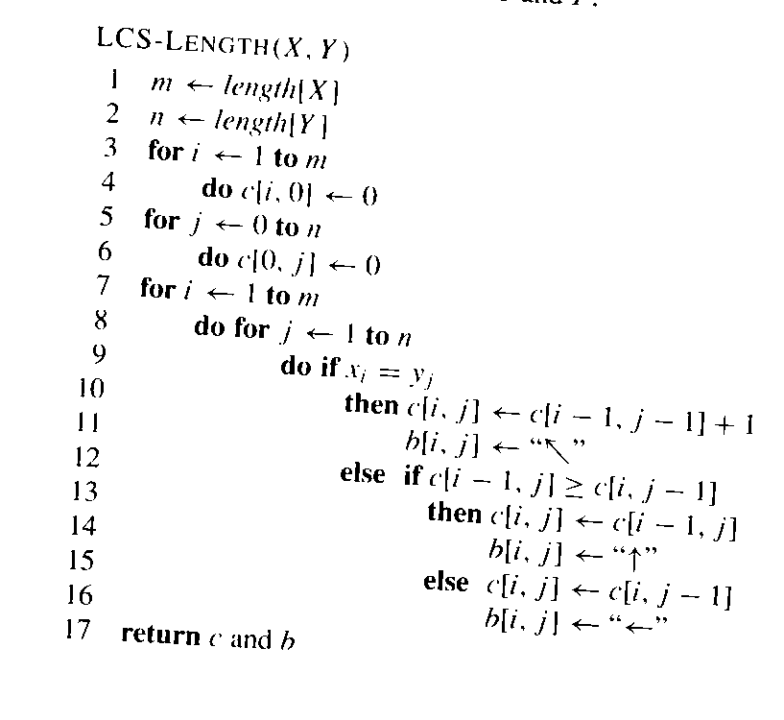
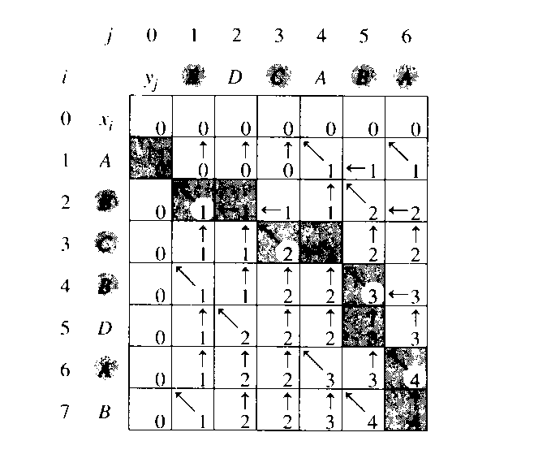
Example: LCS
Step 3: Compute Length of an LCS
What is the asymptotic worst-case time complexity?
B
C
B
A
0
B
1
C
2
B
3
A
4
c table
(represent b table)
source: 91.503 textbook Cormen, et al.

Slide 15
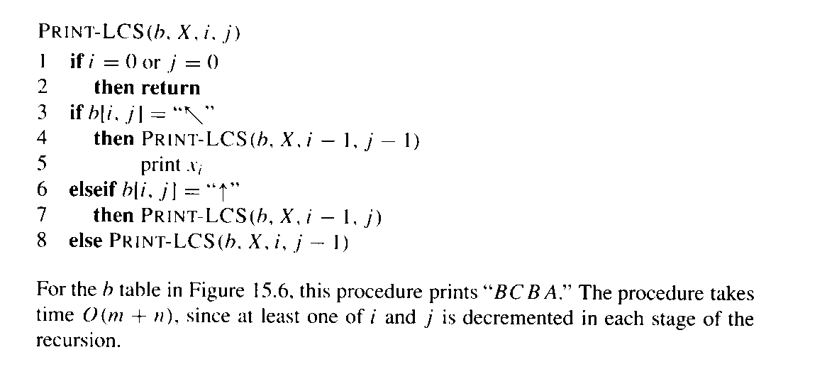
Example: LCS
Step 4: Construct an LCS
source: 91.503 textbook Cormen, et al.

Slide 16
Example: LCS
Improve the Code
source: 91.503 textbook Cormen, et al.
Can eliminate b table
  c[i,j] depends only on 3 other c table entries:
    c[i-1,j-1] c[i-1,j] c[i,j-1]
    given value of c[i,j], can pick the one in O(1) time
    reconstruct LCS in O(m+n) time similar to PRINT-LCS
    same Θ(mn) space, but Θ(mn) was needed anyway...
  Asymptotic space reduction
    leverage: need only 2 rows of c table at a time
      row being computed
      previous row
    can also do it with ~ space for 1 row of c table
      but does not preserve LCS reconstruction data

Slide 17
Dynamic Programming
Activity Selection
Notes:
I joined the UMass Lowell Computer Science faculty this summer. This collection of slides is intended to familiarize the reader/viewer with my field of research (Computational Geometry), summarize my previous research results in this field and outline my plan for Computational Geometry research at UMass Lowell.

Slide 18
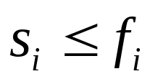
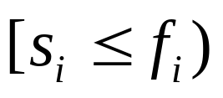
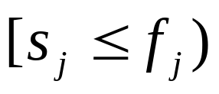
Activity Selection
Optimization Problem
Problem Instance:
  Set S = {1,2,...,n} of n activities
  Each activity i has:
    start time: s_{i}
    finish time : f_{i}
  Activities i, j are compatible iff non-overlapping:
  Objective:
    select a maximum-sized set of mutually compatible activities
source: 91.503 textbook Cormen, et al.

Slide 19
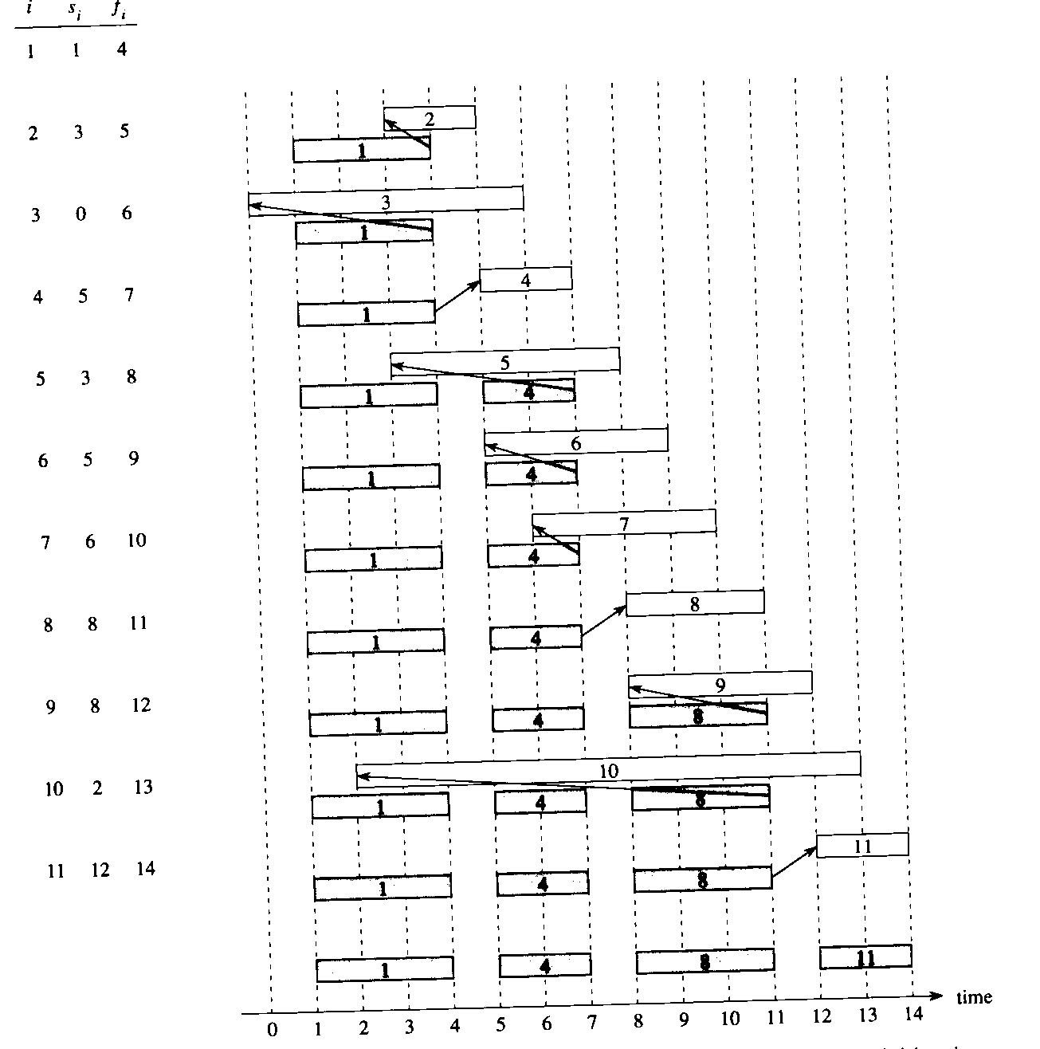
source: 91.503 textbook Cormen, et al.

Slide 20
Algorithmic Progression
“Brute-Force”
  (board work)
Dynamic Programming #1
  Exponential number of subproblems
  (board work)
Dynamic Programming #2
  Quadratic number of subproblems
  (board work)
Greedy Algorithm
  (board work: next week)

