Slide 1
Divide-and-Conquer
General idea:
Divide a problem into subprograms of the same kind; solve subprograms using the same approach, and combine partial solution (if necessary).
Young
CS 331 D&A of Algo.
Topic: Divide and Conquer

Slide 2

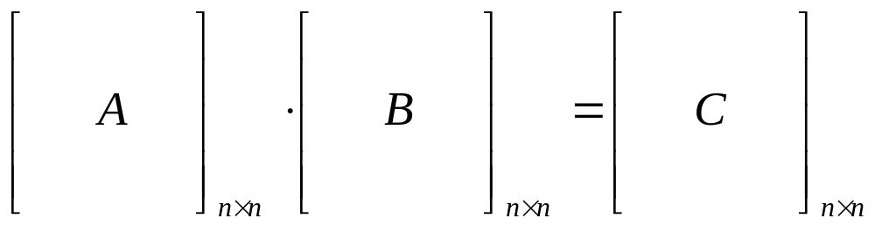
2. Matrix multiplication
The problem:
Multiply two matrices A and B, each of size
Young
CS 331 D&A of Algo.
Topic: Divide and Conquer

Slide 3
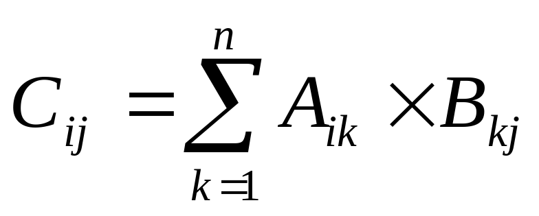
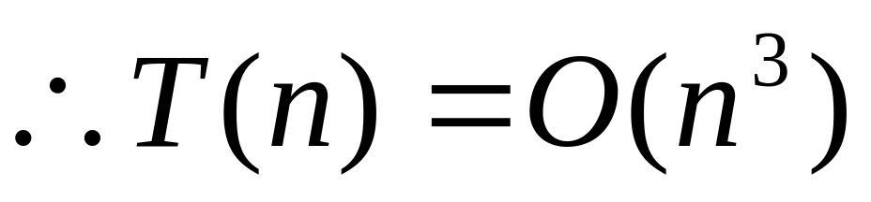
The traditional way:
use three for-loop
Young
CS 331 D&A of Algo.
Topic: Divide and Conquer

Slide 4
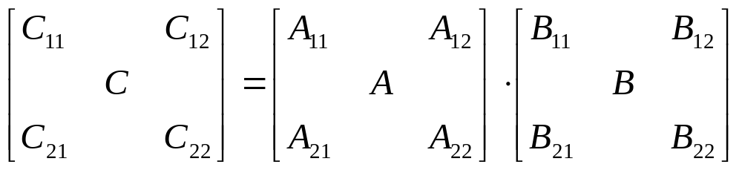
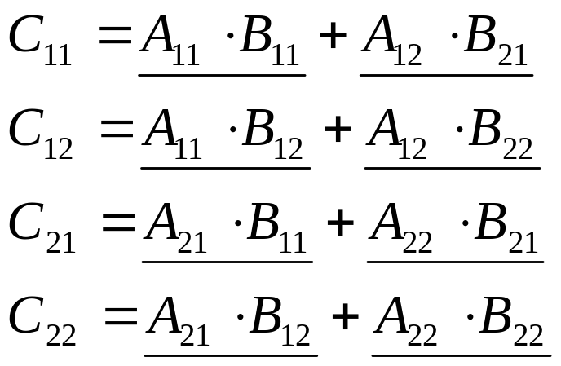
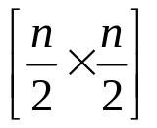
The Divide-and-Conquer way:
transform the problem of multiplying A and B, each of size [n×n] into 8 subproblems, each of size
Young
CS 331 D&A of Algo.
Topic: Divide and Conquer

Slide 5
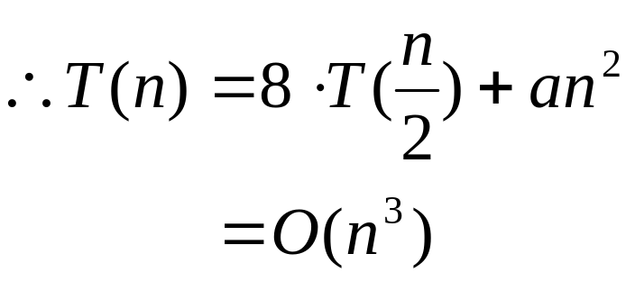
which an² is for addition
so, it is no improvement compared with the traditional way
Young
CS 331 D&A of Algo.
Topic: Divide and Conquer

Slide 6
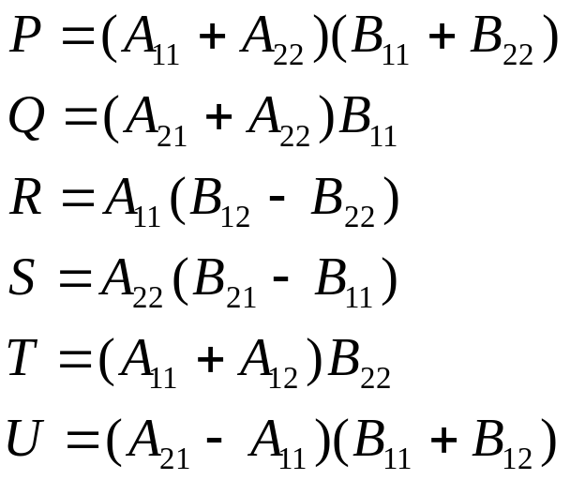
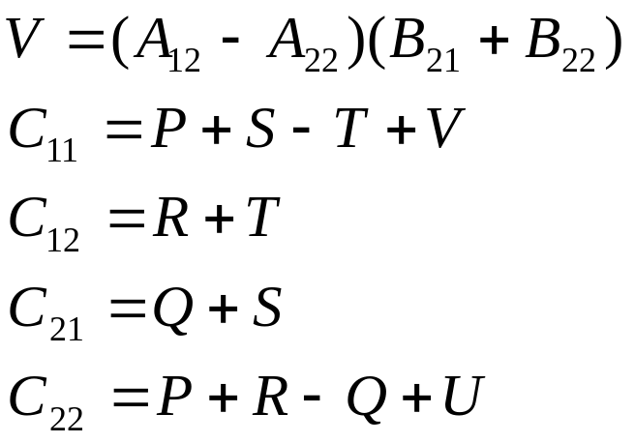
Strassen’s matrix multiplication:
• Discover a way to compute the C_{ij}’s using 7 multiplications and 18 additions or subtractions
Young
CS 331 D&A of Algo.
Topic: Divide and Conquer

Slide 7
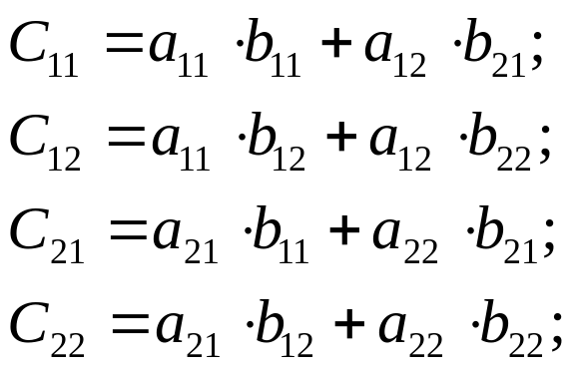
Algorithm :
Strassen (n, A, B, C) // n is size, A,B the input matrices, C output matrix
begin
if n = 2,
else
(cont.)
Topic: Divide and Conquer

Slide 8


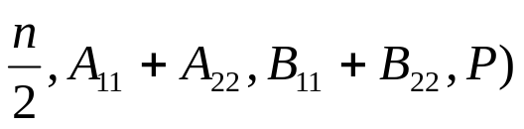
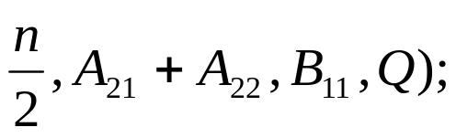
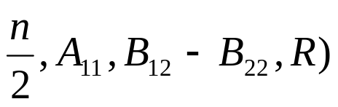
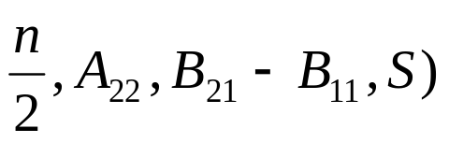
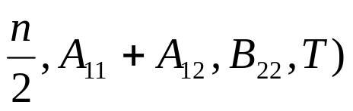
else
Partition A into 4 submatrices: ;
Partition B into 4 submatrices: ;
call Strassen ( ;
call Strassen (
call Strassen ( ;
call Strassen ( ;
call Strassen ( ;
Topic: Divide and Conquer

Slide 9
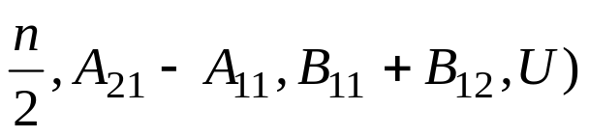
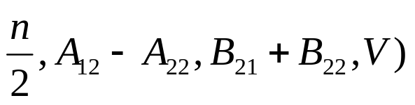
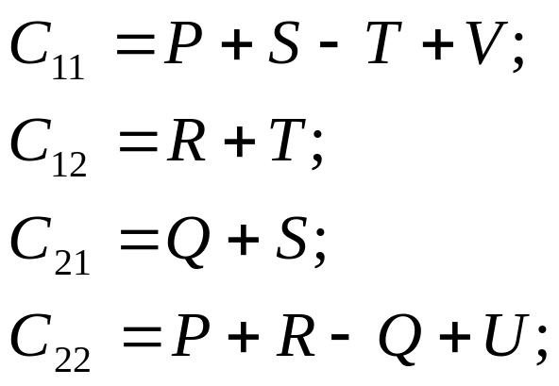
call Strassen ( ;
call Strassen ( ;
end;
Topic: Divide and Conquer

Slide 10
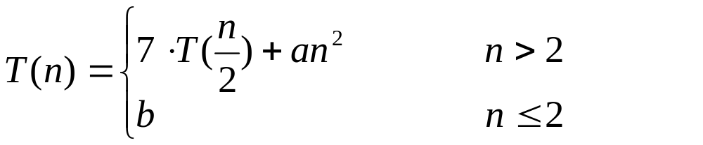
Analysis:
Young
CS 331 D&A of Algo.
Topic: Divide and Conquer

