Slide 1
Chapter 2: DBMS Architecture

Slide 2
Client/Server Architecture
A client module is typically designed so that it will run on a user workstation or personal computer
A server module, typically handles data storage, access, search, and other functions.

Slide 3
Data Abstraction
It means suppression of details of data organization and storage, and highlighting of the essential features for an improved understanding of data.
Data model: a collection of concepts that can be used to describe the structure of a database to achieve the data abstraction
The structure of a database includes data types, relationships, and constraints that apply to the data.

Slide 4
Data Models: Categories
High Level or Conceptual Data Model
  close to the way many users perceive data
Representational (or implementation) data models
  Provide concepts that may be easily understood by end users
  Hides many details of data storage on disk but can be implemented on a computer system directly.
Low Level or Physical Data Model
  Describes the details of how data is stored on the computer storage media

Slide 5
Conceptual Data Model
Use concepts such as entities, attributes, and relationships.
Entity: An entity represents a real-world object or concept described in the database
Attribute: An attribute represents some property of interest that further describes an entity
Relationship: A relationship among two or more entities represents an association among the entities
Entity-Relationship (ER) model: a popular high-level conceptual data model

Slide 6
Representational or implementation data models
Include the widely used relational data model, as well as the so-called legacy data models (the network and hierarchical models)
Representational data models represent data by using record structures and hence are sometimes called record-based data models.
Object Data Management Group (ODMG) Object data model is a higher-level implementation data models that are closer to conceptual data models.

Slide 7
Physical Data Models
Describe how data is stored as files in the computer by representing information such as record formats, record orderings, and access paths
Access path: is a structure that makes the search for particular database records efficient.
Index: index is an example of an access path that allows direct access to data using an index term or a keyword

Slide 8
Schema, Instances & Database State
Schema: The description of a database is called the database schema, which is specified during database design and is not expected to change frequently
Database State: The data in the database at a particular moment in time is called a database state or snapshot. It is also called the current set of occurrences or instances in the database
The schema is sometimes called the intension, and a database state is called an extension of the schema.

Slide 9
Three Schema Architecture
The internal level has an internal schema, which describes the physical storage structure of the database. The internal schema uses a physical data model and describes the complete details of data storage and access paths for the database.
The conceptual level has a conceptual schema, which describes the structure of the whole database for a community of users. The conceptual schema hides the details of physical storage structures and concentrates on describing entities, data types, relationships, user operations, and constraints.

Slide 10
Three Schema Architecture Contd...
The external or view level includes a number of external schemas or user views. Each external schema describes the part of the database that a particular user group is interested in and hides the rest of the database from that user group.

Slide 11
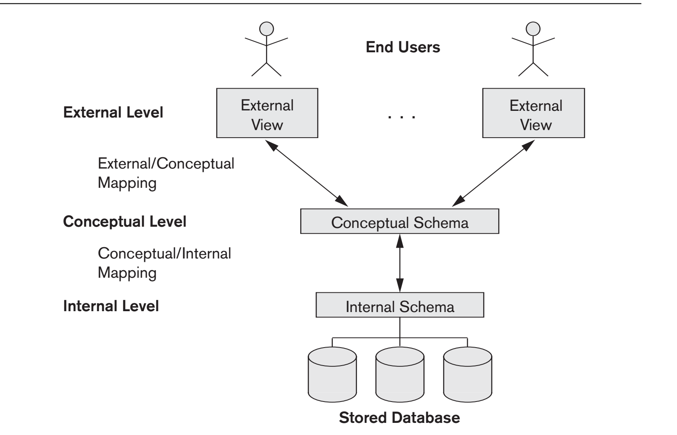
Three Schema Architecture
The processes of transforming requests and results between levels are called mappings.

Slide 12
Data Independance
It is defined as the capacity to change the schema at one level of a database system without having to change the schema at the next higher level.
Logical data independence: is the capacity to change the conceptual schema without having to change external schemas or application programs.
Physical data independence: is the capacity to change the internal schema without having to change the conceptual schema. Hence, the external schemas need not be changed as well.

Slide 13
Database Languages and Interfaces
Data Definition Language (DDL)
  used by the DBA and by database designers to define conceptual and internal schemas
  DDL compiler is used to process DDL statements in order to identify descriptions of the schema constructs and to store the schema description in the DBMS catalog.
Storage Definition Language (SDL)
  used to specify the internal schema
  DDL is used to specify the conceptual schema

Slide 14
Database Languages and Interfaces Contd...
View definition language (VDL)
  Needed to specify user views and their mappings to the conceptual schema
  In RDBMS, SQL is used in the role of VDL to define user or application views as results of predefined queries
Data manipulation language (DML)
  DBMS provides a set of operations to perform the typical manipulations including retrieval, insertion, deletion, and modification of the data
  Low-level DMLs are also called record-at-a-time ypically retrieves individual records or objects from the database and processes each separately.

Slide 15
Database Languages and Interfaces Contd...
Highlevel DMLs
  can retrieve many records in a single DML statement; therefore, they are called set-at-a-time or set-oriented DMLs
Declarative Languages
  A query in a high-level DML often specifies which data to retrieve rather than how to retrieve it; therefore, such languages are also called declarative.
Note: DML commands, whether high level or low level, are embedded in a general-purpose programming language, that language is called the host language and the DML is called the data sublanguage

Slide 16
DBMS Interfaces
Menu-Based Interfaces for Web Clients or Browsing
Forms-Based Interfaces
Graphical User Interfaces:
  A GUI typically displays a schema to the user in diagrammatic form. The user then can specify a query by manipulating the diagram
Natural Language Interfaces:
  These interfaces accept requests written in English or some other language and attempt to understand them.

Slide 17
DBMS Interfaces Contd...
Speech Input and Output
  Limited use of speech as an input query and speech as an answer to a question or result of a request is becoming commonplace
  Applications with limited vocabularies such as inquiries for telephone directory, flight arrival/departure, and credit card account information are allowing speech for input and output to enable customers to access this information.
Interfaces for Parametric Users.
  Parametric users, such as bank tellers, often have a small set of operations that they must perform repeatedly.
  function keys in a terminal can be programmed to initiate various commands which reduces the number of keystrokes for parameteric users
Interfaces for the DBA.
  Contain privileged commands that can be used only by the DBA staff. These include commands for creating accounts, setting system parameters, granting account authorization, changing a schema, and reorganizing the storage structures of a database

Slide 18
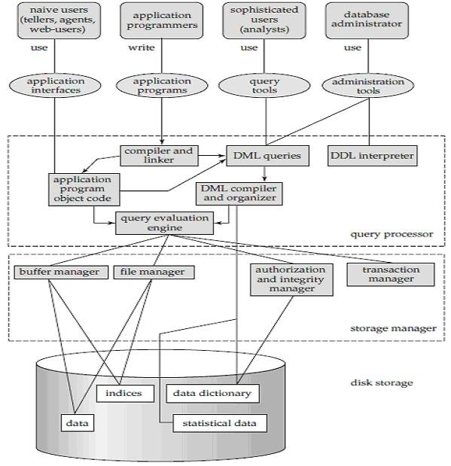

Slide 19
MY NOTES:-
SDLC(Software Development Life Cycle) – Analysis(understanding requirements), Design(includes database design), Coding, Testing.
Conceptual SCHEMA- who’s data(entity), relevant data(attribute), what type of relationship, what constraints will be there = All sum together we can say that we have to build ER model.
Internal SCHEMA- structure of DBMS i.e.; how data will be used.
Data Independence- Changing one level in such a way that we don’t have to change other levels(higher levels).
Differentiate High level DMLs and Low level DMLs?

Slide 20
(L3)MY NOTES:-
ENTITY is generally like objects of OOPs.
ENTITY TYPE(represented by rectangle) is generally like class of OOPs. Also called entity set.
1st design of DBMS is designing of ER model
Prepare Attributes for MCQs
  Attributes representation in ER diagram– simple, single, stored are represented by single oval; composite is represented by hierarchical oval; derived is by dotted-oval and multi-valued by double oval.
  In SCHEMA multivalued is represented by {} and component of composite attribute by ().
  Key attribute(which is unique and can’t be left blank) are represented by underline.
  A single attribute cannot be attached to any other attribute but only with entity.
  SSN(Social Security no.) as Aadhar card in India which is unique no.

Slide 21
Entity are of two types:
  Strong Entity – having key attribute. E.g.
  Weak Entity – no key attribute. E.g.
Recursive relationship is important for short ques/ans
No entity type can exists with no attribute.

Slide 22
SQL
Fixed length record system – char
Variable length record system – varchar, varchar2
F-read and F-write is used to read/write in binary format ( encrypted format we cannot see ) in c language.
C
SQL is a query language which is used to manage relational database as per American National Standard Institute (ANSI) .
CONSTRAINTS – 1) Column level constraints
        2) Table level constraints

