Slide 1
Mapping Cardinality
Mapping cardinalities, or cardinality ratios, express the number of entities to which another entity can be associated via a relationship set.
One-to-one: An entity in A is associated with at most one entity in B, and an entity in B is associated with at most one entity in A.
One-to-many. An entity in A is associated with any number (zero or more) of entities in B. An entity in B, however, can be associated with at most one entity in A
Many-to-one. An entity in A is associated with at most one entity in B. An entity in B, however, can be associated with any number (zero or more) of entities in A.
Many-to-many. An entity in A is associated with any number (zero or more) of entities in B, and an entity in B is associated with any number (zero or more) of entities in A

Slide 2
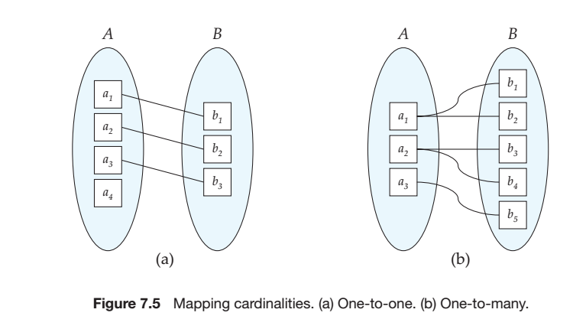
Mapping Cardinalities

Slide 3
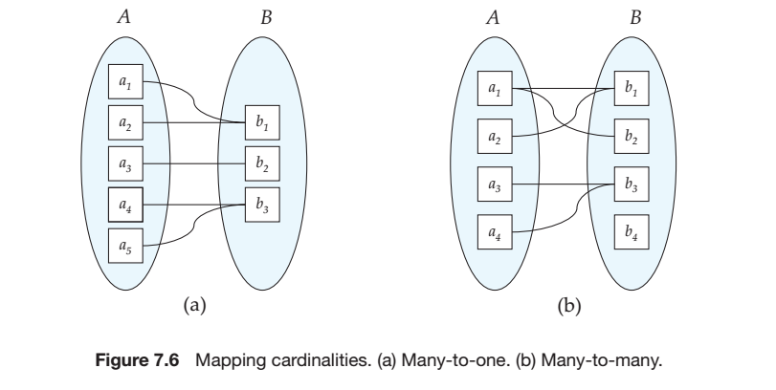
Mapping Cardinalities

Slide 4
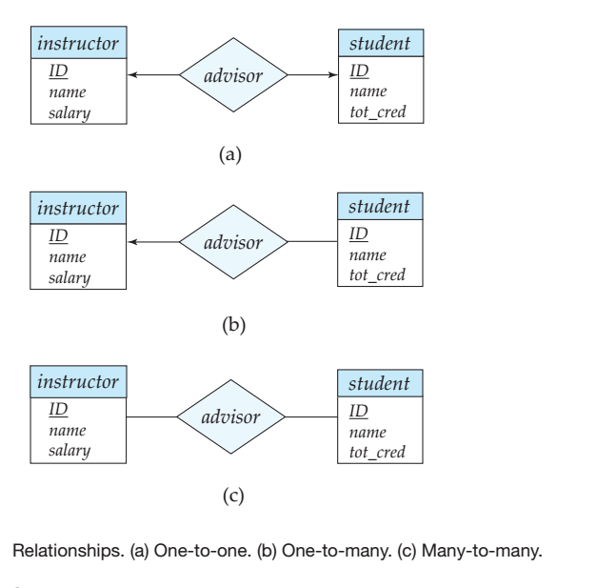

Slide 5
Keys
The values of the attribute values of an entity must be such that they can uniquely identify the entity
No two entities in an entity set are allowed to have exactly the same value for all attributes
Keys also help to identify relationships uniquely, and thus distinguish relationships from each other

Slide 6
Keys Contd...
A superkey is a set of one or more attributes that, taken collectively, allow us to identify uniquely a tuple in the relation.
Candidate Keys: A superkey may contain extraneous attributes. The superkeys for which no proper subset (minimal super key) is a superkey.
Primary key: It is used to denote a candidate key that is chosen by the database designer as the principal means of identifying tuples within a relation.
Foreign Key: A relation, say r 1 , may include among its attributes the primary key of another relation, say r 2 . This attribute is called a foreign key from r 1 , referencing r 2 . The relation r 1 is also called the referencing relation of the foreign key dependency, and r 2 is called the referenced relation of the foreign key.

Slide 7
Referential Integrity
A referential integrity constraint requires that the values appearing in specified attributes of any tuple in the referencing relation also appear in specified attributes of at least one tuple in the referenced relation.

