Slide 1
Extended ER-Diagram

Slide 2
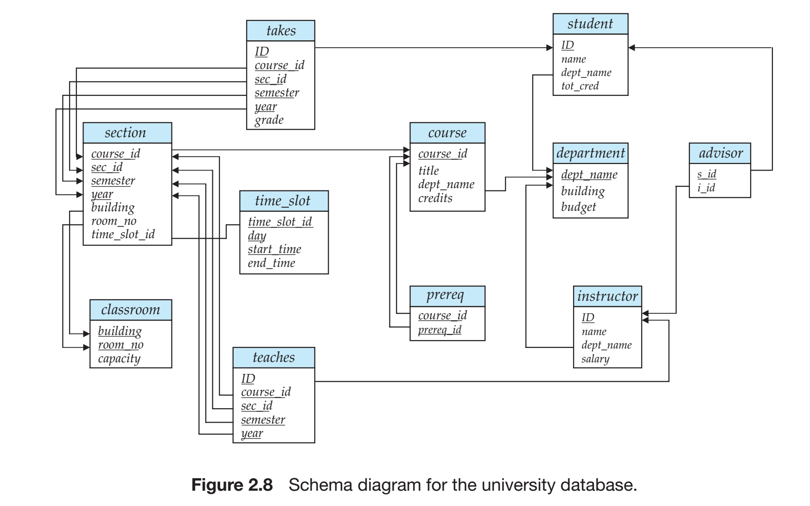

Slide 3
Specialization
The process of designating subgroupings within an entity set is called specialization.
The specialization of person allows us to distinguish among person entities according to whether they correspond to employees or students: in general, a person could be an employee, a student, both, or neither
An entity set may be specialized by more than one distinguishing feature.
It can be overlapping as well as disjoint
The specialization relationship may also be
referred to as a superclass-subclass relationship

Slide 4
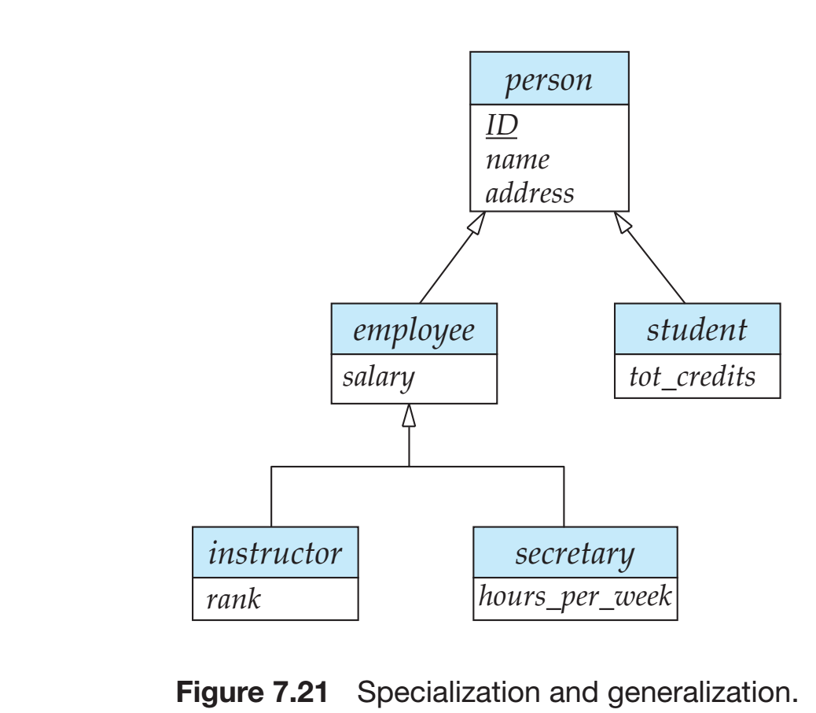

Slide 5
Generalisation
The process in which multiple entity sets are synthesized into a higher-level entity set on the basis of common features.
It is a containment relationship that exists between a higher-level entity set and one or more lower-level entity sets
n our example, employee is the higher-level entity set and instructor and secretary are lower-level entity sets. In this case, attributes that are conceptually the same had different names in the two lower-level entity sets.
To create a generalization, the attributes must be given a common name and represented with the higher-level entity person.

Slide 6
Generalization Contd ...
Higher- and lower-level entity sets also may be designated by the terms superclass and subclass, respectively.
The person entity set is the superclass of the employee and student subclasses.

Slide 7
Constraints on Generalizations
Condition-defined. In condition-defined lower-level entity sets, membership is evaluated on the basis of whether or not an entity satisfies an explicit condition or predicate.
For example, assume that the higher-level entity set student has the attribute student type.
Since all the lower-level entities are evaluated on the basis of the same attribute (in this case, on student type), this type of generalization is said to be attribute-defined

Slide 8
Completeness Constraint
Total generalization or specialization: Each higher-level entity must belong to a lower-level entity set.
Partial generalization or specialization. Some higher-level entities may not belong to any lower-level entity set.

Slide 9
Constraints on Generalizations Contd...
User-defined. User-defined lower-level entity sets are not constrained by a membership condition; rather, the database user assigns entities to a given entity set.
A second type of constraint relates to whether or not entities may belong to more than one lower-level entity set within a single generalization
  Disjoint, Overlapping

Slide 10
Constraints on Generalizations Contd...
Total generalization or specialization. Each higher-level entity must belong to a lower-level entity set.
Partial generalization or specialization. Some higher-level entities may not belong to any lower-level entity set.

Slide 11
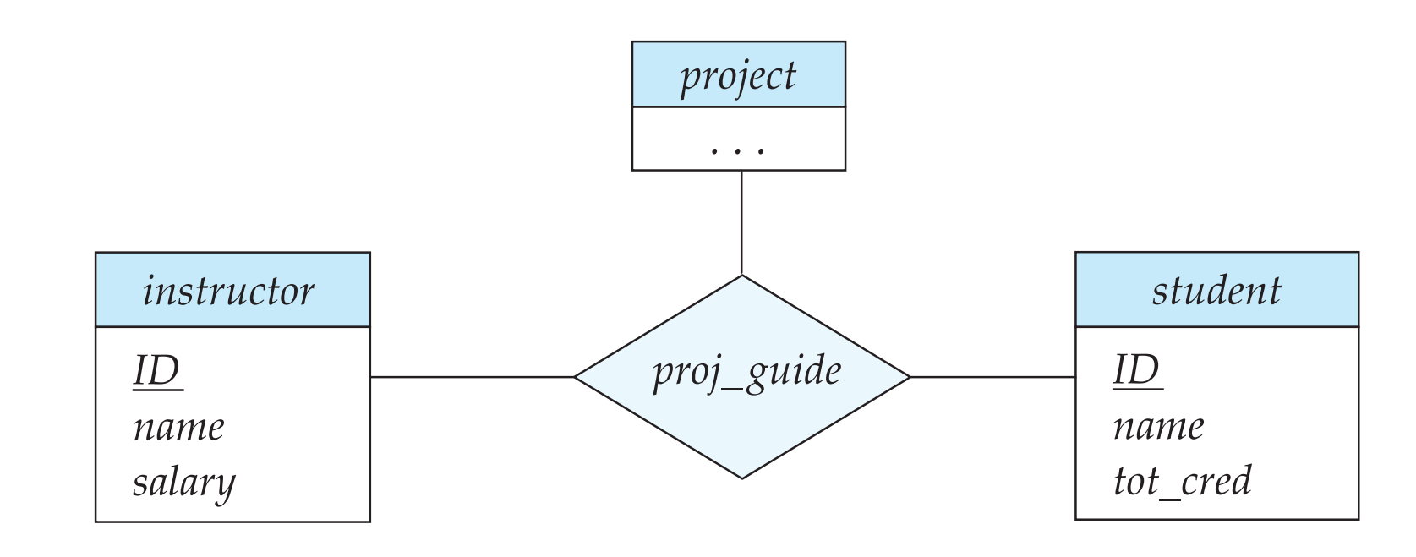
Aggregation
One limitation of the E-R model is that it cannot express relationships among relationships.

Slide 12
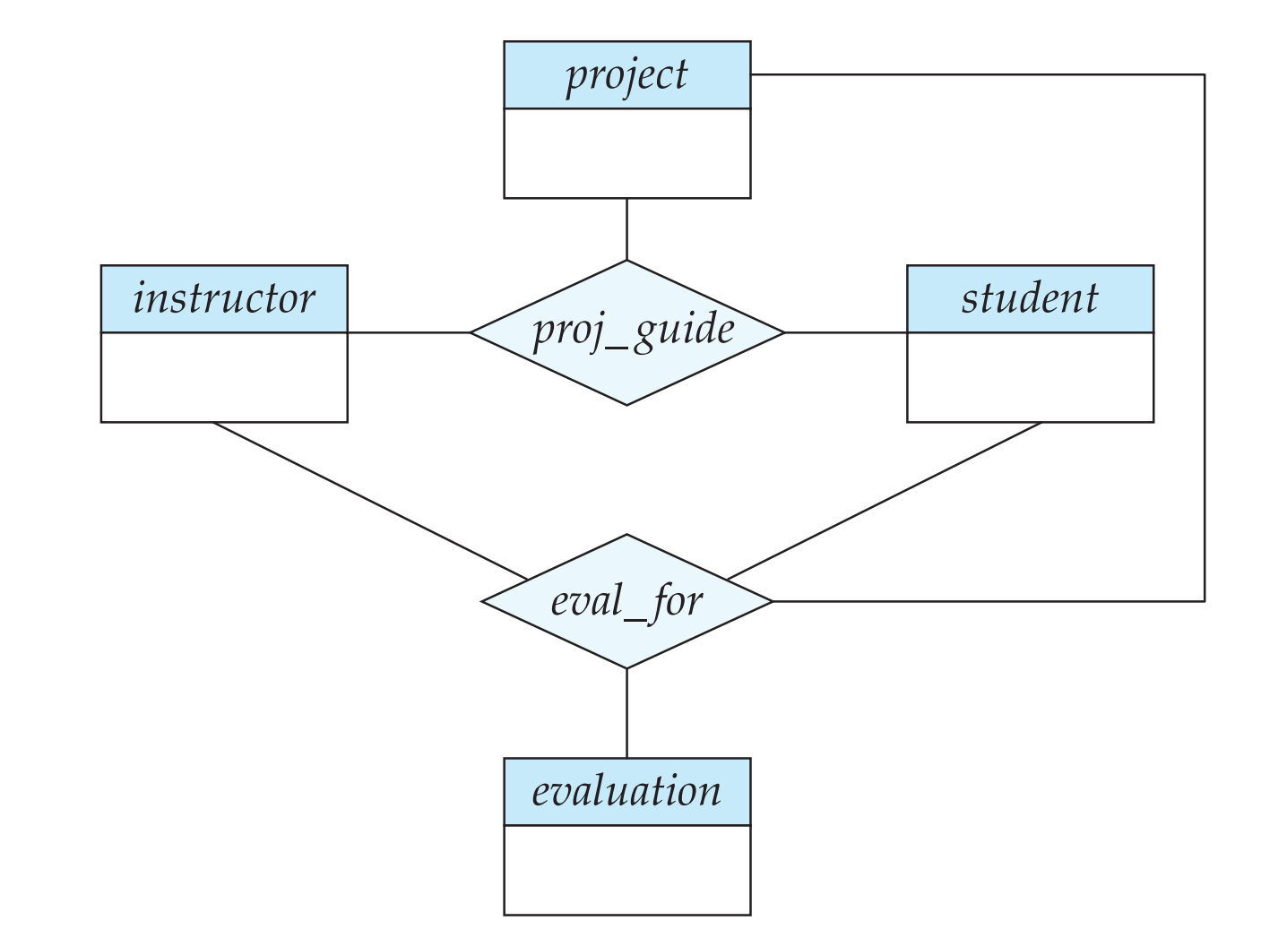

Slide 13
