Slide 1
Lecture 3
Arrays, Classes & Methods in Java
Vijay Kumar Dwivedi

Slide 2
Motivation
How to organize 100 Student objects?
100 different Student object names?
Organize data for efficient access
  Class: different data types in one object
  Array: multiple objects of the same type

Slide 3
Overview
An array
  a single name for a collection of data values
  all of the same data type
  subscript notation to identify one of the values
A carryover from earlier programming languages
More than a primitive type, less than an object
  like objects when used as method parameters and return types
  do not have or use inheritance
Accessing each of the values in an array
  Usually a for loop

Slide 4
Creating Arrays
General syntax for declaring an array:
Base_Type[] Array_Name = new Base_Type[Length];
Examples:
80-element array with base type char:
char[] symbol = new char[80];
100-element array of doubles:
double[] reading = new double[100];
70-element array of Species:
Species[] specimen = new Species[70];

Slide 5
Three Ways to Use [ ] (Brackets) with an Array Name
Declaring an array: int[] pressure
  creates a name of type "int array"
  types int and int[] are different
    int[]: type of the array
    int : type of the individual values
To create a new array, e.g. pressure = new int[100];
To refer to a specific element in the array
- also called an indexed variable, e.g.
pressure[3] = 10;
System.out.println("You entered" + pressure[3]);

Slide 6
Three Ways to Use [ ] (Brackets) with an Array Name
Declaring an array: int[] pressure
  creates a name of type "int array"
  types int and int[] are different
    int[]: type of the array
    int : type of the individual values
To create a new array, e.g. pressure = new int[100];
To refer to a specific element in the array
- also called an indexed variable, e.g.
pressure[3] = 10;
System.out.println("You entered" + pressure[3]);

Slide 7
Some Array Terminology
Array name
temperature[n + 2]
temperature[n + 2]
temperature[n + 2]
temperature[n + 2] = 32;
Index - also called a subscript
- must be an int,
- or an expression that evaluates to an int
Indexed variable - also called an element or subscripted variable
Value of the indexed variable
- also called an element of the array
Note that "element" may refer to either a single indexed variable in the array or the value of a single indexed variable.

Slide 8
Array Length
Specified by the number in brackets when created with new
  maximum number of elements the array can hold
  storage is allocated whether or not the elements are assigned values
the attribute length,
Species[] entry = new Species[20];
      System.out.println(entry.length);
The length attribute is established in the declaration and cannot be changed unless the array is redeclared

Slide 9
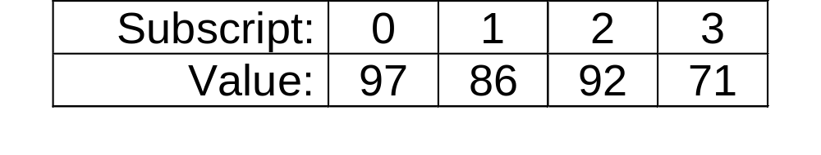
Subscript Range
Array subscripts use zero-numbering
  the first element has subscript 0
  the second element has subscript 1
  etc. - the n^{th} element has subscript n-1
  the last element has subscript length-1
For example: an int array with 4 elements

Slide 10
Subscript out of Range Error
Using a subscript larger than length-1 causes a run time (not a compiler) error
  an ArrayOutOfBoundsException is thrown
    you do not need to catch it
    you need to fix the problem and recompile your code
Other programming languages, e.g. C and C++, do not even cause a run time error!
  one of the most dangerous characteristics of these languages is that they allow out of bounds array indices.

Slide 11
Array Length Specified at Run-time
// array length specified at compile-time
int[] array1 = new int[10];
// array length specified at run-time
// calculate size…
int size = …;
int[] array2 = new int[size];

Slide 12
Programming Tip:
Use Singular Array Names
Using singular rather than plural names for arrays improves readability
Although the array contains many elements the most common use of the name will be with a subscript, which references a single value.
It is easier to read:
  score[3] than
  scores[3]

Slide 13
Initializing an Array's Values in Its Declaration
can be initialized by putting a comma-separated list in braces
Uninitialized elements will be assigned some default value, e.g. 0 for int arrays (explicit initialization is recommended)
The length of an array is automatically determined when the values are explicitly initialized in the declaration
For example:
  double[] reading = {5.1, 3.02, 9.65};
  System.out.println(reading.length);
  - displays 3, the length of the array reading

Slide 14
Initializing Array Elements in a Loop
A for loop is commonly used to initialize array elements
For example:
  int i;//loop counter/array index
  int[] a = new int[10];
  for(i = 0; i < a.length; i++)
  a[i] = 0;
  note that the loop counter/array index goes from 0 to length - 1
  it counts through length = 10 iterations/elements using the zero-numbering of the array index
Programming Tip:
Do not count on default initial values for array elements
  explicitly initialize elements in the declaration or in a loop

Slide 15
Arguments for the Method main
The heading for the main method shows a parameter that is an array of Strings:
public static void main(String[] arg)
When you run a program from the command line, all words after the class name will be passed to the main method in the arg array.
java TestProgram Josephine Student
The following main method in the class TestProgram will print out the first two arguments it receives:
In this example, the output from the command line above will be:
Hello Josephine Student
Public static void main(String[] arg)
{
System.out.println(“Hello “ + arg[0] + “ “ + arg[1]);
}

Slide 16
Using = with Array Names:
Remember They Are Reference Types
int[] a = new int[3];
int[] b = new int[3];
for(int i=0; i < a.length; i++)
a[i] = i;
b = a;
System.out.println(a[2] + " " + b[2]);
a[2] = 10;
System.out.println(a[2] + " " + b[2]);
The output for this code will be:
2 2
10 10
This does not create a copy of array a;
it makes b another name for array a.
A value changed in a
is the same value obtained with b

Slide 17
Using == with array names: remember they are reference types
a and b are both
3-element arrays of ints
int i;
int[] a = new int[3];
int[] b = new int[3];
for(i=0; i < a.length; i++)
a[i] = 0;
for(i=0; i < b.length; i++)
b[i] = 0;
if(b == a)
System.out.println("a equals b");
else
System.out.println("a does not equal b");
all elements of a and b are assigned the value 0
tests if the addresses of a and b are equal, not if the array values are equal
The output for this code will be " a does not equal b" because the addresses of the arrays are not equal.

Slide 18
Behavior of Three Operations
 | Primitive Type | Class Type | Entire Array | Array Element
Assignment (=) | Copy content | Copy address | Copy address | Depends on primitive/ class type
Equality (==) | Compare content | Compare address | Compare address | Depends on primitive/ class type
Parameter Passing | Pass by value (content) | Pass by reference (address) | Pass by reference (address) | Depends on primitive/ class type

Slide 19
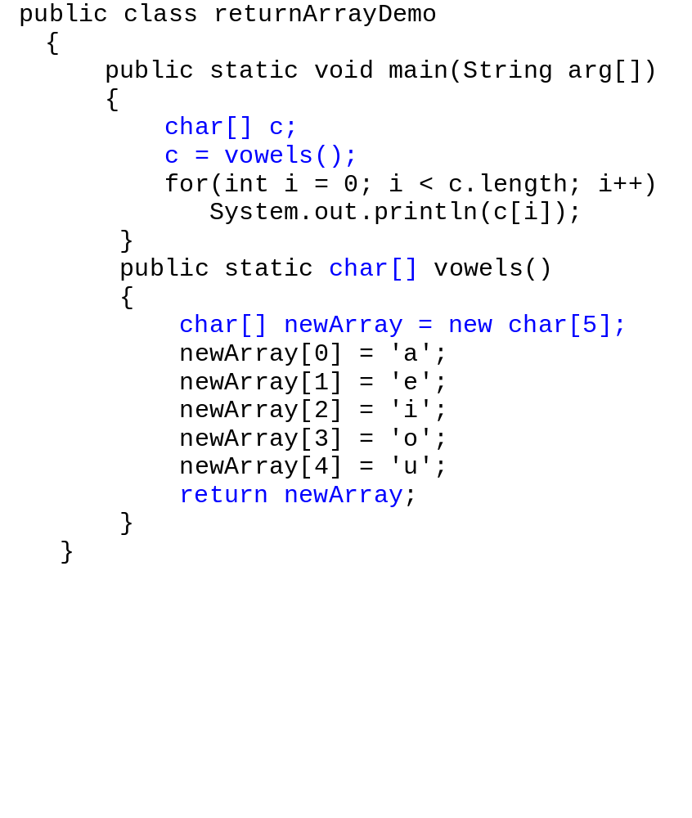
Methods that Return an Array
the address of the array is passed
The local array name within the method is just another name for the original array
c, newArray, and the return type of vowels are
all the same type: char []

Slide 20
Searching an Array
There are many techniques for searching an array for a particular value
Sequential search:
  start at the beginning of the array and proceed in sequence until either the value is found or the end of the array is reached*
    if the array is only partially filled, the search stops when the last meaningful value has been checked
  it is not the most efficient way
  but it works and is easy to program
* Or, just as easy, start at the end and work backwards toward the beginning

Slide 21
Sorting an Array
Sorting a list of elements is another very common problem (along with searching a list)
  sort numbers in ascending order
  sort numbers in descending order
  sort strings in alphabetic order
  etc.
There are many ways to sort a list, just as there are many ways to search a list
Selection sort
  one of the easiest
  not the most efficient, but easy to understand and program

Slide 22
Selection Sort Algorithm for an Array of Integers
To sort an array on integers in ascending order:
Find the smallest number and record its index
swap (interchange) the smallest number with the first element of the array
  the sorted part of the array is now the first element
  the unsorted part of the array is the remaining elements
repeat Steps 2 and 3 until all elements have been placed
  each iteration increases the length of the sorted part by one

Slide 23
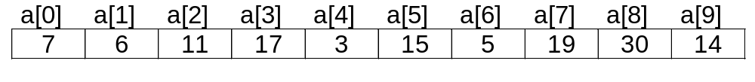
Selection Sort Example
Key:
smallest remaining value
sorted elements
Problem: sort this 10-element array of integers in ascending order:
1st iteration: smallest value is 3, its index is 4, swap a[0] with a[4]
before:
after:
2nd iteration: smallest value in remaining list is 5, its index is 6, swap a[1] with a[6]
How many iterations are needed?
Chapter 10
Java: an Introduction to Computer Science & Programming - Walter Savitch

Slide 24
Example: Selection Sort
Notice the precondition: every array element has a value
may have duplicate values
broken down into smaller tasks
  "find the index of the smallest value"
  "interchange two elements"
  private because they are helper methods (users are not expected to call them directly)

Slide 25
Bubble Sort
Basic Idea:
  Expand the sorted portion one by one
  “Sink” the largest element to the bottom after comparing adjacent elements
  The smaller items “bubble” up
Algorithm:
  While the unsorted portion has more than one element
    Compare adjacent elements
    Swap elements if out of order
    Largest element at the bottom, reduce the unsorted portion by one

Slide 26
Bubble Sort: An example
First Iteration:
  [5, 3], 4, 9, 2 → [3, 5], 4, 9, 2
  3, [5, 4], 9, 2 → 3, [4, 5], 9, 2
  3, 4, [5, 9], 2 → 3, 4, [5, 9], 2
  3, 4, 5, [9, 2] → 3, 4, 5, [2, 9]
Second Iteration:
  [3, 4], 5, 2, 9 → [3, 4], 5, 2, 9
  3, [4, 5], 2, 9 → 3, [4, 5], 2, 9
  3, 4, [5, 2], 9 → 3, 4, [2, 5], 9
Third Iteration:
  [3, 4], 2, 5, 9 → [3, 4], 2, 5, 9
  3, [4, 2], 5, 9 → 3, [2, 4], 5, 9
Fourth Iteration:
  [3, 2], 4, 5, 9 → [2, 3], 4, 5, 9

Slide 27
Multidimensional Arrays
Arrays with more than one index
  number of dimensions = number of indexes
Arrays with more than two dimensions are a simple extension of two-dimensional (2-D) arrays
A 2-D array corresponds to a table or grid
  one dimension is the row
  the other dimension is the column
  cell: an intersection of a row and column
  an array element corresponds to a cell in the table

Slide 28
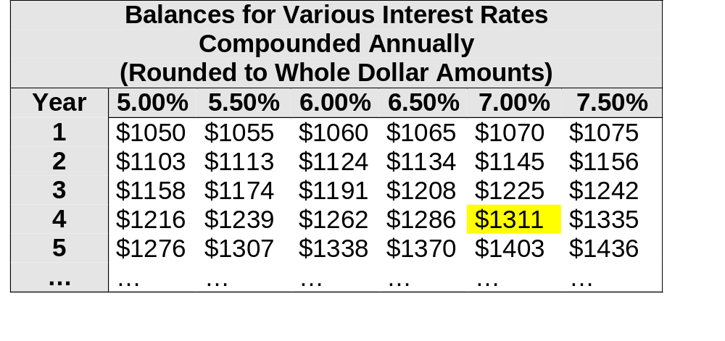
Table as a 2-Dimensional Array
The table assumes a starting balance of $1000
First dimension: row identifier - Year
Second dimension: column identifier - percentage
Cell contains balance for the year (row) and percentage (column)
Balance for year 4, rate 7.00% = $1311
Chapter 11
Java: an Introduction to Computer Science & Programming - Walter Savitch

Slide 29
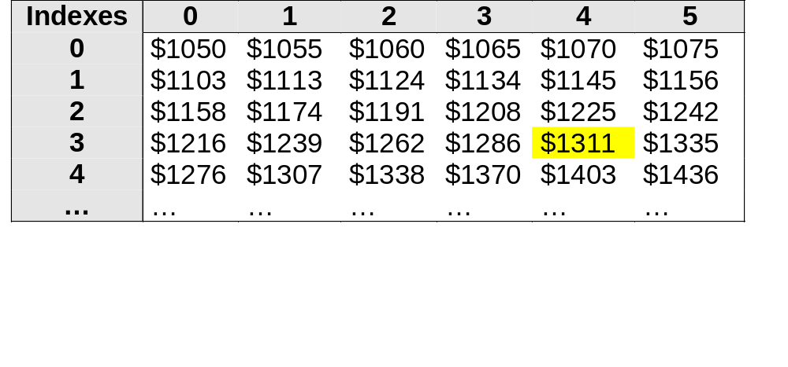
Table as a 2-D Array
Column Index 4
(5th column)
Row Index 3
(4th row)
Generalizing to two indexes: [row][column]
First dimension: row index
Second dimension: column index
Cell contains balance for the year/row and percentage/column
All indexes use zero-numbering
  Balance[3][4] = cell in 4th row (year = 4) and 5th column (7.50%)
  Balance[3][4] = $1311 (shown in yellow)
Chapter 11
Java: an Introduction to Computer Science & Programming - Walter Savitch

Slide 30
Java Code to Create a 2-D Array
Syntax for 2-D arrays is similar to 1-D arrays
Declare a 2-D array of ints named table
  the table should have ten rows and six columns
  int[][] table = new int[10][6];

Slide 31
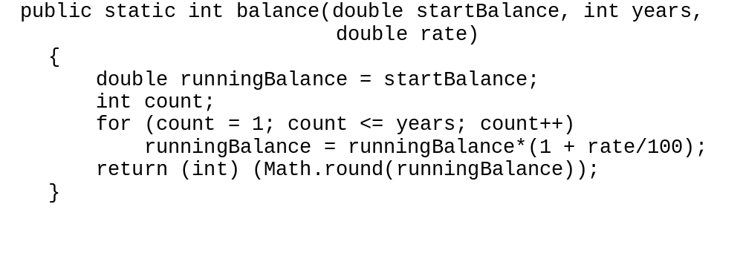
Method to Calculate the Cell Values
balance(starting, years, rate) = (starting) x (1 + rate)^{years}
The repeated multiplication by (1 + rate) can be done in a for loop that repeats years times.
balance method in class InterestTable

Slide 32
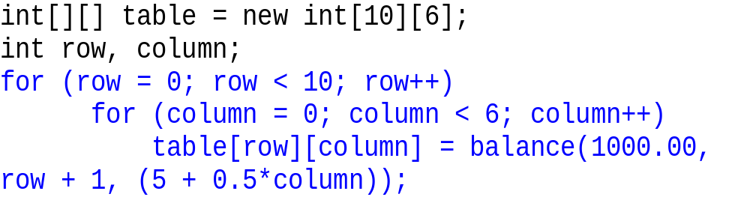
Processing a 2-D Array: for Loops Nested 2-Deep
To process all elements of an n-D array nest n for loops
  each loop has its own counter that corresponds to an index
For example: calculate and enter balances in the interest table
  inner loop repeats 6 times (six rates) for every outer loop iteration
  the outer loop repeats 10 times (10 different values of years)
  so the inner repeats 10 x 6 = 60 times = # cells in table
Excerpt from main method of InterestTable

Slide 33
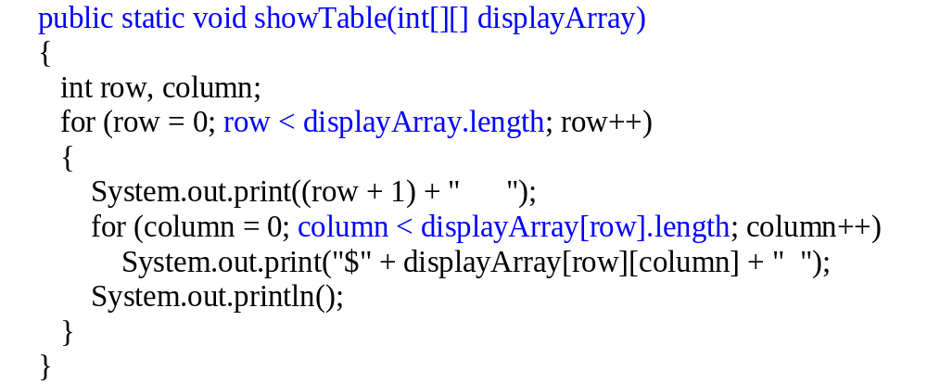
Multidimensional Array Parameters and Returned Values
Methods may have multi-D array parameters
Methods may return a multi-D array as the value returned
The situation is similar to 1-D arrays, but with more brackets
Example: a 2-D int array as a method argument
Notice how the number
of rows is obtained
Notice how the number
of columns is obtained
showTable method from class InterestTable2

Slide 34
Implementation of
Multidimensional Arrays
Multidimensional arrays are implemented as arrays of arrays.
Example:
int[][] table = new int[3][4];
  table is a one-dimensional array of length 3
  Each element in table is an array with base type int.
Access a row by only using only one subscript:
  table[0].length gives the length (4) of the first row in the array
Note: table.length (which is 3 in this case) is not the same thing as table[0].length (which is 4).
0 1 2 3
0
1
2
table[0] refers to the first row in the array, which is a one-dimensional array.

Slide 35
Ragged Arrays
Ragged arrays have rows of unequal length
  each row has a different number of columns, or entries
Ragged arrays are allowed in Java
Example: create a 2-D int array named b with 5 elements in the first row, 7 in the second row, and 4 in the third row:
  int[][] b = new int[3][];
  b[0] = new int[5];
  b[1] = new int[7];
  b[2] = new int[4];

Slide 36
Nested Loops with Multidimensional Arrays
for (employeeNumber = 1;
employeeNumber <= numberOfEmployees; employeeNumber++)
{ // Process one employee
sum = 0;
for (dayNumber = 0; dayNumber < 5; dayNumber++)
sum = sum + hours[dayNumber][employeeNumber – 1];
weekHours[employeeNumber – 1] = sum;
}
0
1
2
0
8
0
9
The method computeWeekHours uses nested for loops to compute the week's total hours for each employee.
Each time through the outer loop body, the inner loop adds all the numbers in one column of the hours array to get the value for one element in the weekHours array.
1
8
0
9
hours array
2
8
8
8
3
8
8
4
4
8
8
8
0
1
2
weekHours
array
40
24
38

