Slide 1

Object Oriented System Design
Sequence Diagram
Unit 2
Notes:
1

Slide 2
Sequence Diagram
The sequence diagram represents the flow of messages in the system and is also termed as an event diagram.
It helps in envisioning several dynamic scenarios.
It portrays the communication between any two lifelines as a time-ordered sequence of events, such that these lifelines took part at the run time.

Slide 3
In UML, the lifeline is represented by a vertical bar, whereas the message flow is represented by a vertical dotted line that extends across the bottom of the page.
It incorporates the iterations as well as branching.

Slide 4
Purpose of a Sequence Diagram
To model high-level interaction among active objects within a system.
To model interaction among objects inside a collaboration realizing a use case.
It either models generic interactions or some certain instances of interaction.

Slide 5
Notations of a Sequence Diagram
1.Actors
2. Lifelines 3. Messages
4. Guards

Slide 6
1. Actors
An actor in a UML diagram represents a type of role where it interacts with the system and its objects.
It is important to note here that an actor is always outside the scope of the system we aim to model using the UML diagram.
We use actors to depict various roles including human users and other external subjects.
We represent an actor in a UML diagram using a stick person notation. We can have multiple actors in a sequence diagram

Slide 7
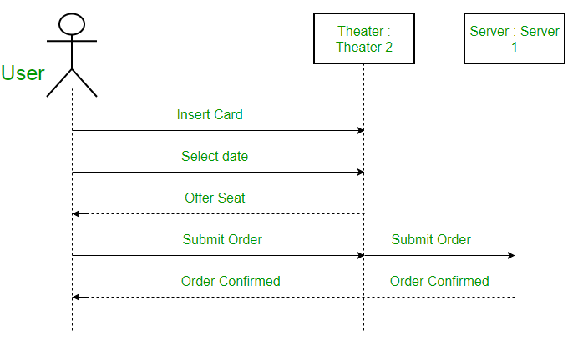
Here the user in seat reservation system is shown as an actor where it exists outside the system and is not a part of the system.

Slide 8
Lifelines
A lifeline is a named element which depicts an individual participant in a sequence diagram.
So basically each instance in a sequence diagram is represented by a lifeline. Lifeline elements are located at the top in a sequence diagram.
The standard in UML for naming a lifeline follows the following format Instance Name : Class Name

Slide 9
We display a lifeline in a rectangle called head with its name and type.
The head is located on top of a vertical dashed line (referred to as the stem) as shown above.
If we want to model an unnamed instance, we follow the same pattern except now the portion of lifeline’s name is left blank.

Slide 10
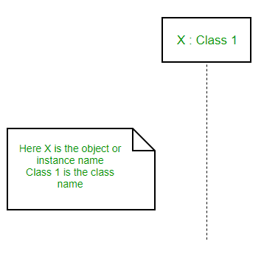

Slide 11
Messages
Communication between objects is depicted using messages.
The messages appear in a sequential order on the lifeline.
We represent messages using arrows.
Lifelines and messages form the core of a sequence diagram.

Slide 12
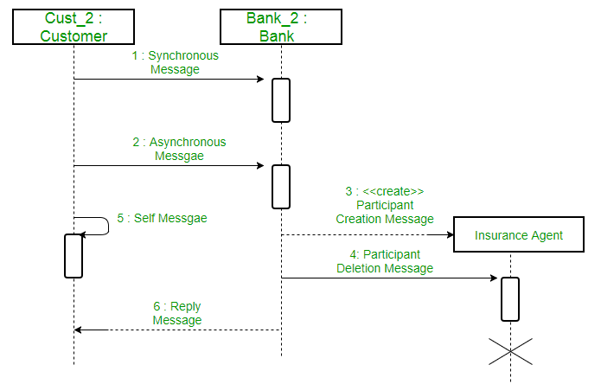
Messages can be broadly classified into the following categories

Slide 13
Synchronous Messages
A synchronous message waits for a reply before the interaction can move forward.
The sender waits until the receiver has completed the processing of the message.
The caller continues only when it knows that the receiver has processed the previous message i.e. it receives a reply message.
A large number of calls in object oriented programming are synchronous.
We use a solid arrow head to represent a synchronous message.

Slide 14
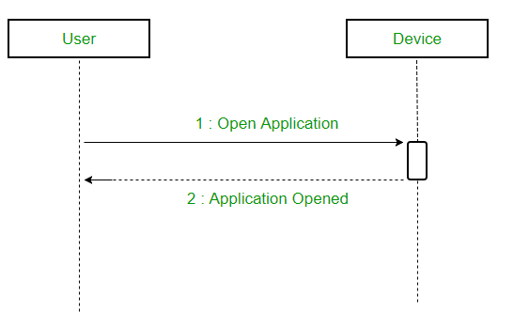
A sequence diagram using a synchronous message

Slide 15
Asynchronous Messages
An asynchronous message does not wait for a reply from the receiver.
The interaction moves forward irrespective of the receiver processing the previous message or not.
We use a lined arrow head to represent an asynchronous message.

Slide 16
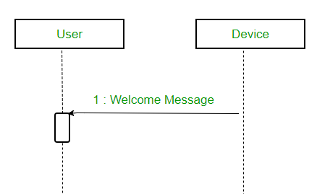

Slide 17
Create message
We use a Create message to instantiate a new object in the sequence diagram.
There are situations when a particular message call requires the creation of an object.
It is represented with a dotted arrow and create word labelled on it to specify that it is the create Message symbol. For example – The creation of a new order on a e-commerce website would require a new object of Order class to be created.

Slide 18
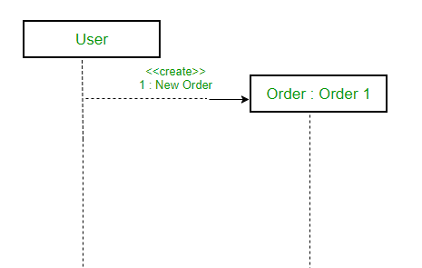
A situation where create message is used

Slide 19
Delete Message
We use a Delete Message to delete an object.
When an object is deallocated memory or is destroyed within the system we use the Delete Message symbol.
It destroys the occurrence of the object in the system.
It is represented by an arrow terminating with a x. For example – In the scenario below when the order is received by the user, the object of order class can be destroyed.

Slide 20
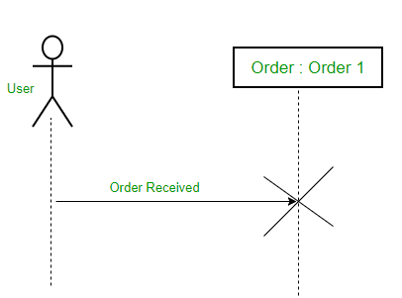
For example – In the scenario below when the order is received by the user, the object of order class can be destroyed.

Slide 21
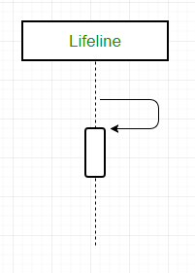
Self Message
Certain scenarios might arise where the object needs to send a message to itself.
Such messages are called Self Messages and are represented with a U shaped arrow.

Slide 22
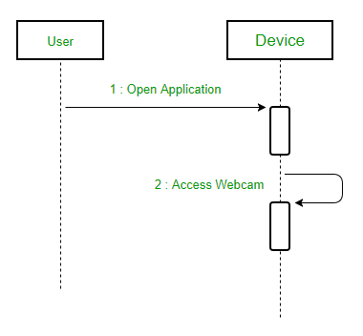
For example – Consider a scenario where the device wants to access its webcam. Such a scenario is represented using a self message.

Slide 23

Reply Message
Reply messages are used to show the message being sent from the receiver to the sender.
We represent a return/reply message using an open arrowhead with a dotted line.
The interaction moves forward only when a reply message is sent by the receiver.

Slide 24
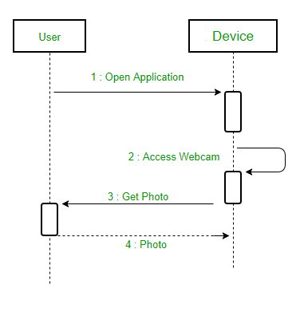
For example – Consider the scenario where the device requests a photo from the user. Here the message which shows the photo being sent is a reply message.

Slide 25
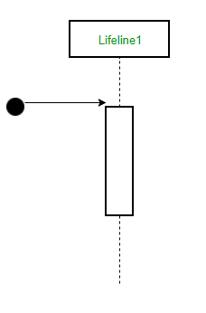
Found Message
A Found message is used to represent a scenario where an unknown source sends the message.
It is represented using an arrow directed towards a lifeline from an end point.
For example: Consider the scenario of a hardware failure.

Slide 26
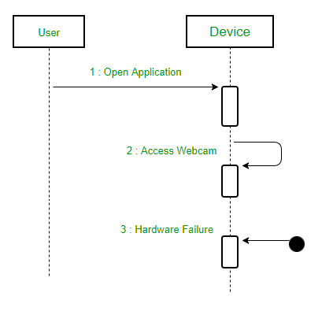
It can be due to multiple reasons and we are not certain as to what caused the hardware failure.

Slide 27
Lost Message
A Lost message is used to represent a scenario where the recipient is not known to the system.
It is represented using an arrow directed towards an end point from a lifeline.
For example: Consider a scenario where a warning is generated.

Slide 28
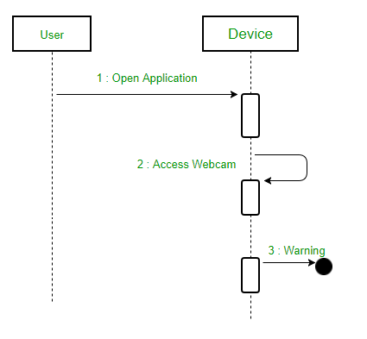
A scenario where lost message is used

Slide 29
Guards
To model conditions we use guards in UML.
They are used when we need to restrict the flow of messages on the pretext of a condition being met.
Guards play an important role in letting software developers know the constraints attached to a system or a particular process.
For example: In order to be able to withdraw cash, having a balance greater than zero is a condition that must be met as shown below.

Slide 30
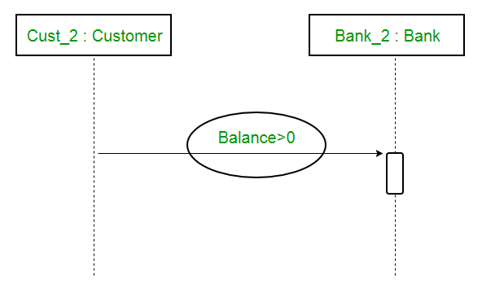

Slide 31
Sequence diagram depicts the sequence diagram for an emotion based music player:
Firstly the application is opened by the user.
The device then gets access to the web cam.
The webcam captures the image of the user.
The device uses algorithms to detect the face and predict the mood.
It then requests database for dictionary of possible moods.
The mood is retrieved from the database.
The mood is displayed to the user.
The music is requested from the database.
The playlist is generated and finally shown to the user.

Slide 32
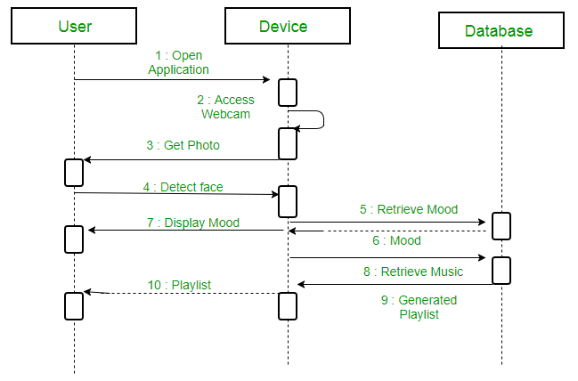
A sequence diagram for an emotion based music player

Slide 33
Uses of sequence diagrams
Used to model and visualize the logic behind a sophisticated function, operation or procedure.
They are also used to show details of UML use case diagrams.
Used to understand the detailed functionality of current or future systems.
Visualize how messages and tasks move between objects or components in a system.

