Slide 1

SQL
Presented by : Prashant Soni ‘Technical Trainer, UCER‘
Notes:
Are your classroom colors different than what you see in this template? That’s OK! Click on Design -> Variants (the down arrow) -> Pick the color scheme that works for you!
Feel free to change any “You will…” and “I will…” statements to ensure they align with your classroom procedures and rules!

Slide 2
Objectives
After completing this session, you should be able to
do the following:
Perform the various types of SQL operations:
DDL (Data Definition Language) Queries
DQL (Data Query Language) Queries
DML (Data Manipulation Language) Queries
DCL (Data Control Language) Queries
Able to answer the interview’s important questions based on SQL.

Slide 3
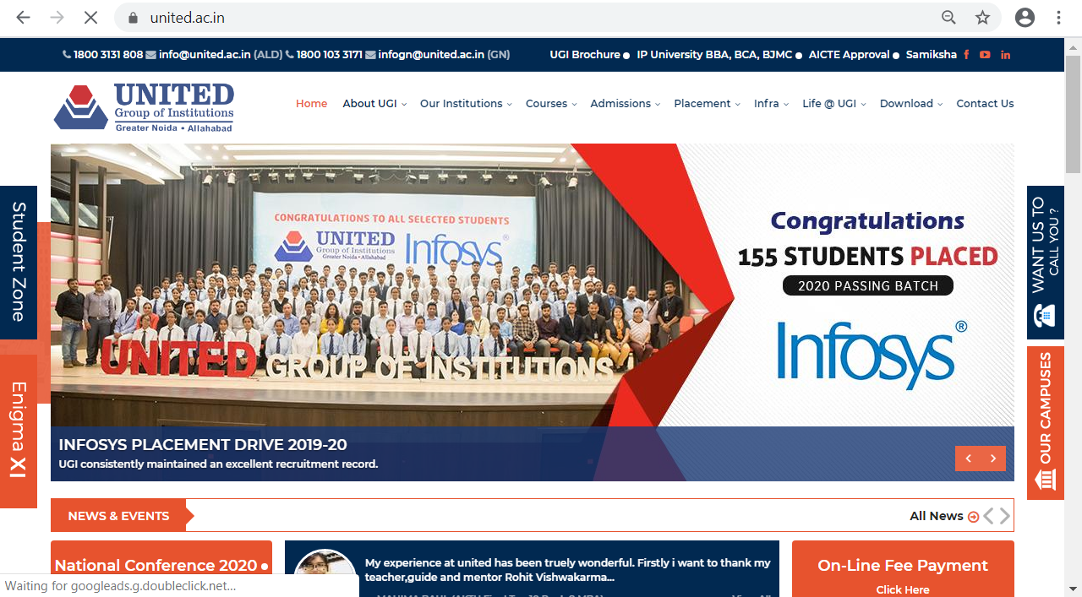

Slide 4
Important Part of Any Website
IMPORTANT
Q1. What is the difference between Front and Back End? (Asked by Infosys, TCS, Wipro, etc. in 2018,19)
Q2. What technology did you used as front End and Backend in Your project? (Asked by Infosys 2017,18,19)
Front End
Human or digital users interact directly with various aspects of the front end of a website.
Back End
It is the knowledge base behind the front end
It is the visible part of the web site
It comprises three components: server, application, and database.

Slide 5
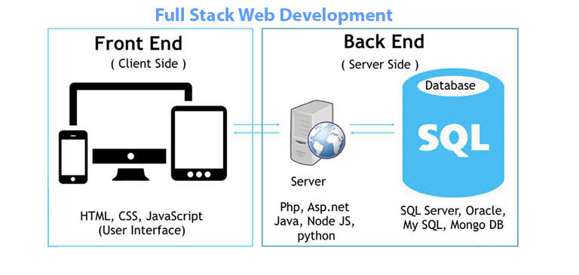
IMPORTANT
Q1.What is the difference between SQL and MYSQL? (Asked by INFOSYS, TCS in 2017,18,19)
Q2.What is the full form of PHP? (Asked by INFOSYS in 2019)

Slide 6
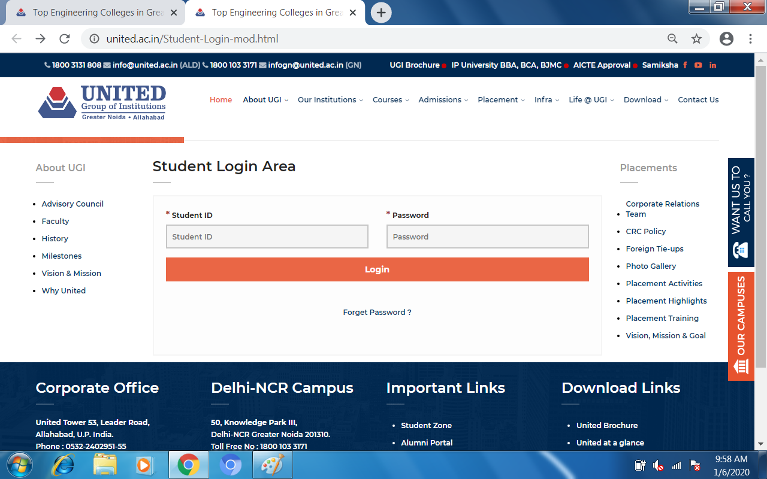
WHAT IS THE ROLE OF “SQL” IN ANY PROJECT

Slide 7

WHAT IS THE ROLE OF “SQL” IN ANY PROJECT

Slide 8
Introduction
IMPORTANT
Q1.Full form of SQL? (Asked by INFOSYS, TCS in 2017,18,19)
Q2.Why did we say that SQL is a universal language? (Asked by INFOSYS in 2019)
SQL stands for Structured Query Language
SQL was initially developed at IBM by Donald D. Chamberlin and Raymond F in 1970
SQL is used to communicate with a database
SQL is a non-procedural language
IN SQL we need to only describe what we ‘want to be done’.
Also, they are using different dialects, such as −
MS SQL Server using T-SQL,
Oracle using PL/SQL,
MS Access version of SQL is called JET SQL (native format) etc.

Slide 9
SQL Environment
IMPORTANT
Q1.What is the difference between DDL and DML ? (Asked by INFOSYS, TCS in 2017,18,19)
Q2.What is schema? (Asked by MIND in 2019)
Schema
The structure that contains descriptions of objects created by a user (base tables, views, constraints)
Data Definition Language (DDL)
Commands that define a database, including creating, altering, and dropping tables and establishing constraints
Data Query Language (DQL)
A set of schemas that constitute the description of a database
Data Manipulation Language (DML)
Commands that maintain and query a database
Data Control Language (DCL)
Commands that control a database, including administering privileges and committing data

Slide 10
SQL COMMANDS
DDL (Data Definition Language)
DML (Data Manipulation Language)
DCL (Data Control Language)
DQL (Data Query Language)
CREATE
ALTER
DROP
RENAME
TRUNCATE
COMMENT
INSERT
UPDATE
DELETE
MERGE
GRANT
REVOKE
SELECT

Slide 11
SQL COMMANDS
DDL (Data Definition Language)
DML (Data Manipulation Language)
DCL (Data Control Language)
DQL (Data Query Language)
CREATE
ALTER
DROP
RENAME
TRUNCATE
INSERT
UPDATE
DELETE
MERGE
GRANT
REVOKE
SELECT

Slide 12
DDL COMMANDS…
The Create Command to create table
SYNTAX
Create table TableName(clo1 datatype(size), clo2 datatype(size)[CONSTRAINT],……. clon datatype(size));
EXAMPLE
Create table Demo( FirstName varchar2(20),LastName varchar2(20),salary number(5));

Slide 13
DDL COMMANDS…
The ALTER Command is used to:-
Adding New Columns
Dropping a Column from the Table
Modifying Existing Table
Adding Constraints in Table

Slide 14
DDL COMMANDS…
The ALTER Command to add new column in table
SYNTAX
ALTER table TableName add ColumnName datatype(size);
EXAMPLE
ALTER table Demo add dept number(2);

Slide 15
DDL COMMANDS…
The ALTER Command to Remove a column from table
SYNTAX
Alter Table TableName drop Column ColumnName;
EXAMPLE
Alter Table Demo drop column dept;

Slide 16
DDL COMMANDS…
The ALTER Command to modify existing column in table
SYNTAX
Alter table TableName modify ColumnName newdatatype(newsize);
EXAMPLE
alter table Demo modify dept number(5);

Slide 17
DDL COMMANDS…
The ALTER Command to add constraint for particular column
SYNTAX
Alter table TableName add CONSTRAINT constraintname constrainttype (ColumnName);
EXAMPLE
Alter table Demo add CONSTRAINT consprim PRIMARY KEY (emp_id);

Slide 18
DDL COMMANDS…
Drop command use to drop the table structure from database.
SYNTAX
Drop table TableName;
EXAMPLE
Drop table Demo;

Slide 19
DDL COMMANDS…
Rename command is use to rename the table in the database..
SYNTAX
Alter Table table_name Rename to new_Table_Name
EXAMPLE
Alter table Demo Rename to Demo_emp;

Slide 20
DDL COMMANDS…
Rename command is use to rename the column in the Table.
SYNTAX
Alter Table table_name Rename column old_column_name to new_column_Name
EXAMPLE
Alter table Demo Rename column dept to dept_no;

Slide 21
SQL COMMANDS
DDL (Data Definition Language)
DML (Data Manipulation Language)
DCL (Data Control Language)
DQL (Data Query Language)
CREATE
ALTER
DROP
RENAME
TRUNCATE
COMMENT
INSERT
UPDATE
DELETE
MERGE
GRANT
REVOKE
SELECT

Slide 22
Writing Basic SQL SELECT Statements

Slide 23
Capabilities of SQL SELECT Statements
Projection
Selection
Table 1
Table 1
Join
Table 1
Table 2
Notes:
Capabilities of SQL SELECT Statements
A SELECT statement retrieves information from the database. Using a SELECT statement, you can do the following:
Projection: You can use the projection capability in SQL to choose the columns in a table that you want returned by your query. You can choose as few or as many columns of the table as you require.
Selection: You can use the selection capability in SQL to choose the rows in a table that you want returned by a query. You can use various criteria to restrict the rows that you see.
Joining: You can use the join capability in SQL to bring together data that is stored in different tables by creating a link between them. You learn more about joins in a later lesson.
Instructor Note
Inform students that selection and projection are often considered horizontal and vertical partitioning.

Slide 24
Basic SELECT Statement
SELECT *|{[DISTINCT] column|expression [alias],...}
FROM table;
SELECT identifies what columns
FROM identifies which table
Notes:
Basic SELECT Statement
In its simplest form, a SELECT statement must include the following:
A SELECT clause, which specifies the columns to be displayed
A FROM clause, which specifies the table containing the columns listed in the SELECT clause
In the syntax:
SELECT is a list of one or more columns
* selects all columns
DISTINCT suppresses duplicates
column|expression selects the named column or the expression
alias gives selected columns different headings
FROM table specifies the table containing the columns
Note: Throughout this course, the words keyword, clause, and statement are used as follows:
A keyword refers to an individual SQL element. For example, SELECT and FROM are keywords.
A clause is a part of a SQL statement. For example, SELECT employee_id, last_name, ... is a clause.
A statement is a combination of two or more clauses. For example, SELECT * FROM employees is a SQL statement.

Slide 25
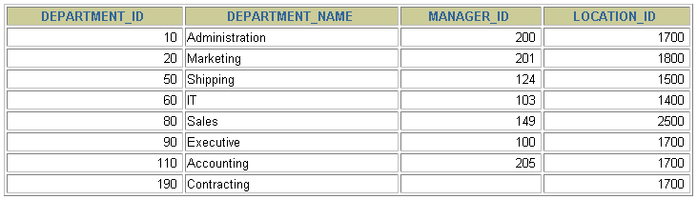
Selecting All Columns
SELECT *
FROM departments;
Notes:
Selecting All Columns of All Rows
You can display all columns of data in a table by following the SELECT keyword with an asterisk (*). In the example on the slide, the department table contains four columns: DEPARTMENT_ID, DEPARTMENT_NAME, MANAGER_ID, and LOCATION_ID. The table contains seven rows, one for each department.
You can also display all columns in the table by listing all the columns after the SELECT keyword. For example, the following SQL statement, like the example on the slide, displays all columns and all rows of the DEPARTMENTS table:
SELECT department_id, department_name, manager_id, location_id
FROM departments;
Instructor Note
Let the students know that details of all the tables are given in Appendix B.

Slide 26
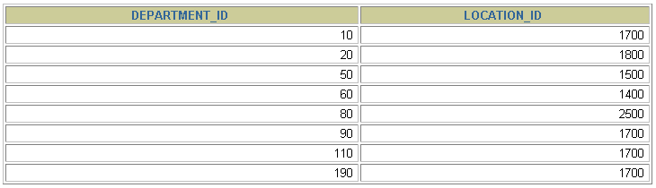
Selecting Specific Columns
SELECT department_id, location_id
FROM departments;
Notes:
Selecting Specific Columns of All Rows
You can use the SELECT statement to display specific columns of the table by specifying the column names, separated by commas. The example on the slide displays all the department numbers and location numbers from the DEPARTMENTS table.
In the SELECT clause, specify the columns that you want, in the order in which you want them to appear in the output. For example, to display location before department number going from left to right, you use the following statement:
SELECT location_id, department_id
FROM departments;
Instructor Note
You can also select from pseudocolumns. A pseudocolumn behaves like a table column but is not actually stored in the table. You cannot insert or delete values of the pseudocolumns. Some available pseudocolumns are CURRVAL, NEXTVAL, LEVEL, ROWID, and ROWNUM.
…

Slide 27
Writing SQL Statements
SQL statements are not case sensitive.
SQL statements can be on one or more lines.
Keywords cannot be abbreviated or split across lines.
Clauses are usually placed on separate lines.
Indents are used to enhance readability.
Notes:
Writing SQL Statements
Using the following simple rules and guidelines, you can construct valid statements that are both easy to read and easy to edit:
• SQL statements are not case sensitive, unless indicated.
SQL statements can be entered on one or many lines.
• Keywords cannot be split across lines or abbreviated.
Clauses are usually placed on separate lines for readability and ease of editing.
• Indents should be used to make code more readable.
Keywords typically are entered in uppercase; all other words, such as table names and columns, are entered in lowercase.
Executing SQL Statements
Using iSQL*Plus, click the Execute button to run the command or commands in the editing
window.
Instructor Note
Although not required in iSQL*Plus, placing a semicolon (;) at the end of the last clause is recommended. Other environments, such as PL/SQL programs, require that the end of each statement contains a semicolon.

Slide 28
Column Heading Defaults
iSQL*Plus:
Default heading justification: Center
Default heading display: Uppercase
Notes:
Column Heading Defaults
In iSQL*Plus, column headings are displayed in uppercase and centered.
SELECT last_name, hire_date, salary
FROM employees;
You can override the column heading display with an alias. Column aliases are covered later in this lesson.
…

Slide 29
Arithmetic Expressions
Create expressions with number and date data by using arithmetic operators.
Operator
+
-
*
/
Description
Add
Subtract
Multiply
Divide
Notes:
Arithmetic Expressions
You may need to modify the way in which data is displayed, perform calculations, or look at what-if scenarios. These are all possible using arithmetic expressions. An arithmetic expression can contain column names, constant numeric values, and the arithmetic operators.
Arithmetic Operators
The slide lists the arithmetic operators available in SQL. You can use arithmetic operators in any clause of a SQL statement except in the FROM clause.
Instructor Note
You can use the addition and subtraction operators only with DATE and TIMESTAMP data types.

Slide 30
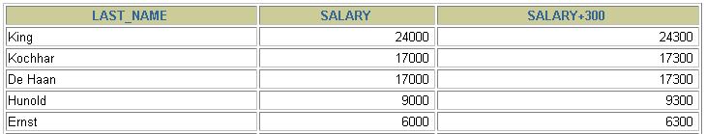

Using Arithmetic Operators
SELECT last_name, salary, salary + 300
FROM employees;
…
Notes:
Using Arithmetic Operators
The example in the slide uses the addition operator to calculate a salary increase of $300 for all employees and displays a new SALARY+300 column in the output.
Note that the resultant calculated column SALARY+300 is not a new column in the EMPLOYEES table; it is for display only. By default, the name of a new column comes from the calculation that generated it—in this case, salary+300.
Note: The Oracle9i server ignores blank spaces before and after the arithmetic operator.

Slide 31
Operator Precedence
_
*
/
+
Multiplication and division take priority over addition and subtraction.
Operators of the same priority are evaluated from left to right.
Parentheses are used to force prioritized evaluation and to clarify statements.
Notes:
Operator Precedence
If an arithmetic expression contains more than one operator, multiplication and division are evaluated first. If operators within an expression are of same priority, then evaluation is done from left to right.
You can use parentheses to force the expression within parentheses to be evaluated first.

Slide 32
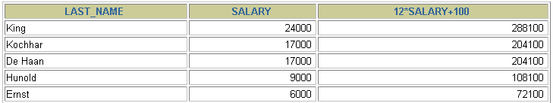

Operator Precedence
SELECT last_name, salary, 12*salary+100
FROM employees;
…
Notes:
Operator Precedence (continued)
The example on the slide displays the last name, salary, and annual compensation of employees. It calculates the annual compensation as 12 multiplied by the monthly salary, plus a one-time bonus of $100. Notice that multiplication is performed before addition.
Note: Use parentheses to reinforce the standard order of precedence and to improve clarity. For example, the expression on the slide can be written as (12*salary)+100 with no change in the result.
Instructor Note
Demo: 1_prec1.sql, 1_prec2.sql
Purpose: To illustrate viewing a query containing no parentheses and executing a query with parentheses to override rules of precedence.

Slide 33
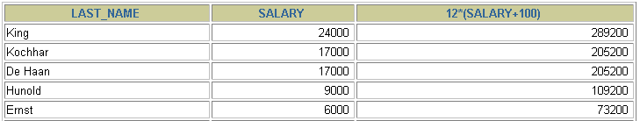

Using Parentheses
SELECT last_name, salary, 12*(salary+100)
FROM employees;
…
Notes:
Using Parentheses
You can override the rules of precedence by using parentheses to specify the order in which operators are executed.
The example on the slide displays the last name, salary, and annual compensation of employees. It calculates the annual compensation as monthly salary plus a monthly bonus of $100, multiplied by 12. Because of the parentheses, addition takes priority over multiplication.

Slide 34
Defining a Null Value
A null is a value that is unavailable, unassigned, unknown, or inapplicable.
A null is not the same as zero or a blank space.
SELECT last_name, job_id, salary, commission_pct
FROM employees;
…
…
Notes:
Null Values
If a row lacks the data value for a particular column, that value is said to be null, or to contain a null.
A null is a value that is unavailable, unassigned, unknown, or inapplicable. A null is not the same as zero or a space. Zero is a number, and a space is a character.
Columns of any data type can contain nulls. However, some constraints, NOT NULL and PRIMARY KEY, prevent nulls from being used in the column.
In the COMMISSION_PCT column in the EMPLOYEES table, notice that only a sales manager or sales representative can earn a commission. Other employees are not entitled to earn commissions. A null represents that fact.
Instructor Note
Demo: 1_null.sql
Purpose: To illustrate calculating with null values.

Slide 35
Null Values in Arithmetic Expressions
Arithmetic expressions containing a null value
evaluate to null.
SELECT last_name, 12*salary*commission_pct
FROM employees;
…
…
Notes:
Null Values (continued)
If any column value in an arithmetic expression is null, the result is null. For example, if you attempt to perform division with zero, you get an error. However, if you divide a number by null, the result is a null or unknown.
In the example on the slide, employee King does not get any commission. Because the COMMISSION_PCT column in the arithmetic expression is null, the result is null.
For more information, see Oracle9i SQL Reference, “Basic Elements of SQL.”

Slide 36
Defining a Column Alias
A column alias:
Renames a column heading
Is useful with calculations
Immediately follows the column name - there can also be the optional AS keyword between the column name and alias
Requires double quotation marks if it contains spaces or special characters or is case sensitive
Notes:
Column Aliases
When displaying the result of a query, iSQL*Plus normally uses the name of the selected column as the column heading. This heading may not be descriptive and hence may be difficult to understand. You can change a column heading by using a column alias.
Specify the alias after the column in the SELECT list using a space as a separator. By default, alias headings appear in uppercase. If the alias contains spaces or special characters (such as # or $), or is case sensitive, enclose the alias in double quotation marks (" ").
Instructor Note
Within a SQL statement, a column alias can be used in both the SELECT clause and the ORDER BY clause. You cannot use column aliases in the WHERE clause. Both alias features comply with the ANSI SQL 92 standard.
Demo: 1_alias.sql
Purpose: To illustrate the use of aliases in expressions.

Slide 37


Using Column Aliases
SELECT last_name AS name, commission_pct comm
FROM employees;
…
SELECT last_name "Name", salary*12 "Annual Salary"
FROM employees;
…
Notes:
Column Aliases (continued)
The first example displays the names and the commission percentages of all the employees. Notice that the optional AS keyword has been used before the column alias name. The result of the query is the same whether the AS keyword is used or not. Also notice that the SQL statement has the column aliases, name and comm, in lowercase, whereas the result of the query displays the column headings in uppercase. As mentioned in a previous slide, column headings appear in uppercase by default.
The second example displays the last names and annual salaries of all the employees. Because Annual Salary contain a space, it has been enclosed in double quotation marks. Notice that the column heading in the output is exactly the same as the column alias.
Instructor Note
Point out the optional AS keyword in the first example and the double quotation marks in the second example. Also show that the aliases always appear in uppercase, unless enclosed within double quotation marks.

Slide 38
Concatenation Operator
A concatenation operator:
Concatenates columns or character strings to other columns
Is represented by two vertical bars (||)
Creates a resultant column that is a character expression
Notes:
Concatenation Operator
You can link columns to other columns, arithmetic expressions, or constant values to create a character expression by using the concatenation operator (||). Columns on either side of the operator are combined to make a single output column.

Slide 39
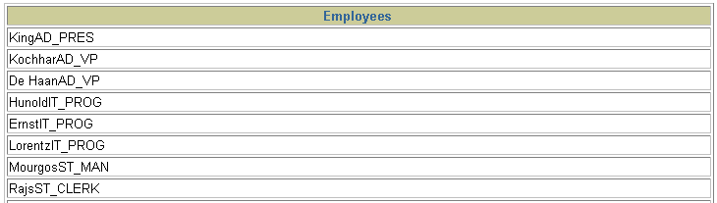
Using the Concatenation Operator
SELECT last_name||job_id AS "Employees"
FROM employees;
…
Notes:
Concatenation Operator (continued)
In the example, LAST_NAME and JOB_ID are concatenated, and they are given the alias Employees. Notice that the employee last name and job code are combined to make a single output column.
The AS keyword before the alias name makes the SELECT clause easier to read.

Slide 40
Literal Character Strings
A literal is a character, a number, or a date included in the SELECT list.
Date and character literal values must be enclosed within single quotation marks.
Each character string is output once for each row returned.
Notes:
Literal Character Strings
A literal is a character, a number, or a date that is included in the SELECT list and that is not a column name or a column alias. It is printed for each row returned. Literal strings of free-format text can be included in the query result and are treated the same as a column in the SELECT list.
Date and character literals must be enclosed within single quotation marks (' '); number literals need not.

Slide 41
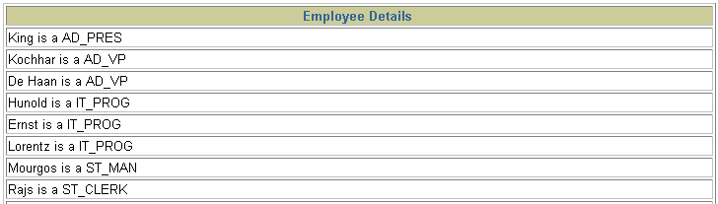
Using Literal Character Strings
SELECT last_name ||' is a '||job_id
AS "Employee Details"
FROM employees;
…
Notes:
Literal Character Strings (continued)
The example on the slide displays last names and job codes of all employees. The column has the heading Employee Details. Notice the spaces between the single quotation marks in the SELECT statement. The spaces improve the readability of the output.
In the following example, the last name and salary for each employee are concatenated with a literal to give the returned rows more meaning.
SELECT last_name ||': 1 Month salary = '||salary Monthly
FROM employees;
…

Slide 42
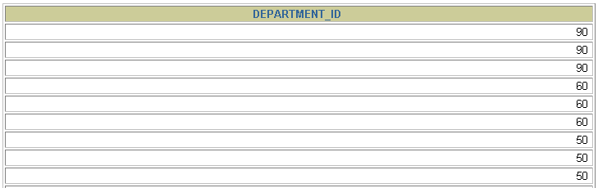
Duplicate Rows
The default display of queries is all rows, including
duplicate rows.
SELECT department_id
FROM employees;
…
Notes:
Duplicate Rows
Unless you indicate otherwise, iSQL*Plus displays the results of a query without eliminating duplicate rows. The example on the slide displays all the department numbers from the EMPLOYEES table. Notice that the department numbers are repeated.

Slide 43
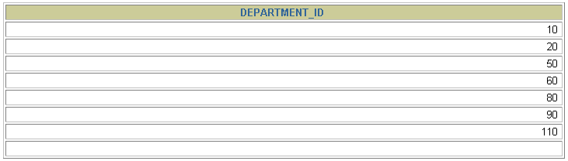
Eliminating Duplicate Rows
Eliminate duplicate rows by using the DISTINCT keyword in the SELECT clause.
SELECT DISTINCT department_id
FROM employees;
Notes:
Duplicate Rows (continued)
To eliminate duplicate rows in the result, include the DISTINCT keyword in the SELECT clause immediately after the SELECT keyword. In the example on the slide, the EMPLOYEES table actually contains 20 rows but there are only seven unique department numbers in the table.
You can specify multiple columns after the DISTINCT qualifier. The DISTINCT qualifier affects all the selected columns, and the result is every distinct combination of the columns.
SELECT DISTINCT department_id, job_id
FROM employees;
…

Slide 44
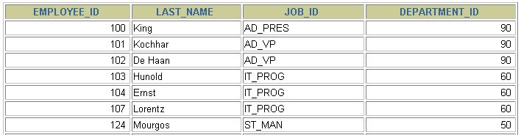

Limiting Rows Using a Selection
EMPLOYEES
…
“retrieve all employees in department 90”
Notes:
Limiting Rows Using a Selection
In the example on the slide, assume that you want to display all the employees in department 90. The rows with a value of 90 in the DEPARTMENT_ID column are the only ones returned. This method of restriction is the basis of the WHERE clause in SQL.

Slide 45
Limiting the Rows Selected
Restrict the rows returned by using the WHERE clause.
The WHERE clause follows the FROM clause.
SELECT *|{[DISTINCT] column|expression [alias],...}
FROM table
[WHERE condition(s)];
Notes:
Limiting the Rows Selected
You can restrict the rows returned from the query by using the WHERE clause. A WHERE clause contains a condition that must be met, and it directly follows the FROM clause. If the condition is true, the row meeting the condition is returned.
In the syntax:
WHERE restricts the query to rows that meet a condition
condition is composed of column names, expressions, constants, and a comparison operator
The WHERE clause can compare values in columns, literal values, arithmetic expressions, or functions. It consists of three elements:
Column name
Comparison condition
Column name, constant, or list of values

Slide 46

Using the WHERE Clause
SELECT employee_id, last_name, job_id, department_id
FROM employees
WHERE department_id = 90 ;
Notes:
Using the WHERE Clause
In the example, the SELECT statement retrieves the name, job ID, and department number of all employees whose job ID is SA_REP.
Note that the job title SA_REP has been specified in uppercase to ensure that it matches the job ID column in the EMPLOYEES table. Character strings are case sensitive.

Slide 47
Comparison Conditions
Operator
=
>
>=
<
<=
<>
Meaning
Equal to
Greater than
Greater than or equal to
Less than
Less than or equal to
Not equal to
Notes:
Comparison Conditions
Comparison conditions are used in conditions that compare one expression to another value or expression. They are used in the WHERE clause in the following format:
Syntax
... WHERE expr operator value
For Example
... WHERE hire_date='01-JAN-95'
... WHERE salary>=6000
... WHERE last_name='Smith'
An alias cannot be used in the WHERE clause.
Note: The symbol != and ^= can also represent the not equal to condition.

Slide 48

Using Comparison Conditions
SELECT last_name, salary
FROM employees
WHERE salary <= 3000;
Notes:
Using the Comparison Conditions
In the example, the SELECT statement retrieves the last name and salary from the EMPLOYEES table, where the employee salary is less than or equal to 3000. Note that there is an explicit value supplied to the WHERE clause. The explicit value of 3000 is compared to the salary value in the SALARY column of the EMPLOYEES table.

Slide 49
Other Comparison Conditions
Operator
BETWEEN ...AND...
IN(set)
LIKE
IS NULL
Meaning
Between two values (inclusive),
Match any of a list of values
Match a character pattern
Is a null value

Slide 50
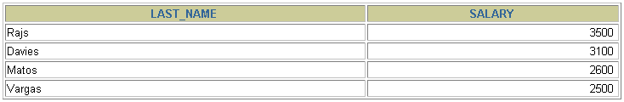
Using the BETWEEN Condition
Use the BETWEEN condition to display rows based on a range of values.
SELECT last_name, salary
FROM employees
WHERE salary BETWEEN 2500 AND 3500;
Lower limit
Upper limit
Notes:
The BETWEEN Condition
You can display rows based on a range of values using the BETWEEN range condition. The range that you specify contains a lower limit and an upper limit.
The SELECT statement on the slide returns rows from the EMPLOYEES table for any employee whose salary is between $2,500 and $3,500.
Values specified with the BETWEEN condition are inclusive. You must specify the lower limit first.
Instructor Note
Emphasize that the values specified with the BETWEEN operator in the example are inclusive. Explain that BETWEEN … AND … is actually translated by Oracle server to a pair of AND conditions: (a >= lower limit) AND (a <= higher limit). So using BETWEEN … AND … has no performance benefits, and it is used for logical simplicity.
Demo: 2_betw.sql
Purpose: To illustrate using the BETWEEN operator.

Slide 51
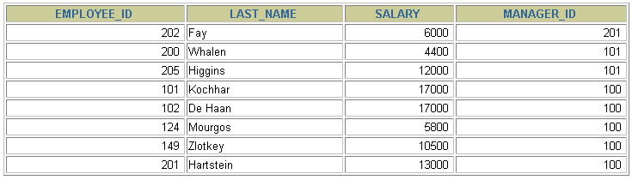
Using the IN Condition
Use the IN membership condition to test for values in
a list.
SELECT employee_id, last_name, salary, manager_id
FROM employees
WHERE manager_id IN (100, 101, 201);
Notes:
The IN Condition
To test for values in a specified set of values, use the IN condition. The IN condition is also known as the membership condition.
The slide example displays employee numbers, last names, salaries, and manager’s employee numbers for all the employees whose manager’s employee number is 100, 101, or 201.
The IN condition can be used with any data type. The following example returns a row from the EMPLOYEES table for any employee whose last name is included in the list of names in the WHERE clause:
SELECT employee_id, manager_id, department_id
FROM employees
WHERE last_name IN ('Hartstein', 'Vargas');
If characters or dates are used in the list, they must be enclosed in single quotation marks ('').
Instructor Note
Explain that IN ( ... ) is actually translated by Oracle server to a set of OR conditions: a = value1 OR a = value2 OR a = value3. So using IN ( ... ) has no performance benefits, and it is used for logical simplicity.
Demo: 2_in.sql
Purpose: To illustrate using the IN operator.

Slide 52
Using the LIKE Condition
Use the LIKE condition to perform wildcard searches of valid search string values.
Search conditions can contain either literal characters or numbers:
% denotes zero or many characters.
_ denotes one character.
SELECT first_name
FROM employees
WHERE first_name LIKE 'S%';
Notes:
The LIKE Condition
You may not always know the exact value to search for. You can select rows that match a character pattern by using the LIKE condition. The character pattern-matching operation is referred to as a wildcard search. Two symbols can be used to construct the search string.
The SELECT statement on the slide returns the employee first name from the EMPLOYEES table for any employee whose first name begins with an S. Note the uppercase S. Names beginning with an s are not returned.
The LIKE condition can be used as a shortcut for some BETWEEN comparisons. The following example displays the last names and hire dates of all employees who joined between January 1995 and December 1995:
SELECT last_name, hire_date
FROM employees
WHERE hire_date LIKE '%95';

Slide 53

Using the LIKE Condition
You can combine pattern-matching characters.
You can use the ESCAPE identifier to search for the actual % and _ symbols.
SELECT last_name
FROM employees
WHERE last_name LIKE '_o%';
Notes:
Combining Wildcard Characters
The % and _ symbols can be used in any combination with literal characters. The example on the slide displays the names of all employees whose last names have an o as the second character.
The ESCAPE Option
When you need to have an exact match for the actual % and _ characters, use the ESCAPE option. This option specifies what the escape character is. If you want to search for strings that contain ‘SA_’, you can use the following SQL statement:
SELECT employee_id, last_name, job_id
FROM employees
WHERE job_id LIKE '%SA\_%' ESCAPE '\';
The ESCAPE option identifies the backslash (\) as the escape character. In the pattern, the escape character precedes the underscore (_). This causes the Oracle Server to interpret the underscore literally.

Slide 54
Using the NULL Conditions
Test for nulls with the IS NULL operator.
SELECT last_name, manager_id
FROM employees
WHERE manager_id IS NULL;
Notes:
The NULL Conditions
The NULL conditions include the IS NULL condition and the IS NOT NULL condition.
The IS NULL condition tests for nulls. A null value means the value is unavailable, unassigned, unknown, or inapplicable. Therefore, you cannot test with = because a null cannot be equal or unequal to any value. The slide example retrieves the last names and managers of all employees who do not have a manager.
For another example, to display last name, job ID, and commission for all employees who are NOT entitled to get a commission, use the following SQL statement:
SELECT last_name, job_id, commission_pct
FROM employees
WHERE commission_pct IS NULL;
…

Slide 55
Logical Conditions
Operator
AND OR
NOT
Meaning
Returns TRUE if both component conditions are true
Returns TRUE if either component condition is true
Returns TRUE if the following condition is false
Notes:
Logical Conditions
A logical condition combines the result of two component conditions to produce a single result based on them or inverts the result of a single condition. A row is returned only if the overall result of the condition is true. Three logical operators are available in SQL:
AND
OR
NOT
All the examples so far have specified only one condition in the WHERE clause. You can use several conditions in one WHERE clause using the AND and OR operators.

Slide 56

Using the AND Operator
AND requires both conditions to be true.
SELECT employee_id, last_name, job_id, salary
FROM employees
WHERE salary >=10000
AND job_id LIKE '%MAN%';
Notes:
The AND Operator
In the example, both conditions must be true for any record to be selected. Therefore, only employees who have a job title that contains the string MAN and earn $10,000 or more are selected.
All character searches are case sensitive. No rows are returned if MAN is not in uppercase. Character strings must be enclosed in quotation marks.
AND Truth Table
The following table shows the results of combining two expressions with AND:
Instructor Note
Demo: 2_and.sql
Purpose: To illustrate using the AND operator.

Slide 57
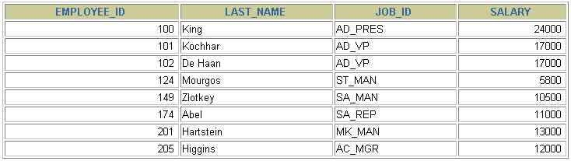
Using the OR Operator
OR requires either condition to be true.
SELECT employee_id, last_name, job_id, salary
FROM employees
WHERE salary >= 10000
OR job_id LIKE '%MAN%';
Notes:
The OR Operator
In the example, either condition can be true for any record to be selected. Therefore, any employee who has a job ID containing MAN or earns $10,000 or more is selected.
The OR Truth Table
The following table shows the results of combining two expressions with OR:
Instructor Note
Demo: 2_or.sql
Purpose: To illustrate using the OR operator.

Slide 58
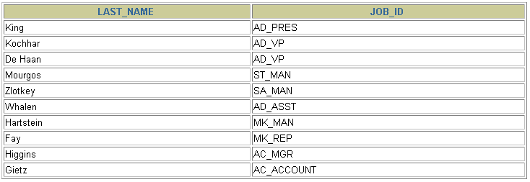
Using the NOT Operator
SELECT last_name, job_id
FROM employees
WHERE job_id
NOT IN ('IT_PROG', 'ST_CLERK', 'SA_REP');
Notes:
The NOT Operator
The slide example displays the last name and job ID of all employees whose job ID is not IT_PROG, ST_CLERK, or SA_REP.
The NOT Truth Table
The following table shows the result of applying the NOT operator to a condition:
Note: The NOT operator can also be used with other SQL operators, such as BETWEEN, LIKE, and NULL.
... WHERE job_id NOT IN ('AC_ACCOUNT', 'AD_VP')
... WHERE salary NOT BETWEEN 10000 AND 15000
... WHERE last_name NOT LIKE '%A%'
... WHERE commission_pct IS NOT NULL

Slide 59
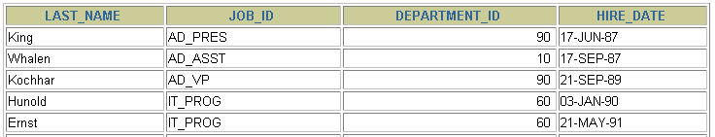
ORDER BY Clause
Sort rows with the ORDER BY clause
ASC: ascending order, default
DESC: descending order
The ORDER BY clause comes last in the SELECT statement.
SELECT last_name, job_id, department_id, hire_date
FROM employees
ORDER BY hire_date ;
…
Notes:
The ORDER BY Clause
The order of rows returned in a query result is undefined. The ORDER BY clause can be used to sort the rows. If you use the ORDER BY clause, it must be the last clause of the SQL statement. You can specify an expression, or an alias, or column position as the sort condition.
Syntax
SELECT expr
FROM table
[WHERE condition(s)]
[ORDER BY {column, expr} [ASC|DESC]];
In the syntax:
ORDER BY specifies the order in which the retrieved rows are displayed
ASC orders the rows in ascending order (this is the default order)
DESC orders the rows in descending order
If the ORDER BY clause is not used, the sort order is undefined, and the Oracle server may not fetch rows in the same order for the same query twice. Use the ORDER BY clause to display the rows in a specific order.
Instructor Note
Let the students know that the ORDER BY clause is executed last in query execution. It is placed last unless the FOR UPDATE clause is used.

Slide 60
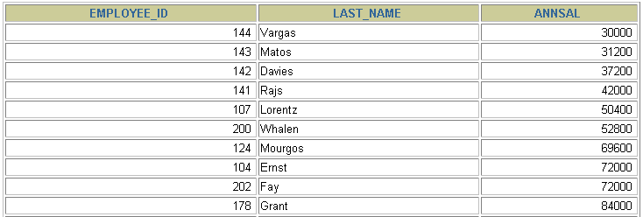
Sorting by Column Alias
SELECT employee_id, last_name, salary*12 annsal
FROM employees
ORDER BY annsal;
…
Notes:
Sorting by Column Aliases
You can use a column alias in the ORDER BY clause. The slide example sorts the data by annual salary.
Instructor Note
Internally, the order of execution for a SELECT statement is as follows:
FROM clause
WHERE clause
SELECT clause
ORDER BY clause

Slide 61
SQL COMMANDS
DDL (Data Definition Language)
DML (Data Manipulation Language)
DCL (Data Control Language)
DQL (Data Query Language)
CREATE
ALTER
DROP
RENAME
TRUNCATE
COMMENT
INSERT
UPDATE
DELETE
MERGE
GRANT
REVOKE
SELECT

Slide 63
Data Manipulation Language
A DML statement is executed when you:
Add new rows to a table
Modify existing rows in a table
Remove existing rows from a table
A transaction consists of a collection of DML statements that form a logical unit of work.
Notes:
Data Manipulation Language
Data manipulation language (DML) is a core part of SQL. When you want to add, update, or delete data in the database, you execute a DML statement. A collection of DML statements that form a logical unit of work is called a transaction.
Consider a banking database. When a bank customer transfers money from a savings account to a checking account, the transaction might consist of three separate operations: decrease the savings account, increase the checking account, and record the transaction in the transaction journal. The Oracle server must guarantee that all three SQL statements are performed to maintain the accounts in proper balance. When something prevents one of the statements in the transaction from executing, the other statements of the transaction must be undone.
Instructor Note
DML statements can be issued directly in iSQL*Plus, performed automatically by tools such as Oracle Forms Services, or programmed with tools such as the 3GL precompilers.
Every table has INSERT, UPDATE, and DELETE privileges associated with it. These privileges are automatically granted to the creator of the table, but in general they must be explicitly granted to other users.
Starting with Oracle 7.2, you can place a subquery in the place of the table name in an UPDATE statement, essentially the same way you use a view.

Slide 64
The INSERT Statement Syntax
Add new rows to a table by using the INSERT statement.
Only one row is inserted at a time with this syntax.
INSERT INTO table [(column [, column...])]
VALUES (value [, value...]);
Notes:
Adding a New Row to a Table (continued)
You can add new rows to a table by issuing the INSERT statement.
In the syntax:
table is the name of the table
column is the name of the column in the table to populate
value is the corresponding value for the column
Note: This statement with the VALUES clause adds only one row at a time to a table.

Slide 65
Inserting New Rows
Insert a new row containing values for each column.
List values in the default order of the columns in the table.
Optionally, list the columns in the INSERT clause.
Enclose character and date values within single quotation marks.
INSERT INTO departments(department_id, department_name,
manager_id, location_id)
VALUES (70, %100, 1700);
1 row created.
Notes:
Adding a New Row to a Table (continued)
Because you can insert a new row that contains values for each column, the column list is not required in the INSERT clause. However, if you do not use the column list, the values must be listed according to the default order of the columns in the table, and a value must be provided for each column.
DESCRIBE departments
For clarity, use the column list in the INSERT clause. Enclose character and date values within single quotation marks; it is not recommended to enclose numeric values within single quotation marks.
Number values should not be enclosed in single quotes, because implicit conversion may take place for numeric values assigned to NUMBER data type columns if single quotes are included.

Slide 66
Inserting Rows with Null Values
Implicit method: Omit the column from the column list.
INSERT INTO departments (department_id,
department_name )
VALUES (30, 'Purchasing');
1 row created.
Explicit method: Specify the NULL keyword in the VALUES clause.
INSERT INTO departments
VALUES (100, 'Finance', NULL, NULL);
1 row created.
Notes:
Methods for Inserting Null Values
Be sure that you can use null values in the targeted column by verifying the Null? status with the iSQL*Plus DESCRIBE command.
The Oracle Server automatically enforces all data types, data ranges, and data integrity constraints. Any column that is not listed explicitly obtains a null value in the new row.
Common errors that can occur during user input:
Mandatory value missing for a NOT NULL column
Duplicate value violates uniqueness constraint
Foreign key constraint violated
CHECK constraint violated
Data type mismatch
Value too wide to fit in column

Slide 67
The UPDATE Statement Syntax
Modify existing rows with the UPDATE statement.
Update more than one row at a time, if required.
UPDATE table
SET column = value [, column = value, ...]
[WHERE condition];
Notes:
Updating Rows
You can modify existing rows by using the UPDATE statement.
In the syntax:
table is the name of the table
column is the name of the column in the table to populate
value is the corresponding value or subquery for the column
condition identifies the rows to be updated and is composed of column names expressions, constants, subqueries, and comparison operators
Confirm the update operation by querying the table to display the updated rows.
For more information, see Oracle9i SQL Reference, “UPDATE.”
Note: In general, use the primary key to identify a single row. Using other columns can unexpectedly cause several rows to be updated. For example, identifying a single row in the EMPLOYEES table by name is dangerous, because more than one employee may have the same name.

Slide 68
Updating Rows in a Table
Specific row or rows are modified if you specify the WHERE clause.
All rows in the table are modified if you omit the WHERE clause.
UPDATE employees
SET department_id = 70
WHERE employee_id = 113;
1 row updated.
UPDATE copy_emp
SET department_id = 110;
22 rows updated.
Notes:
Updating Rows (continued)
The UPDATE statement modifies specific rows if the WHERE clause is specified. The slide example transfers employee 113 (Popp) to department 70.
If you omit the WHERE clause, all the rows in the table are modified.
SELECT last_name, department_id
FROM copy_emp;
Note: The COPY_EMP table has the same data as the EMPLOYEES table.
…

Slide 69
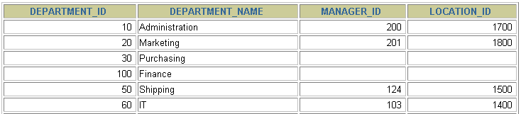
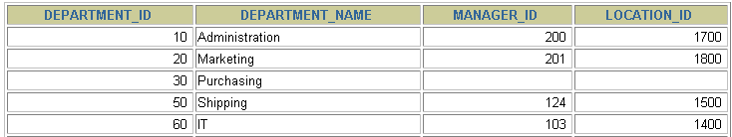
Removing a Row from a Table
DEPARTMENTS
Delete a row from the DEPARTMENTS table.
Notes:
Removing a Row from a Table
The slide graphic removes the Finance department from the DEPARTMENTS table (assuming that there are no constraints defined on the DEPARTMENTS table).
Instructor Note
After all the rows have been eliminated with the DELETE statement, only the data structure of the table remains. A more efficient method of emptying a table is with the TRUNCATE statement. You can use the TRUNCATE statement to quickly remove all rows from a table or cluster. Removing rows with the TRUNCATE statement is faster than removing them with the DELETE statement for the following reasons:
The TRUNCATE statement is a data definition language (DDL) statement and generates no rollback information. It is covered in a subsequent lesson.
Truncating a table does not fire the delete triggers of the table.
If the table is the parent of a referential integrity constraint, you cannot truncate the table. Disable the constraint before issuing the TRUNCATE statement.

Slide 70
The DELETE Statement
You can remove existing rows from a table by using
the DELETE statement.
DELETE [FROM] table
[WHERE condition];
Notes:
Deleting Rows
You can remove existing rows by using the DELETE statement.
In the syntax:
table is the table name condition identifies the rows to be deleted and is composed of column names, expressions, constants, subqueries, and comparison operators
Note: If no rows are deleted, a message “0 rows deleted.” is returned:
For more information, see Oracle9i SQL Reference, “DELETE.”
Instructor Note
The DELETE statement does not ask for confirmation. However, the delete operation is not made permanent until the data transaction is committed. Therefore, you can undo the operation with the ROLLBACK statement if you make a mistake.

Slide 71
Deleting Rows from a Table
Specific rows are deleted if you specify the WHERE clause.
All rows in the table are deleted if you omit the WHERE clause.
DELETE FROM departments
WHERE department_name = 'Finance';
1 row deleted.
DELETE FROM copy_emp;
22 rows deleted.
Notes:
Deleting Rows (continued)
You can delete specific rows by specifying the WHERE clause in the DELETE statement. The slide example deletes the Finance department from the DEPARTMENTS table. You can confirm the delete operation by displaying the deleted rows using the SELECT statement.
SELECT *
FROM departments
WHERE department_name = 'Finance';
no rows selected.
If you omit the WHERE clause, all rows in the table are deleted. The second example on the slide deletes all the rows from the COPY_EMP table, because no WHERE clause has been specified.
Example
Remove rows identified in the WHERE clause.
DELETE FROM employees
WHERE employee_id = 114;
1 row deleted.
DELETE FROM departments
WHERE department_id IN (30, 40);
2 rows deleted.

Slide 72
The MERGE Statement
Provides the ability to conditionally update or insert data into a database table
Performs an UPDATE if the row exists, and an INSERT if it is a new row:
Avoids separate updates
Increases performance and ease of use
Is useful in data warehousing applications
Notes:
MERGE Statements
SQL has been extended to include the MERGE statement. Using this statement, you can update or insert a row conditionally into a table, thus avoiding multiple UPDATE statements. The decision whether to update or insert into the target table is based on a condition in the ON clause.
Since the MERGE command combines the INSERT and UPDATE commands, you need both INSERT and UPDATE privileges on the target table and the SELECT privilege on the source table.
The MERGE statement is deterministic. You cannot update the same row of the target table multiple times in the same MERGE statement.
An alternative approach is to use PL/SQL loops and multiple DML statements. The MERGE statement, however, is easy to use and more simply expressed as a single SQL statement.
The MERGE statement is suitable in a number of data warehousing applications. For example, in a data warehousing application, you may need to work with data coming from multiple sources, some of which may be duplicates. With the MERGE statement, you can conditionally add or modify rows.

Slide 73
The MERGE Statement Syntax
You can conditionally insert or update rows in a
table by using the MERGE statement.
MERGE INTO table_name table_alias
USING (table|view|sub_query) alias
ON (join condition)
WHEN MATCHED THEN
UPDATE SET
col1 = col_val1,
col2 = col2_val
WHEN NOT MATCHED THEN
INSERT (column_list)
VALUES (column_values);
Notes:
Merging Rows
You can update existing rows and insert new rows conditionally by using the MERGE statement.
In the syntax:
INTO clause specifies the target table you are updating or inserting into
USING clause identifies the source of the data to be updated or inserted; can be a table, view, or subquery
ON clause the condition upon which the MERGE operation either updates or inserts
WHEN MATCHED | instructs the server how to respond to the results of the join condition
WHEN NOT MATCHED
For more information, see Oracle9i SQL Reference, “MERGE.”

Slide 74
Merging Rows
Insert or update rows in the COPY_EMP table to match
the EMPLOYEES table.
MERGE INTO copy_emp c
USING employees e
ON (c.employee_id = e.employee_id)
WHEN MATCHED THEN
UPDATE SET
c.first_name = e.first_name,
c.last_name = e.last_name,
...
c.department_id = e.department_id
WHEN NOT MATCHED THEN
INSERT VALUES(e.employee_id, e.first_name, e.last_name,
e.email, e.phone_number, e.hire_date, e.job_id,
e.salary, e.commission_pct, e.manager_id,
e.department_id);
Notes:
Example of Merging Rows
MERGE INTO copy_emp c
USING employees e
ON (c.employee_id = e.employee_id)
WHEN MATCHED THEN
UPDATE SET
c.first_name = e.first_name,
c.last_name = e.last_name,
c.email = e.email,
c.phone_number = e.phone_number,
c.hire_date = e.hire_date,
c.job_id = e.job_id,
c.salary = e.salary,
c.commission_pct = e.commission_pct,
c.manager_id = e.manager_id,
c.department_id = e.department_id
WHEN NOT MATCHED THEN
INSERT VALUES(e.employee_id, e.first_name, e.last_name,
e.email, e.phone_number, e.hire_date, e.job_id,
e.salary, e.commission_pct, e.manager_id,
e.department_id);
The example shown matches the EMPLOYEE_ID in the COPY_EMP table to the EMPLOYEE_ID in the EMPLOYEES table. If a match is found, the row in the COPY_EMP table is updated to match the row in the EMPLOYEES table. If the row is not found, it is inserted into the COPY_EMP table.

Slide 75
SQL COMMANDS
DDL (Data Definition Language)
DML (Data Manipulation Language)
DCL (Data Control Language)
DQL (Data Query Language)
CREATE
ALTER
DROP
RENAME
TRUNCATE
COMMENT
INSERT
UPDATE
DELETE
MERGE
GRANT
REVOKE
SELECT

Slide 76
Controlling User Access
Database
administrator
Username and password
Privileges
Users
Notes:
Controlling User Access
In a multiple-user environment, you want to maintain security of the database access and use. With Oracle server database security, you can do the following:
Control database access
Give access to specific objects in the database
Confirm given and received privileges with the Oracle data dictionary
Create synonyms for database objects
Database security can be classified into two categories: system security and data security. System security covers access and use of the database at the system level, such as the username and password, the disk space allocated to users, and the system operations that users can perform. Database security covers access and use of the database objects and the actions that those users can have on the objects.

Slide 77
Privileges
Database security:
System security
Data security
System privileges: Gaining access to the database
Object privileges: Manipulating the content of the database objects
Schemas: Collections of objects, such as tables, views, and sequences
Notes:
Privileges
Privileges are the right to execute particular SQL statements. The database administrator (DBA) is a high-level user with the ability to grant users access to the database and its objects. The users require system privileges to gain access to the database and object privileges to manipulate the content of the objects in the database. Users can also be given the privilege to grant additional privileges to other users or to roles, which are named groups of related privileges.
Schemas
A schema is a collection of objects, such as tables, views, and sequences. The schema is owned by a database user and has the same name as that user.
For more information, see Oracle9i Application Developer’s Guide - Fundamentals, “Establishing a Security Policy” section, and Oracle9i Concepts, “Database Security” topic.

Slide 78
Creating Users
The DBA creates users by using the CREATE USER statement.
CREATE USER user
IDENTIFIED BY password;
CREATE USER scott
IDENTIFIED BY tiger;
User created.
Notes:
Creating a User
The DBA creates the user by executing the CREATE USER statement. The user does not have any privileges at this point. The DBA can then grant privileges to that user. These privileges determine what the user can do at the database level.
The slide gives the abridged syntax for creating a user.
In the syntax:
user is the name of the user to be created
password specifies that the user must log in with this password
For more information, see Oracle9i SQL Reference, “GRANT” and “CREATE USER.”
Instructor Note
For information on DROP USER, refer to Oracle9i SQL Reference, “DROP USER.”

Slide 79
Granting System Privileges
The DBA can grant a user specific system privileges.
GRANT create session, create table,
create sequence, create view
TO scott;
Grant succeeded.
Notes:
Granting System Privileges
The DBA uses the GRANT statement to allocate system privileges to the user. Once the user has been granted the privileges, the user can immediately use those privileges.
In the example on the slide, user Scott has been assigned the privileges to create sessions, tables, sequences, and views.
Instructor Note
A user needs to have the required space quota to create tables.

Slide 80
What is a Role?
Users
Manager
Privileges
Allocating privileges
without a role
Allocating privileges
with a role
Notes:
What is a Role?
A role is a named group of related privileges that can be granted to the user. This method makes it easier to revoke and maintain privileges.
A user can have access to several roles, and several users can be assigned the same role. Roles are typically created for a database application.
Creating and Assigning a Role
First, the DBA must create the role. Then the DBA can assign privileges to the role and users to the role.
Syntax
CREATE ROLE role;
In the syntax:
role is the name of the role to be created
Now that the role is created, the DBA can use the GRANT statement to assign users to the role as well as assign privileges to the role.
Instructor Note
Discuss the following four points about roles:
Are named groups of related privileges
Can be granted to users
Simplify the process of granting and revoking privileges
Are created by a DBA

Slide 81
Creating and Granting Privileges to a Role
Create a role
Grant privileges to a role
Grant a role to users
CREATE ROLE manager;
Role created.
GRANT create table, create view
TO manager;
Grant succeeded.
GRANT manager TO DEHAAN, KOCHHAR;
Grant succeeded.
Notes:
Creating a Role
The example on the slide creates a manager role and then allows managers to create tables and views. It then grants DeHaan and Kochhar the role of managers. Now DeHaan and Kochhar can create tables and views.
If users have multiple roles granted to them, they receive all of the privileges associated with all of the roles.

Slide 82
Granting Object Privileges
Grant query privileges on the EMPLOYEES table.
Grant privileges to update specific columns to users and roles.
GRANT select
ON employees
TO sue, rich;
Grant succeeded.
GRANT update (department_name, location_id)
ON departments
TO scott, manager;
Grant succeeded.
Notes:
Guidelines
To grant privileges on an object, the object must be in your own schema, or you must have been granted the object privileges WITH GRANT OPTION.
An object owner can grant any object privilege on the object to any other user or role of the database.
The owner of an object automatically acquires all object privileges on that object.
The first example on the slide grants users Sue and Rich the privilege to query your EMPLOYEES table. The second example grants UPDATE privileges on specific columns in the DEPARTMENTS table to Scott and to the manager role.
If Sue or Rich now want to SELECT data from the employees table, the syntax they must use is:
SELECT *
FROM scott.employees;
Alternatively, they can create a synonym for the table and SELECT from the synonym:
CREATE SYNONYM emp FOR scott.employees;
SELECT * FROM emp;
Note: DBAs generally allocate system privileges; any user who owns an object can grant object privileges.
Instructor Note
Please read the Instructor Note at the end of this lesson.

Slide 83
Using the WITH GRANT OPTION and PUBLIC Keywords
Give a user authority to pass along privileges.
Allow all users on the system to query data from Alice’s DEPARTMENTS table.
GRANT select, insert
ON departments
TO scott
WITH GRANT OPTION;
Grant succeeded.
GRANT select
ON alice.departments
TO PUBLIC;
Grant succeeded.
Notes:
The WITH GRANT OPTION Keyword
A privilege that is granted with the WITH GRANT OPTION clause can be passed on to other users and roles by the grantee. Object privileges granted with the WITH GRANT OPTION clause are revoked when the grantor’s privilege is revoked.
The example on the slide gives user Scott access to your DEPARTMENTS table with the privileges to query the table and add rows to the table. The example also allows Scott to give others these privileges.
The PUBLIC Keyword
An owner of a table can grant access to all users by using the PUBLIC keyword.
The second example allows all users on the system to query data from Alice’s DEPARTMENTS table.
Instructor Note
If a statement does not use the full name of an object, the Oracle server implicitly prefixes the object name with the current user’s name (or schema). If user Scott queries the DEPARTMENTS table, for example, the system selects from the SCOTT.DEPARTMENTS table.
If a statement does not use the full name of an object, and the current user does not own an object of that name, the system prefixes the object name with PUBLIC. For example, if user Scott queries the USER_OBJECTS table, and Scott does not own such a table, the system selects from the data dictionary view by way of the PUBLIC.USER_OBJECTS public synonym.

Slide 84
How to Revoke Object Privileges
You use the REVOKE statement to revoke privileges granted to other users.
Privileges granted to others through the WITH GRANT OPTION clause are also revoked.
REVOKE {privilege [, privilege...]|ALL}
ON object
FROM {user[, user...]|role|PUBLIC}
[CASCADE CONSTRAINTS];
Notes:
Revoking Object Privileges
You can remove privileges granted to other users by using the REVOKE statement. When you use the REVOKE statement, the privileges that you specify are revoked from the users you name and from any other users to whom those privileges were granted through the WITH GRANT OPTION clause.
In the syntax:
CASCADE is required to remove any referential integrity constraints made to the CONSTRAINTS object by means of the REFERENCES privilege
For more information, see Oracle9i SQL Reference, “REVOKE.”

Slide 85
Revoking Object Privileges
As user Alice, revoke the SELECT and INSERT privileges given to user Scott on the DEPARTMENTS table.
REVOKE select, insert
ON departments
FROM scott;
Revoke succeeded.
Notes:
Revoking Object Privileges (continued)
The example on the slide revokes SELECT and INSERT privileges given to user Scott on the DEPARTMENTS table.
Note: If a user is granted a privilege with the WITH GRANT OPTION clause, that user can also grant the privilege with the WITH GRANT OPTION clause, so that a long chain of grantees is possible, but no circular grants are permitted. If the owner revokes a privilege from a user who granted the privilege to other users, the revoking cascades to all privileges granted.
For example, if user A grants SELECT privilege on a table to user B including the WITH GRANT OPTION clause, user B can grant to user C the SELECT privilege with the WITH GRANT OPTION clause as well, and user C can then grant to user D the SELECT privilege. If user A revokes privilege from user B, then the privileges granted to users C and D are also revoked.
Instructor Note
Revoking system privileges is not within the scope of this lesson. For information on this topic refer to: Oracle9i SQL Reference, “REVOKE system_privileges_and_roles. ”

Slide 87
Dismissal
You will… | I will...
make sure your space is clean and organized complete your class job if you have one make sure you have your homework or the directions for homework have <insert teacher’s name> sign off on your behavior <folder/sheet> and place it in your backpack sit quietly until you are dismissed (Is it OK to talk? Absolutely! Just make sure you are using a whisper voice so we can hear all announcements!) say goodbye to <insert teacher’s name> and your friends as you leave | look to make sure all student spaces are clean and organized make sure you are completing your class job, if you have one sign off on your behavior <folder/sheet> <insert what you will do during dismissal… will you be reading to them, talking to them about their day, doing work, etc.?>

Slide 88
THANK YOU!

