Slide 1
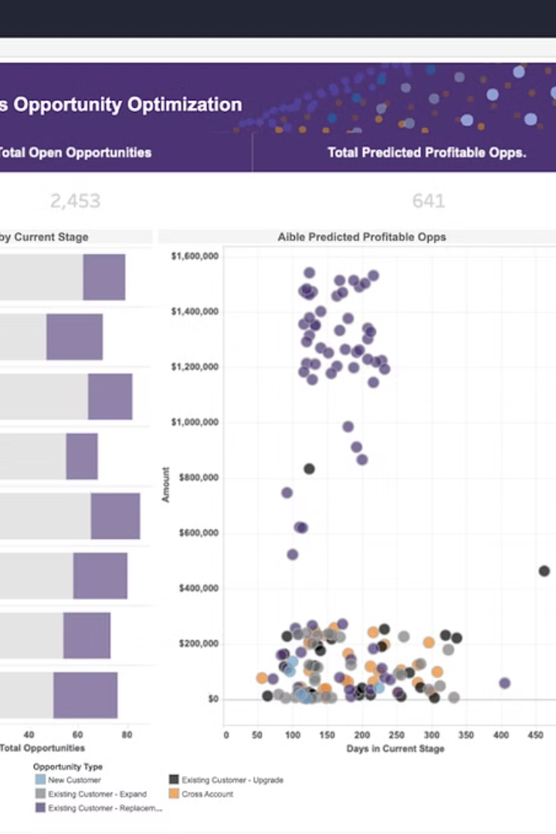


Introduction to Finance Dashboard App with Machine Learning
An innovative finance dashboard app with integrated machine learning capabilities is designed to provide advanced data analysis and predictive insights for financial decision-making.
by NARALASETTY VARUN .

Slide 2

Overview of MERN Stack
1
Frontend & Backend
MERN stack comprises MongoDB, Express.js, React, and Node.js, offering a comprehensive solution for building robust web applications.
2
Component-Based
It follows a modular, component-based architecture, promoting code reusability and efficient development processes.
3
Community Support
With active community support, MERN stack encourages the use of open source technologies and libraries, enabling fast-paced development.

Slide 3
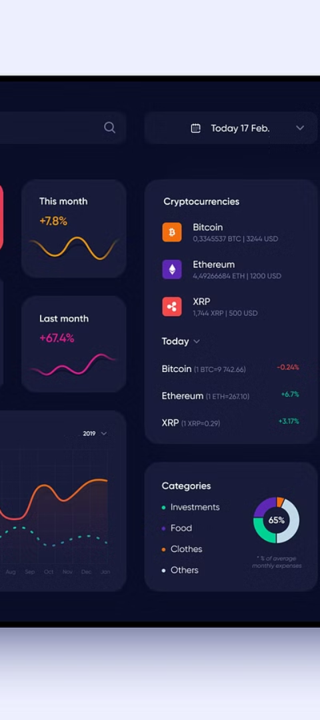
Literature Review on Finance Dashboard App Development
1
Data Visualization
2
User Experience
Research emphasizes the importance of intuitive data visualization techniques tailored for finance-specific metrics.
Studies highlight the significance of user-friendly interfaces and personalized user experiences in finance dashboard apps.
3
Security Measures
The literature stresses the need for robust security protocols to protect sensitive financial data and prevent unauthorized access.

Slide 4
Literature Review on Machine Learning in Finance
Enhanced Predictive Analytics
Risk Management
Studies highlight the effectiveness of machine learning algorithms in enhancing predictive analytics for financial trends and risk assessment.
Literature showcases the role of machine learning in optimizing risk management strategies and identifying early warning signals for potential financial risks.

Slide 5
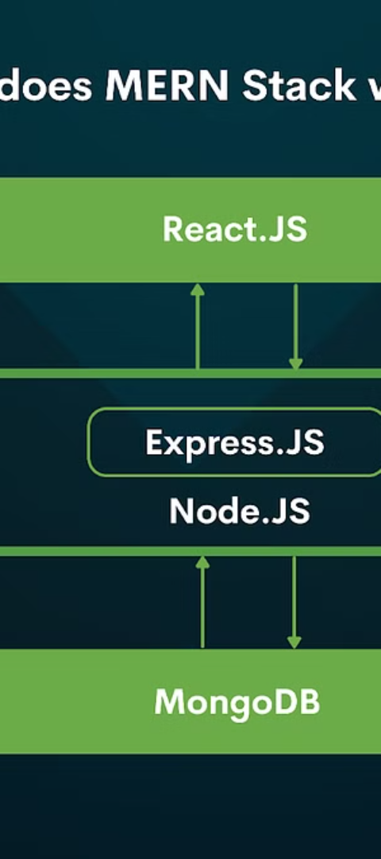

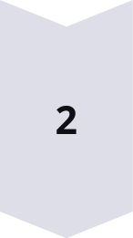
Literature Review on Integrating Machine Learning with MERN Stack
Seamless Integration
Research demonstrates the seamless integration of machine learning models within the MERN stack, enabling real-time data analysis and optimization.
Scalability & Performance
Literature explores the scalable architecture of MERN stack in accommodating machine learning algorithms without compromising performance.

Slide 6
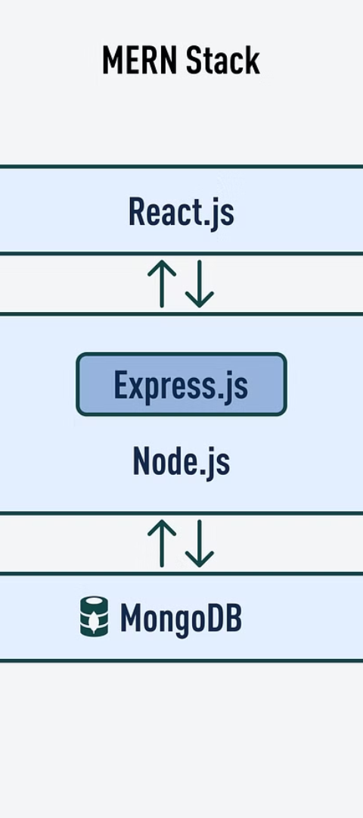
Case Studies of Finance Dashboard Apps with Machine Learning using MERN Stack
Financial Forecasting
Market Trend Analysis
A case study delves into leveraging machine learning within MERN stack to build accurate financial forecasting tools.
Real-world examples showcase MERN stack's role in developing market trend analysis tools using integrated machine learning algorithms.

Slide 7



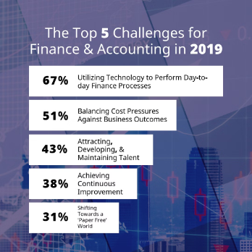
Challenges and Limitations in Developing Finance Dashboard App with Machine Learning using MERN Stack
Technical Complexity
Performance Optimization
Data Model Compatibility
Challenges related to integrating complex machine learning models within the MERN stack architecture are identified.
Understanding data model compatibility issues between MERN stack and machine learning frameworks is crucial to address limitations.
Addressing limitations involves optimizing the performance of machine learning algorithms within the MERN stack environment.

