Slide 1
Hackathon Health Manager

Slide 2
We do not need magic to transform our world. We carry all of the power we need inside ourselves already
-J.K Rowling

Slide 3
1.
INNOVATION

Slide 4
Intelligent Web Application
Details of all pateints is stored.
All reports and presciption are also to be uploaded by pateint.
Advice will be given to pateints according to their previous reports and treatments.
Automatic Detection of Diseases from reports uploaded.

Slide 5
Personalized Doctor
This Application helps pateint to keep a personal doctor 24x7.

Slide 6
TIMELINE
Earlier
In early centuries when doctors were not there people used to go to vaids for their treatment
Mid
Nowadays when the technology has increased to so much extent there are doctors and heath cares in fixed places.
Health Manager
This application will be a enhancement in technology that will help patients to manage and view all medical details.

Slide 7
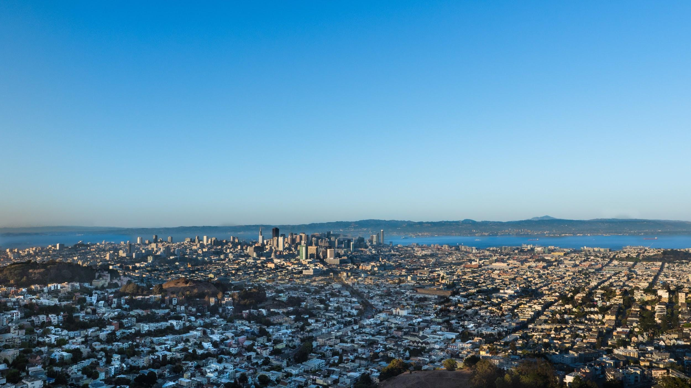
Technologies Used

Slide 8
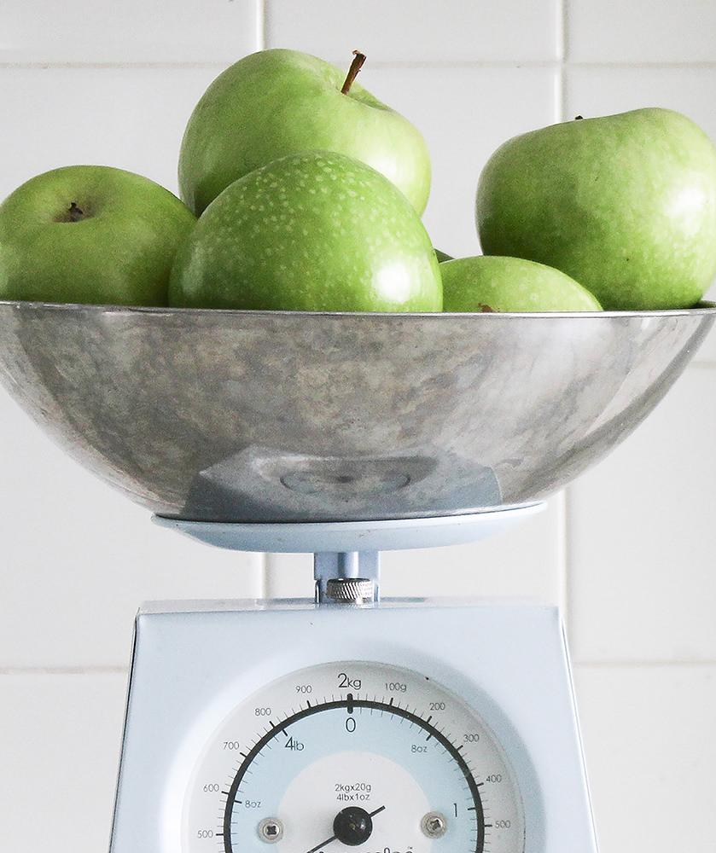
HTML
CSS
JAVA SCRIPT
JSON
BOOTSTRAP
Materialze CSS
JQuery
Facebook Authentication
Google Authentication
OAuth 2.0
Access Tokens for Debugging
Web Content Analysis
Daily Hits
Active users
Platform
Country
Age Gender

Slide 9
Detailed Technologies
Facebook SDK
SDK version 2.5
App ID – 170817 351940 4671
Google SDK
Oauth 2.0
App ID : 77475544713- jv9kgd58uij8cddkgpjbusg3mt5nvdr96. apps.googleusercontent.com
Debugging Delivery of Event
Error Code
Error Message
Error Reason
Bad Request Exception handled fo
Debugging via Long Lived Access Tokens
Code Obfuscation
Image Processing yet to be added (Methodology)

Slide 10
MAPS
OUR OFFICE

Slide 11
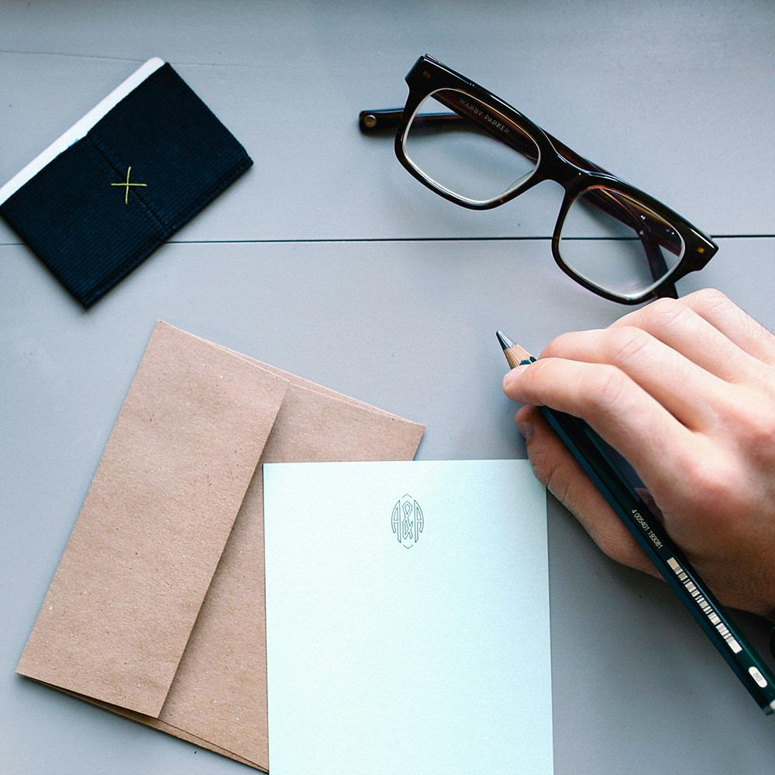
THANKS!
Any questions?

