Slide 1

Advanced
Digital Image Processing
EE 5630
Chapter 7, Project 3 Figure Examples

Slide 2
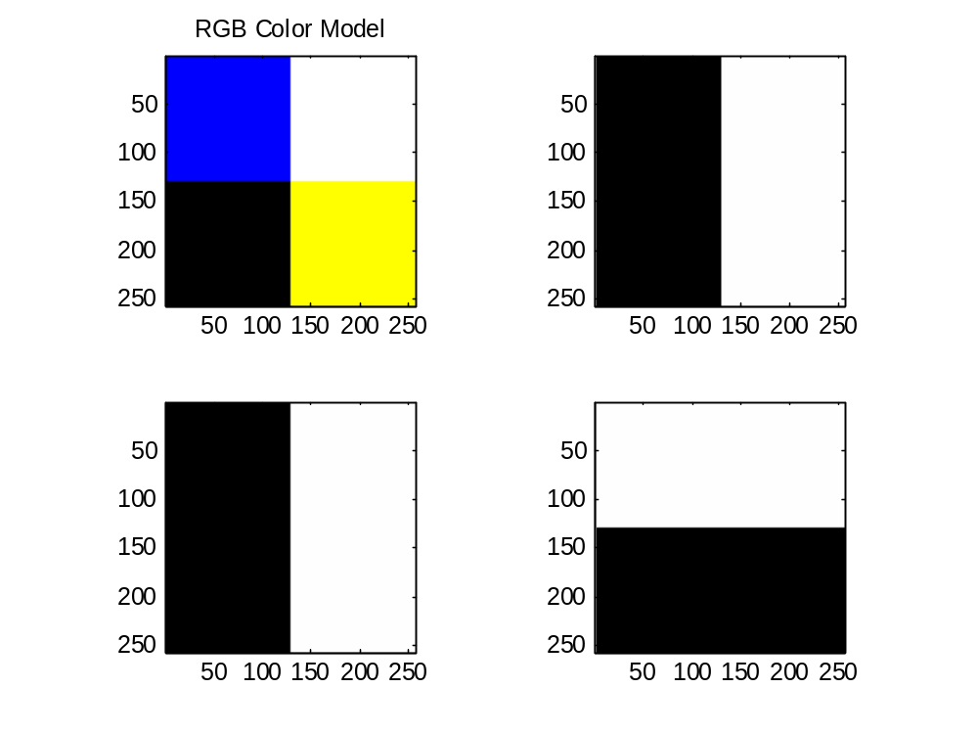

Slide 3
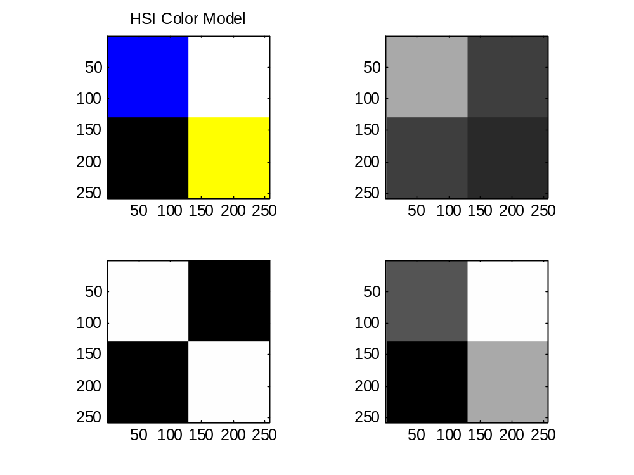

Slide 4
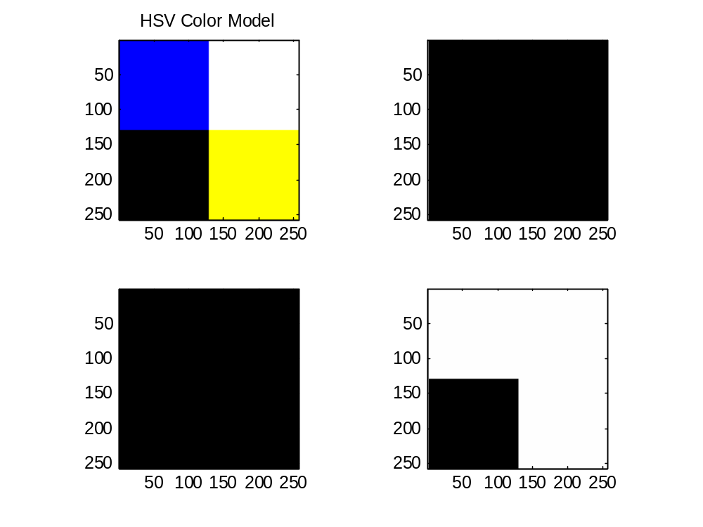
Not part of the project, but from this we can see HSI and HSV are not the same!

Slide 5
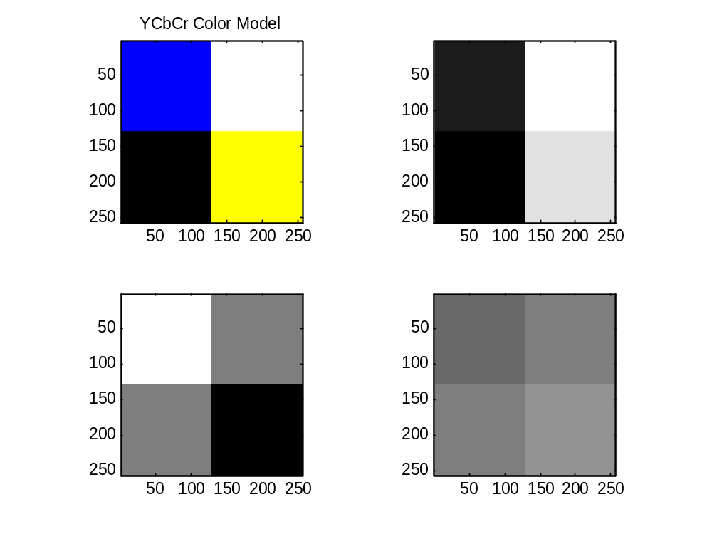

Slide 6
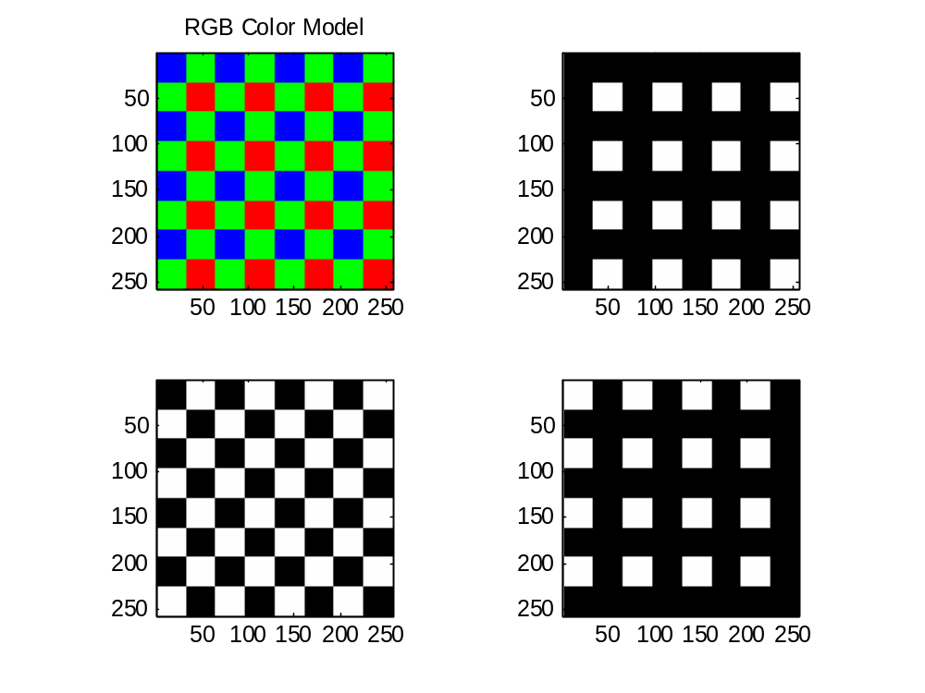

Slide 7
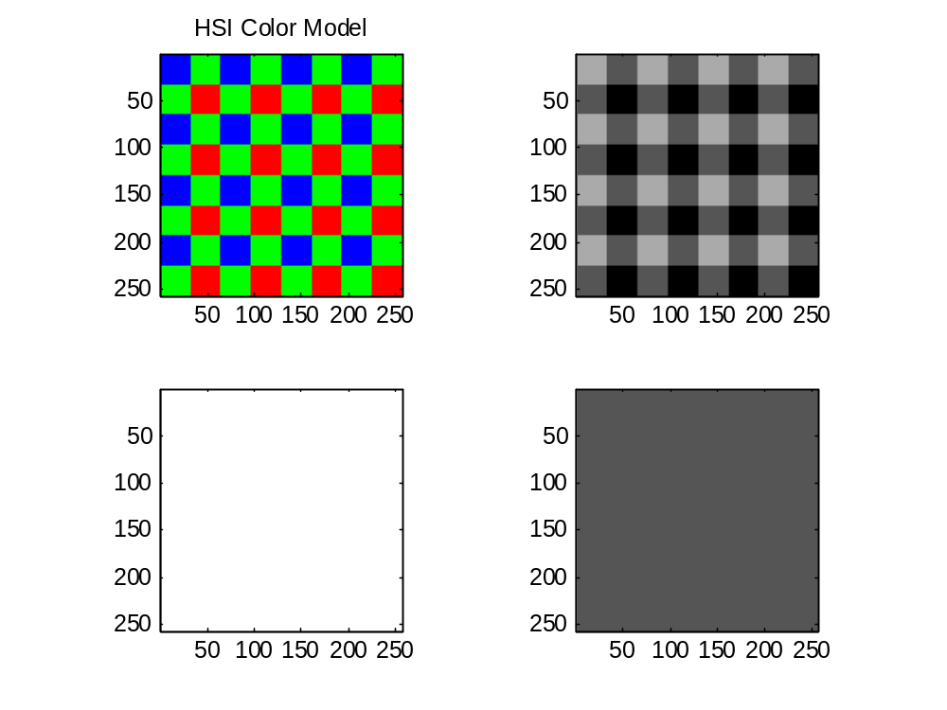

Slide 8
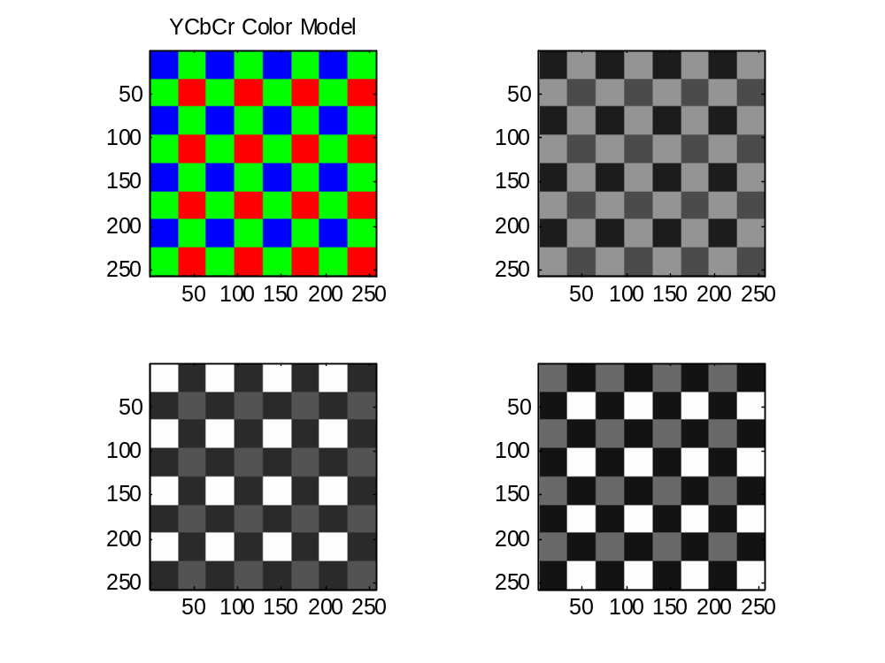

Slide 9
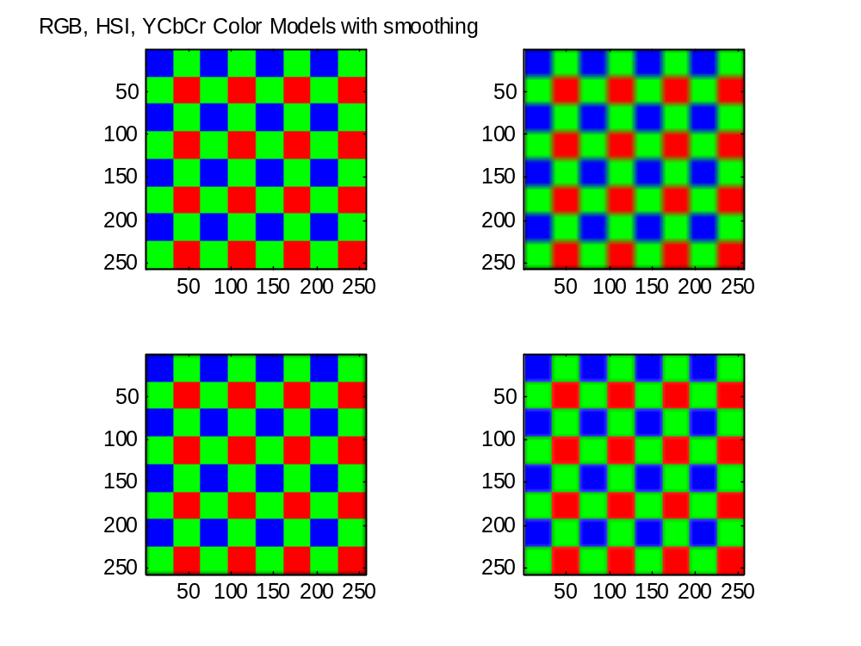

Slide 10
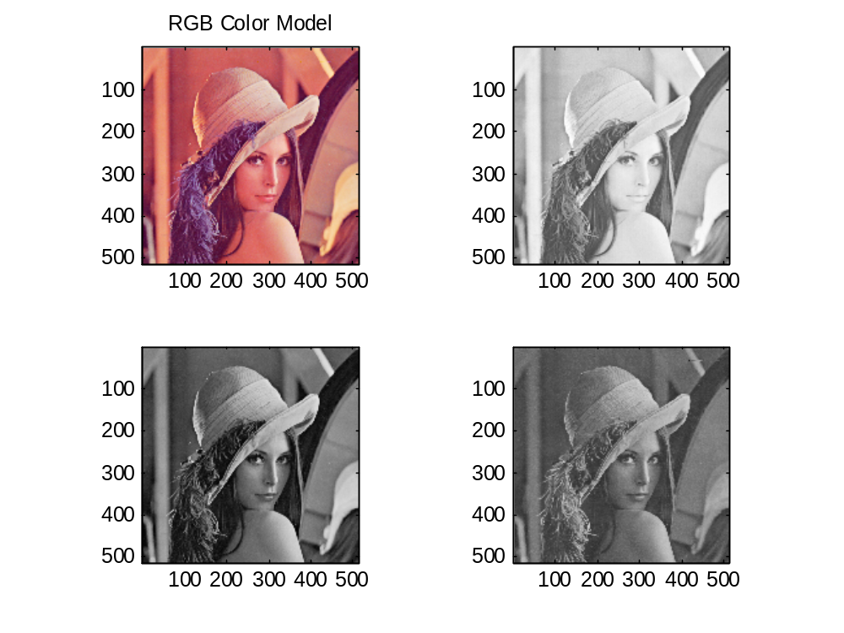

Slide 11
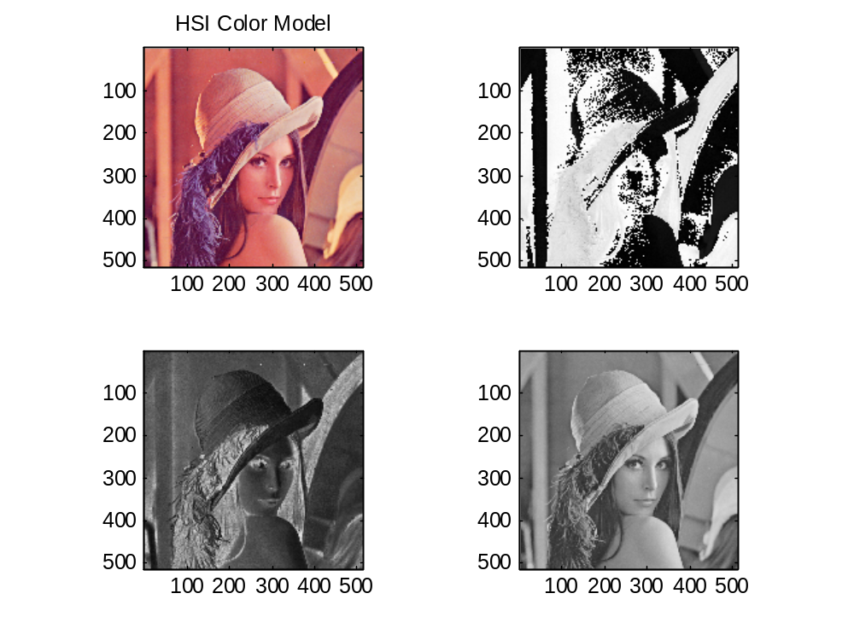

Slide 12
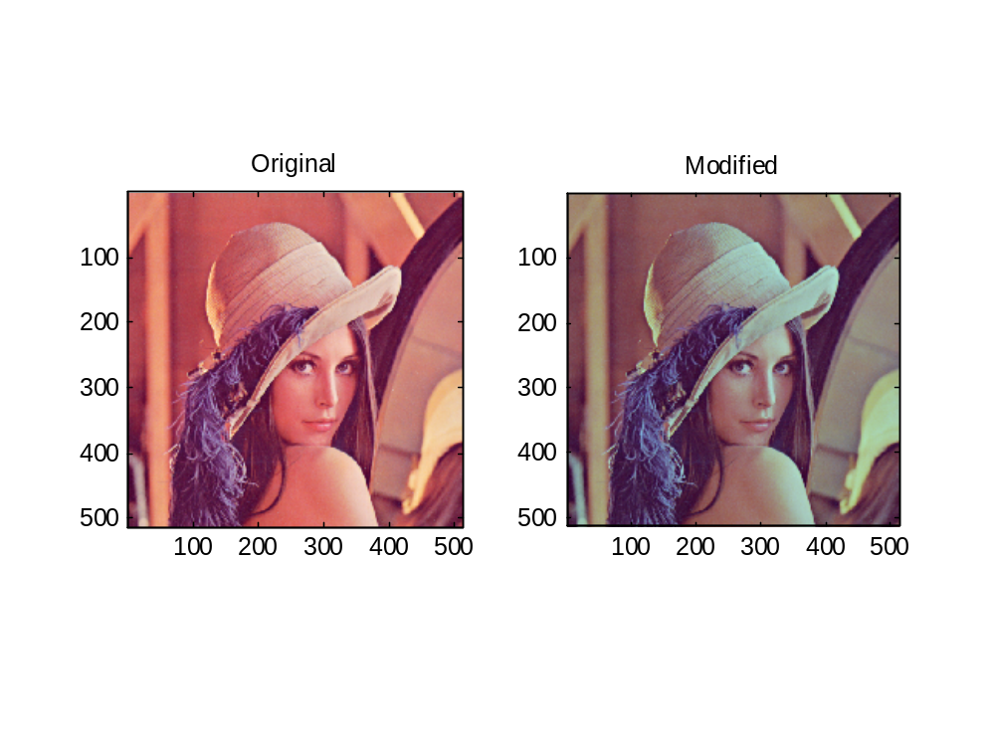
No, this isn’t an optimal modification, just an example. I expect you to get better results for skin tone.

Slide 13
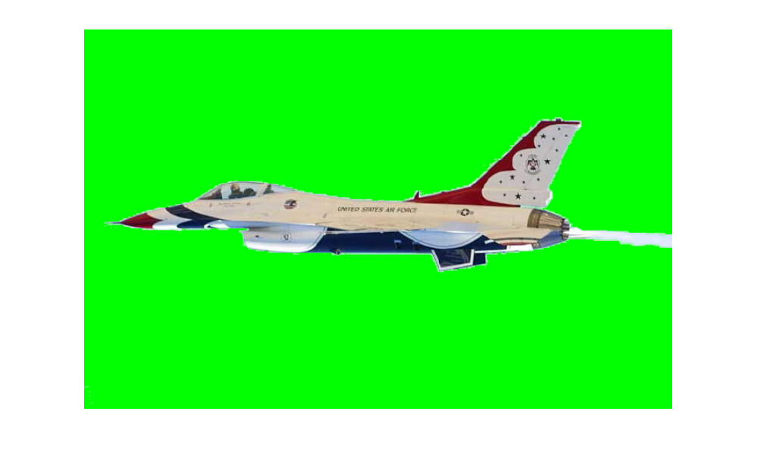

Slide 14
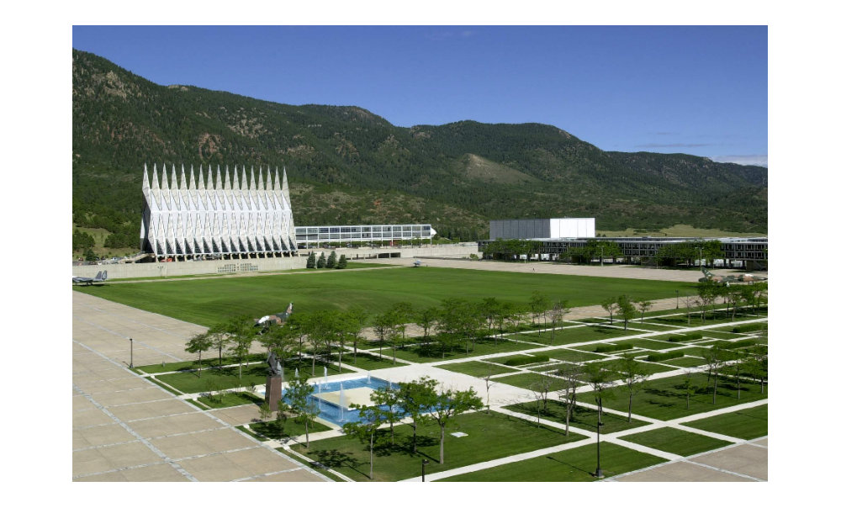

Slide 15


Slide 16
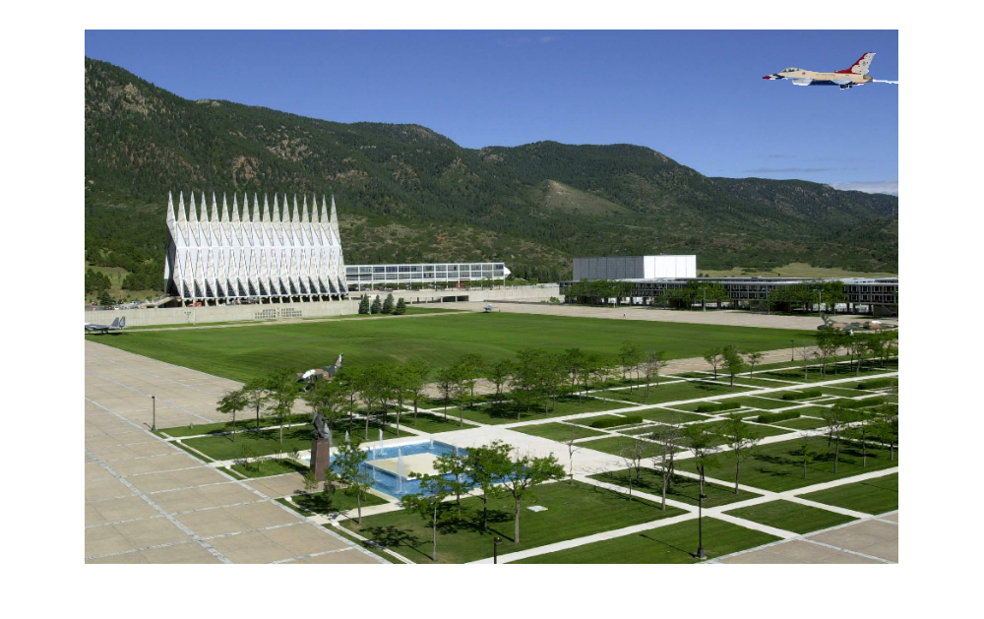

Slide 17
Now doesn’t that look like fun?

