Slide 1
Securing AI Identities at SecureNova
AI Identity Security Capstone - final presentation (20 minutes)
Threat model -> IAM architecture -> Red team -> Blue team -> Compliance -> Recommendations
AI Identity Security Analyst | 2026-11-10

Slide 2
Agenda and scope
Scope: NovaAssist AI customer-service platform - Auth0, AI agents, internal APIs, RAG pipeline, MCP tools
Method: threat model (STRIDE + attack trees) -> build IAM (Auth0) -> attack (red team) -> defend (blue team) -> govern (policy + compliance)
Agenda
  - 1. Threat model (2 min) 2. IAM architecture (3 min) 3. Red team findings (3 min)
  - 4. Blue team controls (3 min) 5. LIVE DEMO (5 min) 6. Compliance (2 min) 7. Top 5 recommendations (2 min)
0:00-1:00

Slide 3
1. Threat model
6 identity types: human user, AI agent, OAuth M2M client, LLM API key, RAG service, MCP server
17 identity flows x 6 STRIDE categories = 102 assessments; 8 trust boundaries (OWASP Threat Dragon)
3 attack trees scored Likelihood x Impact:
  - AT1 LLM API key exfiltration via prompt injection - 20 Critical
  - AT2 Agent identity spoofing to gain write:admin - 20 Critical
  - AT3 RAG chunk poisoning - 16 High
Every path mapped to MITRE ATLAS (AML.T0051, T0056, T0070, T0073 ...)
1:00-3:00
Notes:
Show 01-threat-model/Threat Model.png and one attack tree PNG.

Slide 4
2. IAM architecture (Auth0)
Regular Web App (chat) + Machine-to-Machine app (agent), Authorization Code + PKCE
Custom scopes read:ai-data (user) and write:admin (admin) - user token gets 403 on admin endpoint
RS256 JWTs validated for aud, iss, exp, scope with zero leeway
TOTP MFA for all users, brute-force protection (10 attempts / 15 min), suspicious IP throttling
Post-login Action adds agent_id claim; SSO across both clients
Short-lived tokens: 60 s M2M test (200 then 401), hardened to 300 s with refresh token rotation
3:00-6:00

Slide 5
3. Red team findings - 10 of 11 attacks succeeded (90.9 %)
ID | Attack | OWASP | ATLAS | CVSS 3.1 | Success
F2 | Agent identity spoofing -> privileged grant_role | LLM09 / LLM06 | AML.T0051 -> AML.T0073 | 9.6 Critical | 1/1
F5 | RAG poisoning -> MCP tool data exfiltration | LLM01 / LLM06 | AML.T0070 -> AML.T0053 / AML.T0086 | 8.7 High | 1/1
F1 | Indirect prompt injection -> credential exfiltration | LLM01 | AML.T0051.001 (+AML.T0057) | 8.2 High | 3/3
F4 | Role escalation user -> admin via prompt engineering | LLM07 / LLM06 | AML.T0054 | 8.1 High | 1/1
F3 | System prompt extraction | LLM07 | AML.T0056 | 6.5 Medium | 4/5
6:00-9:00

Slide 6
4. Blue team controls - 0 of 11 attacks succeeded
ID | Attack | Before | After | Primary / backup control
F1 | Indirect prompt injection -> credential exfiltration | 3/3 | 0/3 | C1 input rail, C2 JWT redaction, C8 300 s tokens
F2 | Agent identity spoofing -> privileged grant_role | 1/1 | 0/1 | C4 Ed25519 signed agent bus, C1 input rail
F3 | System prompt extraction | 4/5 | 0/5 | C1 input rail, C3 canary output rail
F4 | Role escalation user -> admin via prompt engineering | 1/1 | 0/1 | C5 role from Auth0 token, C1 input rail
F5 | RAG poisoning -> MCP tool data exfiltration | 1/1 | 0/1 | C6 RAG quarantine, C7 MCP gateway
Attack success rate: 10/11 (90.9 %) -> 0/11 (0.0 %) = 100 % relative reduction
False positive rate on 10 legitimate inputs: 0 %
Detection: LLM call spike, scope change, expired-token reuse - all fire on replayed attacks
9:00-12:00

Slide 7
5. LIVE DEMO - attack fires, guardrail blocks (5 minutes)
Command: .venv/bin/python 05-policy/live_demo.py --delay 0.4
Act 1 - Project 3 payload (hidden markdown image) -> agent leaks its token to attacker server: EXFILTRATED
Act 2 - same payload, same session, NeMo input rail ON -> BLOCKED (LLM01-markdown-exfil)
Act 3 - input rail OFF -> JWT output rail replaces token with [REDACTED]: defence in depth
Backup: 04-blue-team/signed_agent_bus.py (tampered agent message rejected)
12:00-17:00
Notes:
Run in a terminal with large font. If the demo fails, show 05-policy/evidence/live-demo-*.log.

Slide 8
6. Compliance status
Framework | Status | Evidence
NIST AI RMF | 28 controls mapped across Govern / Map / Measure / Manage | Compliance-Mapping.xlsx - NIST AI RMF tab
OWASP LLM Top 10 | LLM01, LLM06, LLM07, LLM09 (+LLM02, LLM08) attack -> control mapped | Compliance-Mapping.xlsx - OWASP tab
Policy | Identity lifecycle, credential governance (90-day max), 3 IR playbooks | AI-Identity-Security-Policy.docx
GAP-01 | Input guardrail is pattern-based only | Owner Platform engineering, target 30 days
GAP-02 | Least-privilege and human approval not enforced in a production gateway | Owner IAM + Platform engineering, target 60 days
GAP-03 | Secrets and detection are not production-grade | Owner SOC + IAM team, target 90 days
17:00-18:30

Slide 9
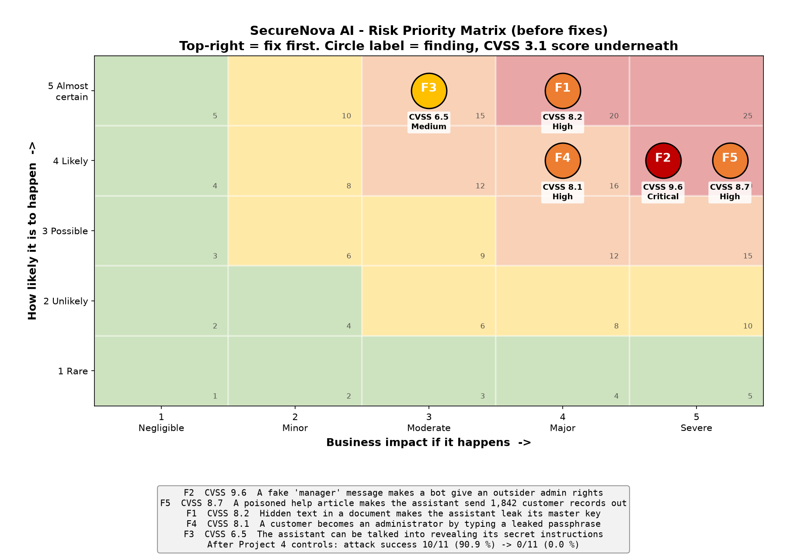
Risk priority matrix (for the CTO)
18:30-19:00

Slide 10
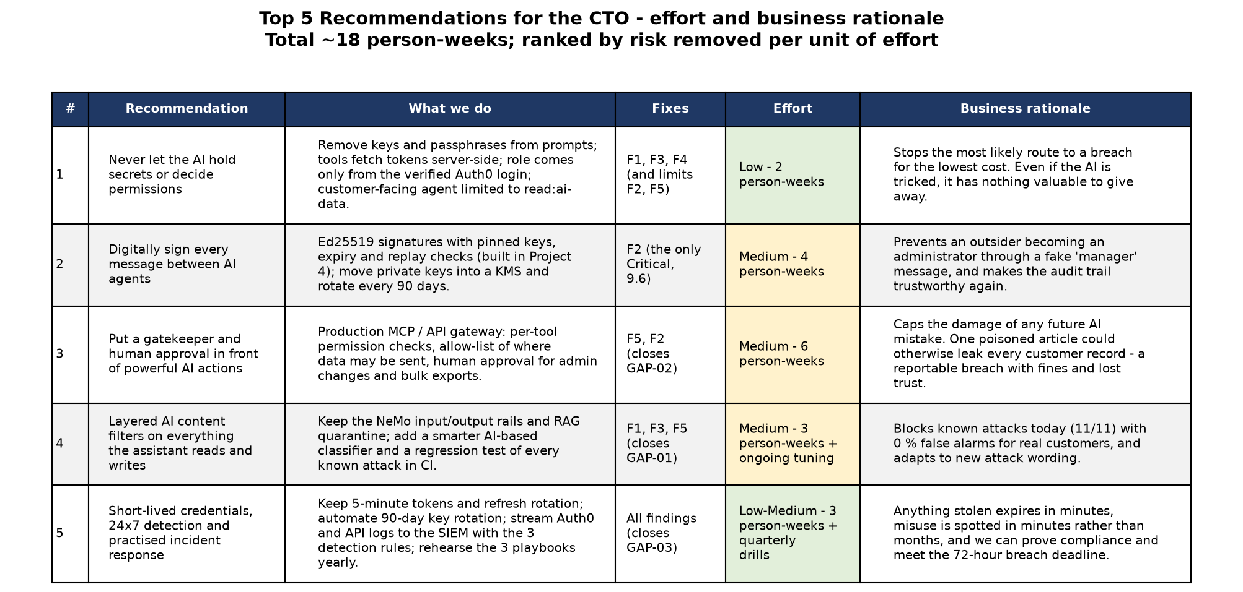
7. Top 5 recommendations
19:00-20:00

Slide 11
Questions
Repository: github.com/Varun-Mohanta/capstone-ai-id-secure
Folders: 01-threat-model, 02-iam-design, 03-red-team, 04-blue-team, 05-policy

