Slide 1


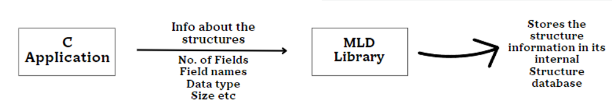
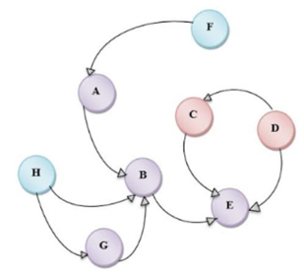
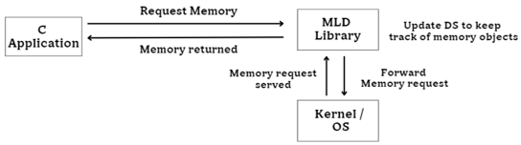
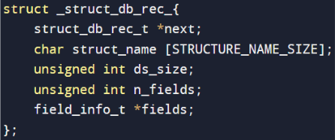
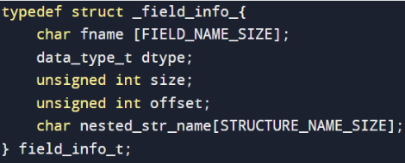

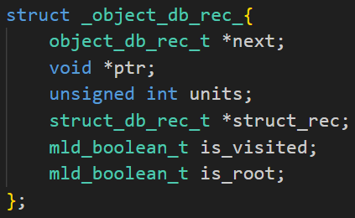
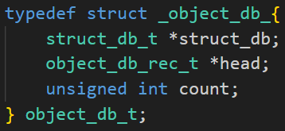

Memory Leak Detection Tool
R V College of Engineering
INTRODUCTION
Procedure
Structure Database
MLD Algorithm
There are two problems related to Memory: Memory corruption and Memory Leak. A memory leak occurs when a process allocates memory and while releasing does not free the memory. As a result, memory is depleted over time and causes slowing down of the system. Java has garbage collector and does not allow programmers to access the physical memory directly, but C / C++ does. So, Java does not suffer from memory corruption.
Normally,
But using the MLD library,
The MLD library must know the information about all the structures used by the application. It is the responsibility of the application to tell MLD library during initialization about all structures. The process of registering the structures used by the application to the MLD library is called Structure Registration. The structure database is maintained using a linked list.
At any point of time the application data structure is a disjoint set of graphs where objects are treated as nodes and one object is connected to other using edges. MLD algorithm runs over the Object and Structure Database and reports those leaked objects. Every graph has a root node which are global or static objects maintained by the application. Thus while traversing from root node , we must be able to reach all other nodes and all unreachable are called leaked objects.
OBJECTIVE
Memory leaks are one of the main reasons for Software Aging. Memory leaks can lead to gradual depletion of available memory resources, eventually causing the application to crash or become unstable. By detecting and addressing memory leaks, the MLD system helps prevent these issues, thereby enhancing the overall stability of the application.
Custom functions Used
Steps in MLD
Object Database
There are some custom functions that we used,
xcalloc() : The xcalloc function is a custom memory allocation function designed to allocate memory for the objects while also registering those objects with a memory leak detection (MLD) system.
xfree() : The xfree function is used to remove the leaked object, that is reported by the MLD algorithm, from the object database and free / deallocate the memory that was allocated to this object.
Create a Structure Database
Create an Object Database
Use the MLD algorithm
The MLD library should have the information about the all the objects that are created by the application. Whenever the new object is created by the application, MLD library will store the relevant information about the object such as corresponding structure details of the object and address of the object. Object record stores the above information. Object record of individual object in used by the application, will be stored in the object database.
References
Raksha Agarwal , Neha Kapil , Rajat Kumar Jain , Dr. Ankit Saxena “Detection of Memory Leaks in C/ C++” February 2020.
Dilip Gangwar , Avita Katal , “Memory Leak Detection Tools : Comparative Analysis” , August 2021.
Vahid Azhari , Simar Bhamra ,“Efficient heap monitoring tool for memory leak detection and root-cause analysis” 2021
System Calls Used
TEAM MEMBERS
Some of the system calls used are,
mmap() : used in xcalloc to allocate the memory to objects to make it more easier and efficient for large data.
mumap() : used in xfree to deallocate the memory that has been allocated using mmap.
Shrivarsha 1RV22CS195
Varun S 1RV22CS227

