Slide 1
IGNITE
Digital Marketing And Trending HOT GADGETS
Varun Shanbhag(A20452310)
Akshay Kulkarni(A20448255)

Slide 2
Data Collection & Processing
Product review data was collected from Amazon Automotive Review data (http://jmcauley.ucsd.edu/data/amazon/)
Json file and have following attribute
  reviewerID – ID of the reviewer
  asin – ID of the product
  reviewerName – name of the reviewer
  helpful – helpfulness rating of the review, e.g. 2/3
  reviewText – text of the review
  overall – rating of the product
  summary – summary of the review
We have done our analysis on following categories viz.
  Books
  Digital Music
  Electronics
  Video Game

Slide 3
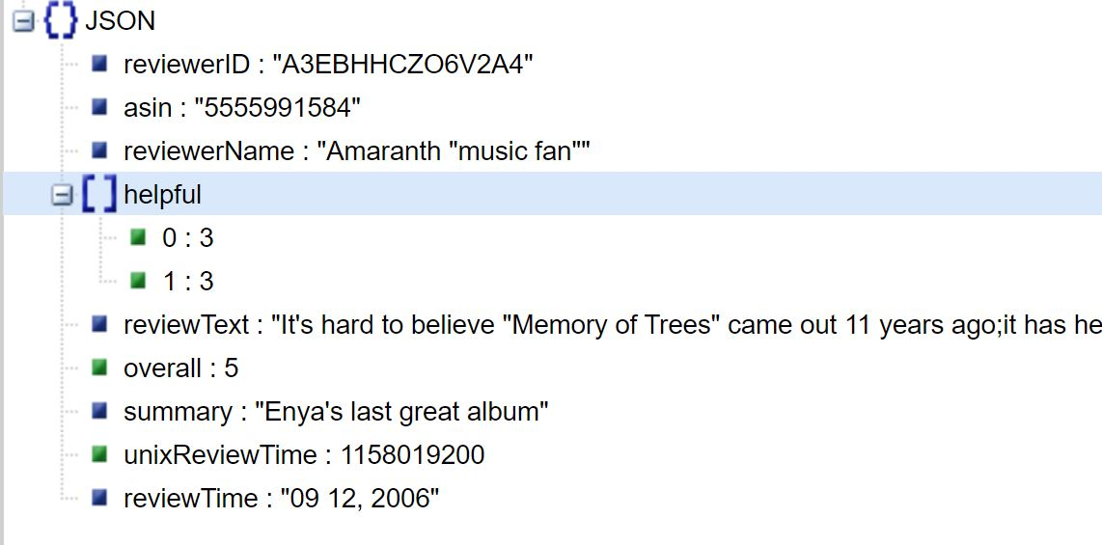
Sample row in json data

Slide 4
Part A – Figuring out Best Product from Data Set
Using python we figure out top 10 products based on ratings
We also consider the number of reviews.
Based on this numbers we create charts for visualization
Part B – Figuring out Trends from Data Set
We parse comment or review text and figure out the most frequent word.
We eliminate stop words.
We also do lemmatization to eliminate noun and adjectives.
https://github.com/Varun-Shanbhag-007/CSP_EWA/blob/master/Trends.ipynb

Slide 5
Displaying processed data on website:
Save all this processed data into database (Mongo)
Query the database and populate the data on website.
Generate real-time links for product based on product id.
  Eg : https://www.amazon.com/dp/<product_id>
Use JS and Servlets to display the data.

Slide 6
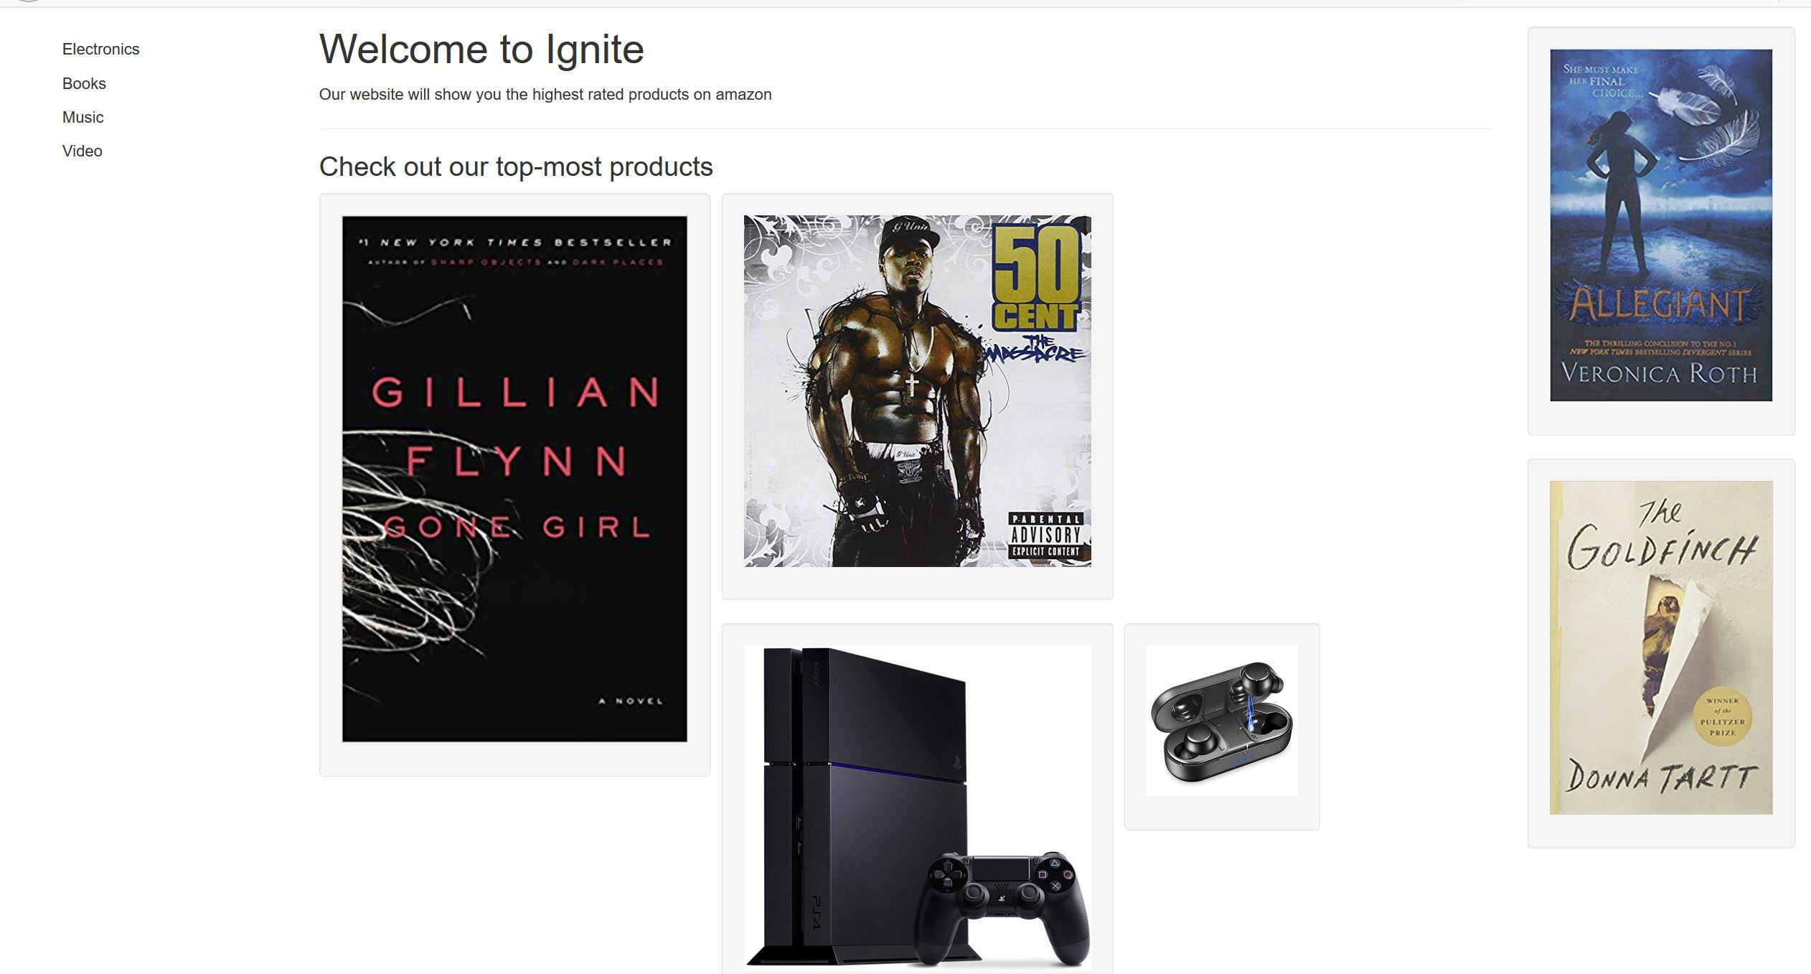

Slide 7
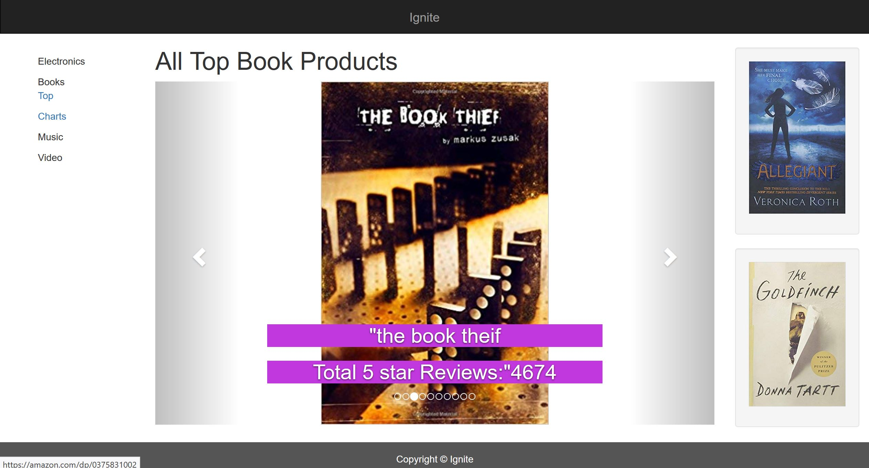

Slide 8
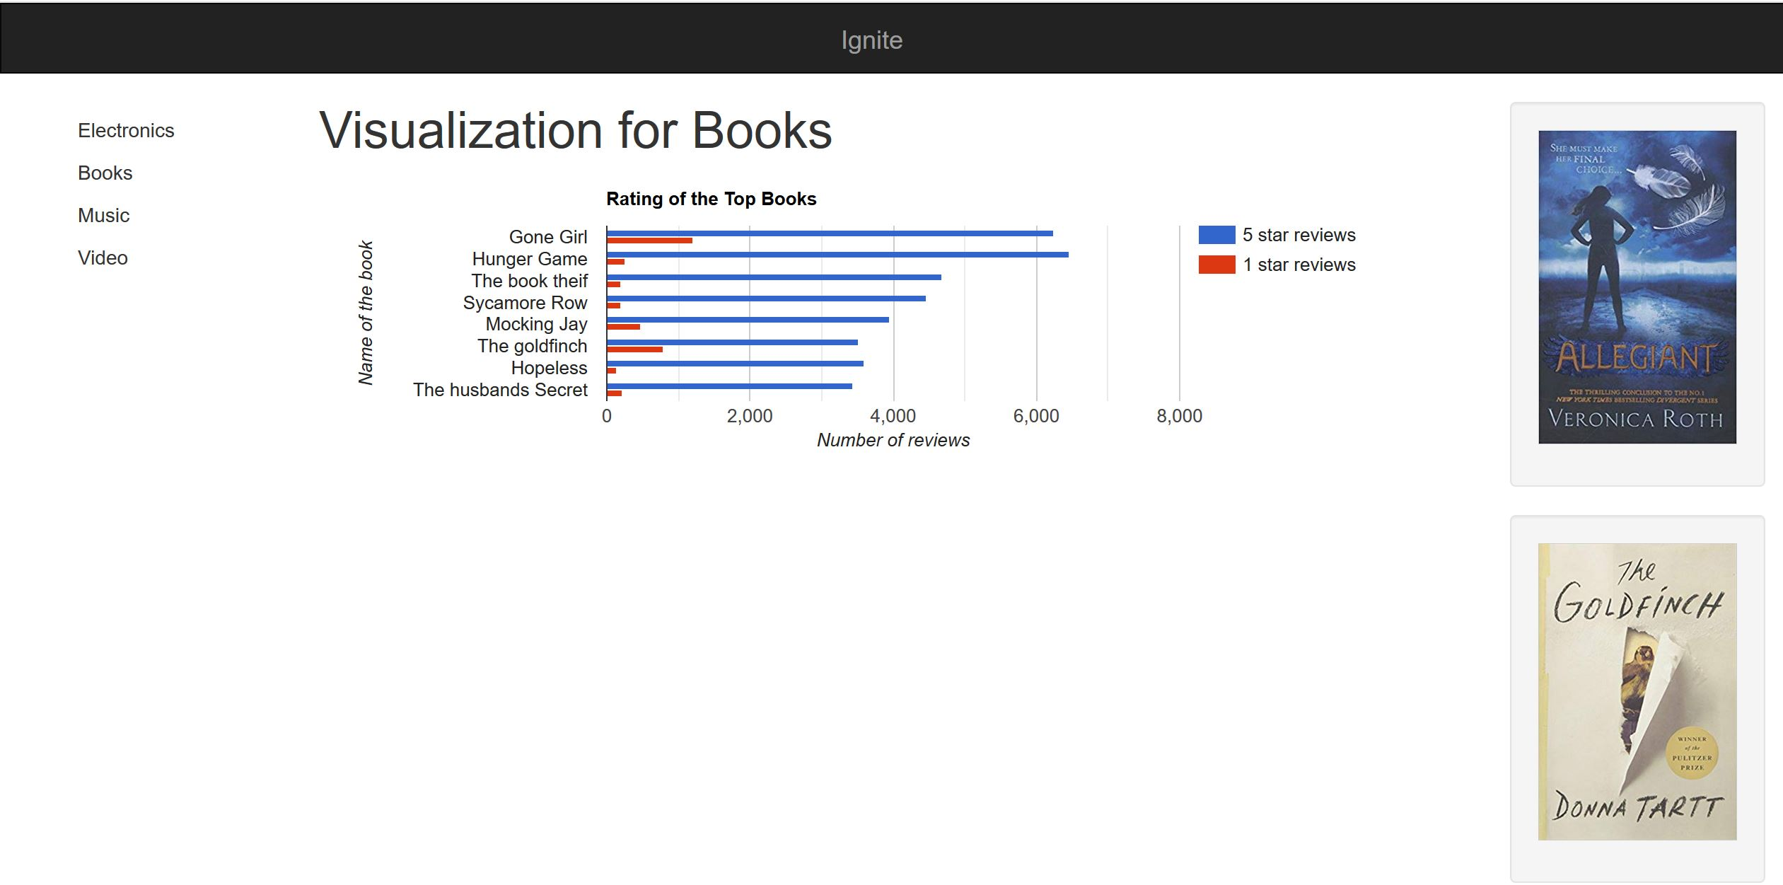

Slide 9
Thanks

