Slide 1
Ignite
(Digital Marketing)
Trending, realtime streaming of hot gadgets
Akshay Kulkarni Varun Shanbagh

Slide 2
Use Case Diagram

Slide 3
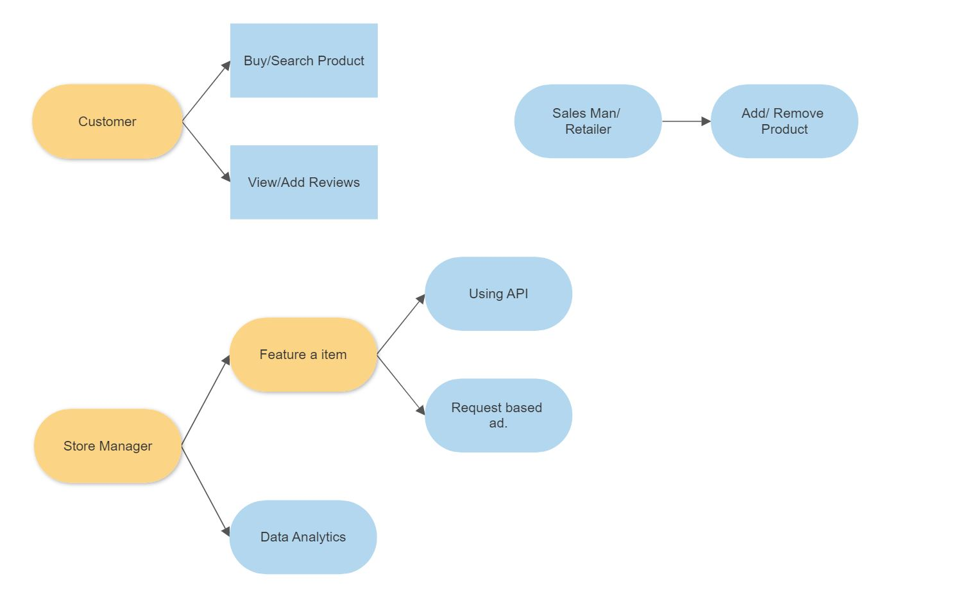

Slide 4
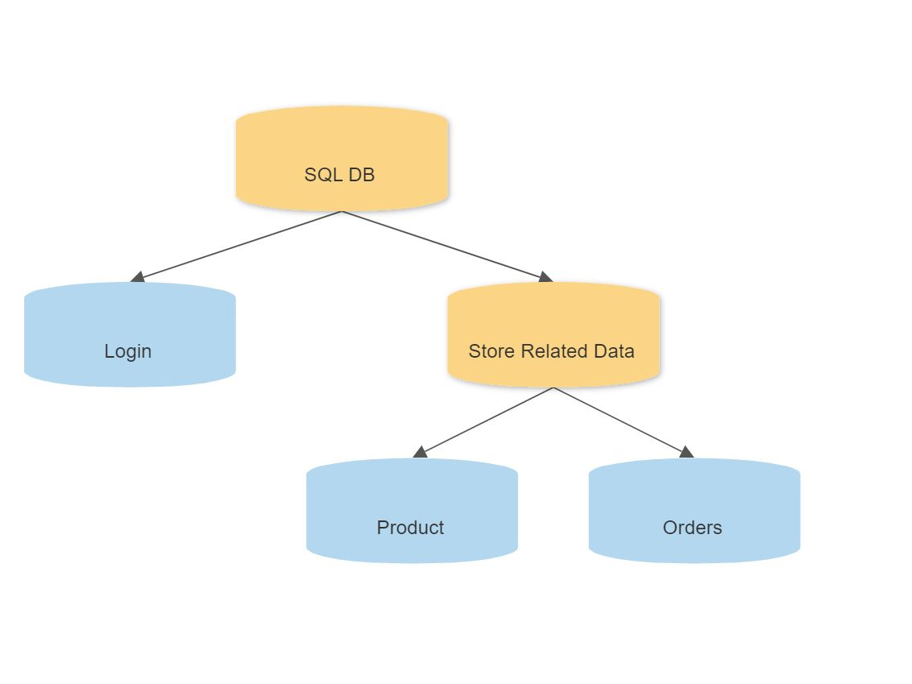

Slide 5
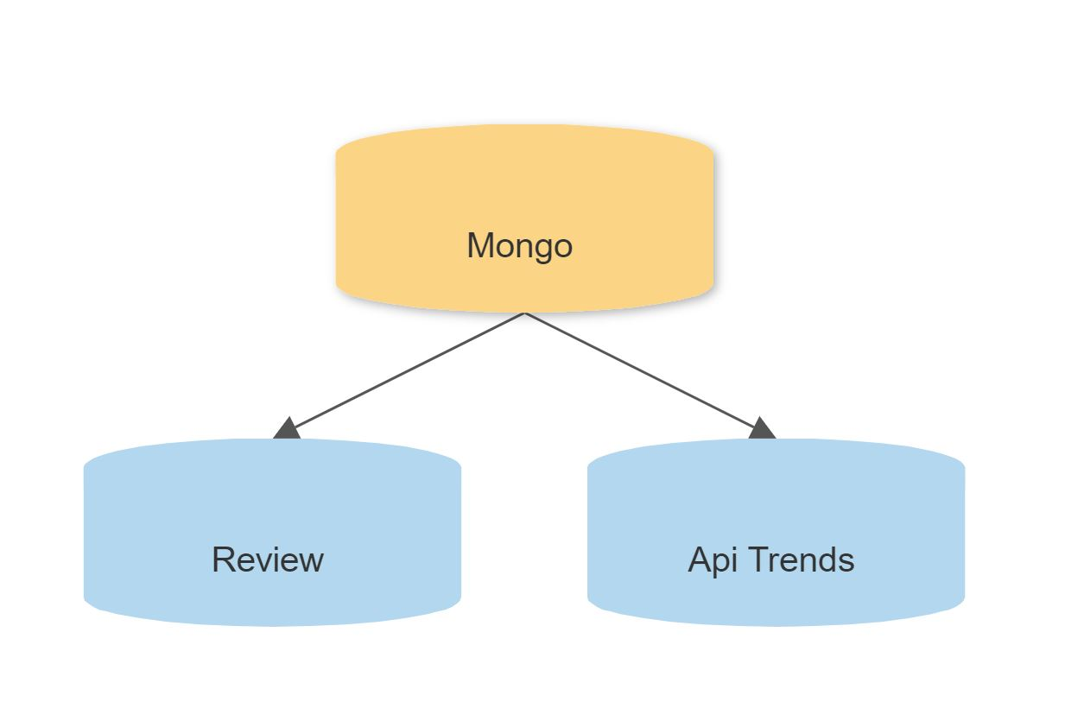

Slide 6
User
View live stream of the product currently getting launched.
Will be able to see real time sentiment analysis of the product.
Can buy the product.
Write reviews/Read reviews.
Will be shown an ad based on his profile.

Slide 7
Store Manager
Will have an ability to feature an item by setting up a parameter.
Data analytics.

Slide 8
Technologies Used
Python
Servlet
Mongo(for storing reviews)
MySQL (for storing products)
APIs like Tweepy and TextBlob

