Slide 1

PROJECT PPT

Slide 2
Student Details
Name : Varun Garlapati
SkillsBuild EmailID : varungarlapati03@gmail.com
College Name : Tirumala Engineering College
College Address : Jonnalagadda, Narasaraopet
Internship Domain : Front End Development

Slide 3
PROJECT TITLE
PORTFOLIO SITE

Slide 4
Agenda
A portfolio website provides a dedicated platform to showcase your skills, projects, and accomplishments. It allows you to present your work in a visually appealing and organized manner, creating a strong impression on potential clients, employers, or collaborators.
A portfolio website is a powerful tool that allows you to showcase your work, build a strong online presence, differentiate yourself, and attract potential clients or employers.
It offers a platform for creativity, professionalism, and effective self-promotion in today's digital age.

Slide 5




Implementation Process for Portfolio Sites
Assess Your Goals
Plan the Structure
Develop the Site
Test and Launch
Define your goals and objectives. Determine what you want your portfolio to achieve.
Determine the site structure, navigation, and content. Sketch the layout.
Utilize the tools and technologies discussed to build the site.
Review functionality, speed, and user experience. Launch your site!

Slide 6
Project Overview
The purpose of a portfolio website is to showcase an individual's or a company's work, skills, and achievements in a visually appealing and organized manner. It serves as an online representation of their professional identity and acts as a platform for potential clients, employers, or collaborators to explore their work and capabilities.
Focus on creating a positive user experience to ensure that visitors can easily navigate the website and find the desired information. The website should be intuitive, responsive, and accessible across different devices and screen sizes.

Slide 7
Who are the End Users
The end users of a portfolio website can vary depending on the purpose and focus of the website. Here are some potential end users for a portfolio website:
Clients : These clients may be individuals, businesses, or organizations looking to hire a professional or engage in a business relationship.
Employers : A portfolio website can be valuable for job seekers, as it allows them to present their skills, experience, and projects to potential employers.
Recruiters: A portfolio website can attract the attention of recruiters who are looking for specific skills or talents.
Students : Your portfolio website can also inspire and provide guidance to students or individuals who are starting their careers in your field.

Slide 8
Your Solution and its Value Proposition
The value proposition of a portfolio website lies in its ability to effectively showcase your skills, work, and achievements to a wide audience, including potential clients, employers, and collaborators.
Personal branding: Your portfolio website is an opportunity to build and showcase your personal brand. Through thoughtful design choices, content creation, and messaging, you can communicate your unique style, values, and strengths.

Slide 9
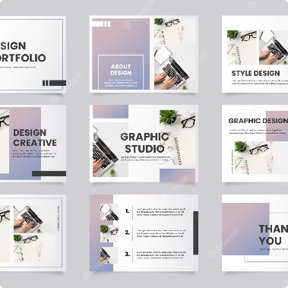

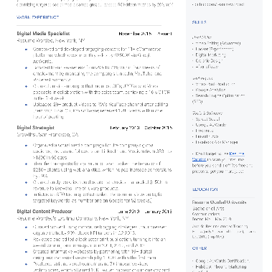
The Importance of a Portfolio Site
First Impression
Networking
Credibility
Your online portfolio represents who you are as a professional. Ensure you leave a lasting impression by building a captivating site.
Your portfolio site showcases your skills and experience. Use it to get hired, secure clients and connect with other professionals.
A professional portfolio site builds credibility and demonstrates your knowledge, skillset and achievements.

Slide 10
How did you Customize the Project and make it your own?
Customizing a project portfolio website involves tailoring the design, content, and functionality to reflect your unque brand.
Consider incorporating your logo or a unique visual element to enhance brand recognition. Customize the navigation menu to reflect the sections and pages relevant to your projects.
Choose a color scheme, typography, and layout that align with your personal or professional aesthetics.

Slide 11
Front End Development Tools and Technologies
JavaScript
Front End Frameworks
Include interactive elements on your site using JavaScript, such as animations, galleries, or contact forms.
Frameworks like React, Angular, and VUE can reduce development time and improve app performance.
1
2
3
4
HTML & CSS
Bootstrap
Use HTML and CSS to build a structure and styling that reflects your brand.
Use Bootstrap to easily build custom and responsive layout that is consistent across different devices.

Slide 12
Modelling
To model a portfolio website, you can follow a structured approach that includes defining the website's purpose, identifying key sections and pages, and organizing the content effectively.
Sections are Home, About, Portfolio, Services, Testimonials, Blog, and Contact.
Include your bio, background, skills, and experience. Highlight your unique selling points and what sets you apart from others in your field.

Slide 13
Design Considerations for Portfolio Sites
User Experience
Typography
Color Scheme
Create a user-friendly design that makes it easy to navigate your site.
Choose a font that aligns with your brand and is easy to read on all devices.
Select a color scheme that supports your message and promotes the visual hierarchy.
Images & Visuals
Use high-quality images and visuals that complement your message and make your portfolio stand out.

Slide 14

Best Practices and Tips for Front End Development
1
Keep it Simple
2
Optimize Performance
3
Maintain Accessibility
Simplicity is key to maintain focus. It is also important to ensure your site is easily maintainable in the future.
Ensure your site is fast and loads quickly. Optimize images, compress files and reduce server requests.
Consider people with visual and auditory disabilities. Ensure that your site is accessible to all individuals.

Slide 15
Results
The result of a portfolio website is a professional and visually appealing online presence that effectively showcases your skills, expertise, and accomplishments.
A well-designed and informative portfolio website enhances your credibility and professionalism.
A well-crafted portfolio website can lead to new opportunities. It can attract potential clients, employers, or collaborators who are impressed by your work and want to engage with you.

Slide 16
Conclusion and Next Steps
Conclusion
Next Steps
By following the tips and best practices mentioned in this presentation, you can build an effective portfolio that showcases your skills and represents your professional brand.
Build your own portfolio or take your existing site to the next level. Continue to learn and incorporate new trends and technologies.

Slide 17
Links
GitHub Project URL : https://github.com/Varun-github7/Project

