Slide 1
OPEN-VOCABULARY MULTIMODAL EMOTION RECOGNITION
Project Report
Lightweight discriminative model · text + audio + visual · short video clips
🎯 Best result: F_s = 44.6 — open-vocabulary emotion recognition (human-aligned 5-fold CV)

Slide 2
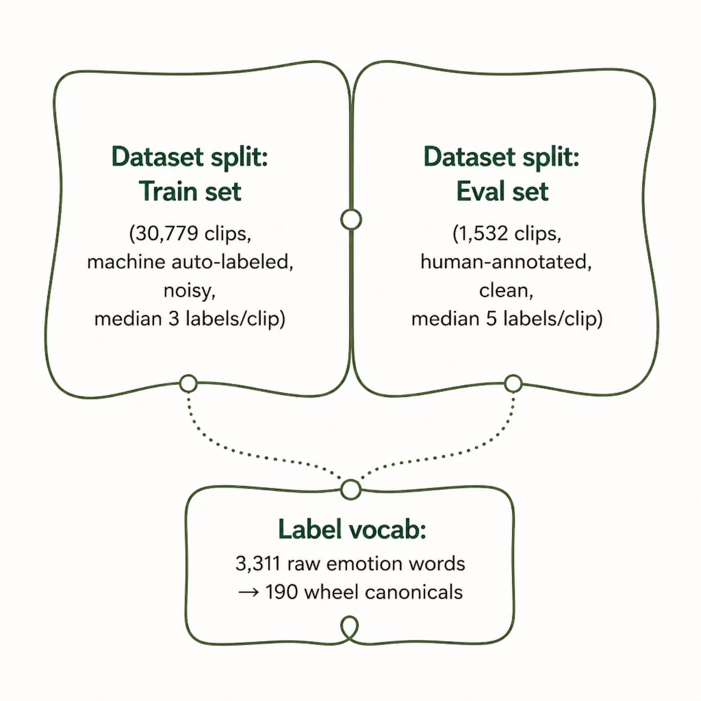
DATA
MER2026 / MER-Caption+ Dataset
Per-Clip Modalities
Audio (WAV)
OpenFace face frames
Chinese & English subtitles
Free-text description
Label Vocabulary
3,311 raw emotion words → 190 wheel canonicals

Slide 3
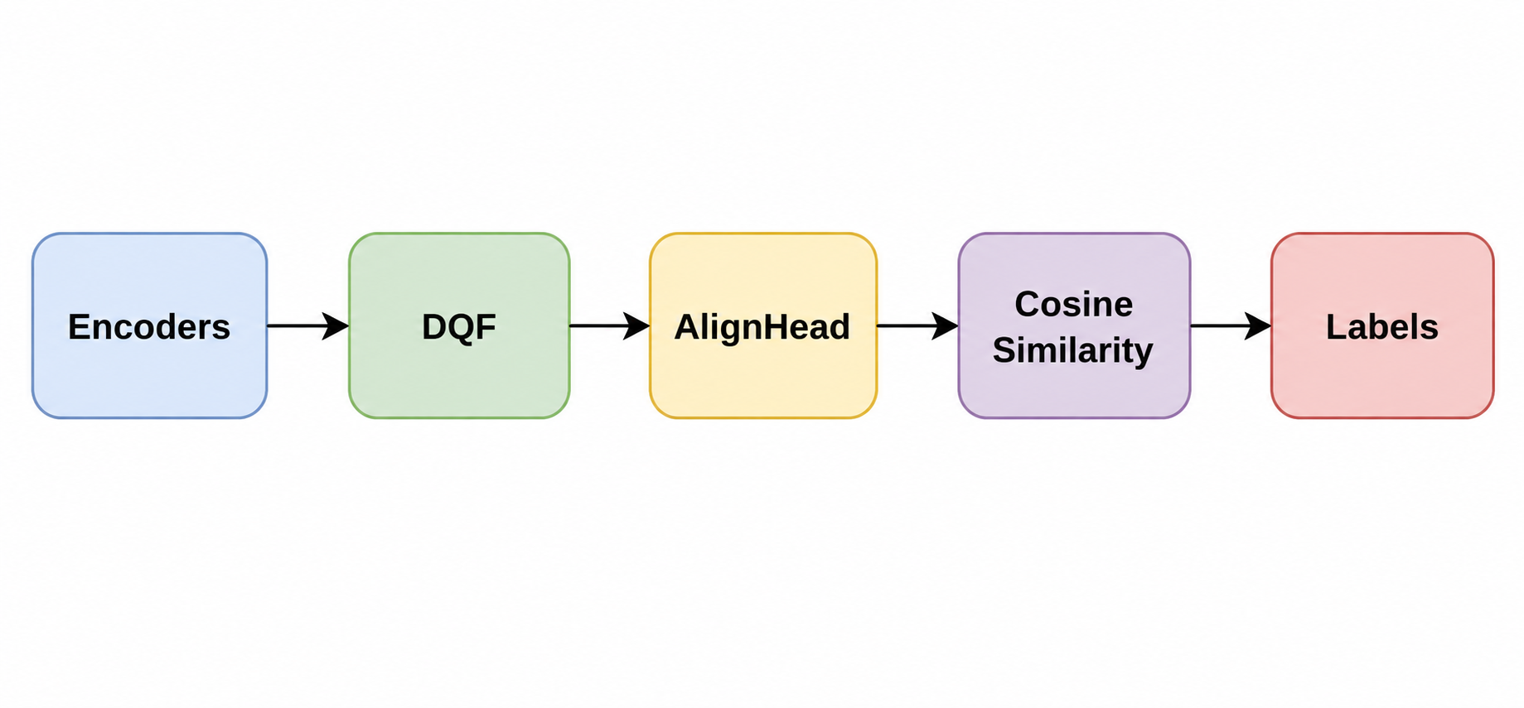
ARCHITECTURE
Overall Pipeline
Encoders are frozen and features cached once — enabling cheap, reproducible training on a single 16 GB GPU.
The open-vocab head cosine-matches against emotion-word anchors to emit labels above a learned threshold.

Slide 4
ARCHITECTURE
Frozen Encoders & Feature Cache
Modality
Encoder
Output Dim
Audio
emotion2vec (plus_large)
1024
Visual
14 + FER-ViT on OpenFace faces [T,112,112,3]
768
Text
BGE-M3 (Chinese-capable)
1024

Slide 5
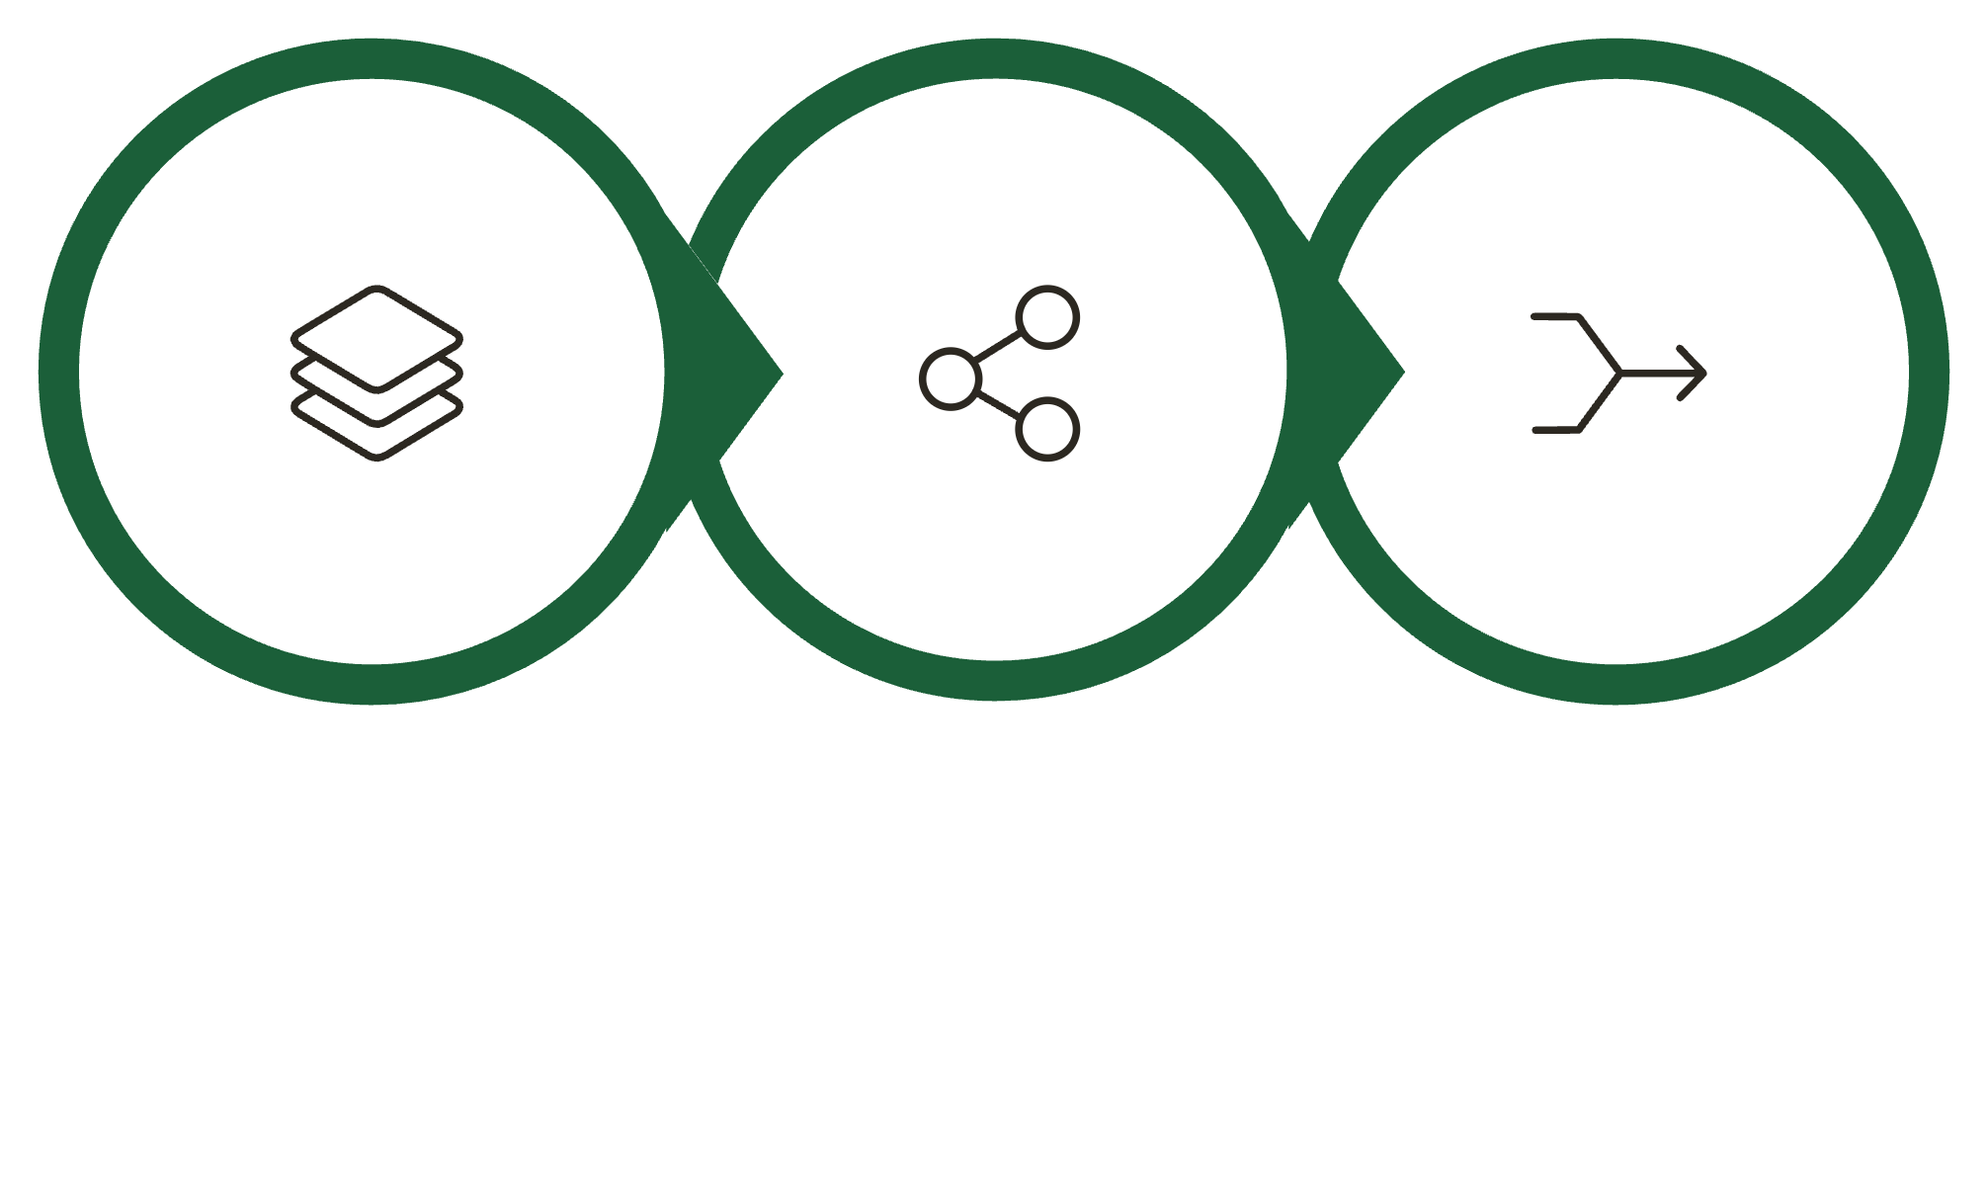
ARCHITECTURE
DQF Fusion Body — Core Architecture
Q-CA Cross-Attn
Q-UA Refine
Global Fusion
Config: d_model=256, heads=4, layers=6, n_query=8 · ≈19.8M trainable params. Outputs 7 granularities {t, a, v, ta, tv, av, tav} for auxiliary loss hooks.

Slide 6
METHODOLOGY
Open-Vocab Head & Training Objective
AlignHead
Loss Function
Fused tav [256] → 512 → 1024, L2-normalized into BGE text space. Inference: cosine-match vs. frozen emotion-word anchors → emit labels above learned threshold (open-vocab by construction).
Multi-positive InfoNCE (word anchors)
DQF multi-granularity auxiliary losses

Slide 7

METHODOLOGY
Evaluation Metric: F_s
F_s = emotion-wheel-grouped set metric (Lian et al., OV-MER, ICML 2025) — the only selection metric.
Group Mapping
Set Precision / Recall
Selection Rule
Maps each predicted/gold word → wheel group (synonyms merged: joyful ≈ happy)
Per-sample set precision/recall → corpus harmonic mean
Never select on accuracy or loss — only F_s (checkpoint + threshold on val)

Slide 8
RESULTS
🎯 Best Result: F_s = 44.6
44.6
36.5
~28
Human-Aligned CV ⭐
Machine-Only CV
Cross-Data (Rejected)
1,532 human clips · linear probe (frozen feats)
30,779 machine clips · full DQF (~20M params)
Machine→human transfer — domain gap too large
Trained + evaluated on the 1,532 clean human-labeled clips (5-fold CV, select on val / report on test — no leakage). Upgraded frozen features (emotion2vec-plus-large + FER-ViT + BGE-M3), open-vocab head. Takeaway: clean human labels beat 20× more noisy machine labels → label quality, not quantity.

Slide 9
