Slide 1
TRACEOPS
Autonomous Incident Investigation, Root-Cause Analysis & Safe Recovery
From Operational Signals to Verified Recovery
TEAM PIXELS
Team Leader: Varun S
Team Members: Venunisanandhan S, Venmugilrajan S, Nishal A T, Harish P

Slide 2
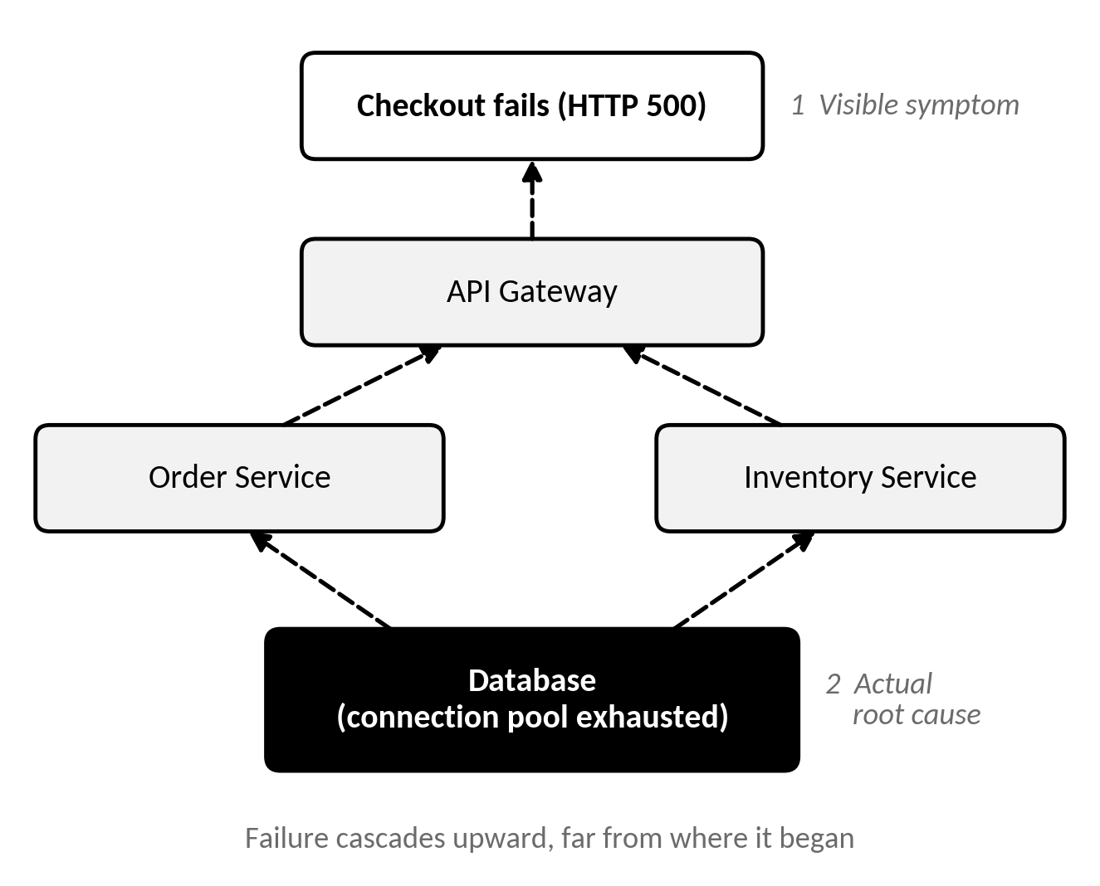
The Problem
Why Is It So Hard to Find the Real Cause of a Failure?
When a system breaks, the error we see is usually just a symptom. The real cause sits somewhere else, and finding it eats up a lot of time.
Clues are scattered across logs, metrics, traces, alerts, deployments, and tickets.
One failure sets off others, so the first error is rarely the root cause.
Connected services make it hard to see the full impact.
Without enough evidence, teams blame the wrong thing and apply the wrong fix.
Engineers piece it all together by hand, and acting too early can make things worse.
The core problem: monitoring tells us something is wrong, but not why.
Our goal: find the actual cause, with evidence to back it up.

Slide 3
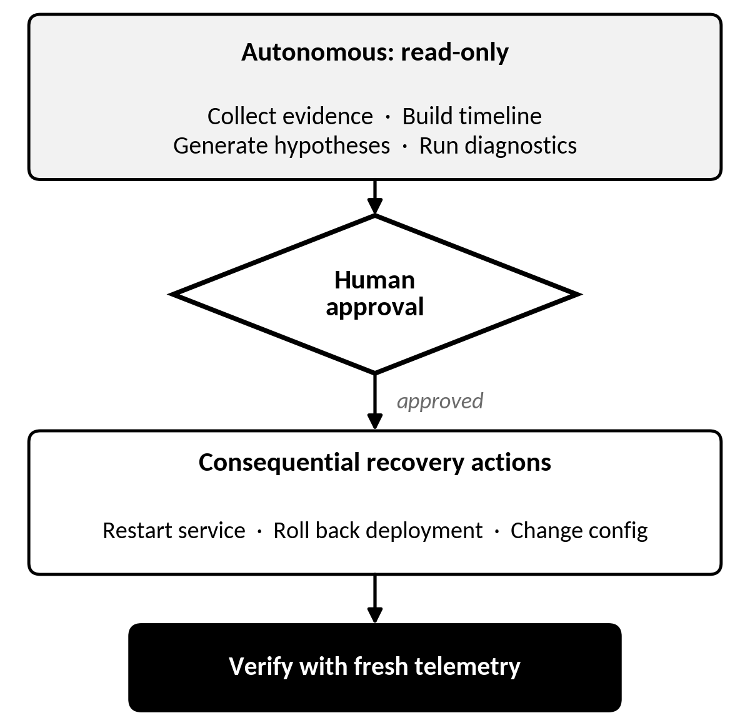
Our Solution
TRACEOPS Investigates Like a Careful Engineer Would
It pulls the evidence together and walks the team through a clear, step-by-step investigation.
Collect evidence: logs, metrics, traces, alerts, deployments, config changes, and past incidents.
Build a timeline: see what happened before, during, and after the incident.
Test several theories: don't assume the first error is the culprit.
Check the facts: run diagnostics to confirm or rule out each theory.
Learn from history: match the evidence against similar past incidents.
Suggest safe fixes: recommend recovery steps based on the cause and its risk.
Verify the recovery: use fresh metrics to confirm the problem is really gone.
Our key principle: investigation and read-only checks run on their own, but risky recovery actions always need a human's approval.

Slide 4
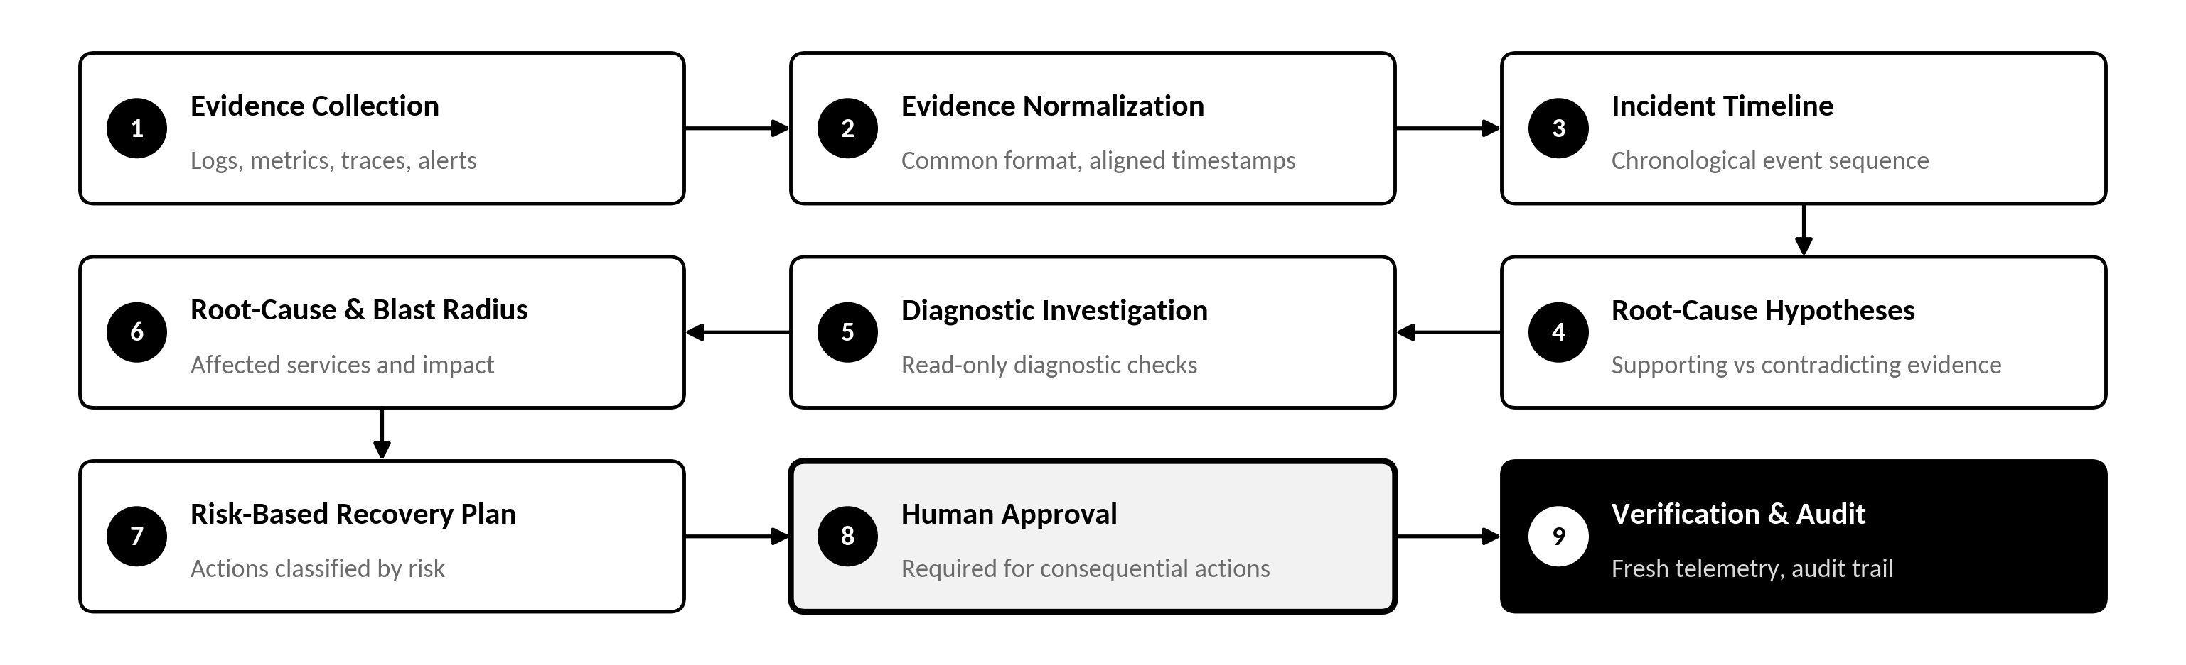
How It Works
From Incident Detection to Verified Recovery
Technology Stack
Frontend
React, Vite, Tailwind CSS, Recharts
Backend
Python, FastAPI
Database
SQLite
AI Integration
Groq API with Qwen model
Investigation
Deterministic hypothesis scoring and diagnostic tools

Slide 5
Impact & Conclusion
Smarter, Safer, and More Reliable Incident Response
What Teams Gain
How We Measure Success
Faster investigations with less guesswork
A clearer view of the real root cause
Safer recovery, with approval before risky actions
Fewer prolonged outages for customers
Less repetitive manual work for on-call engineers
Root-cause accuracy
Evidence coverage and traceability
Investigation time
False-conclusion rate
Recovery verification time
How well it adapts to new evidence
Our vision: TRACEOPS turns incident investigation from a slow, manual hunt into a clear, evidence-driven process. We want to help teams move from reacting to failures towards understanding, preventing, and recovering from them.
INVESTIGATE WITH EVIDENCE. RECOVER WITH CONFIDENCE.
TEAM PIXELS

