Slide 1
ANZ DIVERSITY HACKATHON
Team Name | Learnquest
Team Number | 11
Problem Statement | AI for Learning and Developer Productivity

Slide 2
PROJECT OVERVIEW AND IDEA EXPLANATION
• LearnQuest is an AI-powered Learning Management System designed to provide intelligent, structured, and secure digital education.
• The platform integrates course modules, interactive learning content, coding practice, assessments, and certification within a single ecosystem.
• A Graph Neural Network (GNN) analyzes user performance and learning relationships to recommend personalized next steps and guide students toward higher skill levels.
• AI-powered tools such as Llama-based tutoring assist learners with instant doubt clarification and adaptive question generation.
• The system includes a secure code execution environment for hands-on programming practice.
• Certification exams are protected using an AI-based proctoring system that monitors webcam activity, detects tab switching, and performs audio detection to prevent malpractice.
• The platform provides performance analytics, leaderboard tracking, and digital certificate generation for credible skill validation.
• Overall, LearnQuest combines intelligent personalization, secure evaluation, and scalable architecture to create a reliable and future-ready education platform.

Slide 3
How is our solution different | How Does It Solve the Problem? | USP (Unique Selling Point)
Most learning platforms only provide videos and notes. LearnQuest combines learning, AI support, exams, and certification in one system. We provide real-time AI doubt support instead of waiting for teachers. Our platform includes AI-based proctoring, which many platforms do not offer. It focuses on both learning quality and exam security. | Students get instant help through the AI chatbot. Structured courses reduce confusion in learning. Practice tests improve exam readiness. Secure proctoring prevents cheating. Performance tracking helps students improve continuously. The platform provides personalized learning suggestions based on user performance, helping students focus on weak areas. | All-in-one AI-powered learning and certification platform. 24/7 AI-based doubt clarification system. Secure online exams with intelligent proctoring. Personalized progress tracking and rewards. Reliable and trustworthy digital certificates. Easy-to-use interface designed for beginners and non-technical users.

Slide 4
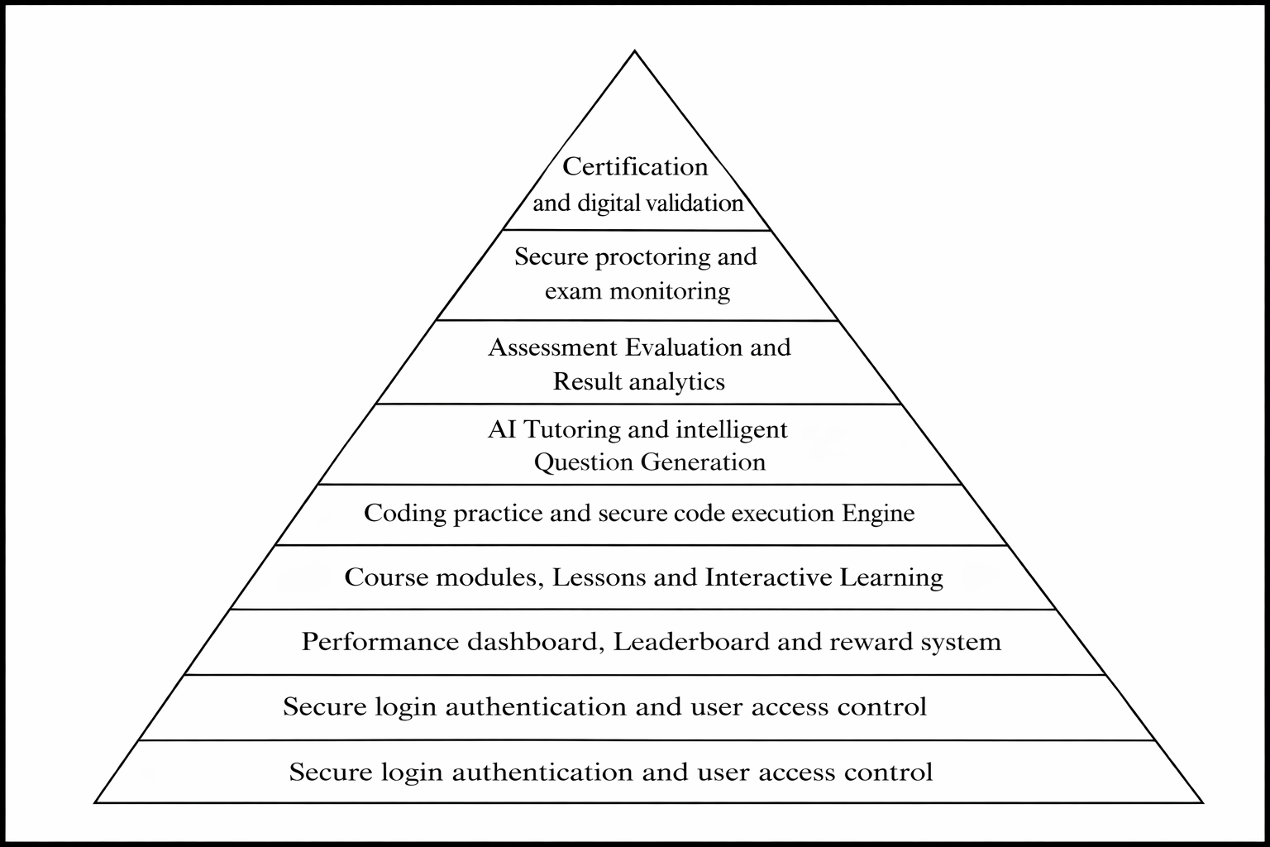
FEATURES OFFERED BY LEARQUEST

Slide 5
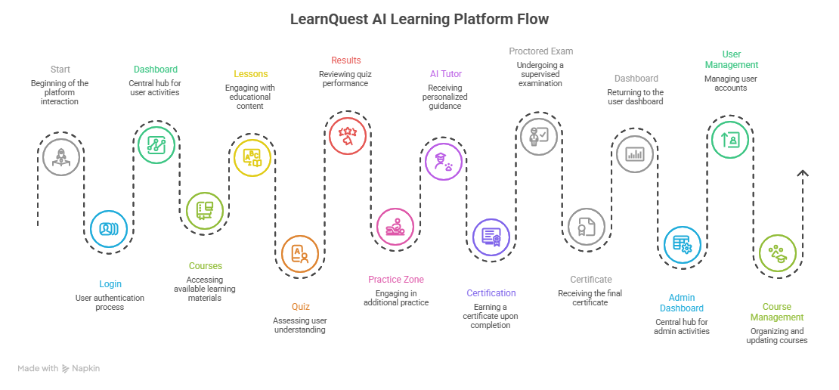
LEARNQUEST PROJECT FLOW

Slide 6
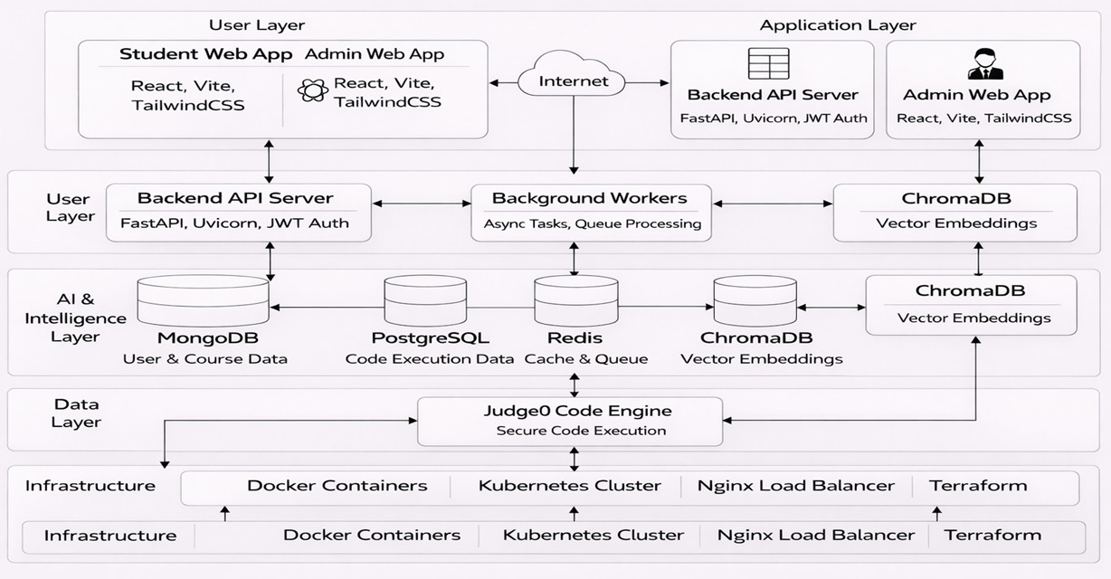
ARCHITECTURE DIAGRAM FOR LEARNQUEST

Slide 7
 | TECH STACK
Layer | Technologies Used | Purpose
Frontend | React, Vite, TailwindCSS, Monaco Editor, Chart.js | Build and display user interface
Backend (API) | FastAPI, Uvicorn, JWT Authentication | Handle requests, authentication, and business logic
AI & Processing | Llama 3, YOLO, MediaPipe, PyTorch, Transformers | AI tutoring, proctoring, and recommendations
Databases | MongoDB, PostgreSQL, Redis, ChromaDB | Store user, course, and AI data
Code Execution | Judge0 | Securely run and evaluate code
Infrastructure | Docker, Kubernetes, Nginx, Terraform | Deployment, scaling, and system management

Slide 8
GRAPH NEURAL NETWORK (GNN) IN LEARNQUEST
• LearnQuest models the learning ecosystem as a connected graph of users, topics, modules, assessments, skill levels, and certifications instead of treating them independently.
• Nodes represent learners and learning components, while edges capture relationships such as topic completion, prerequisite links, assessment attempts, proficiency levels, and learner similarity.
• These relationships are weighted using performance metrics like scores, accuracy, time spent, and engagement.
• The GNN builds a dynamic weighted graph and applies message passing and aggregation to learn meaningful patterns across connected nodes.
• It generates embeddings that represent each learner’s knowledge state and progression.
• Based on these embeddings, the system recommends the next best topic, difficulty progression, remedial areas, and certification readiness.
• This enables adaptive, personalized, and data-driven learning beyond traditional rule-based systems.

