Slide 1
Hackathon 2024: Resume Best Match
High level Design Approach
(BeNxtGen)

Slide 2
High level Requirements and insights
Recruiter can go to the portal and provide the prompt/search criteria to search the top(n) best resumes.
Job searchers can go to the portal and provide the prompt/search criteria which is role lookup to search the top(n) best JD for applying for the openings.
Portal will have two links one for resume and other for Job search
The portal will be available via GCP cloud run and the model to score the resume and job description will be available/deployed to Vertex AI for consumption.
Recruiter/Job Seeker can decide how many resumes/JD they want to be displayed on the UI with highest score resumes/JD be displayed on the top followed by rest as per ranking.

Slide 3
High Level Design
UI Interface Layer
API Layer
Model Classification Layer

Slide 4



Best Resume Match- Architecture
1. Recruiter/Job Seeker
Recruiter/Job Seeker logs in the portal and performs a search for resume/JD role.
Flask API is called in backend.
Python library is used for text extraction from doc and pdf.
Tokenize the document text and prompt text.
Compare the tokenized text from resume/JD and prompt.
Score the document and send the score in descending order with highest being first to portal
sends prompt
Mmessage UI
Tokenization
Flask call
3
Python API
http
Cosine Similarity/ Fuzzy Prediction
4
NPT-DB
Text
Extraction
Scoring
Backend-App

Slide 5
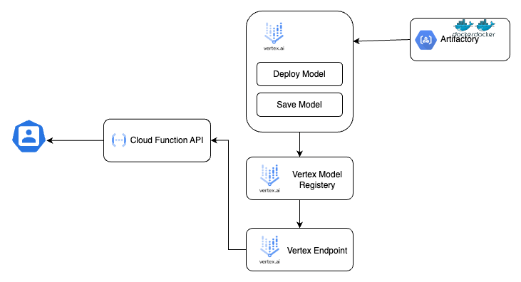
Model Deployment - Architecture(Vertex AI)

Slide 6
Resume Best Match - Benefits
As a recruiter it is difficult to go through all the resumes hence this model can score all the resumes based on the required prompt shared by them and showcase only the desired resumes
As a Job Seeker its difficult to search the required role from the huge collection of Job Openings hence this model can list the top rated job opening/description based on the role searched for provided as a prompt to the model.

