Slide 1

Pros and Cons Of Robo Advocate

Slide 2
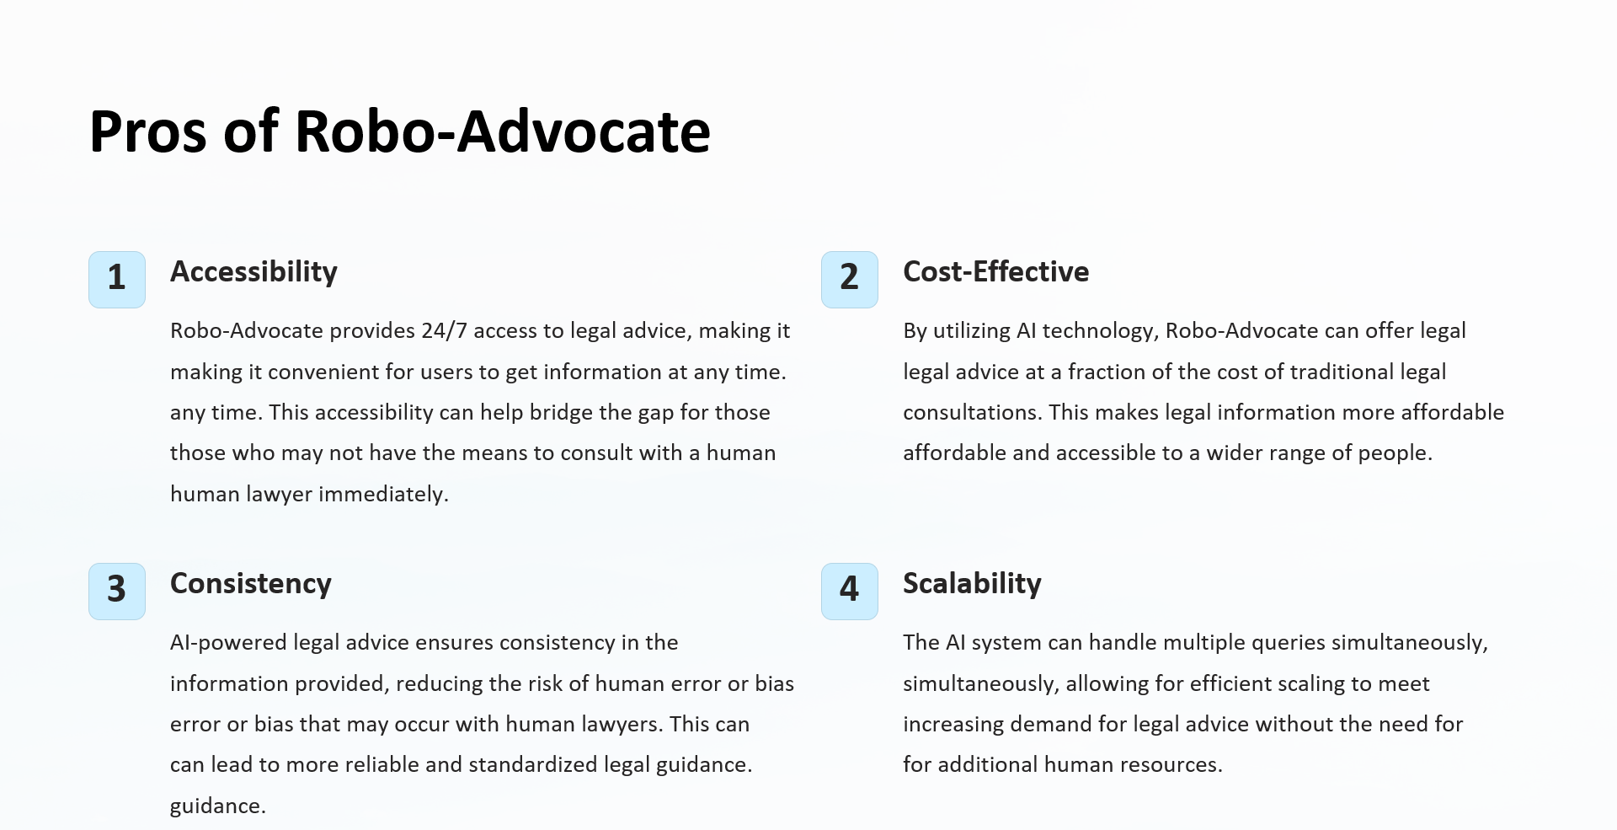

Slide 3
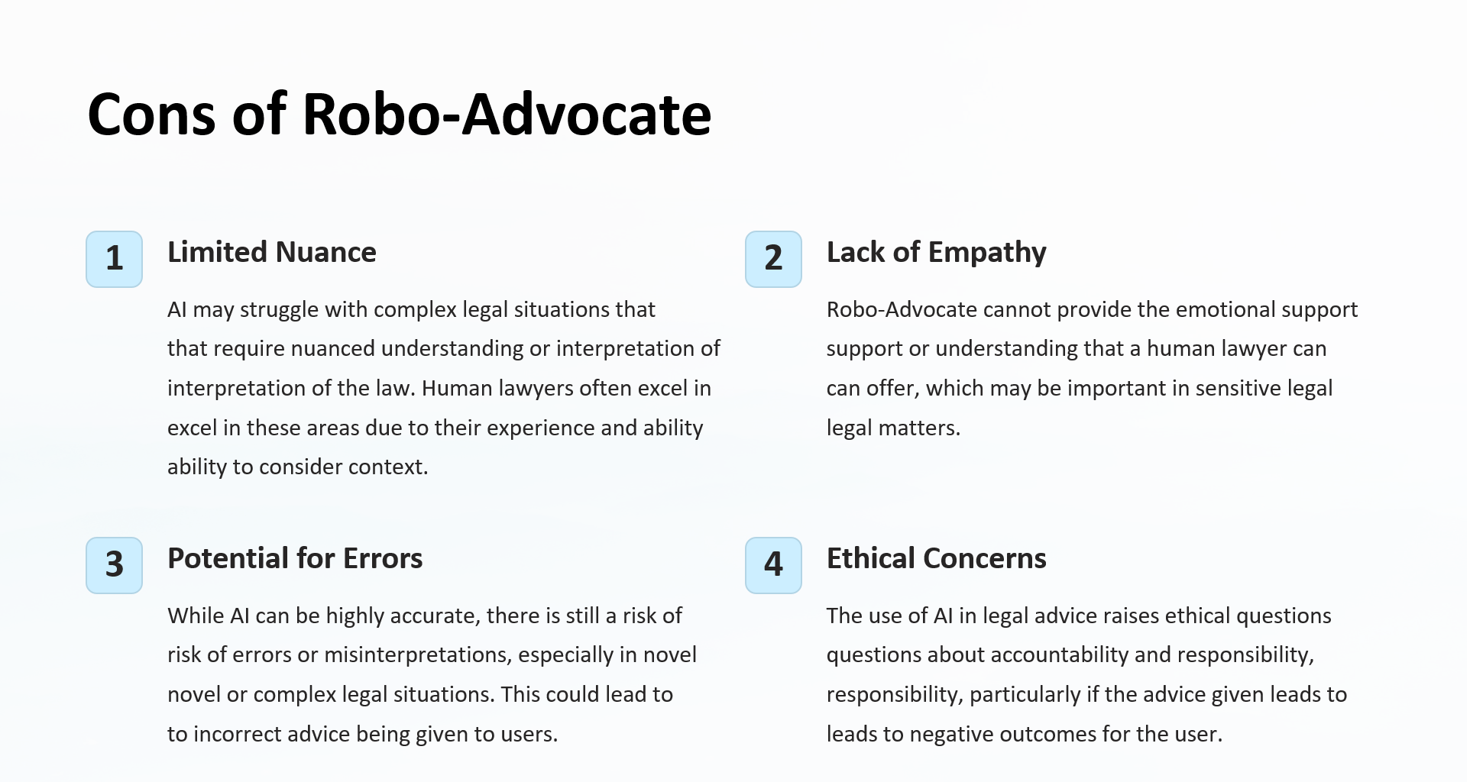

Slide 4
