Slide 1
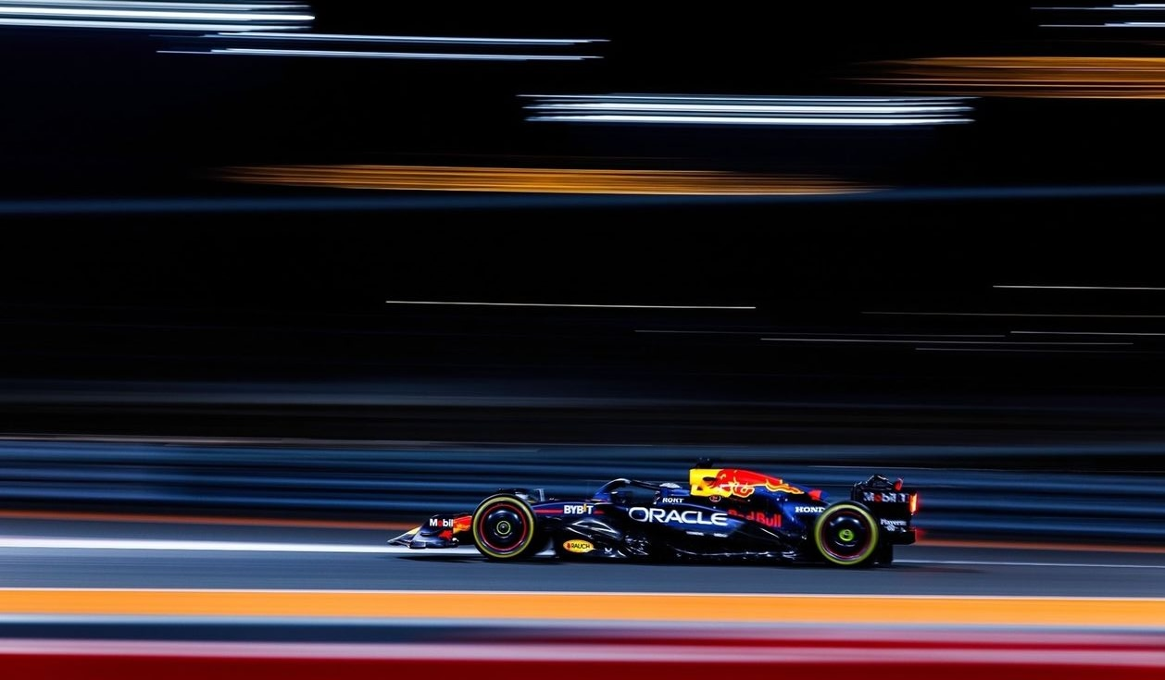
BETA RELEASE
Dominance Redefined
Visualizing Max Verstappen's 2023 Formula 1 Season
VARUN BRAHMA
Data Visualization · Spring 2026

Slide 2
INTRODUCTION
Turning a memory into measurement
19
Fans remember 2023 as Verstappen's most dominant season — but what does dominance actually look like in the data?
Wins out of 22 races
575
This project moves past the headline statistic and decomposes Verstappen's 2023 season into four lenses:
race-by-race progression, teammate comparison, historical benchmarking, and cross-sport context.
Championship points
2
Wins for his teammate

Slide 3
PROJECT OBJECTIVES
Four lenses on dominance
01
02
Within-Season Dominance
Driver vs. Car
How did the championship gap grow race by race? Where did Verstappen separate from the field?
Pérez drove the same RB19. If the car alone explained 2023, the comparison should look identical. It doesn't.
03
04
F1 History
Cross-Sport Greats
How does 2023 stack up against Ascari 1952, Clark 1963, Senna 1988, Schumacher 2004, Vettel 2013, Hamilton 2020?
Beyond Formula 1 — comparing Verstappen's season to peak performances in tennis, golf, and swimming.

Slide 4
OBJECTIVE 1 · DEMO
Bar Chart Race
Race-by-race championship progression — top 8 drivers, animated and scrubbable.
Play / Pause control
Animation cycles automatically; viewers can stop on any race.
Round scrubber slider
Drag to jump to any of the 22 races.
Driver hover-isolate
Hovering any bar dims the rest, isolating one driver against the field.
Tooltip with race detail
Driver, race name, cumulative points.
→ Switch to live demo

Slide 5
OBJECTIVE 2 · DEMO
Stats Comparison + Small Multiples
Same car, different results — Verstappen vs. Pérez across six metrics.
Season totals row
THE GAP
Six paired bars — points, wins, podiums, poles, fastest laps, points/race.
575
285
2 × 6 small multiples
Each metric tracked race by race for both drivers, shared y-domain per column.
vs
Driver focus toolbar
MAX
PÉREZ
Highlight Verstappen / Pérez / Show Both — Focus + Context interaction.
Tooltips per race
Same car. Twice the points.
Race name, round, cumulative metric, finishing position.
19 wins to 2.
→ Switch to live demo

Slide 6
OBJECTIVE 3 · DEMO
Parallel Coordinates — Historical Benchmark
Seven historically dominant F1 seasons — every metric normalized to a percentage so eras are directly comparable.
Win Rate
Podium Rate
Pole Rate
Fastest Lap Rate
Points Capture
Reliability
Seasons compared
Verstappen 2023
Hamilton 2020
Vettel 2013
Schumacher 2004
Senna 1988
Clark 1963
Ascari 1952
Non-obvious finding: Senna 1988 had a 81% pole rate vs Verstappen's 55% — and Ascari 1952 hits 100% on win rate, podium rate AND reliability.
→ Switch to live demo

Slide 7
OBJECTIVE 4 · DEMO
ECDF — Cross-Sport Dominance
Empirical cumulative distribution function. A curve that climbs sharply at low ranks = more dominant.
Three approaches under review
PATH A
PATH B
PATH C
Career Trajectory
+ Comparator
Cross-Sport (normalized)
Multiple seasons of Verstappen's career as separate ECDFs. Real F1 finishing positions. The 'rise to the top' professor suggested.
Path A overlaid with Hamilton's career at the same career stage. Same units, real data, direct generational comparison.
Verstappen vs Federer / Tiger / Phelps. X-axis = 'percentile of field beaten' so the metric works across sports.
→ Bringing all three to peer review for feedback before committing

Slide 8
LIVE DEMO
Try it yourself
https://varun1421.github.io/Verstappen/
Source: github.com/Varun1421/Verstappen
Built with D3.js · Interactive in any modern browser

Slide 9
NEXT STEPS
From Beta to Final
What's pending between now and the final presentation:
1
Decide ECDF approach
Take peer-review feedback on Paths A/B/C and commit to one. Verify any approximate data with web sources.
2
Scrollytelling intro
Replace the four objective cards with a scroll-driven intro sequence (Optional Feature B in the proposal).
3
Annotations + summaries
Add hand-pointed callouts on each viz (e.g. 'Pérez retired here'); a 'season at a glance' stat band.
4
Polish + final report
Debug, refine usability, write the project report (Week 7), prepare the final presentation.
Final submission · May 20

