Slide 1
VEHICLE DETECTION USING IMAGE PROCESSING TECHNIQUES CBIVR JCOMP REVIEW
ARJUN PJ-19BCE1116
VARUN BUDDHA-19BCE1168
RAM-19BCE1162

Slide 2
ABSTRACT
Detects and classifies vehicles into Heavy motor vehicle and Light motor Vehicle.
Helps in managing traffic flow and congestion.
This system is broken down into:
Image Acquisition
Image Analysis
Object detection
Counting
Classification

Slide 3
INTRODUCTION
Effective traffic management is crucial as an average Indian spends around 50 hours a year in traffic jam. Traffic congestion can be prevented by chalking out various traffic plans. With the rise in complexity and count of vehicles on-road, it is difficult to collate information manually to carry out the process. Hence, vehicle detection and count system uses an effective algorithm to curb this and manage the traffic flow without any fuss.
Methods employed to count the vehicles:
Background subtraction
Establishing region of interest
Thresholding
Hole filling
Morphological operations
Calculation of centroid
Counting vehicle in virtual detection zone

Slide 4
MODULES
VEHICLE CLASSIFICATION
VEHICLE DETECTION
VEHICLE COUNT

Slide 5
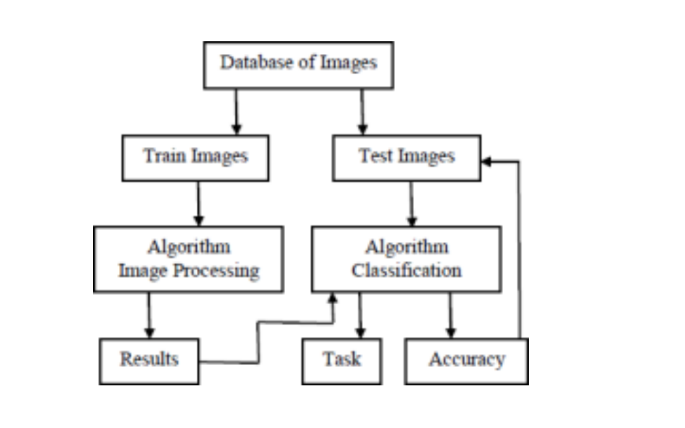
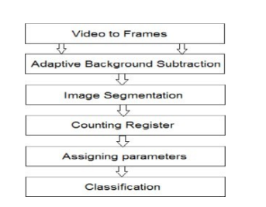
1. VEHICLE CLASSIFICATION
The ML based classification method is categorized in three steps. In the first step, we extract features to be used in the classification. The second step is to select the algorithm that is to be used to classify the vehicle. The final step is to test this model. For classification, the relative width, length and area approach is used.

Slide 6
VEHICLE DETECTION
Several approaches have been introduced for object and vehicle detection based on shape, color, texture or combination of any of these features on both still image and moving images.
This system proposes an efficient video based vehicle detection system based on Harris-Stephen corner detector algorithm. The algorithm was used to develop a standalone vehicle detection and tracking system that determines vehicle counts and speeds at arterial road- ways and freeways.
The proposed video based vehicle detection system was developed to eliminate the need of complex calibration, robustness to contrasts variations, and better performance with low resolutions videos.

Slide 7
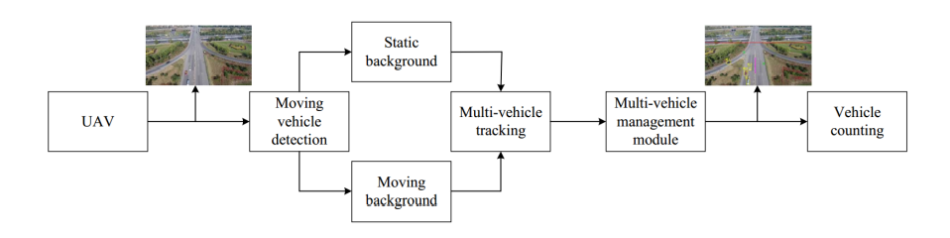
VEHICLE COUNT
A register is utilized for the counting process. This keeps the track of vehicles encountered so far. By calculating the number of centroids of all the blobs available and the number of centroids of moving vehicles will give the number of vehicles that have crossed a particular path.

Slide 8
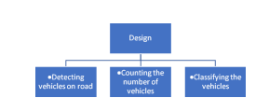
OVERALL DESIGN
The first step taken before applying any of the image processing techniques is the extraction of the frames from the traffic footage. We must apply image processing techniques on one of the frames, preferably on the most general image, and then loop through all the frames in the video.

Slide 9

OUTPUT
The code is generated using OpenCV in python programming language. The video footages are taken from the Internet. The tracking of vehicles start as soon as they enter the frame.
The red line is the counting zone. As soon as a vehicles centroid crosses the line, counter is incremented by 1.

Slide 10
CONCLUSION
Furthermore, it is advantageous due to easy installation of cameras and maintenance cost.
This system can be adjusted easily to provide wider view and more information about traffic. The present system only identifies one vehicle. This system can be developed and extended in future to identify more than one vehicle in a single frame.

Slide 11
REFERENCE
Brutzer, Sebastian, Benjamin Hoferlin, and Gunther Heidemann. "Evaluation of background subtraction techniques for video surveillance." Computer Vision and Pattern Recognition (CVPR), 2011 IEEE Conference on. IEEE, 2011.
https://ieeexplore.ieee.org/document/9194678
Jyotsna Tripathi, Kavita Chaudhary, Akanksha Joshi and Prof. J B Jawale, Automatic Vehicle Counting and Classification, International Journal of Innovative and Emerging Research in Engineering Volume 2, Issue 4, 2015

