Slide 1
Recommendation System
Created by
Varun prabakharan A
Reg no:- 912321104305
3rd year cse
Sacs mavmm engineering college

Slide 2
Project outline
Problem statement
Proposed system /solution
System development approach
Algorithm and deployment
Result
Conclusion

Slide 3
Problem statement
In the recommendation system the problem is trying to forecast the opion the users will have on the dissimilar substance and be able to recommends the finest items to each user. Another some problems in recommendation system are data sparsity, scalability and gray sheep.

Slide 4
Welcome to Recommendation System
Let's embark on a journey to uncover the secrets of recommendation systems and their impact on user experiences. We'll explore the art and science behind personalized recommendations.
Gather data on user interactions, such as ratings, reviews, purchase history, clicks, and browsing behavior.
Explore the data to understand patterns, trends, and relationships between users and items.
identify popular items, user preferences, and potential biases in the data.

Slide 5
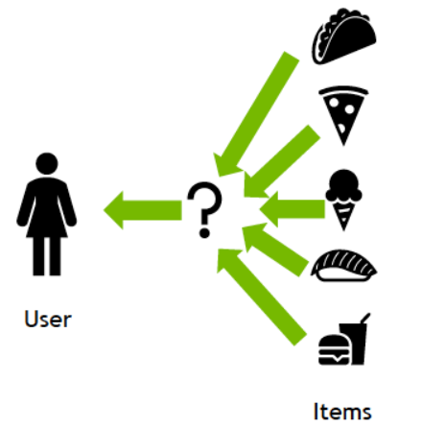
Proposed system /solution
A recommendation system is an artificial intelligence or AI algorithm, usually associated with machine learning, that uses Big Data to suggest or recommend additional products to consumers. These can be based on various criteria, including past purchases, search history, demographic information, and other factors.

Slide 6
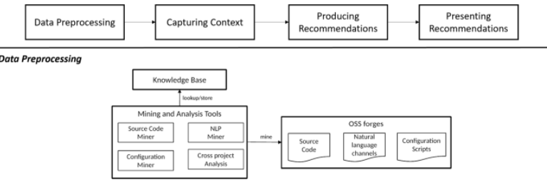
System development approach
A recommendation system is a tool that actively finds information that may be of interest to a user from a large amount of information. Building a system that supports online user decisions, recommending a personalized, highly-matched product or project is a core issue in the recommended system area.

Slide 7
Algorithm and deployment
Problem Definition: Clearly define the goals of your recommendation system. Determine what type of recommendations you want to generate (e.g., product recommendations, content recommendations, movie recommendations).
Data Collection and Preprocessing:
Collect relevant data for your recommendation system. This may include user interactions (e.g., purchases, clicks, ratings), item metadata (e.g., product descriptions, genres), and user information (e.g., demographics).
Preprocess the data to clean it, handle missing values, and transform it into a suitable format for modeling. This may involve techniques such as normalization, encoding categorical variables, and feature engineering.

Slide 8
Algorithm and deployment continuous
3.API Development:
Expose the recommendation functionality through an API to allow integration with other systems (e.g., websites, mobile apps).
Develop APIs for receiving user inputs and returning recommendations.
4.Monitoring and Maintenance:
Implement monitoring mechanisms to track the performance of the recommendation system in production. Monitor metrics such as response time, throughput, and user engagement.
Continuously collect user feedback and update the recommendation model as necessary.
Monitor for changes in data distribution and retrain the model periodically to ensure it remains effective.
5.Privacy and Security:
Implement appropriate measures to protect user privacy and secure sensitive data, especially if the recommendation system deals with personal information.
6.A/B Testing:
Conduct A/B tests to evaluate the effectiveness of the recommendation system and compare different algorithms or configurations

Slide 9
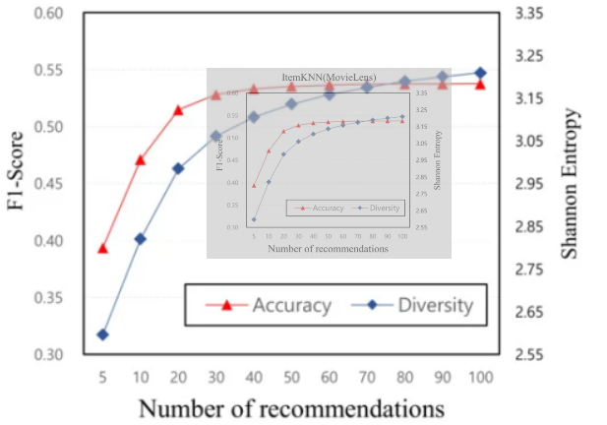
Result
ecommender systems are highly useful as they help users discover products and services they might otherwise have not found on their own. Recommender systems are trained to understand the preferences, previous decisions, and characteristics of people and products using data gathered about their interactions.

Slide 10
Conclusion
Computer-based techniques have been developed to facilitate the search and retrieval process; one of these techniques is recommendation, which guides users in their exploration of available information by seeking and highlighting the most relevant information.

Slide 11
References
https://www.nvidia.com/en-us/glossary/recommendation-system/#:~:text=Recommender%20systems%20are%20highly%20useful,data%20gathered%20about%20their%20interactions.
https://chat.openai.com/c/d8cab226-81d8-4dbc-a76d-74b2b6816116
https://www.sciencedirect.com/science/article/pii/S1110866515000341

Slide 12


