Slide 1
MPCA Mini Project
Project Title : Facial recognition and voice detection using raspberry pi
Section : ‘E’
Students Name : Varun Seshu, Achyuth K Kowshik, Hrithik Shanbhag
SRN :PES2201800074,
PES2201800022,
PES220180082

Slide 2
Problem Statement
To build a 2 step authentication system using facial recognition and audio authentication

Slide 3
Introduction
In the 2 step authentication project, we create a Voice User Interface (VUI) using amazon’s Alexa skill platform, which processes a user’s voice and does the heavy lifting of voice authentication of the user
It also triggers the raspberry pi to start the second step of facial authentication with the endpoint set to the raspberry pi’s ngrok server
The raspberry pi receives the trigger from the hosted alexa skill and the python script captures a picture, we then run a facial recognition script to authenticate the user if the user’s data matches with previously registered users.

Slide 4
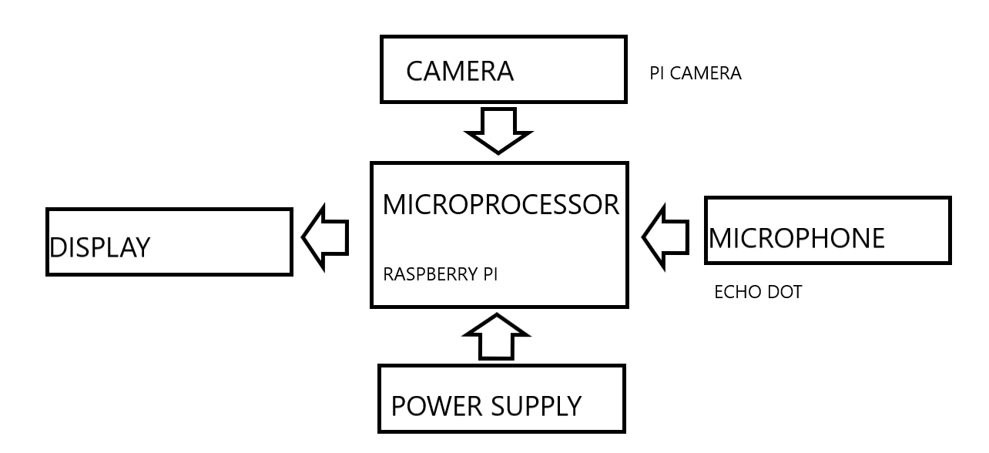
Block Diagram/Circuit Diagram
Notes:
1

Slide 5
Required Components
1) Raspberry Pi
2) Echo Dot
3) Pi camera accessory
4) External screen
Notes:
1

Slide 6
Project Explanation(1 or 2 slides)
The user who needs to be authenticated faces the camera (optical sensor), and uses a voice command to trigger a photo being taken. The software in the Raspberry Pi then processes the picture, identifies the user and responds with whether the user should or shouldn’t be granted access, a screen then displays whether the user is granted/denied access.
Notes:
1

Slide 7
Application
The project can be used in any security system that requires a 2 step audio and facial recognition process. This is a general system decides whether the person is granted/denied access, thus it can have many uses :
1)Door step authentication
2)Authentication for smart phone, laptop, any device which has a camera and microphone
Notes:
<number>

Slide 8
Thank You

