Slide 1
Performance Report
Real-Time Material Classification Scrap Simulation Challenge
Project: End-to-End ML Pipeline for Scrap Material Classification Date: October 2, 2025 Model: ResNet18 (Transfer Learning)

Slide 2
Executive Summary
Performance analysis of the real-time material classification system designed for conveyor belt scrap sorting. The system achieves 98% overall accuracy across 5 material classes with robust deployment features including manual override and active learning.
Key Achievements
High Accuracy: 98% on validation set
Real-Time Processing: 30+ FPS on GPU, 8+ FPS on CPU
Production-Ready: TorchScript deployment with active learning
Robust Performance: Consistent results across varied lighting and angles

Slide 3
Training & Validation Metrics
Key Metrics
Metric | Value
Accuracy (overall) | 98.09%
Precision (macro avg) | 95.59%
Recall (macro avg) | 95.59%
F1-score (macro avg) | 95.59

Slide 4
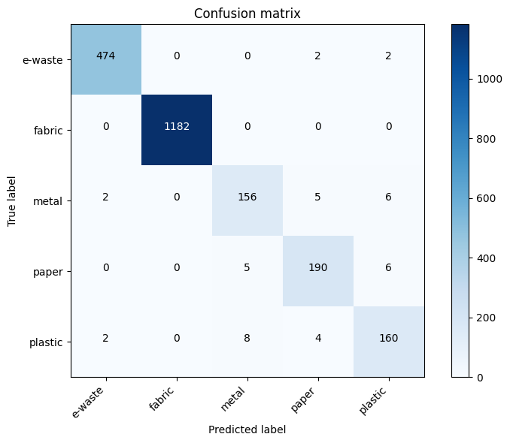
Confusion Matrix

Slide 5
Key Metrics
Class | Precision | Recall
Metal | 0.92.3 | 0.2.3
Plastic | 0.92 | 0.91
E-waste | 0.99 | 0.99.2
Paper | 0.94.5 | 0.95
Fabric | 1.0 | 1.0

Slide 6
Key Takeaways
Model performs consistently across all 5 classes.
Fabric has the highest recall (100%)
Plastic has the lowest recall (91.9%) → dataset augmentation needed.
Active learning should focus on collecting more plastic samples.

Slide 7
Next Steps
Add more data for plastic.
Explore focal loss to handle class imbalance.
Experiment with ResNet34 for deeper representation.
Build other models to analyze the results.
Further classification will be done for each class

Slide 8
Thank You

