Slide 1
RISCV Custom ISA and Software Toolchain
22BEC052 Ishaan Bhimajiyani 22BEC069 Varun Lutharia
Mentor : Dr. Prof. Nagendra Gajjar
Institute of Technology, Nirma University
21/03/2025

Slide 2
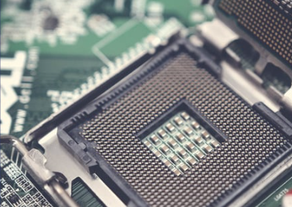
Table of Contents
Introduction to RISCV
Architecture in RISCV
Why RISCV ?
Need for Custom ISA in RISCV
Literature Review
Procedure to Implement Custom ISA
Limitations of RISCV and Custom ISA
Implementation of Architecture
Future Prospects
References
Conclusion

Slide 3
What is RISCV ?
RISC-V is an open-source instruction set architecture used to develop custom processors for a variety of applications, from embedded designs to supercomputers.
Originally developed at the University of California, Berkeley, the RISC-V ISA is considered the fifth generation of processors built on the concept of the reduced instruction set computer (RISC).
Used because of its properties like Being open-source, scalable, modular, and power efficient.

Slide 4

Why RISCV ?
1. Open-Source Nature
2. Simplicity and Modularity
3. Scalability and Customization
4. Ecosystem Growth
5. Security and Transparency
6. Future-Proofing and Long-Term Stability
7. Energy Efficiency
8. Extensible and Customizable ISA
9. Cross-Platform Software Support
10. Multi-Privilege Level Support

Slide 5
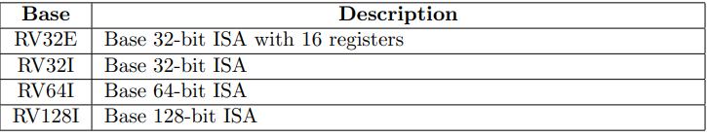
RISCV Architecture
The RISC-V ISA is divided into a base integer instruction set and optional extensions
Standard Extensions: M: Multiplication and Division A: Atomic Instructions F: Single-Precision Floating Point D: Double-Precision Floating Point C: Compressed Instructions V: Vector Processing P: Packed SIMD Instructions

Slide 6
Procedure to Implement Custom ISA
Define the Custom Instructions
Determine the instruction format (R, I, S, etc.) and encoding within the RISC-V ISA, ensure it is compatible with existing.
Modify the RISC-V ISA Specification.
To update instruction set manual to define operation, opcode, and register, add new instruction formats and document encoding rules.
Modify the RISC-V Core
Modify decode, execute, and write-back stages of pipeline to support execution and also to update RTL.
Modify the Assembler and Disassembler.
To update binutils to support new instructions in assembly language, and to ensure correct translation between machine and assembly code.
Final Validation & Benchmarking
Run real world benchmarks to evaluate performance alongwith to optimize, power area etc.

Slide 7
Limitations of RISCV and Custom ISA provide that
Lack of Standardization in Custom Extensions
There is no unified standard for modification leading to fragmentation issues.
Performance Gap with Established Architectures
Compared to x86 and ARM, RISC-V still lags in high-performance computing (HPC) .
Software Ecosystem Maturity
RISC-V software ecosystem (compilers, debuggers, and OS support) is still not as mature or optimized as those for x86 or ARM.
Limited Hardware Support
Major semiconductor companies have yet to fully adopt RISC-V since again not high as high performance as x86 or ARM.
Scalability for High-End Applications
While RISC-V is widely used in embedded systems, scaling it for datacenters, supercomputers, and mobile processors still requires significant advancements in hardware and software support.

Slide 8
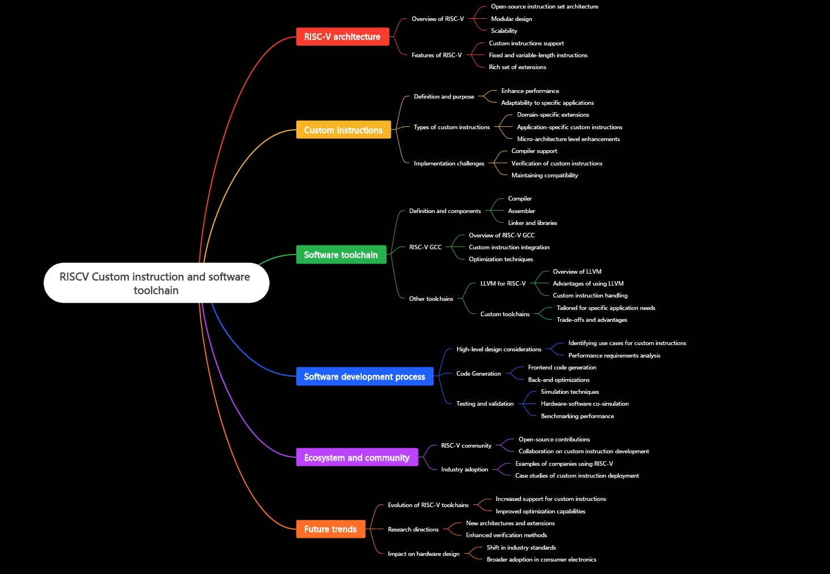

Slide 9
Literature Review
RISC-V Instruction Set Architecture Extensions: A Survey
Authors: Enfang Cui, Tianzheng Li, Qian Wei
Title: RISC-V Instruction Set Architecture Extensions: A Survey
Objective:
To provide a comprehensive overview of RISC-V ISA extensions, including official and custom extensions.
To analyze the requirements of different computing domains such as IoT, AI, HPC, and security.
To identify gaps in current RISC-V ISA and propose future research opportunities.
Achievements:
Reviewed official RISC-V extensions like V-extension (vector processing), H-extension (virtualization), and security-related extensions.
Analyzed custom ISA extensions for AI, cryptography, embedded systems, and cloud computing.
Highlighted challenges in hypervisor technology, trusted computing, and in-memory computing.
Identified future research areas, including cloud computing optimizations, trusted execution environments (TEEs), and in-network computing.

Slide 10
2. Implementation and Analysis of Custom Instructions on RISC-V for Edge-AI Applications
Authors: Ajay Kumar M, Vineet Kumar, Deepu John, Shreejith Shanker
Title: Implementation and Analysis of Custom Instructions on RISC-V for Edge-AI Applications
Objective:
To design and implement custom memory access instructions to optimize Deep Neural Networks (DNNs) on RISC-V.
To reduce latency and power consumption in edge-AI applications.
To propose future ISA extensions supporting bfloat16 data type for AI workloads.
Achievements:
Developed a "load double" instruction reducing memory access time by 50% and power consumption by 30%.
Proposed bfloat16 support for AI computing to enhance model accuracy with lower memory overhead.
Demonstrated the importance of compiler optimizations for fully utilizing custom ISA instructions.

Slide 11
3. An End-to-End Design Flow for Automated Instruction Set Extension and Complex Instruction Selection based on GCC.
Author: Oscar Almer, Richard Bennett, Igor Böhm, Alastair Murray, Xinhao Qu, Marcela Zuluaga, Björn Franke, and Nigel Topham (2009). Title: An End-to-End Design Flow for Automated Instruction Set Extension and Complex Instruction Selection based on GCC. Objective: Develop a comprehensive toolchain for automated instruction set extension (ISE) and complex instruction selection using GCC, targeting extensible processors.
Achievements:
Integrated ISE identification, generation, optimization, and synthesis into a unified framework.
Enabled exploitation of complex custom instruction patterns across multiple applications.
Introduced the EnCore extensible processor core, facilitating synthesis of full extensible designs from Verilog and standard cell libraries.

Slide 12
4. RVCoreP-32IM: An Effective Architecture to Implement Mul/Div Instructions for Five-Stage RISC-V Soft Processors.
Author: Md Ashraful Islam, Hiromu Miyazaki, Kenji Kise (2020).Title: RVCoreP-32IM: An Effective Architecture to Implement Mul/Div Instructions for Five-Stage RISC-V Soft Processors.
Title: RVCoreP-32IM: An Effective Architecture to Implement Mul/Div Instructions for Five-Stage RISC-V Soft Processors. Objective: Enhance the RVCoreP soft processor by integrating the RISC-V M-extension to support multiplication and division instructions, thereby improving performance for embedded systems. Achievements: Developed an extended RVCoreP processor supporting the M-extension, enabling efficient execution of multiplication and division operations. Achieved performance improvements of 1.87× and 3.13× using radix-4 and DSP multipliers, respectively, compared to the baseline RV32I implementation.

Slide 13
Implementations
To optimize performance for specific applications, like Using AI Accelerators, MAC units etc.
Reduce power consumption by eliminating unnecessary instructions. (By reducing redundant equations)
Enhance security by adding custom cryptographic operations, like using AES Encryption Algorithms
Improve hardware-software co-design for domain-specific processors.

Slide 14
Future Prospect
Expanding Industry Adoption
Major tech companies like NVIDIA,Google are integrating RISCV into commercial products.
Advancements in Customization
RISCV open sources helps to design domain specific architecture(AI accelerator,security enhanced processors).
Security enhancements
Development of secure RISC-V architectures for embedded security, blockchain, and trusted execution environments (TEE).

Slide 15
Conclusion
Implementing a custom ISA extension in RISC-V involves modifications across multiple layers, including hardware, assembler, compiler, and simulation tools.
By carefully designing new instructions, integrating them into the RISC-V core, and updating the software toolchain (binutils, GCC/LLVM, QEMU, Spike).
we can achieve significant performance improvements tailored to specific workloads like AI, cryptography, and DSP applications.
Successful implementation requires: Hardware modification (Verilog/Chisel) to support new execution logic. Toolchain adaptation to enable compilation and debugging with custom instructions. Simulation and benchmarking to validate correctness and performance benefits.

Slide 16
References
RISC-V Instruction Set Architecture Extensions: A Survey.
DOI: 10.1109/ACCESS.2023.3246491
Implementation and Analysis of Custom Instructions on RISC-V for Edge-AI Applications.
DOI: 10.1145/3665283.3665342
An End-to-End Design Flow for Automated Instruction Set Extension and Complex Instruction
Selection based on GCC.
DOI: https://www.doc.ic.ac.uk/~phjk/GROW09/papers/05-ISAExtension-Franke.pdf
RVCoreP-32IM: An Effective Architecture to Implement Mul/Div Instructions for Five-Stage
RISC-V Soft Processors.
DOI: https://arxiv.org/abs/2010.16171

Slide 17
THANK YOU

