Slide 1
Research Methodology Project - Processor Custom Instruction Design and Software Toolchain Flow Department of Electronics and Communication Engineering Sem – 6th ^{Guide : Dr. N. P. Gajjar}
Varun Lutharia(22BEC069) and
Ishaan Bhimajiyani(22BEC053)
Notes:
ID=d924773e-9a16-4d6d-9803-8cb819e99682 Recipe=text_billboard Type=TextOnly Variant=0 FamilyID=AccentBoxWalbaum_Zero

Slide 2
Outline
Motivation
Challenges
Objectives
Literature Review
Introduction
Custom Instruction Design flow
Tools and Technology
Expected Outcome
Current Progress
References

Slide 3
Motivation
Performance Optimization and Acceleration – Better for areas like Cryptography , AI since offer workload in efficient manner helps to reduce execution time in such fields Cryptography(AES,RSA etc.) and AI(Matrix multiplication).
Energy Efficiency and Power Optimization – Will require least amount of Power since standard instruction will execute unlike that we see in complex instruction.
RISC-V's Open-Source Flexibility – Can extend modify ISA as per user need unlike seen in ARM or x86, which along with that they possess constraints on modification , limiting adaptability etc.
Software - Hardware Co-Design – Custom Instruction can be built with help of GNU Toolchain (Compiler , Assembler), Going from high level code down to FPGA deployment.
dd

Slide 4
Challenges
Mainly Three challenges are faced which are Hardware Design, Software Toolchain and etc.
Hardware Design Challenges
Pipeline Integration and Hazard Management – Custom Instructions must integrate with existing Pipeline stages of RISCV Processor(Fetch, Decode, Execute, Memory, Write-Back).
Software Toolchain Challenges
GNU Toolchain – RISCV GCC/LLVM Toolchain don’t recognize custom instruction , mayn’t automatically generate the m we need modify instruction selection in LLVM or GCC Backends is required..
Integration and Validation Challenges
FPGA Implementation Bottlenecks – Routing Congestion, timing Violations (Hold and Setup time Violations)and Resource exhaustion when mapping custom instructions logic onto FPGA, and also to balance Speed, Area and Power.
dd

Slide 5
Objectives
Hardware Objective
Design Custom Instructions for Cryptography(AES,RSA)AI Workload to improve execution speed.
Software Objective
To modify RISCV Simulators(Spike , Qemu)correctly decode and execute etc.
System
Objective
To evalaute functionality and compare performance between customized and normal instruction.

Slide 6
Introduction
Introduction comprises of four parts Which are :
Design and Integration
Custom Instruction
Encryption IP Core
RISCV Processor

Slide 7
Introduction
Design and Integration
Design
Creating a custom instruction which will performs MAC Unit operation , defining it’s format ,opcode and execution.
Integration
Implementing this custom instruction into RISCV processor’s pipeline and ensuring it’s working with existing ISA and toolchain.
dd

Slide 8
Custom Instruction
Custom instruction in RISCV itself is specialized operation which are going to be executed by having dedicated hardware logic with the processor.
It mainly means to modify RISCV ISA, compiler(GCC/LLVM) and hardware description (Verilog/VHDL) to support new instructions.
Example : MAC Unit
A custom instruction “MAC Unit” can be added in RISCV processor by doing so it will reduce no. of clock cycles, improving efficiency.
Mainly we need to modify ISA ,toolchain and to integrate with the dedicated hardware associated.
dd

Slide 9
Encryption IP Core
Encryption IP Core:
The process of converting plaintext into cipher text using cryptographic algorithm(AES,RSA etc.)
IP Core(Intellectual Property Core):
Predesigned hardware designed module, reusable hardware module which performs encryption efficiently which is going to be integrated with FPGA or ASIC.
It can be implemented as:
A hardware accelerator inside the processor to accelerate specific operation.
A custom instruction which executes encryption functions in efficient manner reducing no. of clock cycles.
dd

Slide 10
RISCV Processor
Custom instruction in RISCV itself is specialized operation which are going to be executed by having dedicated hardware logic with the processor.
It mainly means to modify RISCV ISA, compiler(GCC/LLVM) and hardware description (Verilog/VHDL) to support new instructions.
dd

Slide 11
Custom Instruction
Custom instruction in RISCV itself is specialized operation which are going to be executed by having dedicated hardware logic with the processor.
It mainly means to modify RISCV ISA, compiler(GCC/LLVM) and hardware description (Verilog/VHDL) to support new instructions.
Example: MAC Algorithm
A matrix multiplication in AES section requires multiplication and addition it turns out to be useful in GF(2^8) which benefits from MAC Style custom instruction.
dd

Slide 12
RISCV Processor
What is RISCV?
It’s an open source Instruction set Architecture (ISA) based on Reduced Instruction Set Computing(RISC) principles.
Unlike If we see in ISA of (ARM,x86).
Key Principles of RISCV:
Open source Free of Cost, could be accessed whenever needed.
Scalability : Supports different architectures set, making it easier to implement get expand , adapt compared to different ISA present.
Custom Extensions : Developers can add custom instruction as per their need without breaking compatibility , rules of standard RISCV software.
Load-store Architecture : Data could be accessed from memory only via help of explicit lw and sw instructions.
Software and Toolchain Support : Supported by GNU Toolchain for compilation , simulation and debugging,compatible with linux , FreeRTOS etc.
dd

Slide 13
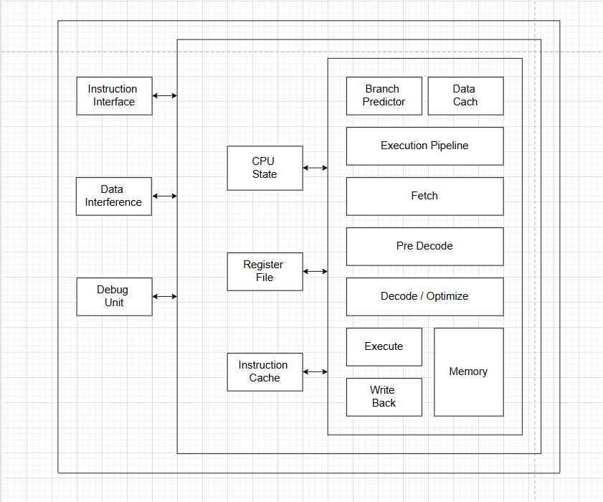
RISCV Architecture
Arithmetic Logic Unit(ALU) :
Performs arithmetic And logical
operations(Add, Sub, And, Or etc.).
Control Unit:
Directs flow of instruction and it’s
Execution based upon Decoded
instructions decide, arithmetic, branch etc.
Memory Unit:
To interface with RAM/ROM for
Load/store(read/write)operations.
Custom Extensions:
Allows to add more as per convenience
new instructions.
dd

Slide 14
Current Progress
Visiting and Studying regarding initial study for RISCV Architecture.
Selecting encryption Algorithm(AES) as IP Core.
To aquire knowledge regarding Algorithm AES and to start work on it but firstly starting with implementation of MAC Unit.
dd

Slide 15
Literature Review
Author: Duc-Thinh Nguyen-Hoang, Khai-Minh Ma, Duy-Linh Le, Hong-Hai Thai, Tran-Bao-Thuong Cao, Duc-Hung Le (2023). Title: Implementation of a 32-Bit RISC-V Processor with Cryptography Accelerators on FPGA and ASIC. Objective: Develop a RISC-V processor with cryptographic accelerators (AES, SHA-1, RSA) for secure edge IoT applications. Achievements:
Achieved 4x throughput improvement in AES encryption.
Implemented secure RSA-2048 and SHA-1 cores.
Successfully tested on FPGA and 65nm CMOS ASIC. Limitations:
RSA-2048 core requires significant area and power.
Limited to conventional cryptographic algorithms (AES-128, SHA-1, RSA).
dd

Slide 16
Literature Review
Author: Yuxing Chen, Xinrui Wang, Suwen Song, Lang Feng, Zhongfeng Wang (2024). Title: RISC-V Custom Instructions of Elementary Functions for IoT Endpoint Devices. Objective: Improve computational efficiency in IoT devices by introducing custom instructions for mathematical functions (log, exp, sin, cos). Achievements:
Speedup of 3.3–18x compared to the baseline RV32IM.
Power overhead:
<5% (tiny), <17% (intermediate), <26% (fast).
Designed three instruction variants for different IoT applications. Limitations:
Focuses on specific IoT functions, not general computing.
Scalability to complex applications not fully evaluated.
dd

Slide 17
Literature Review
Author: Oscar Almer, Richard Bennett, Igor Böhm, Alastair Murray, Xinhao Qu, Marcela Zuluaga, Björn Franke, and Nigel Topham (2009).
Title: An End-to-End Design Flow for Automated Instruction Set Extension and Complex Instruction Selection based on GCC.
Objective: Develop a comprehensive toolchain for automated instruction set extension (ISE) and complex instruction selection using GCC, targeting extensible processors.
Achievements:
Integrated ISE identification, generation, optimization, and synthesis into a unified framework.
Enabled exploitation of complex custom instruction patterns across multiple applications.
Introduced the EnCore extensible processor core, facilitating synthesis of full extensible designs from Verilog and standard cell libraries.
Limitations:
The approach's scalability to larger and more complex applications was not extensively evaluated.
The impact on power consumption and area overhead requires further investigation.
dd

Slide 18
Literature Review
Author: Md Ashraful Islam, Hiromu Miyazaki, Kenji Kise (2020).
Title: RVCoreP-32IM: An Effective Architecture to Implement Mul/Div Instructions for Five-Stage RISC-V Soft Processors.
Objective: Enhance the RVCoreP soft processor by integrating the RISC-V M-extension to support multiplication and division instructions, thereby improving performance for embedded systems.
Achievements:
Developed an extended RVCoreP processor supporting the M-extension, enabling efficient execution of multiplication and division operations.
Achieved performance improvements of 1.87× and 3.13× using radix-4 and DSP multipliers, respectively, compared to the baseline RV32I implementation.
Demonstrated a 13% performance enhancement over equivalent RISC-V processors without the M-extension.
dd

Slide 19
References
[1]. Duc-Thinh Nguyen-Hoang, Khai-Minh Ma “Implementation of a 32-Bit RISC-V Processor with Cryptography Accelerators on FPGA and ASIC” (2023) (accessed in February 2025).
[2]. Yuxing Chen , Xinrui Wang “RISC-V Custom Instructions of Elementary Functions for IoT Endpoint Devices” (2024) (accessed in February 2025).
[3].Oscar Almer, Richard Bennett, Igor Böhm, Alastair Murray, Xinhao Qu, Marcela Zuluaga, Björn Franke, Nigel Topham, "An End-to-End Design Flow for Automated Instruction Set Extension and Complex Instruction Selection based on GCC", (2009) (accessed in March 2025).
[4]. https://arxiv.org/abs/2010.16171
dd

Slide 20







Thank you
Presenter name
Email address
Website

