Slide 1
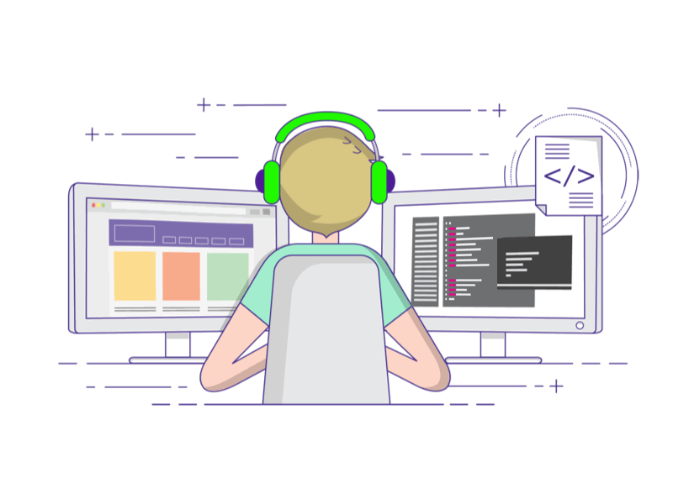
SkillForge:AI Driven Adaptive Learning and Exam Generator
SkillForge is a continuous adaptive learning platform designed to personalize coding education through real-time performance modeling, dynamic roadmap generation, AI-assisted feedback, and secure evaluation infrastructure.
Unlike static learning platforms, SkillForge does not follow a fixed curriculum.
Instead, it maintains a live mastery model for each student and continuously recalibrates:
Question sequencing
Difficulty levels
Learning roadmaps
Project recommendations
Adaptive exams
The system evolves with the learner

Slide 2
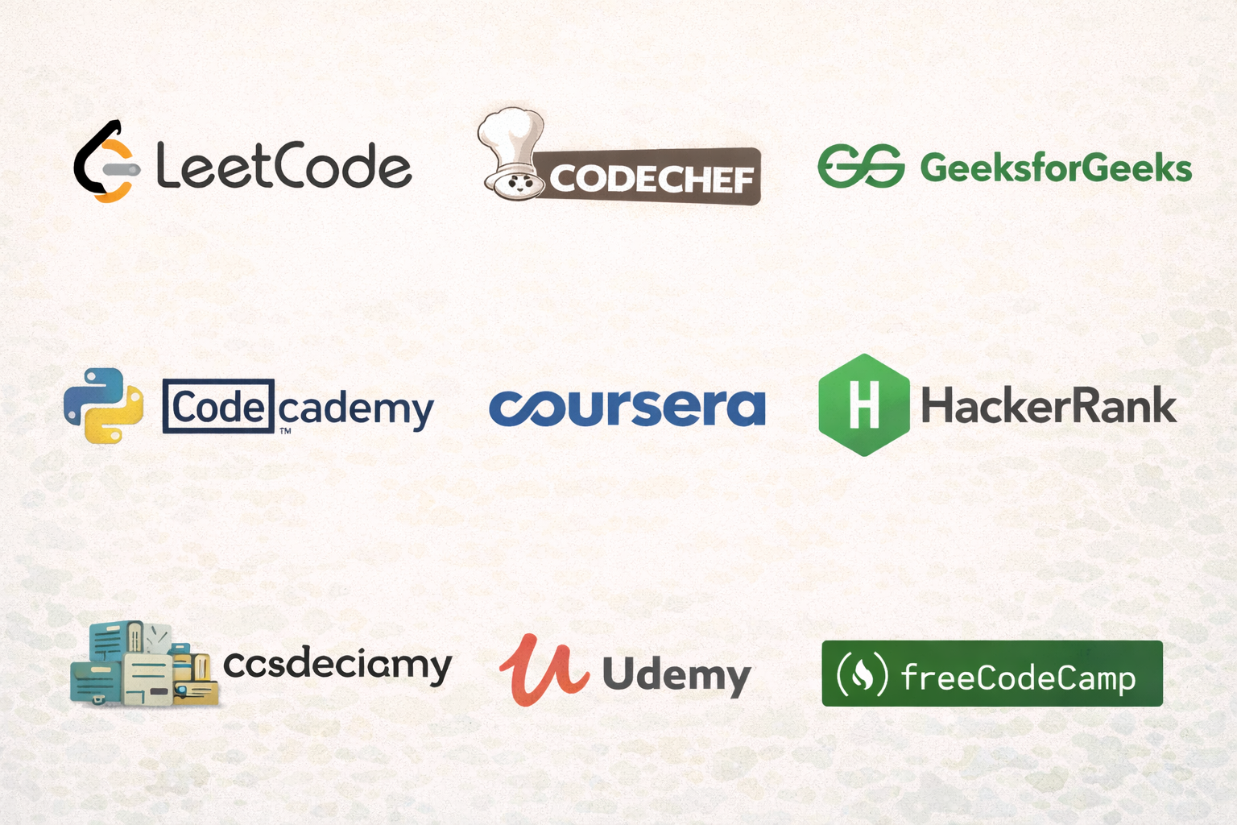
Limitations of Existing Platforms:
Static difficulty progression
Predefined hints not based on student code
No continuous topic mastery vector
Fixed exam templates
Limited tutor analytics
Resume-based hiring signals
Core Objective:
To build an intelligent learning ecosystem that:
Continuously evaluates student performance
Dynamically updates personalized learning roadmaps
Generates context-aware AI feedback
Enables tutor-driven intervention
Provides structured skill visibility
Ensures secure and scalable code execution

Slide 3

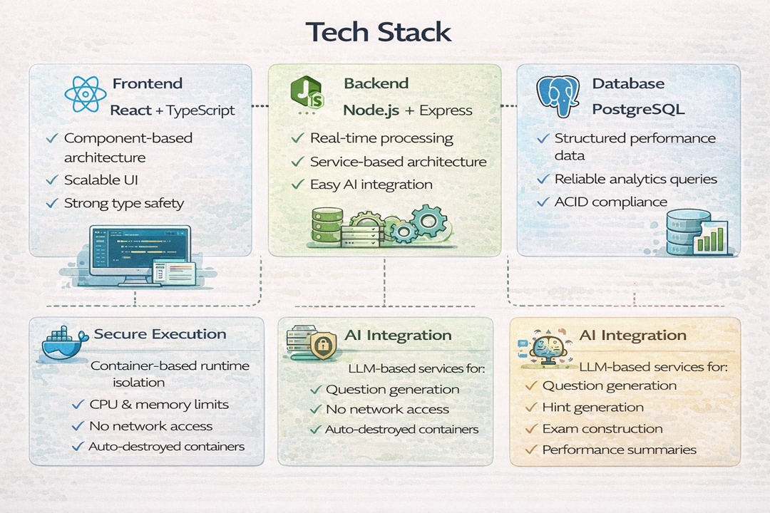


Slide 4
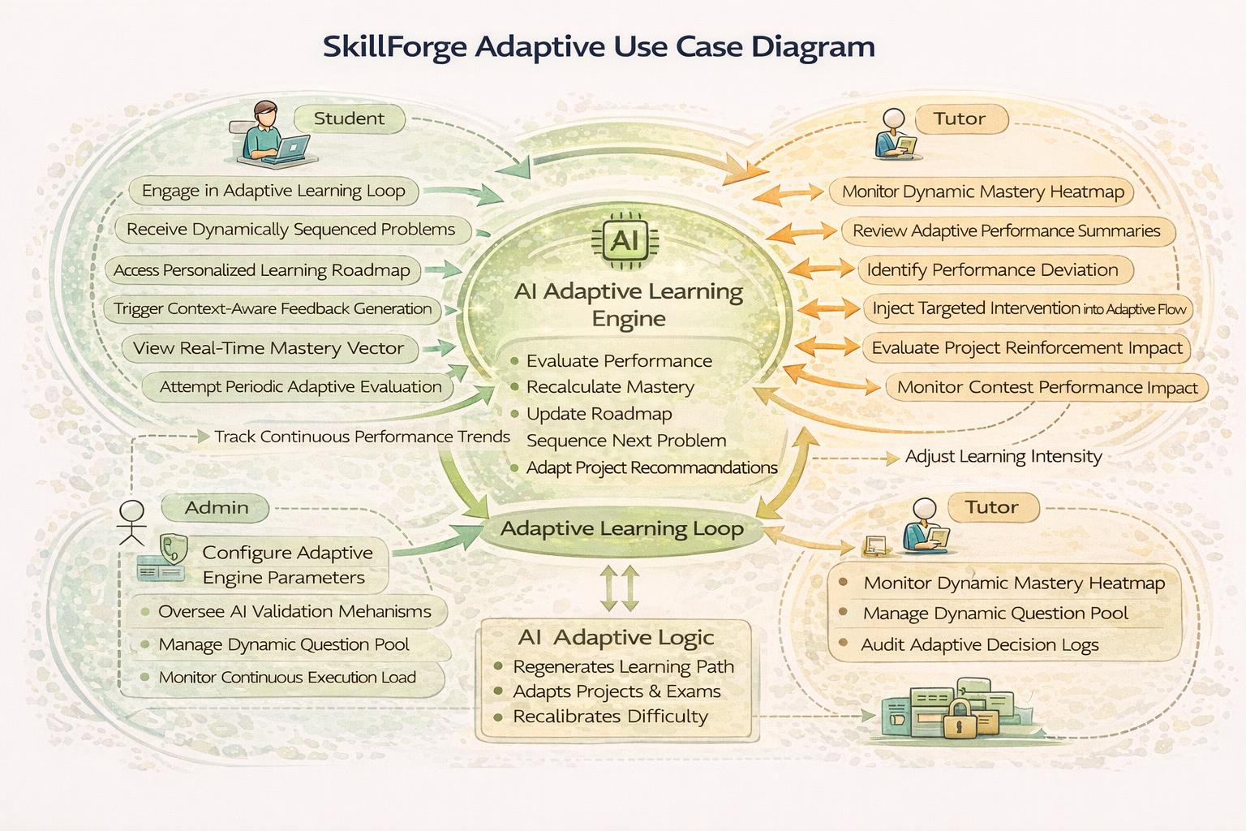

Slide 5
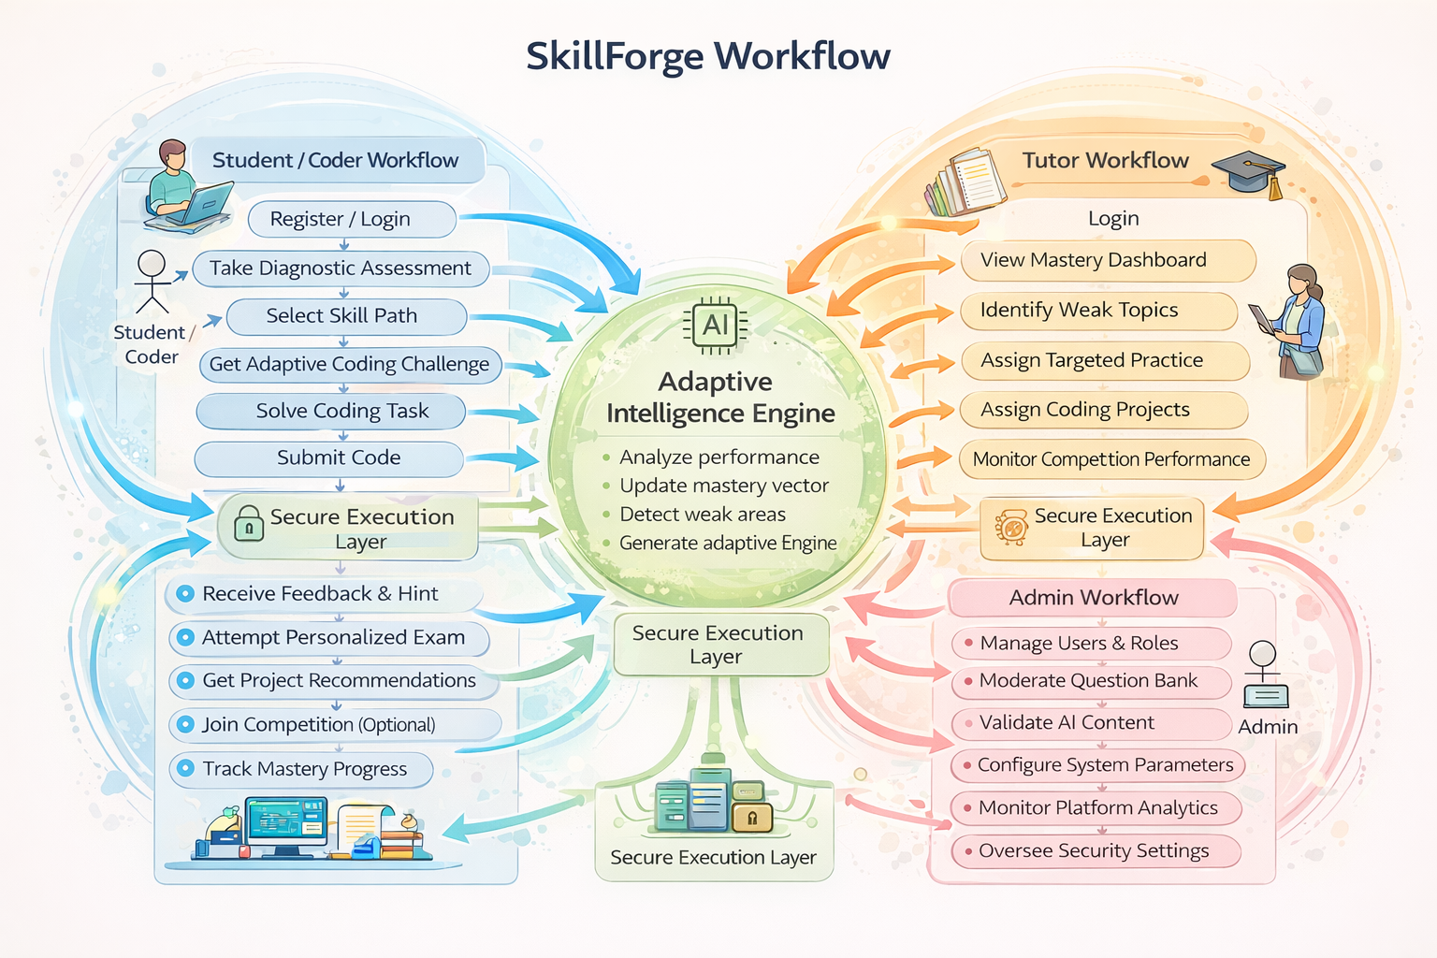

Slide 6
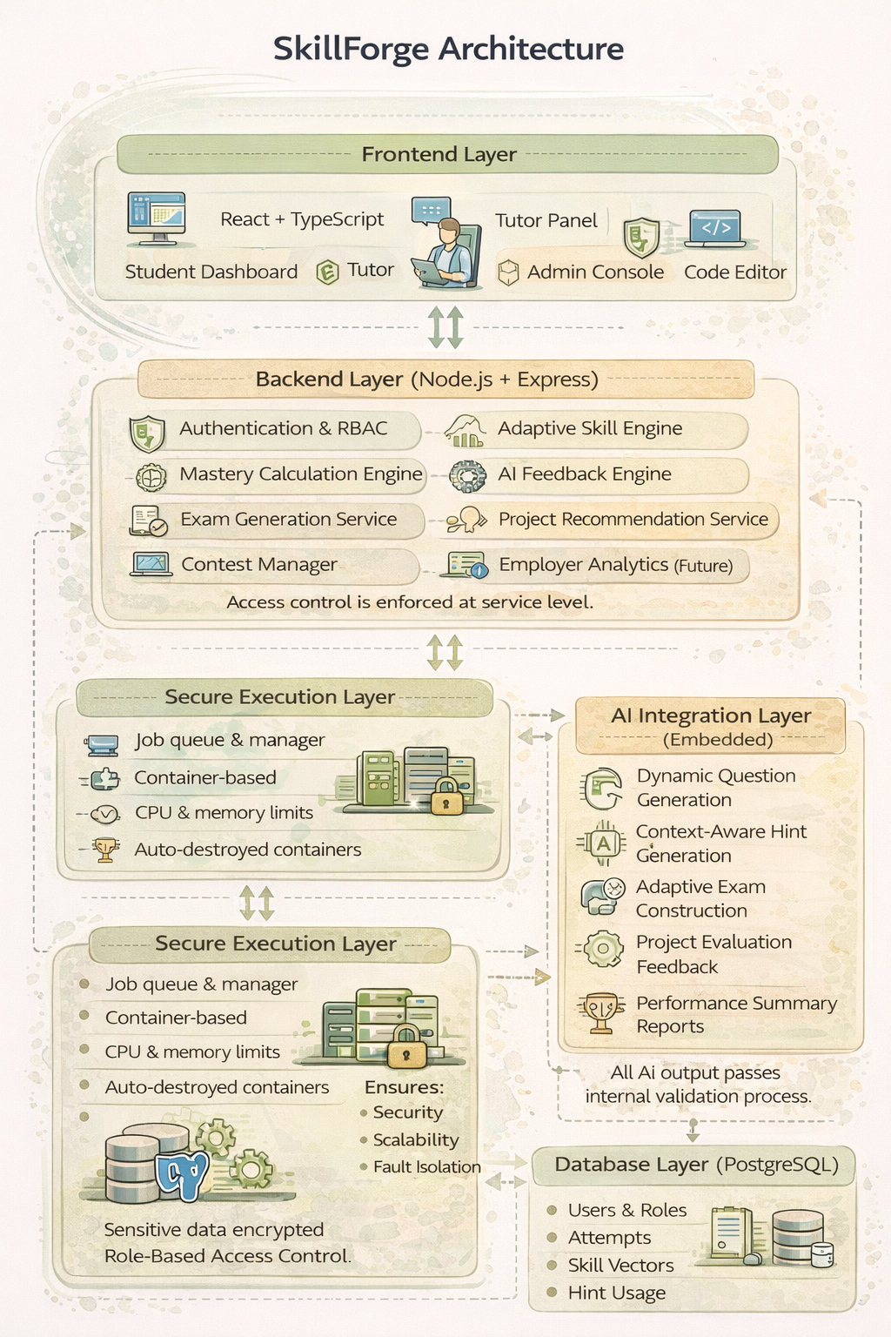
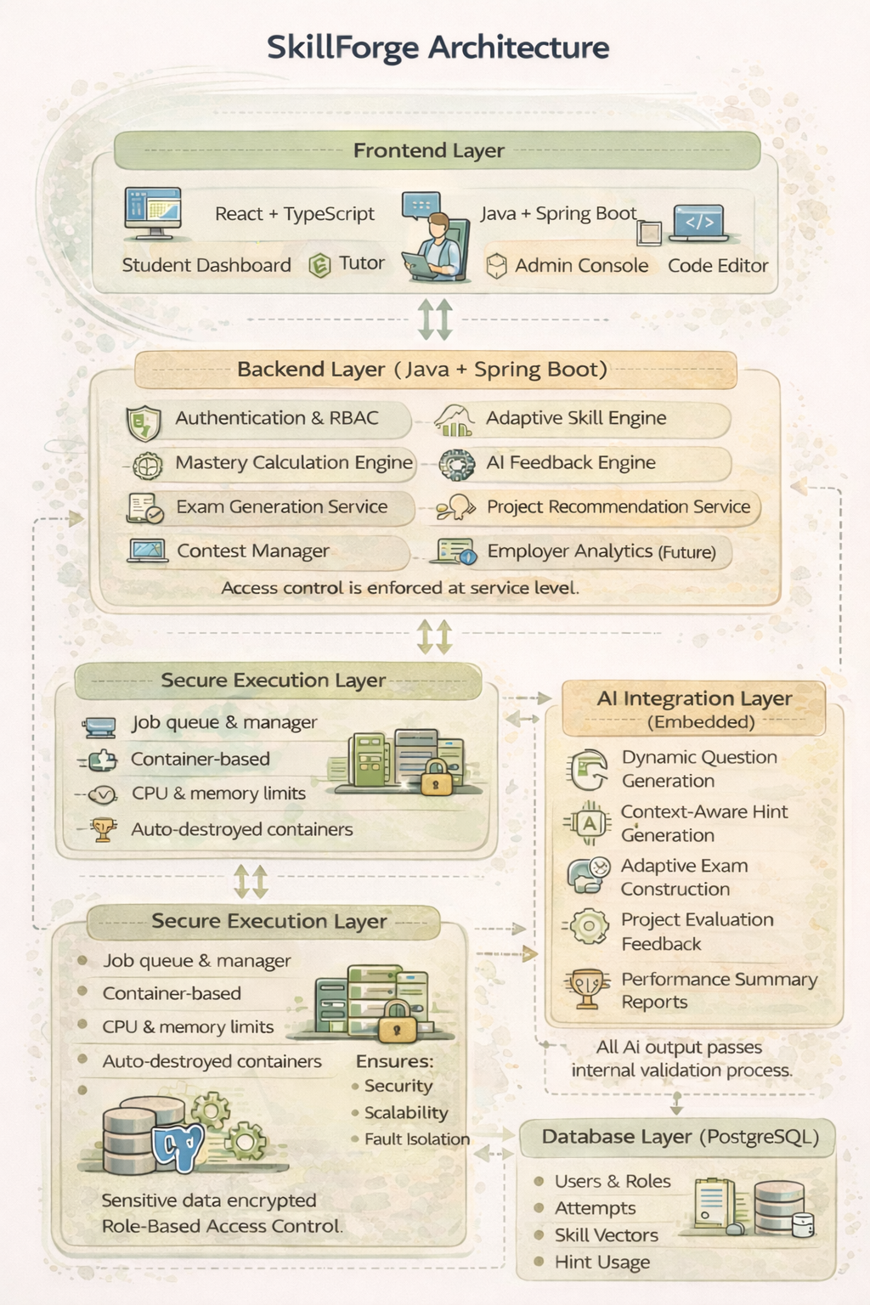

Slide 7
