Slide 1
Return-to-Play ≠ Return-to-Form Database Study of 2,335 Footballers
Return-to-Play and Performance Recovery in European Footballers: Are Players Truly Back to Form?
Varun Jain MSc, Praveen Sritharan MD

Slide 2
Presenter Relationship Disclosure
Presenter Name: Varun Jain
Relationships with financial sponsors in the past two years:
Any direct financial relationships including receipt of honoraria: N/A
Funded grants or clinical trials: N/A
Memberships on advisory boards or speakers’ bureau: N/A
Patents for drugs or devices: N/A
Other: N/A
Any other Financial Disclosures: No Disclosures
2

Slide 3
Background & Methods
Knee injuries are among the most common and career-impacting injuries in professional football
RTP timelines are well-documented, but whether players regain their pre-injury performance remains largely unstudied

Slide 4
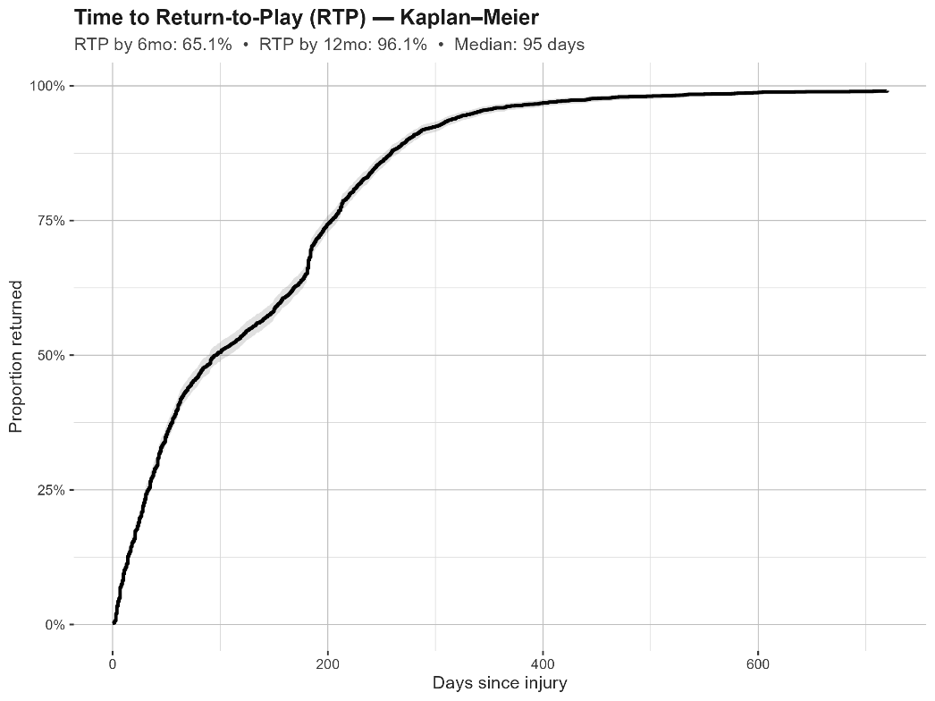
Results
Median return: 95 days
65% returned by 6 months
96% returned by 12 months
Slowest-recovering injuries:
Cruciate ligament tears
Chondral and osteochondral injuries
Patellar tendon rupture
RTP did not differ by playing position (all positions ≈65% at 6mo, ≈96% at 12mo)

Slide 5
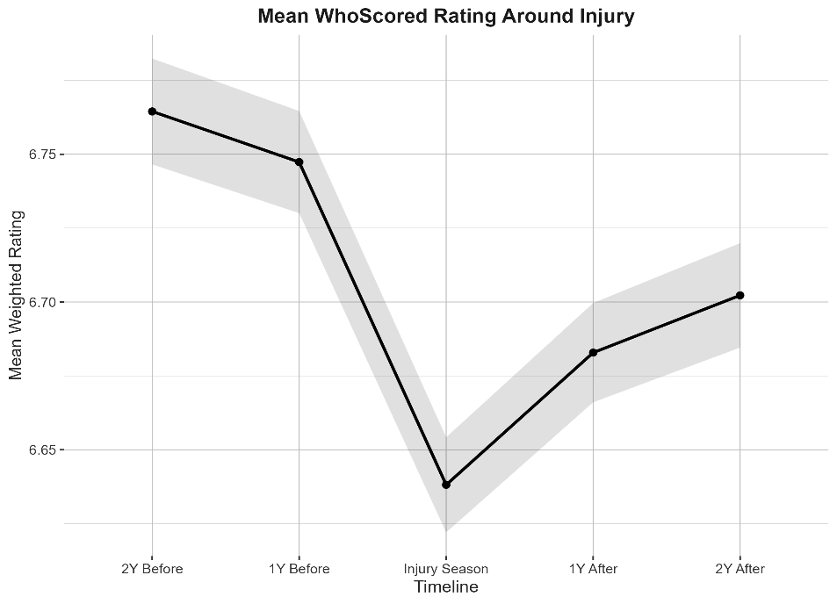

Results & Clinical Implications
RTP did not equal return-to-form:
Performance remained 0.10 pts (0.26 SD) below baseline after 2 yrs
Counsel players (and clubs): clinical recovery does not guarantee performance recovery
Return-to-play ≠ return-to-form
Scan to view Detailed Results and Individual Player Data

