Slide 1

Task Scheduling in Cloud-Fog Computing Systems
Anirudh Yadav 20BCT0184
Varun Agarwal 19BCT0070
Ruksana TabasSum 20BCE2650

Slide 2
Task Scheduling
Task scheduling is the action of assigning resources to perform tasks. The resources may be processors or network links. The tasks may be threads, processes or data flows.
Why is Task Scheduling needed?
Fog computing extends cloud services to the edge of the network. In such a scenario, it is necessary to decide where applications should be executed so that their quality of service requirements can be supported. Thus, a cloud-fog system requires an efficient task scheduler to decide the locality where applications should run.

Slide 3
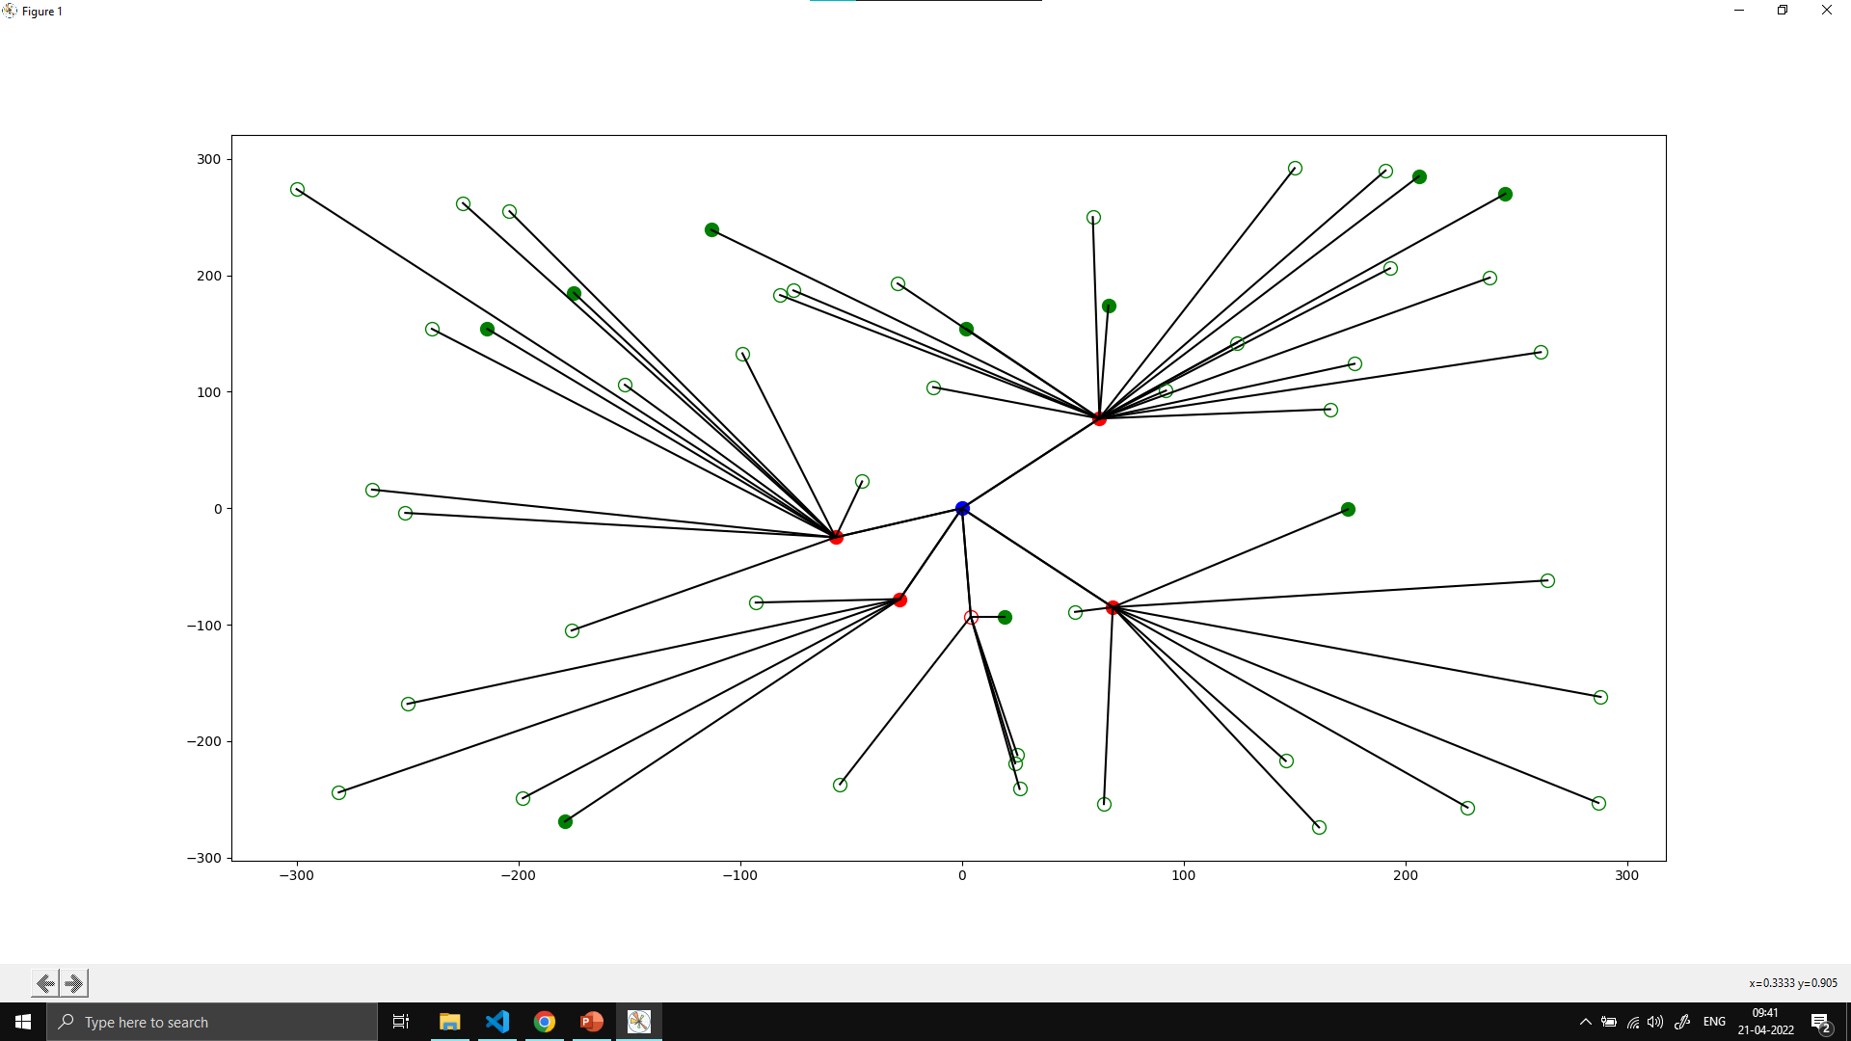
Fog Architecture

Slide 4
Fog Architecture
Simple 3 Tier Architecture , with medical use cases as target demographic
Many IoT devices produce large amount of data and requests need to be handled with as less delay as possible.
Fog layer takes care of this as it is placed between client and the Cloud layer.
Fog layer assist in processing the tasks which are used by the client by providing responses in less time
. It brings the Cloud environment physically closer to the client.
The requests can have different levels of priorities and the higher priority requests should be processed before other lower priority tasks.

Slide 5
Application
The above implementation can be used in emergency notification in healthcare.
Elderly patients who don’t have care taker with them in that case , it can be used.
Whenever any emergency arises the sensor alerts the nearby hospitals so that they could assist the patient without any delay to avoid demises.

Slide 6
Optimization Problem
An optimization problem is defined by variables, domain of variables, list of constraints, and an objective function. The problem then consists of finding appropriate values v1,…vn, such that:
1) vi E Di for each i = 1,….n.
2) for any constraint Ci relating to variables xj1,….xjk, it holds that (vji,….,vjk) E Rj.
3) f(v1,…,vn) is maximum among all (v1,…,vn) tuples that satisfy (1) and (2).
Optimization problem is a multiple objective function and the difficulty of the problems lie in balancing between conflicting objectives.

Slide 7
Types of Task Scheduling
1) Priority Based Scheduling
2) First come, first served
3) Shortest job first
4) Fixed priority pre-emptive scheduling
In our simulation we have utilized priority based, shortest job first, and finally priority based with shortest job first methods.

Slide 8
Assumptions
1) The cloud node is elastic upto a certain point.
2) The fog nodes have limited resources
3) Response time is extremely valuable metric for emergency situations
4) The model is assessed based on cost and response time.

Slide 9
Priority Based Scheduling
Priority scheduling is a method of scheduling processes based on priority. In this method, the scheduler selects the tasks to work as per the priority.
Priority scheduling also helps to involve priority assignments. The processes with higher priority should be carried out first, whereas jobs with equal priorities are carried out on a round-robin or FCFS basis. Priority can be decided based on memory requirements, time requirements, etc.
PB Scheduling is easy to use, the importance of each process is precisely defined, and a good algorithm for applications with fluctuating time and resource requirements.

Slide 10
Priority Based Scheduling
In our Model, the Tasks have been assigned a priority from 1 – 10.
1 being least important , 10 being extremely important.
All the tasks with priority < 5 are only scheduled at the Cloud node to save on cost as they are not enough important to considering spending extra for node processing.
The fog nodes and cloud node sort the tasks by priority and then executes the task one at a time.
If a higher priority task arrives at fog node, it send the lesser priority task to cloud node to process as it will be processed ASAP due to being high priority and we cannot afford to waste time waiting for the slow and memory limited fog node to finish

Slide 11
Shortest Job First
Shortest job first (SJF) or shortest job next, is a scheduling policy that selects the waiting process with the smallest execution time to execute next. SJN, also known as Shortest Job Next (SJN), is a non-preemptive algorithm.
Shortest Job first has the advantage of having a minimum average waiting time among all scheduling algorithms.
It is a Greedy Algorithm.
It may cause starvation if shorter processes keep coming. This problem can be solved using the concept of ageing.

Slide 12
Running Screen Shots

Slide 13
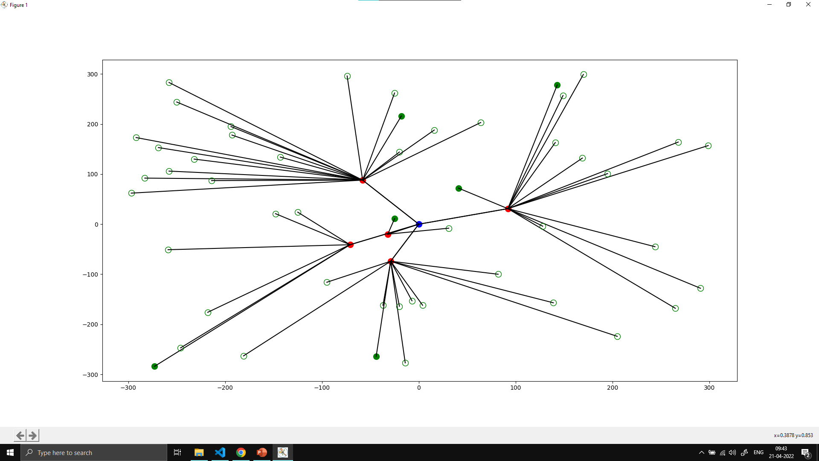
Running Screen Shots

Slide 14
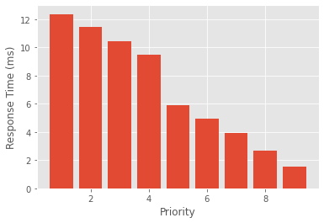
Results (priority)

Slide 15
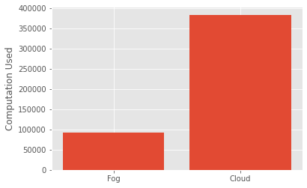
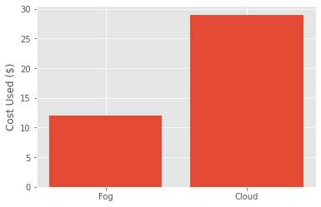
Results (priority)

Slide 16
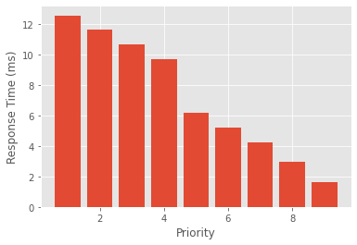
Results (priority)

Slide 17
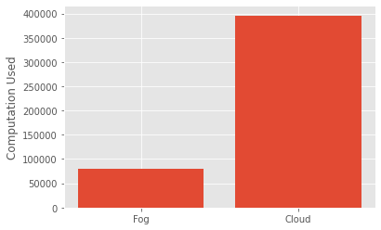
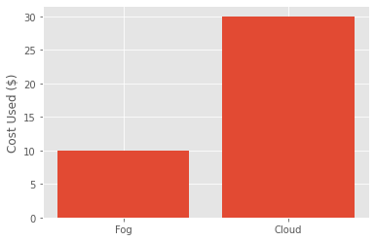
Results (priority)

Slide 18
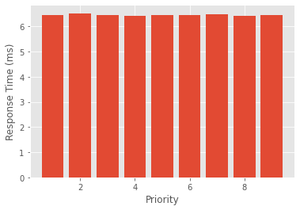
Results (SJF)

Slide 19
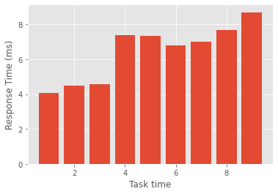
Results (SJF)

Slide 20
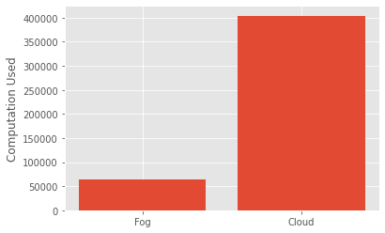
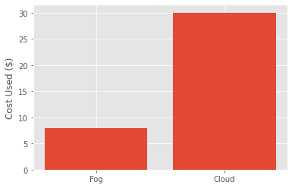
Results (SJF)

Slide 21
Results (SJF)

Slide 22
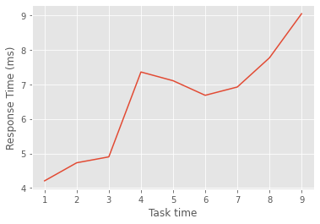
Results (SJF)

Slide 23
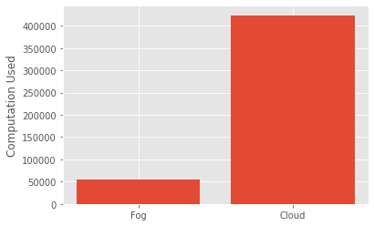
Results (SJF)

Slide 24
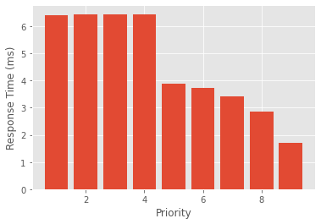
Results (SJF + Priority)

Slide 25
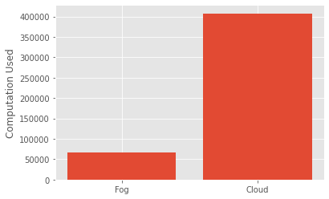

Results (SJF + Priority)

Slide 26
Observations
It can be observed from the above depicted graph the ‘Priority scheduling in Fog’ costs less than the ‘Shortest Job First scheduling in Fog’, but it trades off the execution time for the cost.
SJF + Priority comes in as a sweet middle ground for even response times and cost
SJF is highly useful when no priority is assigned to tasks (no emergency situations) but fails in medical uses

Slide 27
Conclusion
Proposed hybrid method provides a solid way to schedule tasks in a simple fog architecture and can be further studied to improve optimization with state of the art techniques like SWARM optimization.
The study on Task Scheduling taught us a lot about implementing fog and how to apply task scheduling can affect the final outcome in drastic ways.

