Slide 1

INFORMATICS AND COMPUTATIONAL SCIENCE PROGRAMME, UNIVERSITY COLLEGE OF SCIENCE, MOHANLAL SUKHADIYA UNIVERSITY, UDAIPUR BACHELOR OF COMPUTER APPLICATION
WebGen.ai
AI-Powered Website Builder
Submitted to: Submitted by:
Dr.Avinsh Panwar Varun Bhoi & Sourabh Jain

Slide 2
✦ INTRODUCTION
The AI Revolution in Web Building
WebGen.ai is an AI-powered platform that generates complete frontend websites from a simple text prompt. Users describe their idea and receive production-ready HTML, CSS & JavaScript within minutes — no coding required. Powered by DeepSeek AI via OpenRouter.
★
◈
▶
Prompt to Website
Monaco Code Editor
One-Click Deploy
Type a description → AI generates complete HTML, CSS & JS instantly
Professional in-browser VS Code-level editor to fine-tune generated code
Deploy your website live with a unique public URL — shareable instantly
Built with React 18 · Node.js · Express · MongoDB · OpenRouter LLM · Firebase Auth

Slide 3
✦ OBJECTIVES
Core Goals Driving Our Solution
01
02
03
04
AI Website Generation
Monaco Code Editor
AI Chat Modification
One-Click Deployment
Text prompt → complete responsive website via OpenRouter LLM
VS Code-quality in-browser editing for fine-tuning
Chat-based interface to update & refine websites iteratively
Publish live with unique slug-based public URLs instantly
05
06
07
08
Firebase Authentication
Credit-Based System
Project Dashboard
Dark / Light Theme
Secure login via Google OAuth 2.0 + email/password with JWT
Fair usage with user credits — each generation deducts balance
Manage all saved projects — star, delete, deploy & share
Full theme context switching across all pages

Slide 4
✦ ARCHITECTURE
Full-Stack MERN + AI Architecture
CLIENT LAYER
React 18 · Vite 5 · Tailwind CSS · Redux Toolkit · Framer Motion · Monaco Editor
AI LAYER
OpenRouter LLM · Prompt Engineering · Chat-based Modifications
AUTH LAYER
Firebase Authentication · Google OAuth 2.0 · JWT Tokens · Cookie Sessions
BACKEND LAYER
Node.js · Express.js · REST APIs · isAuth Middleware · Multer (Avatar Upload)
DATABASE LAYER
MongoDB · Mongoose ODM · User Schema · Website Schema · Conversation History
REQUEST FLOW: Browser → Express Router → isAuth Middleware → Controller → MongoDB → AI → Response

Slide 5
✦ PROJECT MODULES
Core Functional Modules of the System
Auth Module
Generate Module
01
02
Register, Login, Google OAuth, JWT sessions, cookie management
Prompt → DeepSeek AI → complete HTML/CSS/JS with credit deduction
Editor Module
Dashboard Module
03
04
Monaco editor + AI chat panel for live modifications
Projects grid — star, delete, deploy, copy link, live preview
Sidebar Module
Deploy Module
05
06
Quick prompt templates + recent websites list
One-click publish with unique slug-based public URL
Profile Module
Settings Module
07
08
Edit info, avatar upload (Multer), bio, country, social links
Notification prefs, privacy, language, timezone, theme toggle

Slide 6
✦ FRONTEND TECHNOLOGIES
React + Vite — Modern SPA Architecture
React.js
Vite
^18.2.0
^5.1.4
Component-based UI with hooks
Lightning-fast dev build tool
Tailwind CSS
Redux Toolkit
^4.0.0
Latest
Utility-first responsive styling
Global state management
Framer Motion
Monaco Editor
^11.0.0
Latest
Smooth animations & transitions
In-browser VS Code editor
React Router
Axios
^6.22.0
^1.6.7
Client-side routing & navigation
HTTP requests to backend APIs
Lucide React
React Hot Toast
^0.383.0
Latest
Modern icon library
Real-time toast notifications

Slide 7
✦ BACKEND TECHNOLOGIES
Node.js + Express REST API Architecture
Node.js
^4.x
Express.js
v18+
Minimal REST API framework with middleware
JavaScript runtime for server-side execution
Atlas
MongoDB
^8.x
Mongoose
NoSQL database for users & websites
ODM — User, Website, Message schemas
JWT
bcryptjs
^9.x
^2.x
Stateless token-based authentication
Password hashing with salt rounds
Multer
OpenRouter
^1.x
API
Avatar file upload & validation middleware
Gateway to DeepSeek AI for website generation
Firebase Admin
dotenv
SDK
Latest
Google OAuth 2.0 server-side verification
Environment variable management & config

Slide 8
✦ SYSTEM REQUIREMENTS
Hardware & Software Specifications
■ HARDWARE REQUIREMENTS
● SOFTWARE REQUIREMENTS
Processor
Intel Core i3 or higher (i5 recommended)
OS
Windows 10/11 · macOS · Linux
Runtime
Node.js v18+ (LTS)
RAM
Minimum 4 GB (8 GB recommended)
Database
MongoDB Atlas (cloud)
Storage
20 GB free disk space
IDE
VS Code + ESLint Extension
Network
Active internet connection required
Browser
Chrome / Edge (latest)
Display
1280×720 minimum resolution
Tools
Git · GitHub · Postman
Services
Firebase Account · OpenRouter API Key

Slide 9
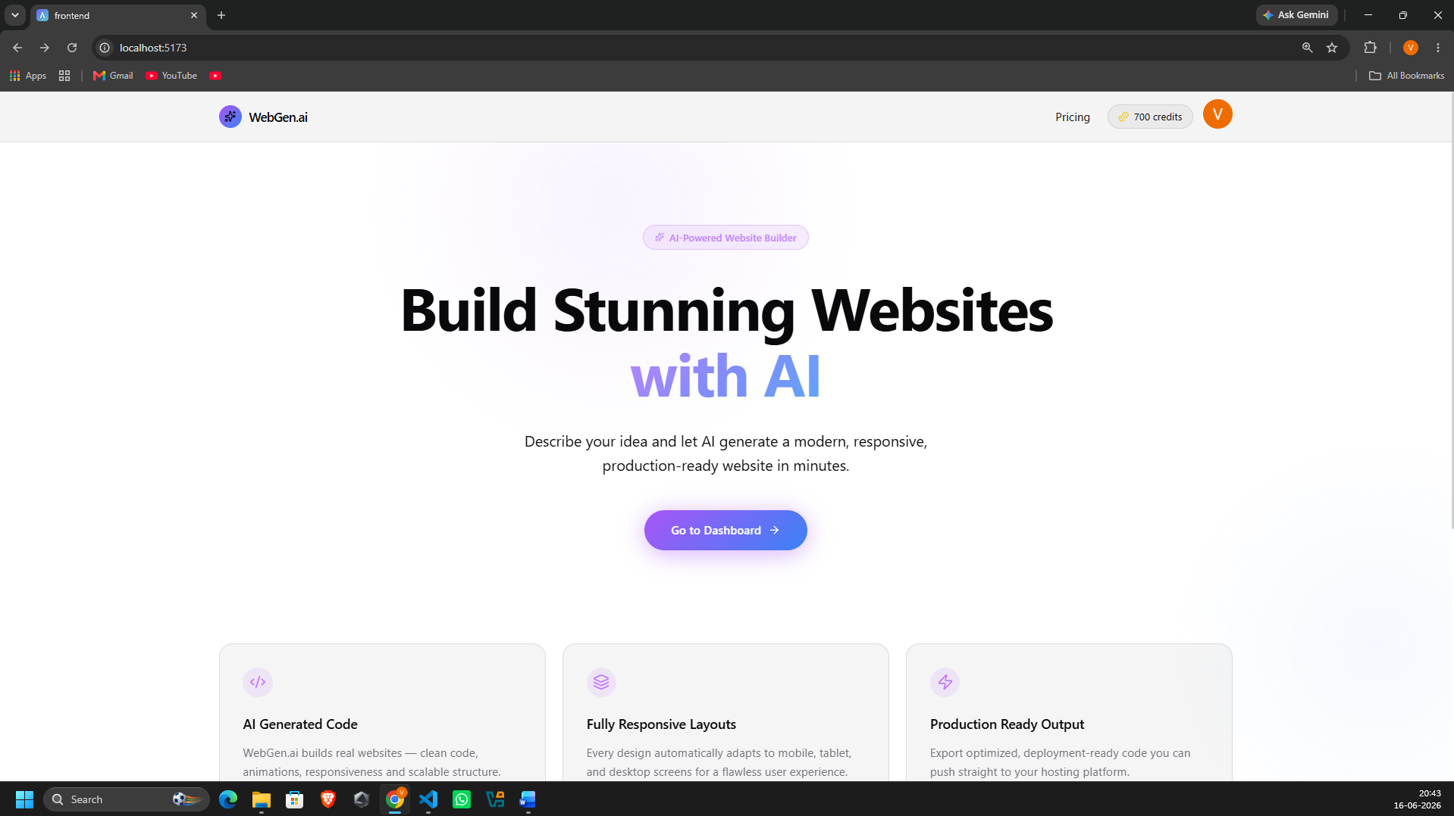
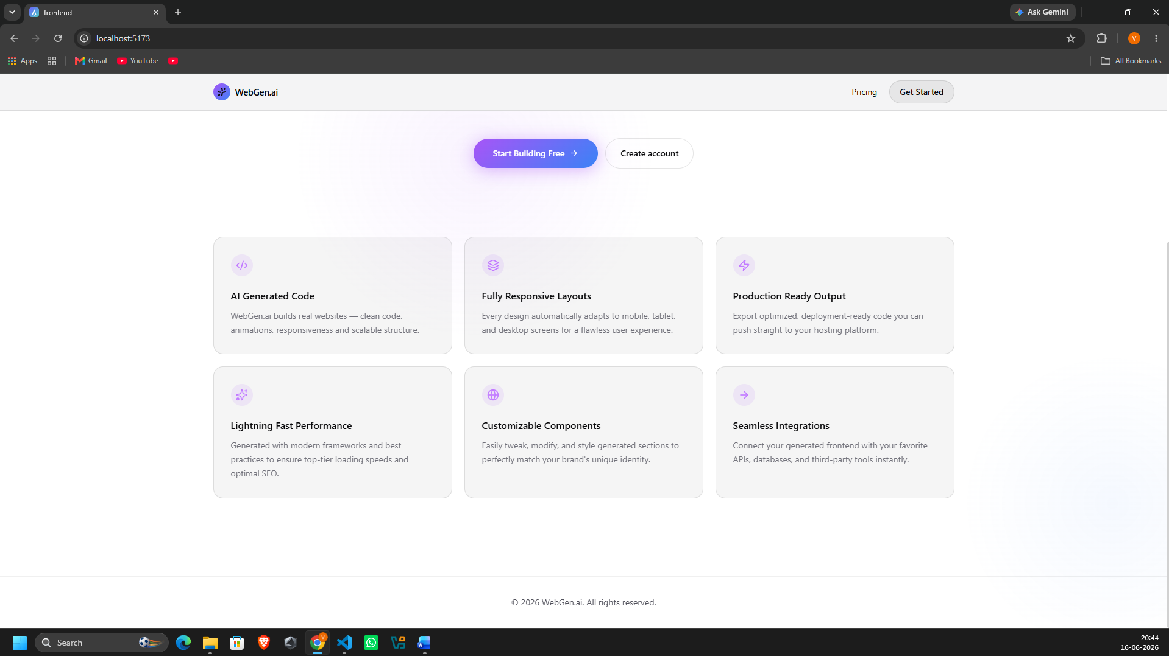
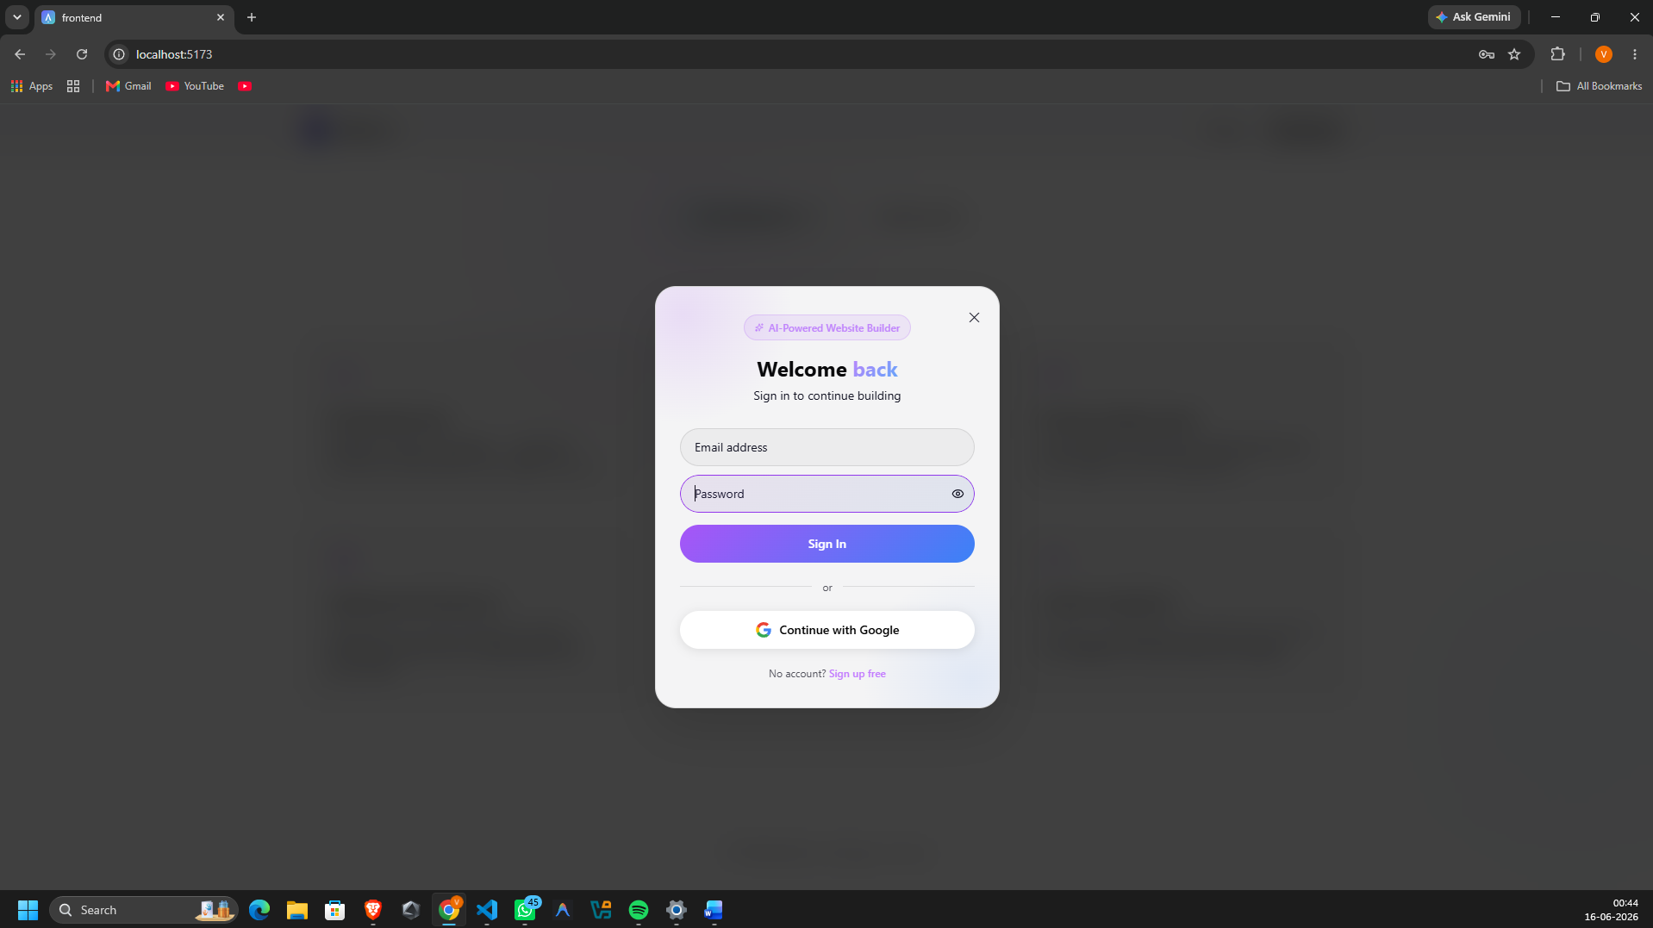
✦ SCREENSHOTS (1/4)
Landing Page & Authentication
Home Page
Features Section
Login Modal
Hero: 'Build Stunning Websites with AI' + CTA
AI Generated Code · Responsive Layouts · Production Ready
Email/password + Google OAuth sign-in
WebGen.ai — Home Page · Login · Sign Up · Feature Cards

Slide 10
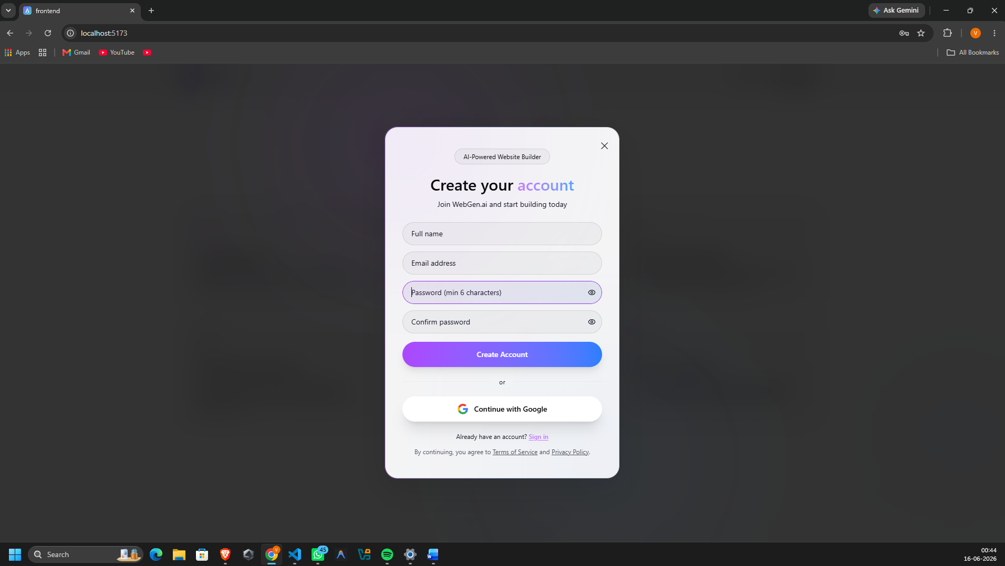
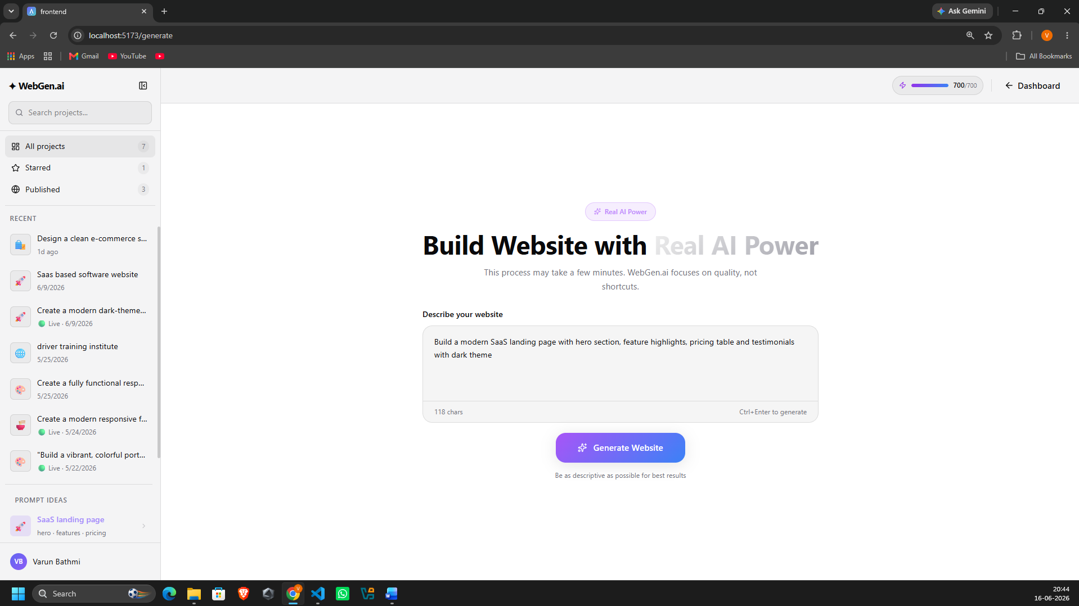
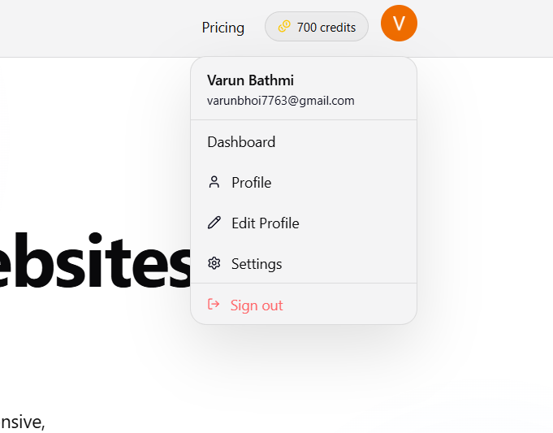
✦ SCREENSHOTS (2/4)
Sign Up & Website Generator
Sign Up Modal
Generator Page
Profile Dropdown
Create account with Google OAuth or email/password
AI prompt input with sidebar: All Projects · Starred · Published
Dashboard · Profile · Edit Profile · Settings · Sign Out
WebGen.ai — Registration · AI Prompt Interface · Project Sidebar

Slide 11
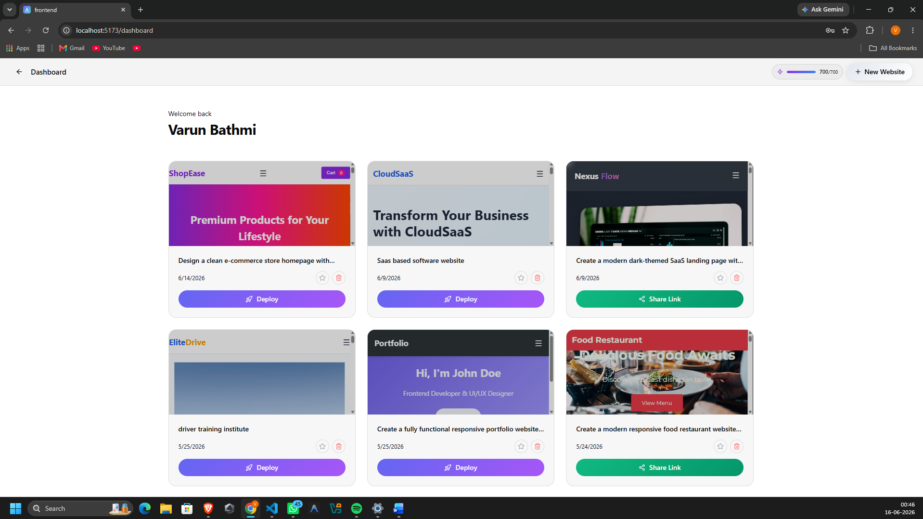
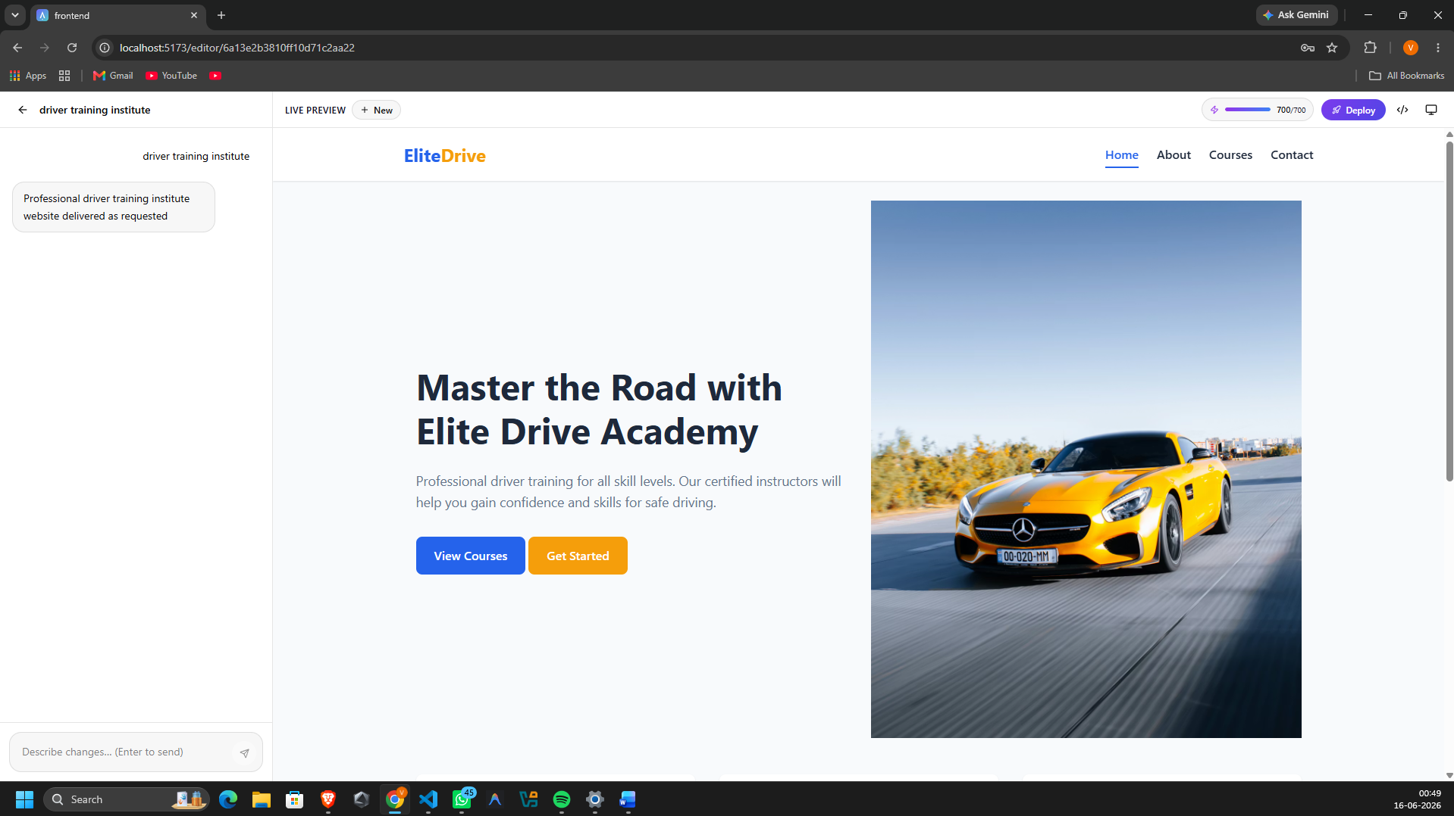
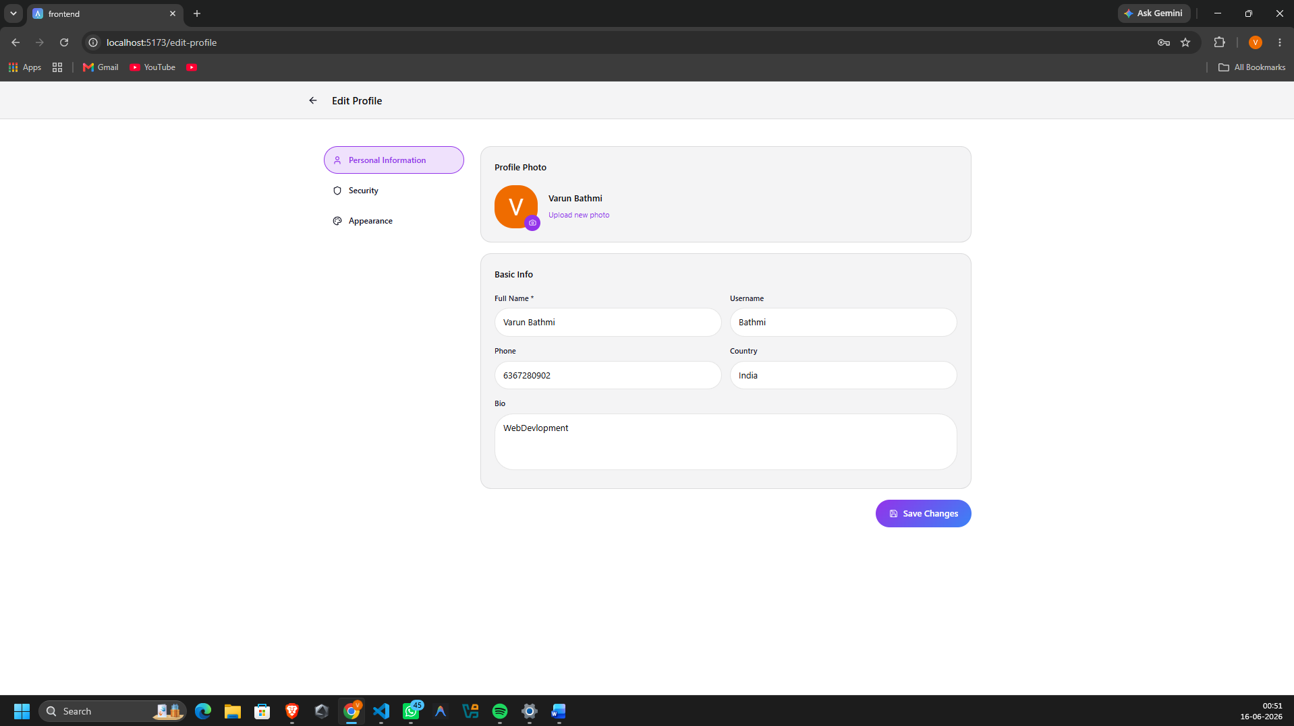
✦ SCREENSHOTS (3/4)
Dashboard & Website Editor
User Dashboard
Website Editor
Edit Profile
All websites grid — Deploy · Share Link · Star · Delete
AI chat panel left · Live iframe preview right · Deploy button
Update name, username, phone, country, bio & avatar photo
WebGen.ai — Projects Grid · Live Editor · AI Chat Modifications

Slide 12
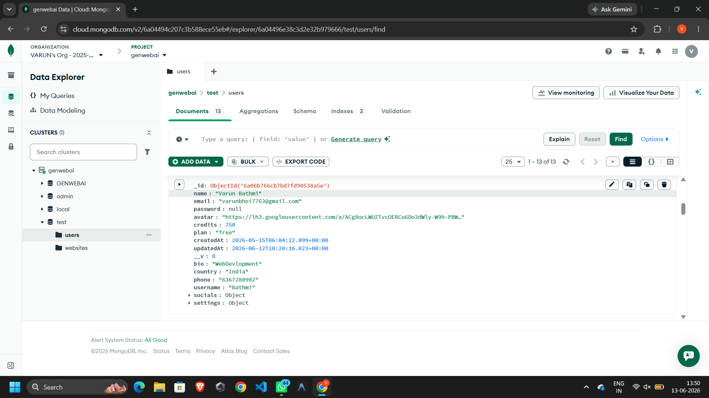
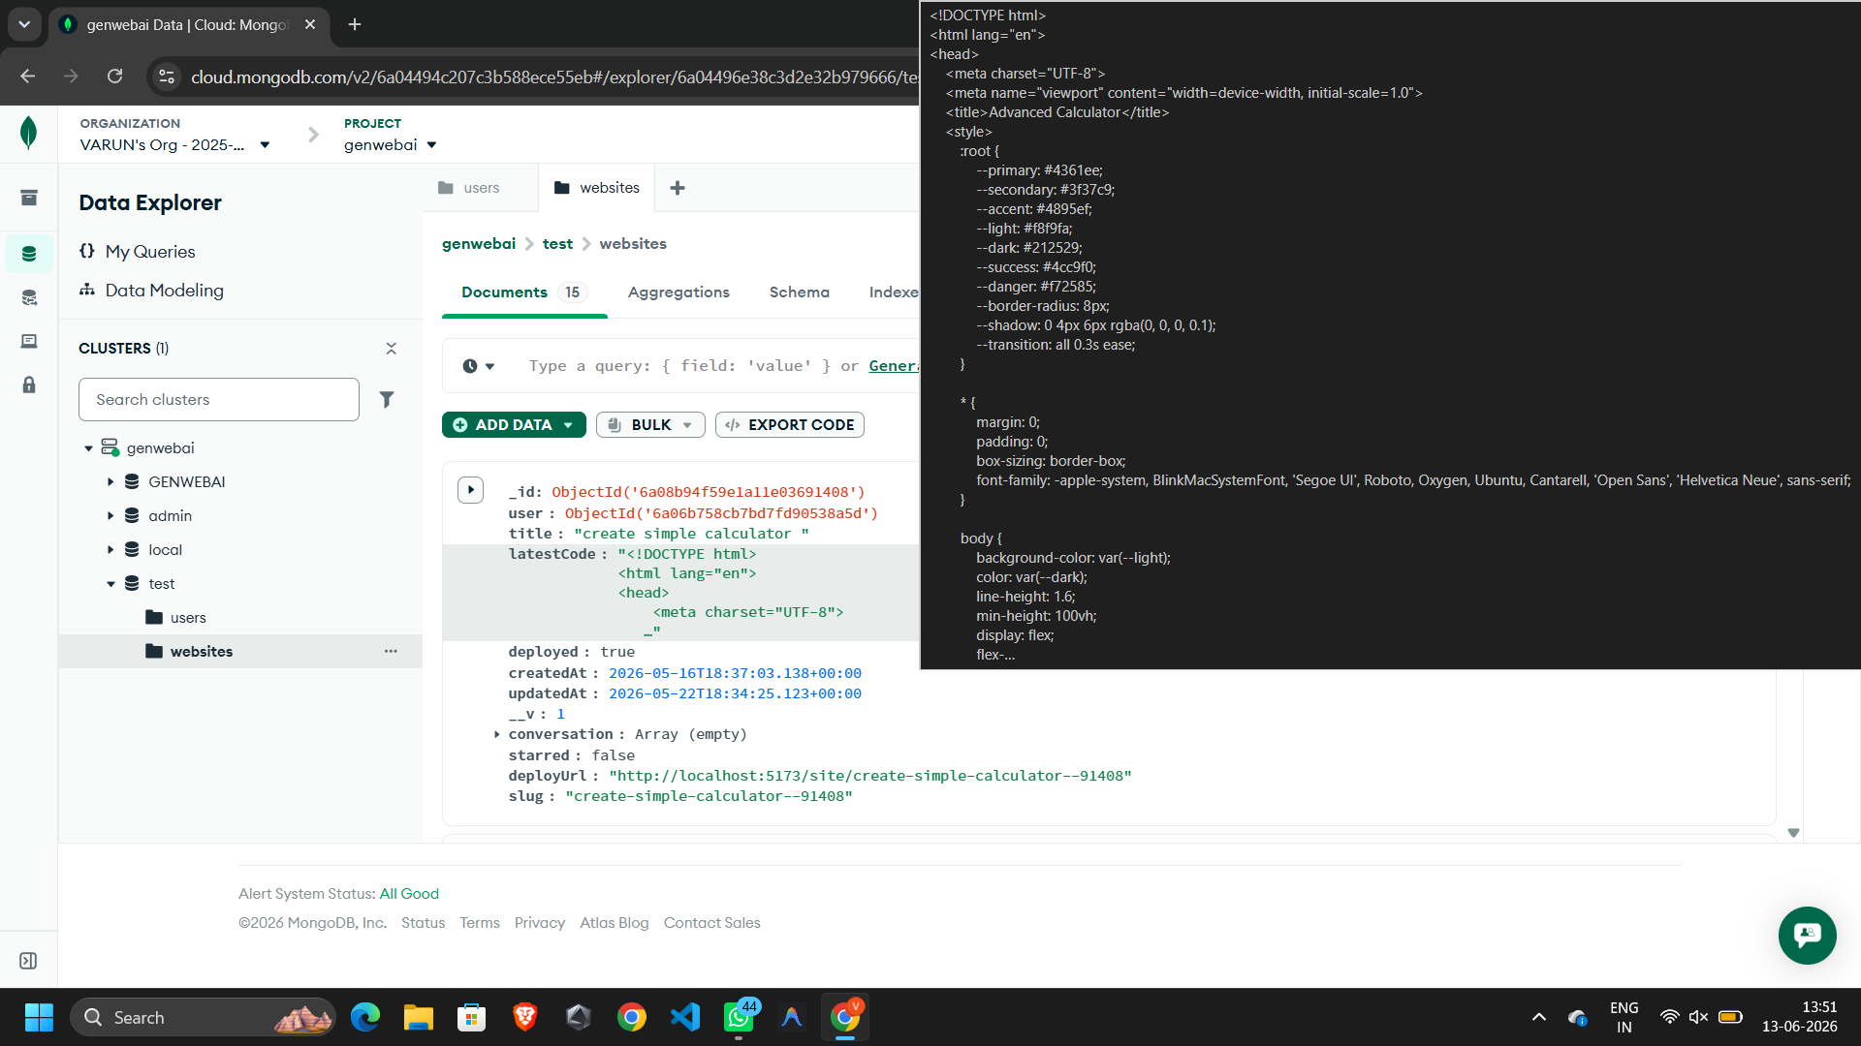
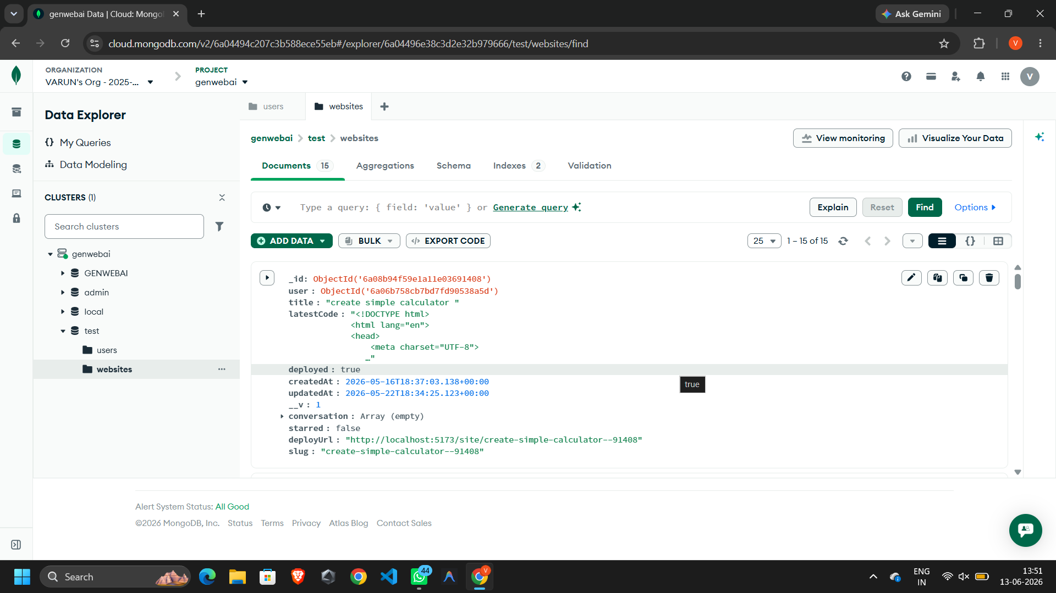
✦ SCREENSHOTS (4/4)
MongoDB Atlas — Database
Users Collection
Websites — HTML Code
Websites Collection
MongoDB Atlas: name, email, credits, plan, avatar, socials fields
latestCode stores full HTML/CSS/JS of each generated website
user ref, title, deployed, slug, deployUrl, conversation array
WebGen.ai — MongoDB Atlas Cloud · Users Collection · Websites Collection

Slide 13
✦ SECURITY & FEATURES
Enterprise-Grade Security & Standout Capabilities
JWT Authentication
Password Encryption
■
▲
Stateless token-based auth — secure API access verified on every request via isAuth middleware
bcryptjs hashing with salt rounds — passwords never stored in plain text in MongoDB
Google OAuth 2.0
Role-Based Access
◉
◆
Firebase-powered Google login with server-side token verification for security
isAuth middleware guards all protected routes — unauthorized requests rejected immediately
OpenRouter LLM Engine
Monaco Code Editor
◈
▣
OpenRouter LLM Engine
VS Code-level in-browser editing with syntax highlighting and real-time preview
Slug-Based Deployment
Credit System
▶
◼
Unique public URL per website — /site/:slug renders live HTML via iframe, no auth needed
Each generation costs credits — user balance tracked in MongoDB, prevents abuse

Slide 14
✦ FUTURE SCOPE
Planned Enhancements & Innovation Roadmap
◉
▶
◉
Multi-Page Generation
React Native Mobile App
Custom Domain Connect
Generate complete multi-page websites from a single prompt
iOS & Android app for prompt-to-website with camera-based input
Allow users to connect their own domain names to deployed websites
◈
◆
★
AI Template Marketplace
Real-Time Collaboration
Voice Prompt Support
Community-shared prompt templates and website themes to browse & remix
Multi-user editing with live cursors — like Figma for AI websites
Speech-to-text input for hands-free website generation

Slide 15
✦ REFERENCES
Technical Resources & Documentation
01
React.js Official Documentation
02
Vite Build Tool Documentation
https://react.dev
https://vitejs.dev
03
MongoDB Documentation
04
Express.js Guide
https://www.mongodb.com/docs
https://expressjs.com
05
OpenRouter API (DeepSeek)
06
Firebase Documentation
https://openrouter.ai
https://firebase.google.com/docs
07
Tailwind CSS Documentation
08
Monaco Editor
https://tailwindcss.com/docs
https://microsoft.github.io/monaco-editor
09
JWT.io — JSON Web Tokens
10
MDN Web Docs
https://jwt.io
https://developer.mozilla.org
Thank You! · | BCA 6th Semester 2025–26 | MLSU Udaipur

